Slide 1
ICT289 Assignment 2: Squash Simulator
By Group 3:
Raymond Ker Sheng Lau
Peter Neve
Jason Gregory Botterill

Slide 2
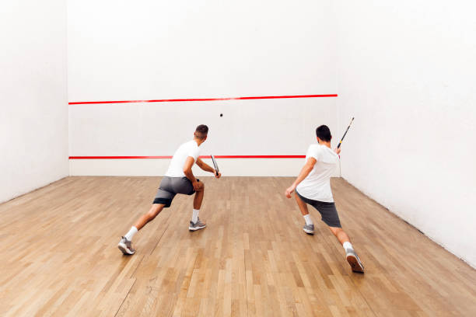
What is a Squash Simulator
Squash + Simulator = Squash Simulator
Squash is a sport that involves two players to play within a boxed room, with the aim of of the game being a complex game of catch with rackets, with the goal for players to cause the other player to fail at “passing” the ball.
The aim for this project is to mimic this sport by creating a
simulated game of Squash using OpenGL and C code.

Slide 3
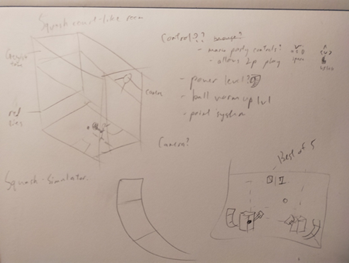
Design/concepts
Initial Concept
Power system
Ball “Warm-up
Scores
Best of 5

Slide 4
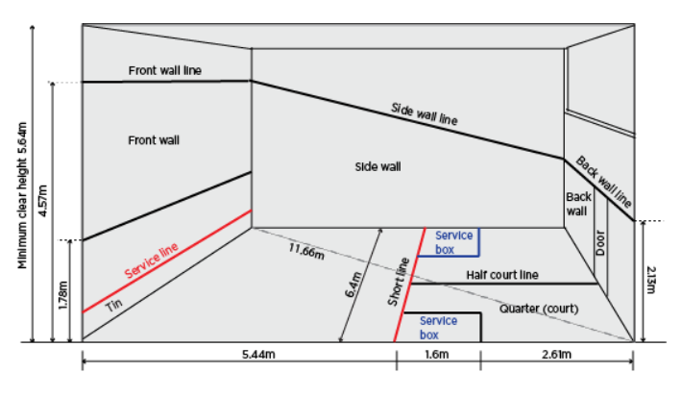
Design/concepts
A regular game of Squash is played between two players in a courtroom/court.
The court is just a large box with red/black lines
Official dimensions used for simulated courts
[1]

Slide 5
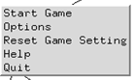
Design/concepts
In-game interface
Used to start game
Allows editing of game properties
Ball “bounciness”
Player’s swing speed
Player’s movement speed
Number of points to win (Default: 5)
Reset
Help
Prompts movement and swing action
Prompts no. of points to win

Slide 6
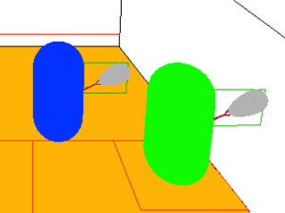
Implementations
Collision (Racket):
Creation of an imaginary box to represent the “racket”
This is a Axis-Aligned Boundary Box (AABB)
Created via the acquisition of maximum and minimum xyz vertices of racket
Ball inverts velocity and gain a small +y velocity(up movement) when hit by racket

Slide 7
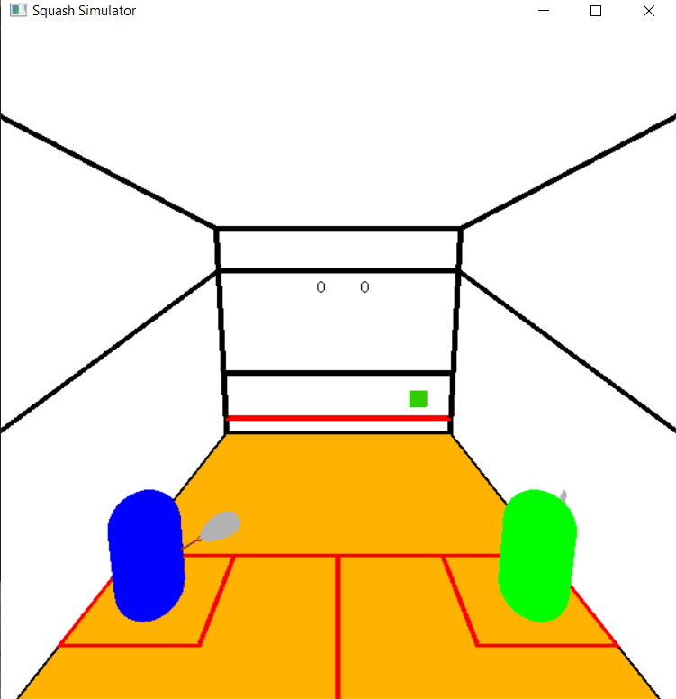
Implementations
Power System:
A coloured block will be created in the corner of the associated player
The colour represents the power that the associated player hits
Green = weak
Red = strong

Slide 8
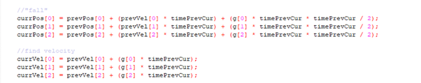
Implementations
Ball motion:
Code which allows for the ball to be affected by gravity and have it velocity changed and affected by the value of gravity. Using timePrevCur to ensure certain amount of change in a second

Slide 9

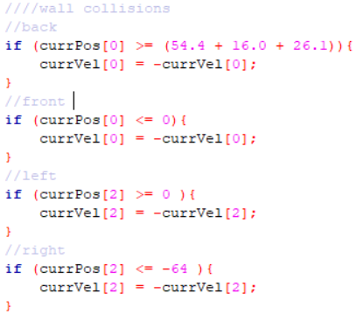
Implementations
Ball Collision (Racket):
Code representing the conditions for the ball colliding with the racket. Vector being checked is that of the centre point of the player and the ball
Ball Collision (Wall):
Checks center position of the ball against the walls of the court (Front, Back, Left Right)

Slide 10
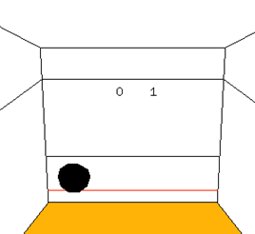
Implementations
Scoring system:
Prompted on court as 2 numerical numbers on the front wall
Increases when a players scores a point
Players need a maximum score of 5 to win
Due to complications, and excessive ball movement (intended), the most viable way of scoring is to cause the other opponent to cause an “out”

Slide 11
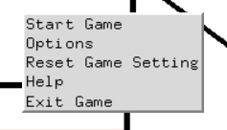
UI implementation
The game menu:
Initiated by right clicking within the squash simulator window borders
Allows the user to:
Start the game
Customise game settings
Reset settings to default
Acquire help in how to play the game and how many points are needed to win
Exit the game

Slide 12
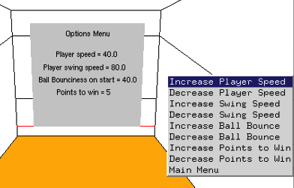
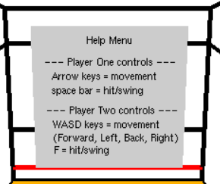
UI implementation
Result of clicking options, allows user to customize game & see set values
Allows use of keys M, N, B, V to edit its respective properties
Upper Case increases
Lower Case decreases
Result of clicking help, shows the user the keys to play the game without looking at documentation or command prompt.

Slide 13
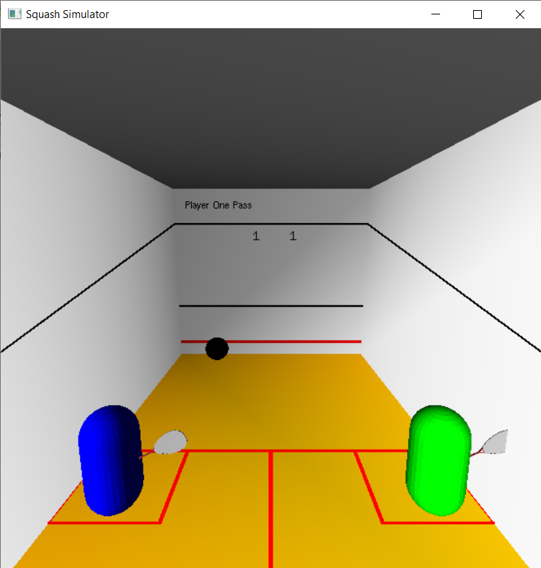
Final Look

Slide 14
Achievements
Achieved:
Achieved creation of ball, room and player/s objects
Ball showcases Newtonian physics
Gravity
Energy loss
Player can hit the ball into a opposing direction
Can tally scores (Limit to 5 to win)
Power system implemented
Indicated by a box over the racket
Changes colour to indicate power level

Slide 15
What had failed/could be done better
Failed:
Unable to mimic mimic regular squash scoring system
Scores are recorded, even when considered out
Works correctly when the opponent misses the ball/doesn't hit the wall with ball
Squash rackets are just for animation/show
Was unable to bind a hitbox to the squash racket, so instead used player to work better
Camera is in a fixed position
The constantly panning camera proved too much so it was scrapped
No title screen
Not enough time to implement

Slide 16
Conclusion
Was able to achieve most project goals, but was unable to deliver all planned items.
Goals achieved
Models made
Physics works
Collisions exists
Scores work
Power system exists
Failed Goals
Failed racket collision
Title screen does not exist
Fixed Camera
Very unrealistic scoring system

Slide 17
References
https://www.dlgsc.wa.gov.au/sport-and-recreation/sports-dimensions-guide/squash

