Slide 1


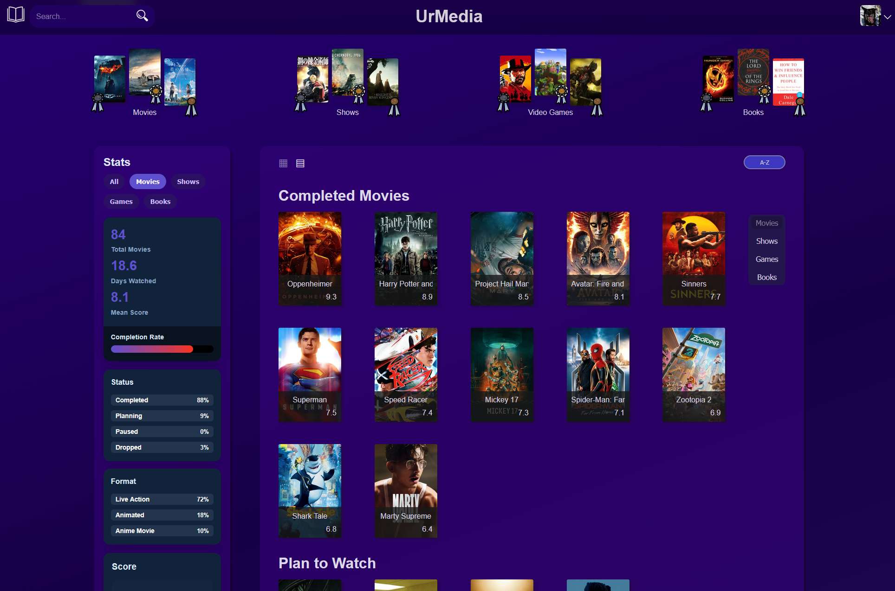
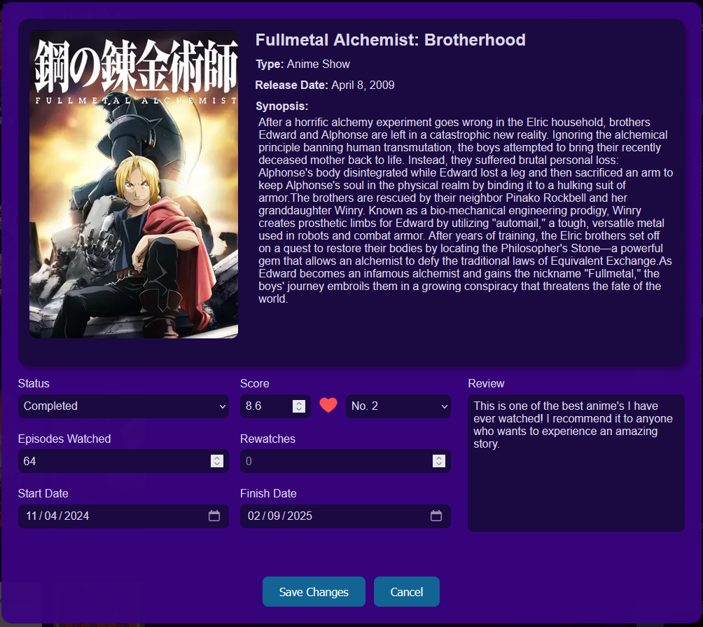
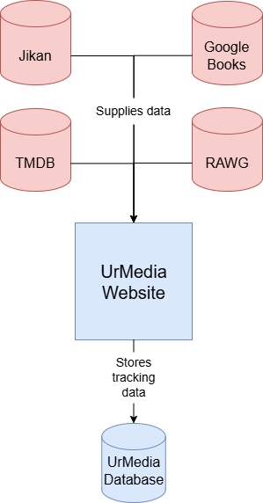
UrMedia
Austin Rowland, Elizabeth Rowland, Skyler Yarbrough, Dhruv Zaver
Dept. Of Computer Science and Information Technology
Abstract
Problem Statement
UrMedia is designed to improve the media logging experience by consolidating multiple tracking services into one intuitive platform. It allows users to track all forms of media in a single location, interact with friends through ratings and reviews, and stay updated with upcoming releases using a countdown feature. A customizable dashboard further enhances usability by organizing content, such as “plan to watch” and “in-progress” lists, within a clean, user-friendly interface.
Enthusiasts of various forms of media - including movies, books, video games, and television shows - often rely on multiple platforms and accounts to track their entertainment. This fragmented experience makes it difficult to organize content, keep up with new releases, and engage with others in one centralized space. In addition, many legacy sites have dated user interfaces, highlighting the messy experience of using many different sites. As a result, users face unnecessary inefficiency when managing media consumption.
Figure 2: When the user selects a piece of media, they have many options for how they would like to track it.
Design
Figure 1: The profile page includes user dashboard, podiums for the user's top-rated media, and the collection of media that the user has added to their list.
The website is divided into three primary categories: tracking media, discovering new media, and staying up to date with releases and activity.
​
The tracking page serves as the core of the platform. Here, users customize their profiles, view and edit the various media they follow, and assign their favorites in a podium-style ranking system displayed on their profile. Other users’ tracking pages can also be viewed, so friends share their latest activity with one another.
​
To support content discovery, the platform highlights popular movies, games, television shows, and books on the landing page, based on engagement from other UrMedia users. Additionally, the site features a filtered search function that enables users to locate specific titles they wish to add to their list.
​
Following updates on shows, games, and friend activity is important to enthusiasts, so UrMedia provides dedicated tabs, including the countdown tab and the friends tab. The countdown tab displays upcoming releases from a user’s planned list, so they never miss a release. The friends tab shows recent activity from connected users, encouraging a more community-driven experience.
References
TypeScript - www.typescriptlang.org/
React.js - https://react.dev/
Next.js - https://nextjs.org/
Node.js - https://nodejs.org/
Supabase - https://supabase.com/
PostgreSQL - https://www.postgresql.org/
Movie Database (TMDB) API - https://www.themoviedb.org
Jikan API - https://jikan.moe/
RAWG Video Game API - https://rawg.io/apidocs
Google Books API - https://developers.google.com/books
Technology
Frontend
The web application is developed with React.js, a JavaScript library for building dynamic, responsive user interfaces through component-based architecture. By utilizing the Next.js framework for server-side rendering and API routing, the application achieves improved performance and simple communication with the backend. This architecture also supports scalability and efficient handling of user interactions as the application grows. The application uses TypeScript and CSS to create a clean, responsive, and maintainable UI.
Data Sources and Hosting
All media titles displayed on the platform are retrieved from external sources to ensure accuracy and consistency with existing tracking services. The app is deployed with Vercel, which integrates well with Next.js.
Figure 3: This UML diagram visualizes the flow of data from the
four larger, pre-existing databases such as TMDB to UrMedia's website page. The tracking information is stored on UrMedia’s database, ensuring only high-quality data is displayed.
Backend
The backend is powered by Supabase, which serves as the central database and handles user authentication while also storing the tracking data of users' media. This allows for efficient passing of user information.
Acknowledgements
We would like to thank Dr. Karen Meisch for her support of students in the College of Science, Technology, Engineering & Mathematics, and Dr. Leong Lee for his support of students in the Department of Computer Science and Information Technology.
Notes:
1

