Slide 1

UrMedia
Austin Rowland, Elizabeth Rowland, Skyler Yarbrough, and Dhruv Zaver

Slide 2
Introduction
On UrMedia, a user can log all the books, video games, anime, manga, and movies they consume in one place, write reviews, and follow the releases of their favorite upcoming series.
The customizable user dashboard will display relevant content, such as their “plan to watch” or “in-progress” lists, in a clean interface that removes the clutter found in most tracker applications.

Slide 3
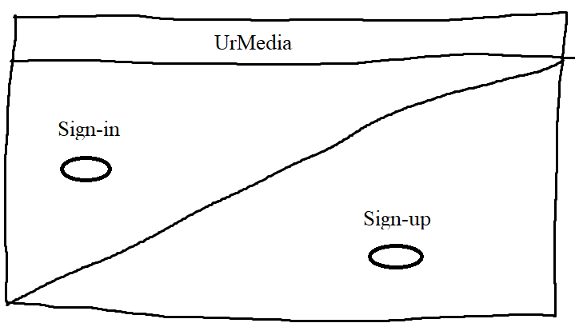
Sign in/Sign up
The page consists of one button for sign in, and one button for sign up
Google Authentication will be used for account creation and login

Slide 4
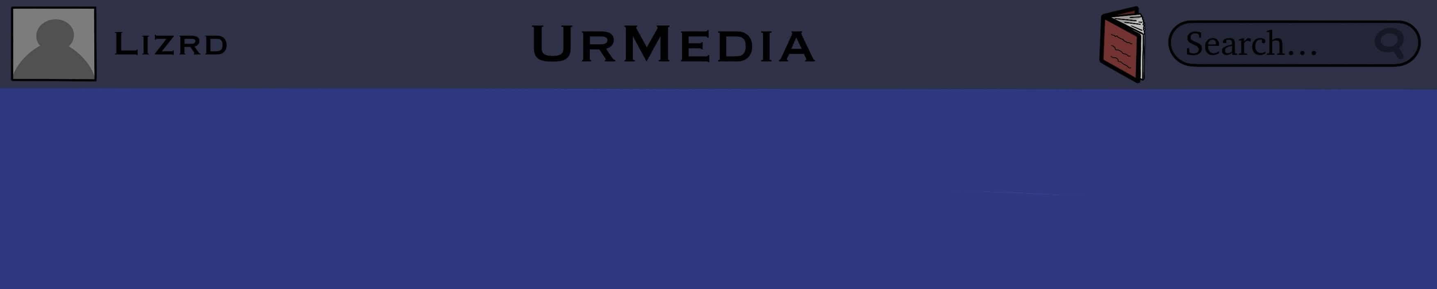
Navigation Bar
Each link will have an icon
Each icon will have a text label when hovered over with the cursor
The website will have a global navigation bar that exists across all pages
It will have a link to the profile page, the media page, a catalog page, a search filter, and a search bar.

Slide 5
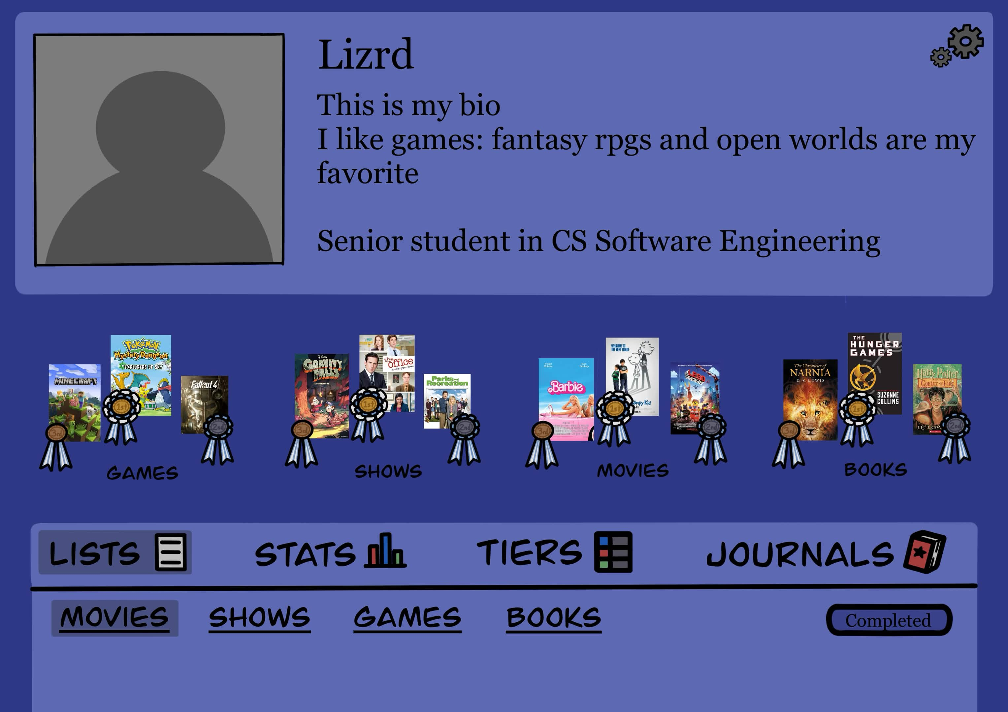
Profile Page
The profile page shows user data
The settings button allows the user to edit their profile picture, bio, and more
Podiums display the user's highest rated games, but can be changed
Both will pop out modals

Slide 6

Profile Edit Modal
In the edit modal, the user can:
Update unique username
Update biography
Update profile picture
Add a birthday
There will be a save changes button, and a cancel button

Slide 7

Podium Modal
If the user is not happy with the auto-populated data in a podium, they can edit it in this modal
All media related to the podium's type will appear in the second half of the modal
The user can drag and drop the desired media into each podium spot

Slide 8
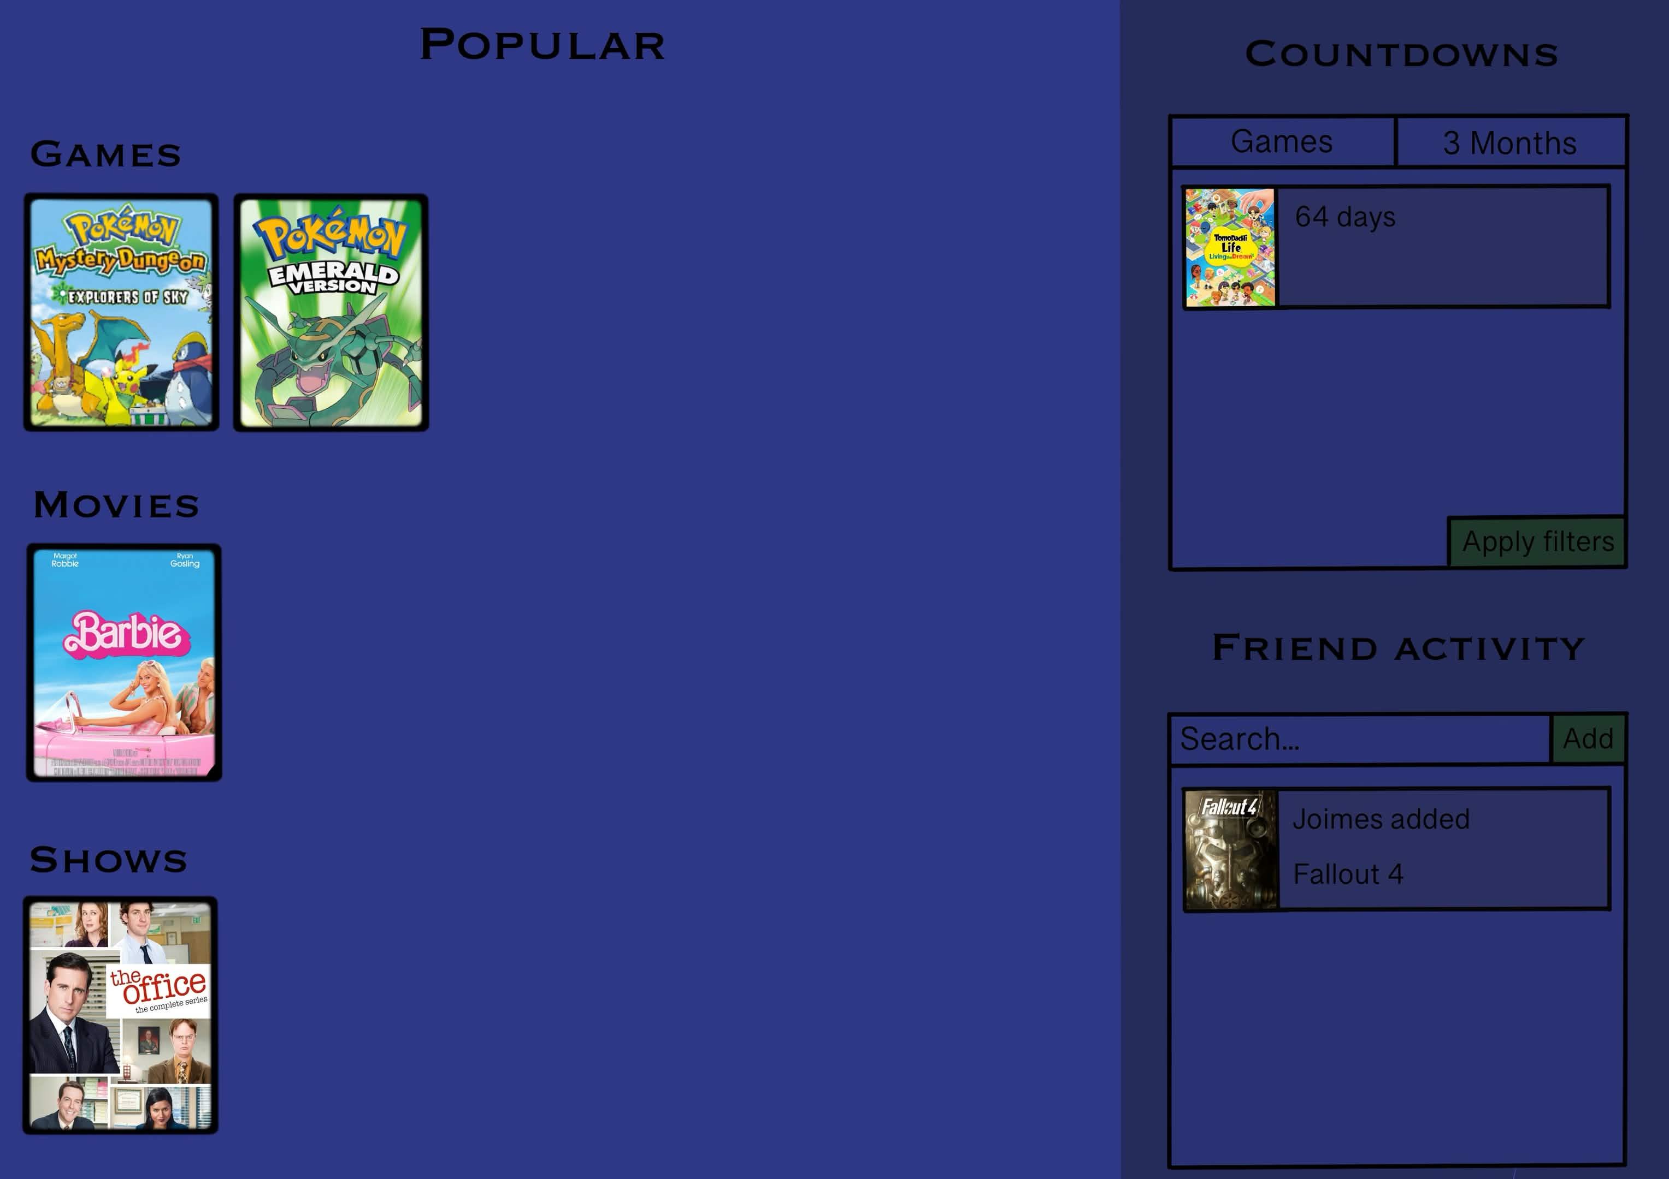
User Lists
Each list will be separated into media types
In the right-hand corner, each media will display the user rating
The filter dropdown menu allows the user to filter by completed, in-progress, plan-to-complete, or dropped
The list will be displayed from highest to lowest rating

Slide 9
Media Page
The media page will be the landing page for all users, with or without signing in
The popular tab will show 5 pieces of media (for each category) that has been added by a lot of users on the website
Each piece of media can be added to the user's list by clicking the plus button

Slide 10
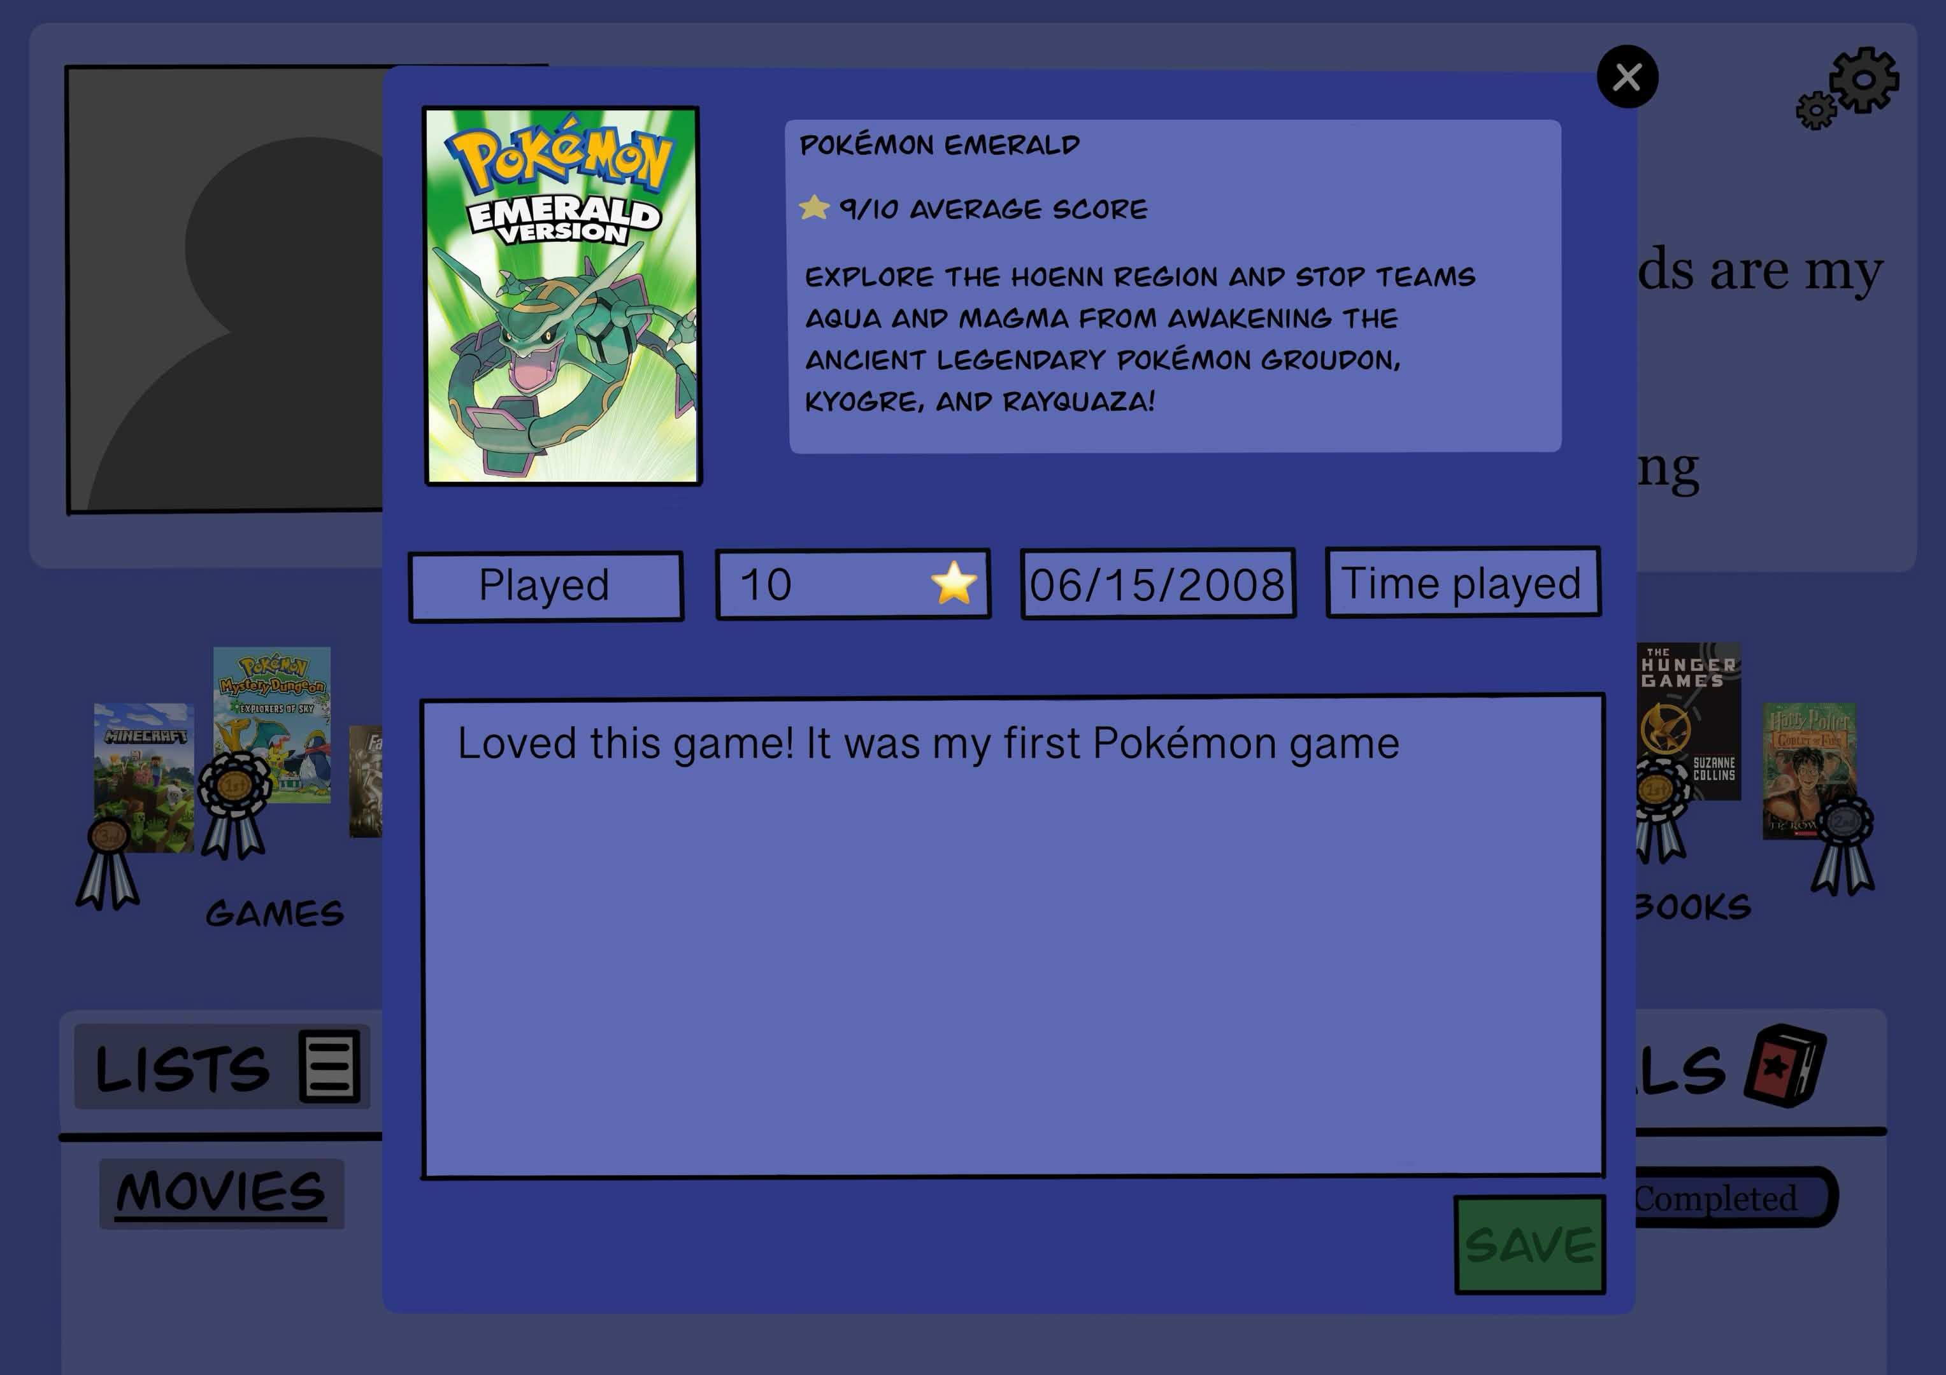
Adding Media
This modal will show more detail about the media, and the user can choose to add it to their list
The user can choose how much progress they made on this media
The user can rate it
Other data that can be entered by the user changes depends on the type of media

Slide 11
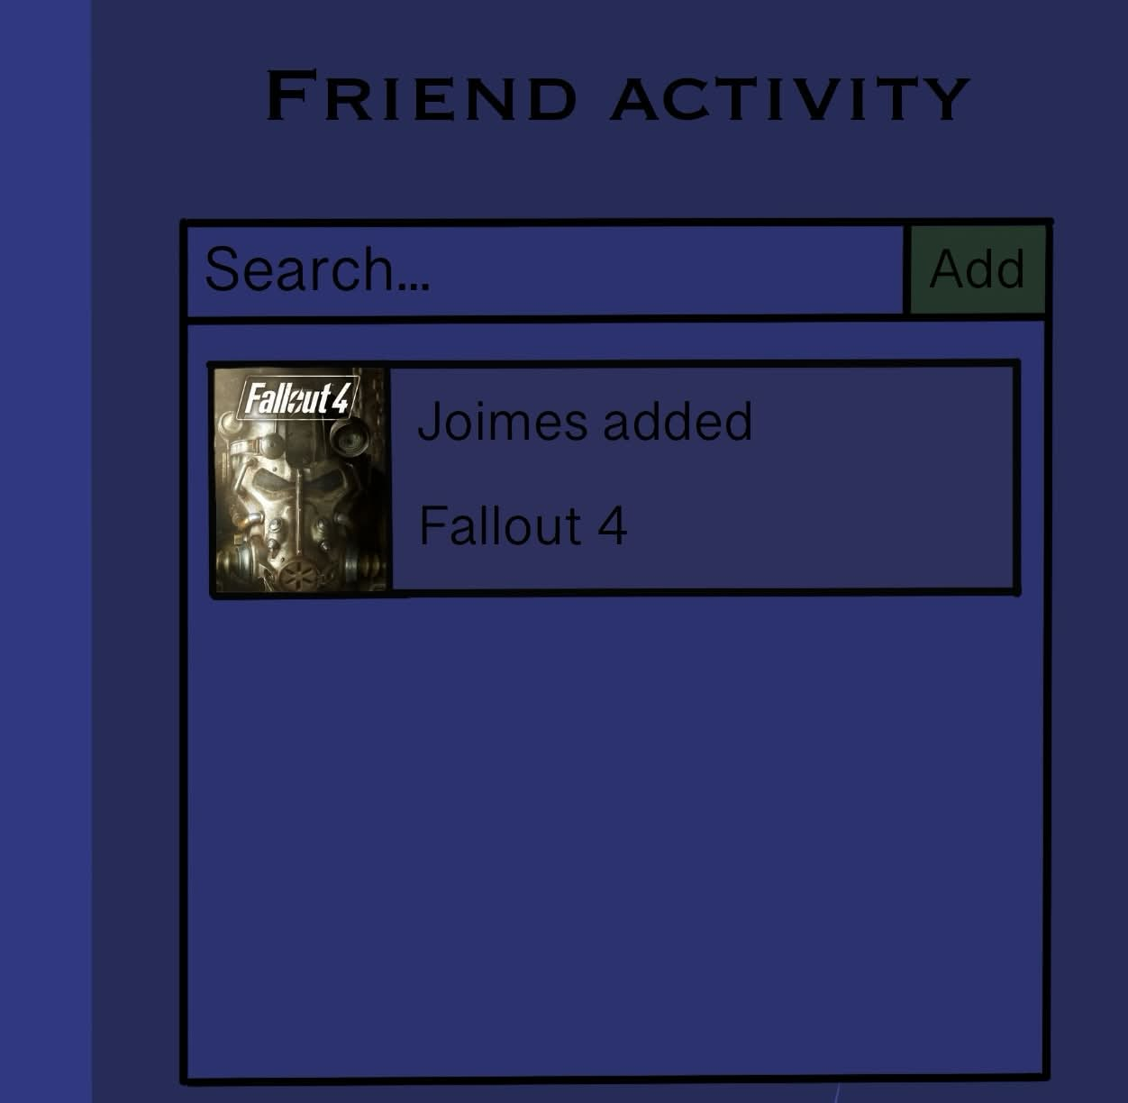
Friend Activity
From this tab of the media page, users can search their friend's usernames and send friend requests
Incoming requests appear here as well
If the user has friends, their recently added media will populate the feed

Slide 12
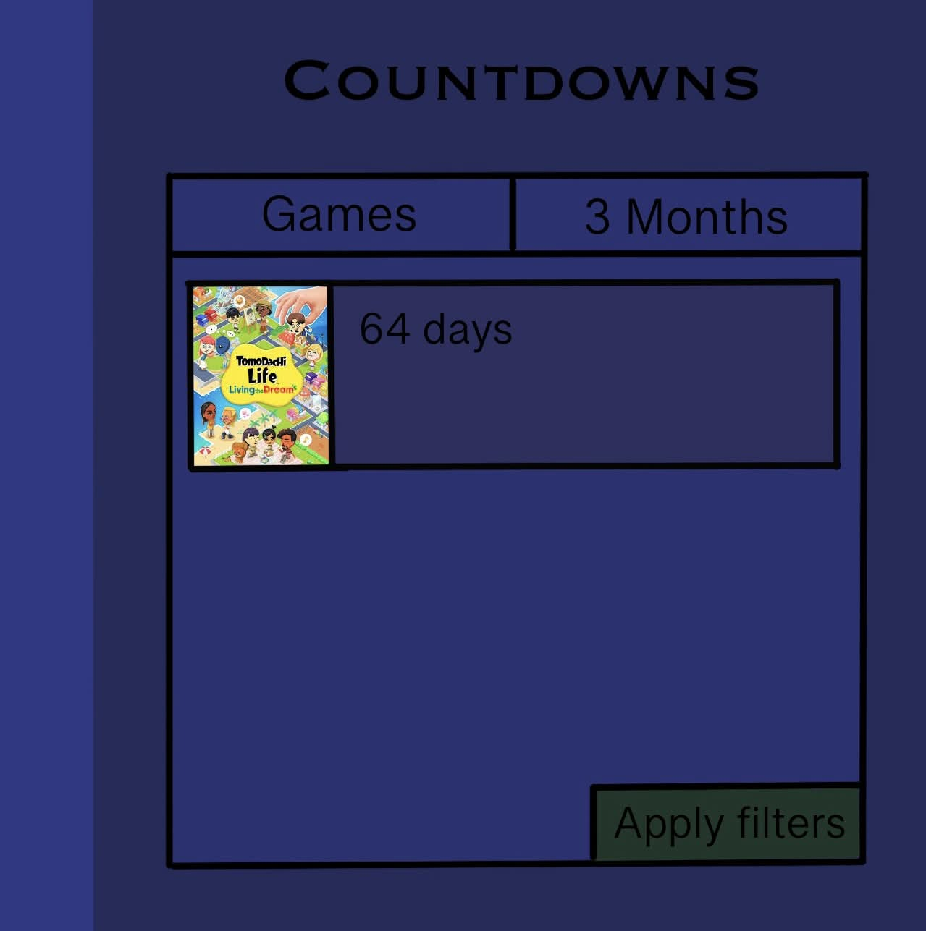
Countdowns
The countdown tab of the media page displays countdowns of new media that the user has interacted with
The multiselect dropdown filter sorts by media type
The dropdown filter sorts by all time, within 3 months, within the year, within the next couple years, and selecting a year
The filters will apply after clicking the apply filter button

Slide 13
Catalog Page
The user can browse the full catalog of media
The search bar allows the user to look up specific media
There will be two filter options:
A text field that allows the user to enter a release year
A multiselect dropdown menu for each media type, All, Games, Books, and Anime/Manga
30 pieces of media will load, and the user can load 30 more by pressing "Next Page"

Slide 14
Risk/Difficult/Interesting Requirements
(Risk) Dependence on external APIs
(Difficult) Filtering and sorting on the browsing page
(Interesting) Handling countdown timers across different user time zones
(Interesting) All in one app for tracking media

Slide 15

Thank you!

