Slide 1
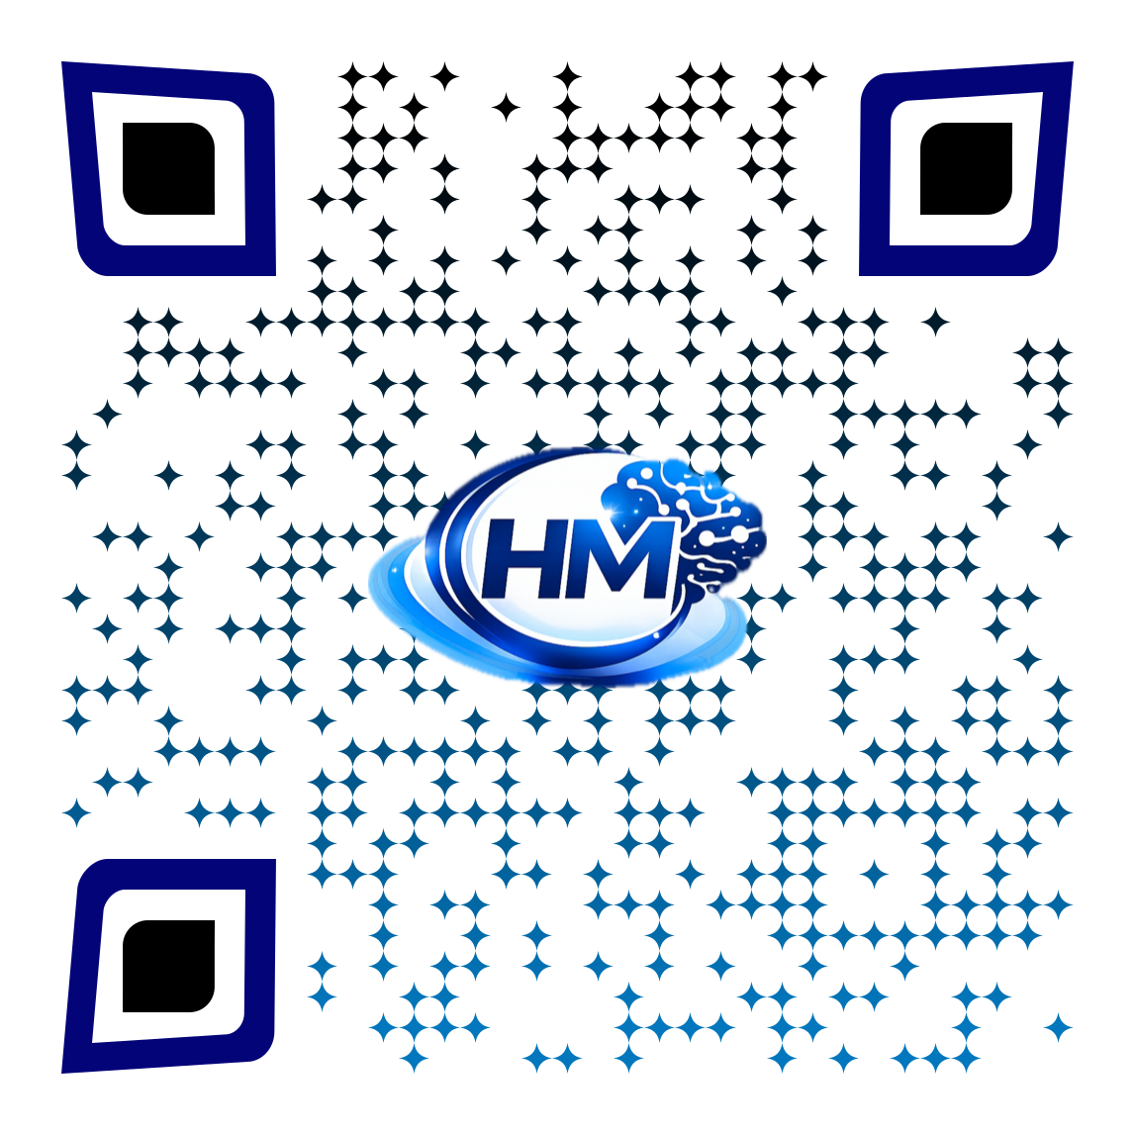
HireMinds.app
A product of RicanNECT
Ismary Torres Szegedi
Info@hireminds.app

Slide 2

Welcome to the Resume Workshop
This Presentation was created for our partner,
YWCA
Presented by HireMinds.app
Together, we are empowering participants with the tools to create professional resumes and move closer to meaningful employment.

Slide 3
Housekeeping
A few expectations before we begin.
Workshop expectations
Session flow
This is a hands-on working session
We will pause for two 15-minute breaks
We will complete short activities throughout the workshop
The goal is to leave with real progress, not just information
Final check: review resume and next steps before dismissal
Please silence or turn off cell phones
Stay engaged and follow along on the website
Ask questions at any time if you get stuck
Keep login information available for today
Respect everyone’s pace and privacy

Slide 4
Workshop outcomes
What participants should know and complete before they leave.
By the end of the session
Participants will also practice
Create a Career Passport account and sign in
Complete core profile information
Build or improve a resume using HireMinds
Understand how to use generators for job search tasks
Identify soft skills and industry core skills to strengthen applications
Navigating the home page and profile editor
Using interview question and follow-up tools
Saving skills and goals that support target roles
Using the job log and budget tools for planning
Finding community support and next-step resources

Slide 5
Workshop agenda
Suggested flow for a full working session.
1
Create Career Passport account and sign in
2
Review the CareerToolkit and navigation
3
Complete the career passport private profile editor
4
Build the resume and review resume formats
5
Practice cover letters, interview tools, and follow-up tools
6
Explore analyzer, skill cards and video library feed,

Slide 6
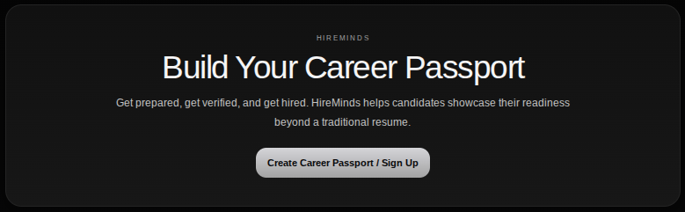
Career Passport home page
Use the real home page so participants know where everything lives.
Sign Up
Create Career Passport / sign-up entry point
What comes next after account creation
How the platform connects profile setup to job search tools

Slide 7
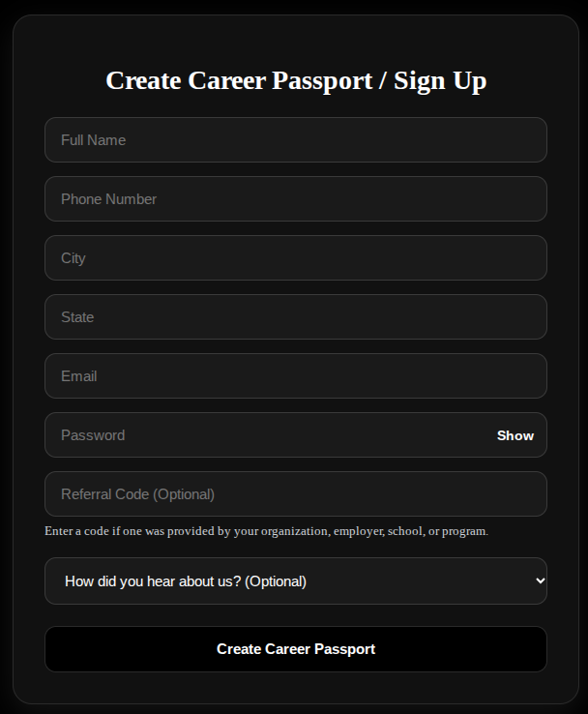
Create the Career Passport
Start on the actual sign-up page participants will use.
What to enter first
Full name, phone number, city, and state
Email address and password for the new account
Use an email participants can access right away
Enter Referral Code: YWCA
Write down login information before moving forward

Slide 8
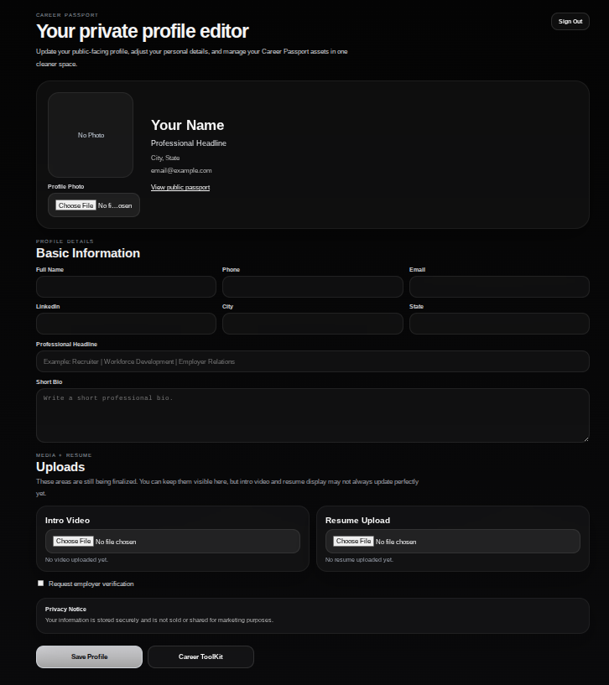
Complete the private profile editor
This is the core setup area participants should finish early in the workshop.
Priority fields
Basic information and contact details
LinkedIn, city, state, and professional headline
Short bio or summary statement
Profile photo only if appropriate and professional

Slide 9
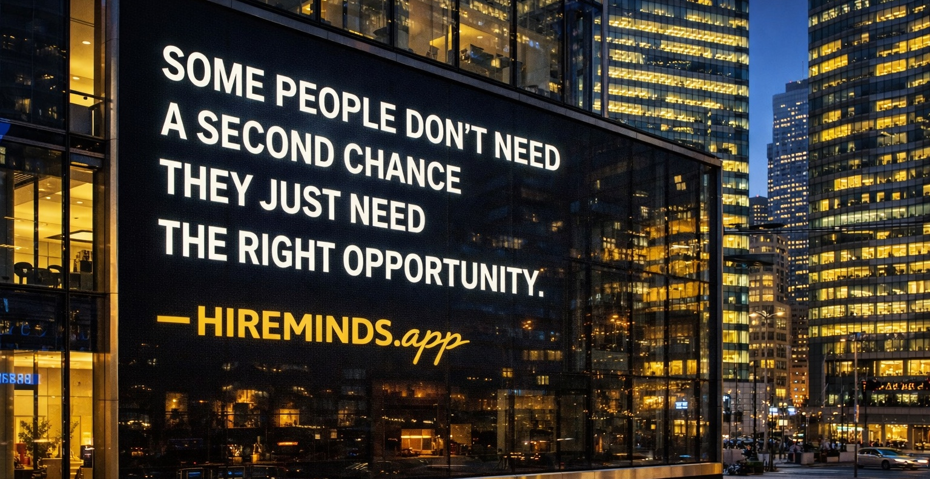
Break 1 — 15 minutes
Stretch, check logins, and be ready to build documents when we return.

Slide 10
Why Reading a Job Description Matters
Now we're going to watch a short video on how to review a job description before applying. .
Helps you understand what the employer is really looking for
Shows whether your skills and experience match the role
Helps you identify important keywords to use in your resume
Gives insight into job duties, expectations, and qualifications
Goal: Help you understand what to look for in a job posting before applying

Slide 11


Slide 12
Searching and Applying Using a Job Board
Now we're going to watch a short video demonstrating how to search and apply for jobs using a job board
Goal: Learn how to search smarter and apply with confidence.
Search for jobs using keywords and location
Filter results to find the best matches
Read job postings carefully before applying
Upload your resume and complete application

Slide 13


Slide 14
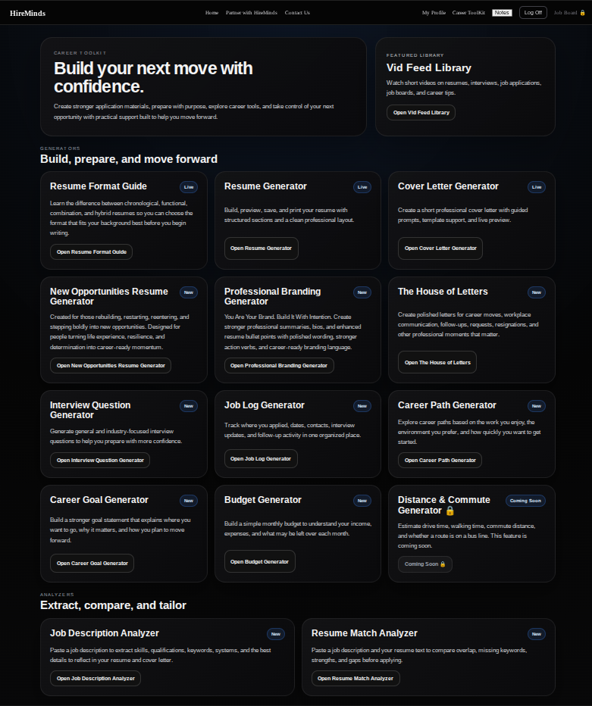
Career ToolKit
Build professional resumes with guided support
Create tailored cover letters for job applications
Prepare for interviews with practice questions
Create short bio or summary statement
Use budget tools
Watch short videos on resume, interviews, job applications, job boards, and career tips.

Slide 15
Resume Formatting
Now we're going to watch a short video that shows how to format a resume, so it looks clean, professional, and easy to read.
Goal: Help participants understand how to organize and format their resume.
Explains the importance of clear headings and sections
Reviews spacing, alignment
Make it easy to scan by employer and ATS
Supports a stronger first impression

Slide 16
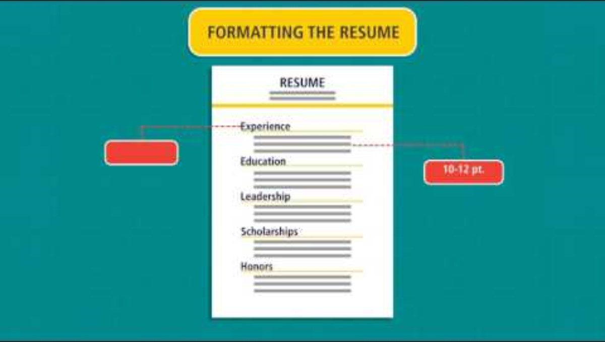

Slide 17
2 Types of Resume Generators
The main tool for turning profile details into a strong working resume.
Resume Generator
New Opportunities Resume
Fully Guided Resume Generator
Creates or improves resume content faster
Turns profile details into usable resume sections
Helps participants organize experience, education, and skills
Gives a starting point that can be edited for target jobs
Veteras
Reentry
Career Restart
Stay at Home Parent
Homemaker, Caregivers
Little to no work experience
Created for those rebuilding, restarting, reentering, and stepping boldly into new opportunities. Designed for people turning life experience, resilience, and determination into career-ready momentum.

Slide 18
Industry core skills vs Soft Skills
Use this section to connect participants with the language employers expect.
Industry Core Skills
Soft Skills
Industry skills help resumes match real job postings
Participants can identify missing or transferable skills
The page supports career exploration and stronger applications
It helps facilitators coach participants toward the right language
Search one target industry or job family
Select five core skills that fit the participant’s goals
Add matching skills to the resume draft where appropriate
Highlight one skill to build next through training or experience

Slide 19
Generators inside HireMinds
Planning tools help participants stay organized after today’s workshop.
Budget Generator
Job Log Generator
Career Path Generator
Resume Format Guide
Helps participants plan income and expenses during a job search
Useful for setting realistic short-term financial goals
Tracks applications, interviews, and follow-ups
Creates accountability and a record of progress
Helps participants see possible next roles and advancement options
Explains resume layout choices and when to use them
Supports cleaner, more readable final resumes
Job Log Generator​
ds
sd
Explains resume layout choices and when to use them
Supports cleaner, more readable final resumes
Explains resume layout choices and when to use them
Supports cleaner, more readable final resumes
Explains resume layout choices and when to use them
Supports cleaner, more readable final resumes
Explains resume layout choices and when to use them
Supports cleaner, more readable final resumes

Slide 20
Analyzer
Move beyond job titles and show the strengths employers look for.
Job Description Analyzer
Resume Match Analyzer
Breaks down the job posting into key requirements
Highlights skills, duties, and qualifications
Identifies important keywords from the posting
Helps you understand what the employer is looking for
Helps you focus on the qualifications and expectations that matters most
Compares resume to job posting
Measures how well you match
Identifies gaps or missing keywords
Helps tailor your resume
Improves your chances of getting noticed by employers
Similar to an ATS because it looks at how well a resume matches a job description
Goal: Helps understand what employers are looking for before you apply.
Goal: Helps you compare your resume to a job posting and identify ways to improve your match.

Slide 21
Vid Library Feed
Show participants that the platform is not only for documents.
1. Offers quick access to career readiness videos.
2. Supports different learning styles through visual content
3. Covers topics like resume, interviews, and job search tips
4. Helps reinforce lesson taught during workshops
5. Gives participants tools they can revisit anytime
6. Makes learning more engaging and interactive
7. Breaks down important topics into simple, digestible videos
8. Expands the toolkit beyond forms and generators
Goal: Helps participants learn through visual, easy-to-follow content they can watch at their own pace.

Slide 22

Break 2 — 15 minutes
When we return, we will finish remaining tools and review final resumes.

Slide 23
Ace Your Job Interview
Now we're going to watch a video on how to Ace our Job Interview.
Goal: Help you feel prepared, confident, and ready to succeed.
Show confidence and professionalism
Make strong first impression
Ask thoughtful questions at the end of the interview
Follow up professionally after the interview

Slide 24
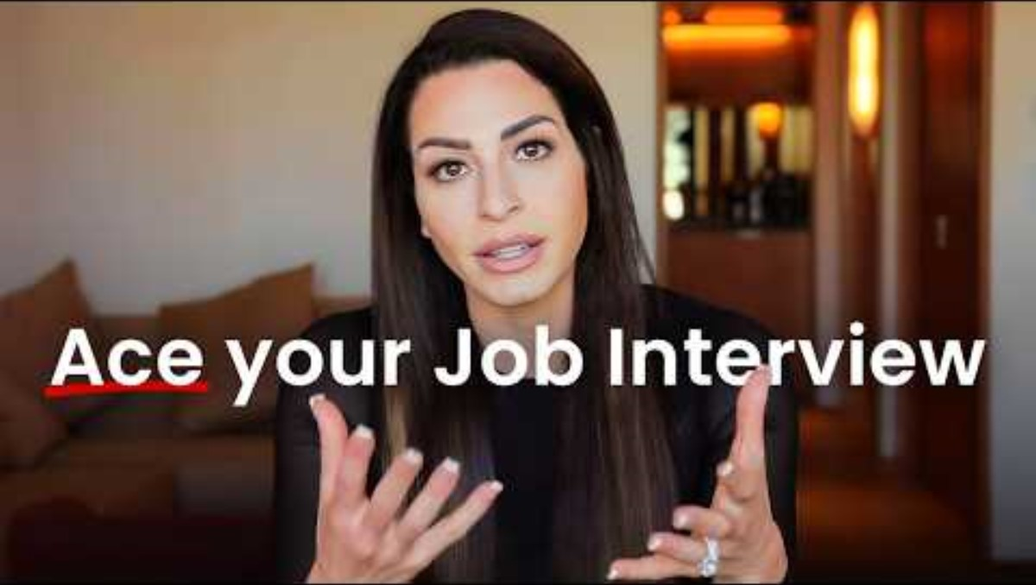

Slide 25
Dressing for the Interview
Now we're going to watch a short video on how to dress based on the job you're interviewing for.
Goal: Dress for the job you want while keeping the company culture in mind.
Dress for the job you want
Match the workplace culture
Keep it neat and professional
Not every job needs a suit
First impressions matter

Slide 26
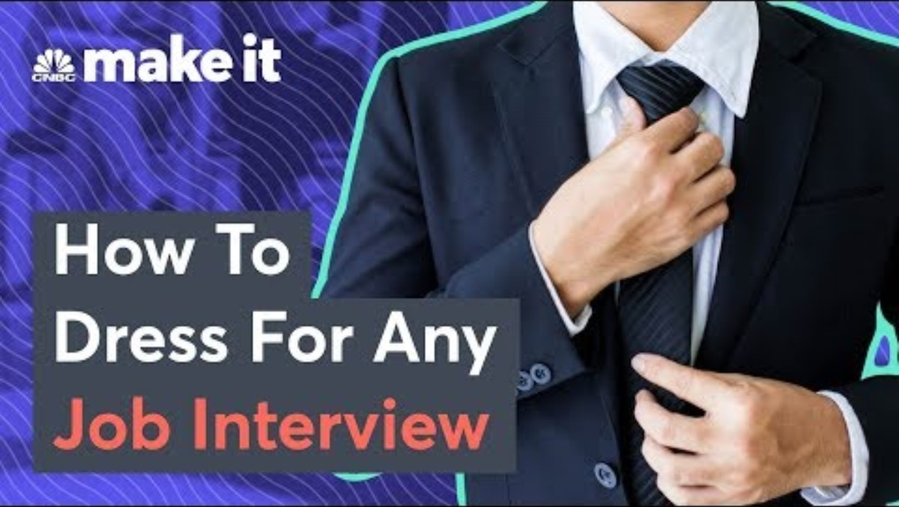

Slide 27
Hands-on website practice
Give participants time to work inside HireMinds while support is available.
1. Sign in and confirm the Career Passport account is active.
2. Complete the profile editor with basic information, headline, and short bio.
3. Build a resume draft and review format choices.
4. Use soft skills and industry core skills to improve the draft.
5. Open one more generator: cover letter, follow-up, budget, job log, interview question, career path, or career goal.
6. Save progress and identify one action to complete after the workshop.
Facilitator check-in: stop halfway through this activity and ask who has a completed resume draft already saved.

Slide 28
Wrap-up and next steps
End the workshop with something completed and something planned.
Before participants leave
Suggested final check
Confirm the Career Passport account is active
Save the resume draft
Save at least one generator output besides the resume
Identify two skills to keep building
Know the next action after today
Does the resume match the target role?
Is the contact information correct?
Were soft skills and industry core skills reviewed?
Was one interview or follow-up tool used?
What will the participant do next within 48 hours?

Slide 29
HireMinds.app
A product of RicanNECT
Ismary Torres Szegedi
Info@hireminds.app

