Slide 1
Stiffness feasible workspace of cable-driven parallel robots with application to optimal design of a planar cable robot
Lisnichenko Marina mRO-1

Slide 2
Goal, tasks
Goal: introduce stiffness-feasible workspace based on stiffness of cable-driven parallel robots (CDPRs).
Tasks: to describe previous methods of describing feasible workspace, the concept of internal forces,

Slide 3
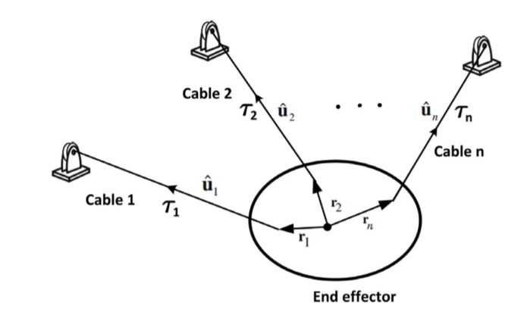
CDPRs
For n degrees of freedom, at least n+1 driving cable must be employed;
can only pull.

Slide 4
Wrench Closure Workspace(WCW)
set of poses of the end-effector where robot able to apply any wrench while cables are taut
any pose X belongs to the WCW if and only if the Jacobian matrix J has full rank and the null space of the Jacobian transpose contains a vector z > 0 (J’z =0)
Depends only on the robot geometry

Slide 5
Maximizing volume of the workspace
Using this kind of criterion as a cost function
Grouped coordinate descent method
analyzed dynamically
the shape and size of the end-effector of CDPR are optimized to maximize the volume of the stable workspace

Slide 6
Internal forces and stiffness
are defined as forces in the cables of the mechanism where externally applied wrench is zero;
stiffness is a function of internal forces, the pose of the end-effector and the geometry of the mechanism, which may apply considerable instability and low position accuracy problems;
stiffness matrix of CDPRs considering four spring model for the cables;
stiffness of the CDPRs is the summation of two stiffnesses: stiffness of the cables and stiffness of the internal forces.

Slide 7
Stability - end-effector’s tendency to return to the static equilibrium when robot undergoes an external disturbance
Previous researches:
Cables must be taut in the whole maneuver space of the robot such as WCW and WFW;
stiffness is a simple scalar index;
motions and location of pulley blocks of CDPR - function of the pose of the end-effector to optimize stiffness and dexterity;
optimized mechanical structure and the geometry configurations of the CDPR;
mechanical approach to achieve optimal stiffness, a couple of springs are attached to the direction of cables in the cable mobile robot;
used actuation redundancy to achieve the desired end-effector stiffness;
min lowest natural frequencies as an objective function in the design of CDPR.

Slide 8
But!
none of the abovementioned studies has not specified a set of poses of the end effector as a workspace where the robot could use allowable values of internal forces for modifying the total stiffness of the robot;
because of this cable robot always endures a concern of unexpected collapse and vibration in the aforementioned workspaces.

Slide 9
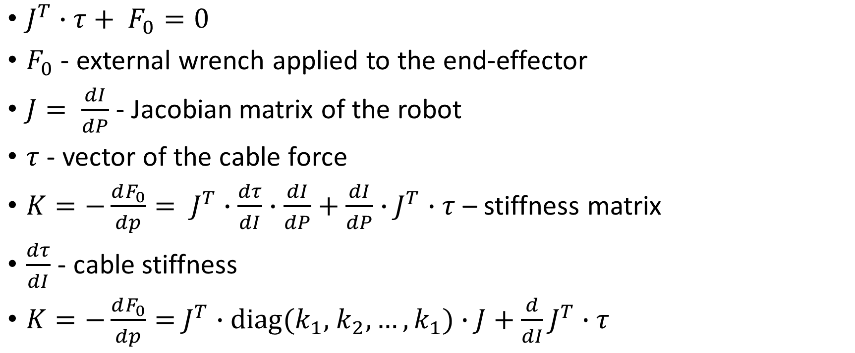
Stiffness introduction
$J^{T}∙τ+ F_{0}=0$
$F_{0}$ - external wrench applied to the end-effector
$J= \frac{dI}{dP}$- Jacobian matrix of the robot
$τ$ - vector of the cable force
$K=−\frac{dF_{0}}{dp}= J^{T}∙\frac{dτ}{dI}∙$ $\frac{dI}{dP}+\frac{dI}{dP}∙J^{T}∙τ$ – stiffness matrix
$\frac{dτ}{dI}$ - cable stiffness
$K=−\frac{dF_{0}}{dp}=$ $J^{T}$ $∙diag(k_{1},$ $k_{2},…, k_{1})∙J+$ $\frac{d}{dI}J^{T}∙τ$

Slide 10
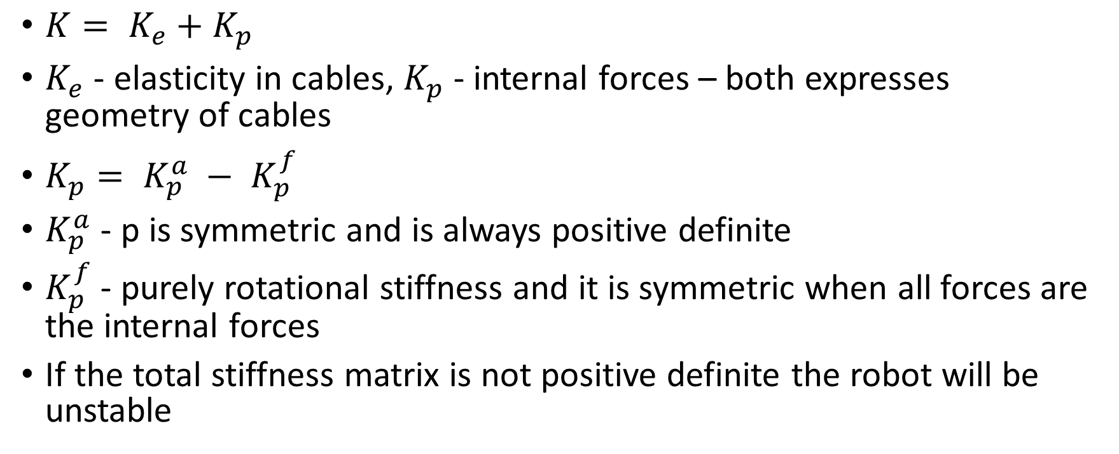
Stiffness introduction
$K= K_{e}+K_{p}$
$K_{e}$ - elasticity in cables, $K_{p}$ - internal forces – both expresses geometry of cables
$K_{p}= K_{p}^{a} − K_{p}^{f}$
$K_{p}^{a}$ - p is symmetric and is always positive definite
$K_{p}^{f}$ - purely rotational stiffness and it is symmetric when all forces are the internal forces
If the total stiffness matrix is not positive definite the robot will be unstable

Slide 11
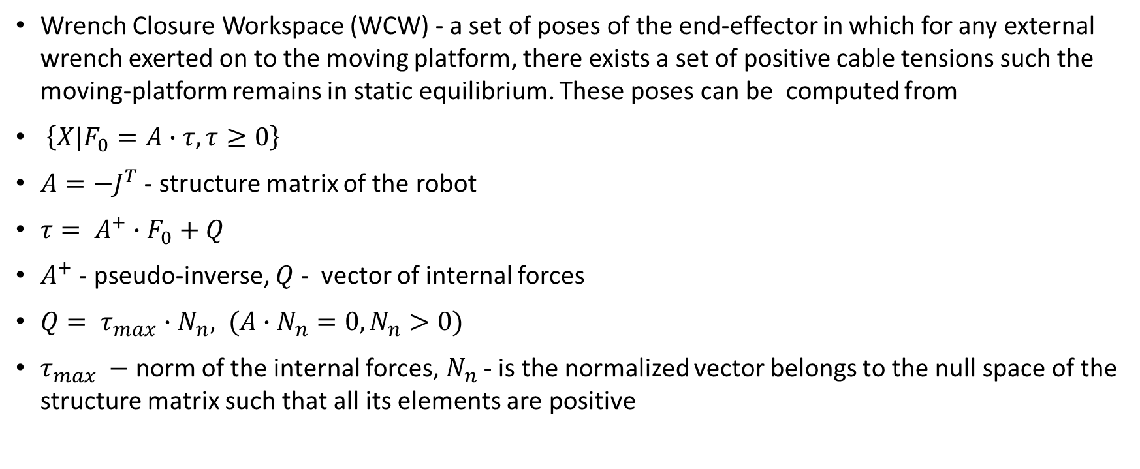
Stiffness-feasible workspace
Wrench Closure Workspace (WCW) - a set of poses of the end-effector in which for any external wrench exerted on to the moving platform, there exists a set of positive cable tensions such the moving-platform remains in static equilibrium. These poses can be computed from
$\left\{X|F_{0}=A∙τ, τ≥0\right\}$
$A=−J^{T}$ - structure matrix of the robot
$τ= A^{+}∙F_{0}+Q$
$A^{+}$ - pseudo-inverse, $Q$ - vector of internal forces
$Q= τ_{max}∙N_{n}, (A∙N_{n}=0,N_{n}>0)$
$τ_{max} −$norm of the internal forces, $N_{n}$ - is the normalized vector belongs to the null space of the structure matrix such that all its elements are positive

Slide 12
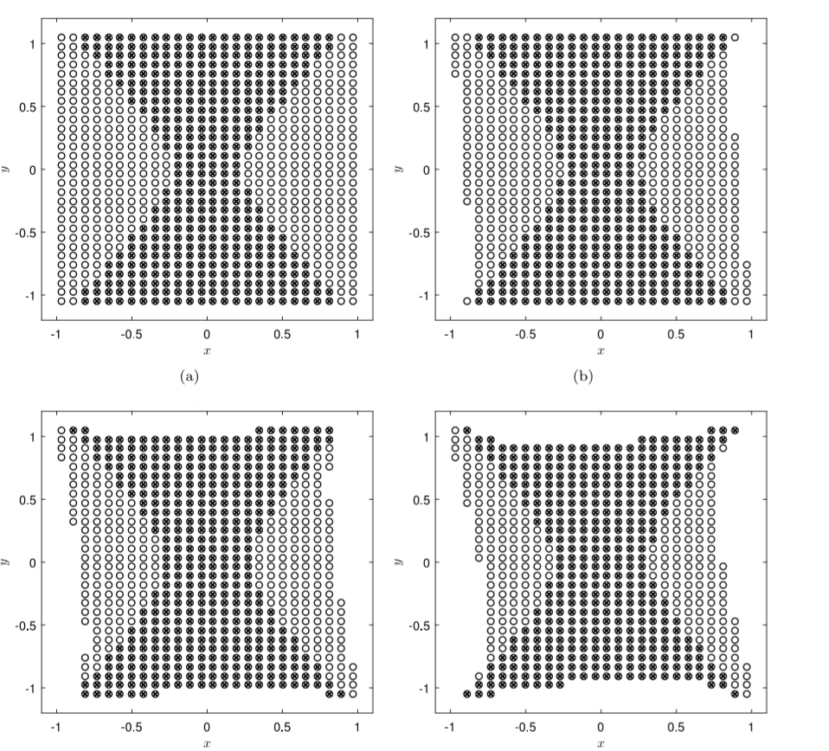
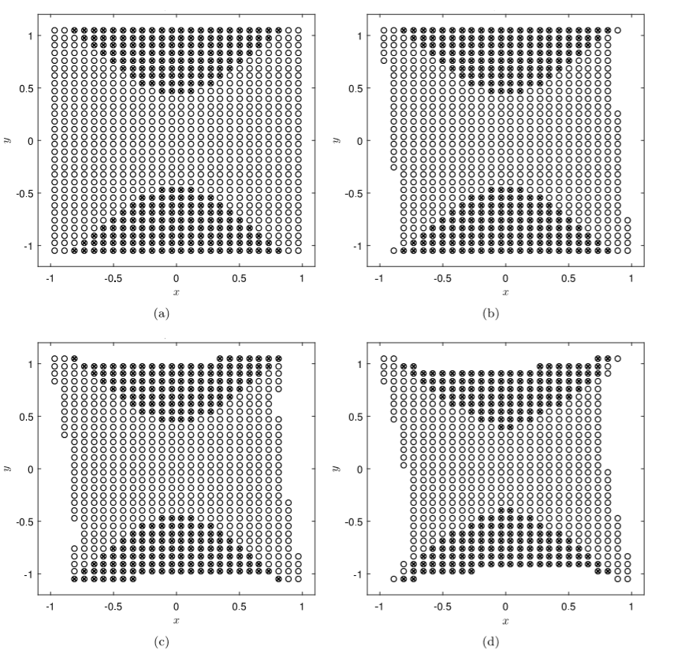
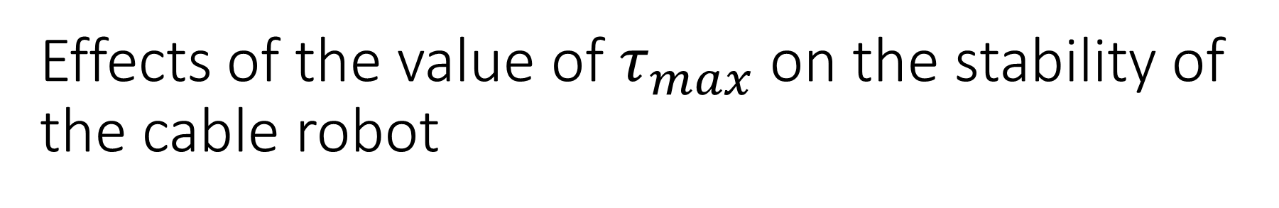
Effects of the value of $τ_{max}$ on the stability of the cable robot
The SFW(×) and WCW (⃝) of a planar CDPR for τmax up to 12 and 80N in four different orientation of the end-effector: (a)0deg, (b)10deg. (c)20deg, (d)30deg.

Slide 13
Properties Stiffness-Feasible Workspace(SFW)
Property1. The SFW is a subset of WCW.
Property2. SFW determines the allowable internal forces range (0,τmax) that guarantee the stability of the robot and tension-ability condition.
Property3. The SFW of CDPR is the function of internal forces and the robot configuration such as the location of cables attachment points.

Slide 14
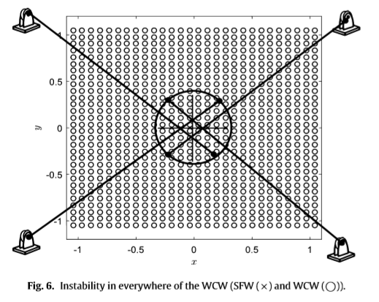
Instability
It is fascinating to note that some circles are not marked by times even for low values of τmax. That means these poses are not stiffness feasible. Moreover, there are some poses that for any value of τmax are not stiffness feasible.
Limitation of CDPRs such as unstable poses and negative effects of the internal forces

Slide 15
Optimization criteria
The goal is to avoid singularities (when Jacobian matrix has a rank deficiency or there are not internal forces at that pose)
So, end-effector of CDPRs should always be in WCW -> we need maximizing the volume of the SFW and WCW.

Slide 16
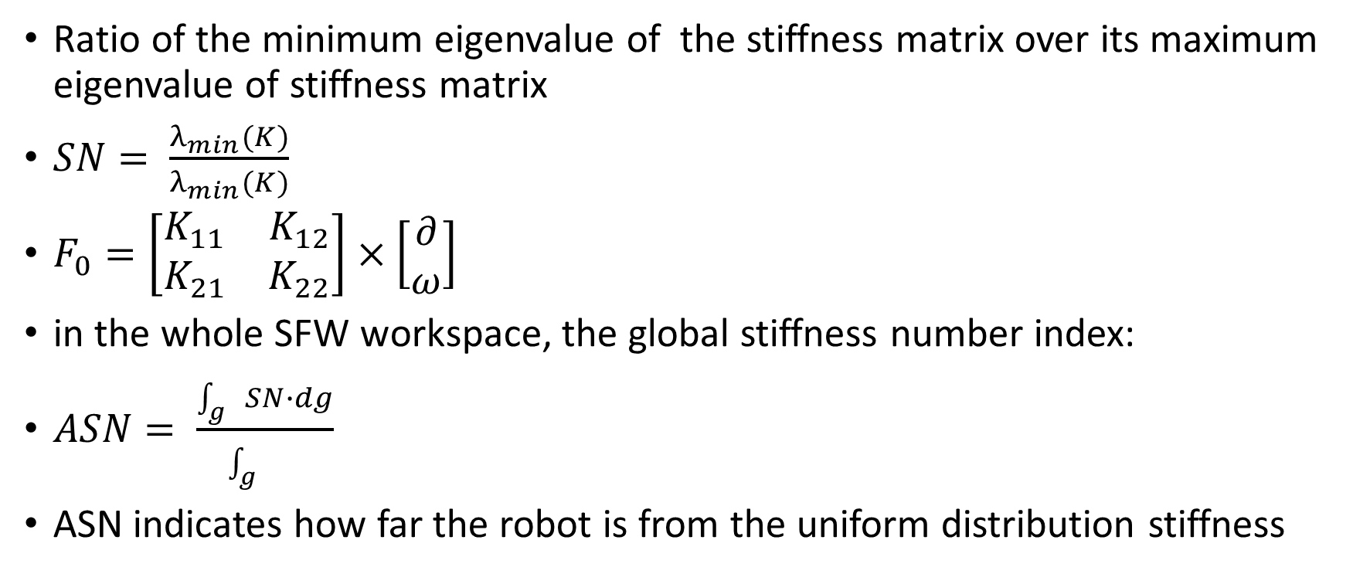
Stiffness number
Ratio of the minimum eigenvalue of the stiffness matrix over its maximum eigenvalue of stiffness matrix
$SN= \frac{λ_{min}(K)}{λ_{min}(K)}$
$F_{0}=\left[\begin{matrix}K_{11} & K_{12} \\ K_{21} & K_{22}\end{matrix}\right]×\left[\begin{matrix}∂ \\ ω\end{matrix}\right]$
in the whole SFW workspace, the global stiffness number index:
$ASN= \frac{\int_{g}{SN∙dg}}{\int_{g}{}}$
ASN indicates how far the robot is from the uniform distribution stiffness

Slide 17
Design parameters. Assumptions
the attachment points of cables on the end-effector plane are considered symmetric with respect to the x, y axes
cables can be arranged to the end-effector plane in a rectangular pattern

Slide 18
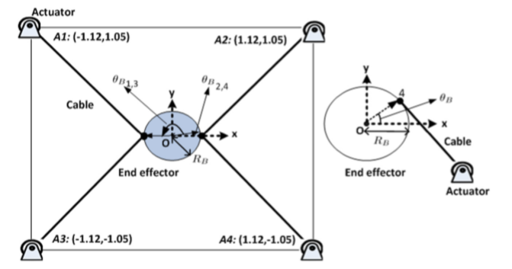
Design parameters
increasing RB the percentage of the WCW is decrease;
by increasing θB the volume of WCW is increased;
percentage of SFW is decreased by increasing θB and RB;
By increasing RB average of stiffness number is increased and by increasing θB, the average of stiffness number is decreased;
Therefore, the effects of design parameter RB on SFW and WCW and the effect of design parameter θB on SFW and average of SN are similar.

Slide 19
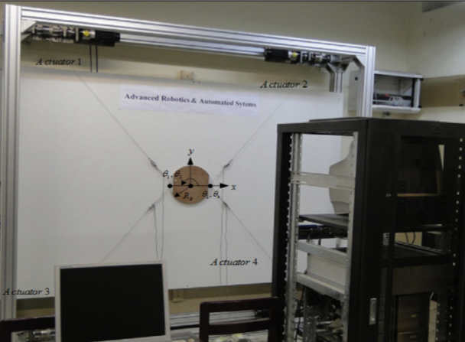
Optimal parameters for CDPR
θB4 =0◦ , θB3 =180◦ , θB2 =0◦, θB1 =180◦ , RB =0.1(m)

Slide 20
Changes
Considering the vital role of the internal forces on the total stiffness of the robot Stiffness Feasible Workspace (SFW) were introduced;
stiffness Number (SN) – indicates the distribution of the stiffness of the structure – was found;
design parameters on the SFW volume and SN were studied;
was optimized the design parameters by maximizing the volume of the SFW, WCW, and uniform distribution of the stiffness;
evolutionary algorithm (EA) was implemented to obtain a set of optimal answers.

Slide 21


