Slide 1
The Spot robot
By Lisnichenko Marina, mRO-1

Slide 2
Goal, tasks
Goal: to create movable model of Spot
Tasks:
1. Build static model;
2. Add actuators;
3. Add camera;
4. Test model.

Slide 3
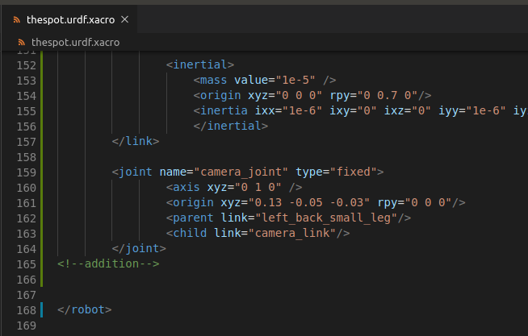
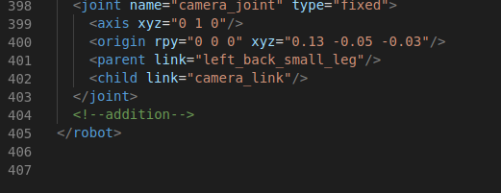
Main features: model code
<-- Xacro
URDF -->

Slide 4
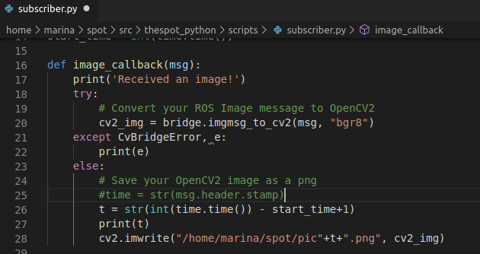
Main features: photo saving
<--for each second: if picture received – save it with name of new time
(incremented to primary)!-->

Slide 5
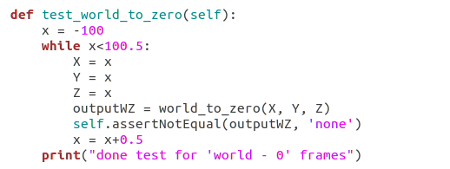
Main features: testing

Slide 6
Results

Slide 7
Conclusion
Was developed movable model of Spot robot, was attached camera. Full model was tested. In the process of creation were learned such skills as operating in ROS, GitHub, work with Gazebo and so on.

