Slide 1
Secure Data Hiding In Images Using Steganography
CAPSTONE PROJECT
Presented By: Utkarsh Pandey
Student Name : Utkarsh Pandey
College Name & Department : Shri Ramswaroop Memorial University & Department of Computer Science Engineering

Slide 2
OUTLINE
Problem Statement
Technology used
Wow factor
End users
Result
Conclusion
Git-hub Link
Future scope

Slide 3
Problem Statement
With increasing concerns over data security, traditional encryption methods are often insufficient for covert communication. Steganography provides a secure way to hide sensitive information within images without drawing suspicion. This project focuses on developing a robust image-based steganography system that ensures secure data embedding and retrieval while maintaining image integrity.

Slide 4
Technology used
Programming Language: Python 🔹 Libraries: OpenCV, NumPy
Concepts: Image Processing, Least Significant Bit (LSB) Steganography Encryption: UTF-8 Encoding for Data Integrity Security: Password-Based Data Extraction

Slide 5
Wow factors
Hybrid Security Approach – Combines steganography with password protection, ensuring only authorized users can decrypt the hidden data.
Minimal Image Distortion – Uses Least Significant Bit (LSB) technique, making the changes imperceptible to the human eye while maintaining image quality.
Adaptive Data Embedding – Dynamically adjusts storage across pixels and channels, optimizing space usage and preventing noticeable alterations in the image.
Efficient Extraction Mechanism – Utilizes a custom delimiter (::END) to accurately retrieve the hidden message, preventing data corruption or overflow.
User-Friendly Interface – Simple command-line interaction for seamless encryption and decryption without requiring deep technical knowledge.
Result: A secure, efficient, and undetectable method for covert communication through images!

Slide 6
End users
Cybersecurity Enthusiasts & Ethical Hackers – For secure data transmission and covert communication.
Government & Intelligence Agencies – To discreetly share classified information without attracting attention.
Journalists & Whistleblowers – For securely transmitting sensitive reports without detection.
Businesses & Corporations – To protect confidential documents and trade secrets from cyber threats.
Privacy-Conscious Individuals – For personal data protection and secure messaging in an era of digital surveillance.

Slide 7
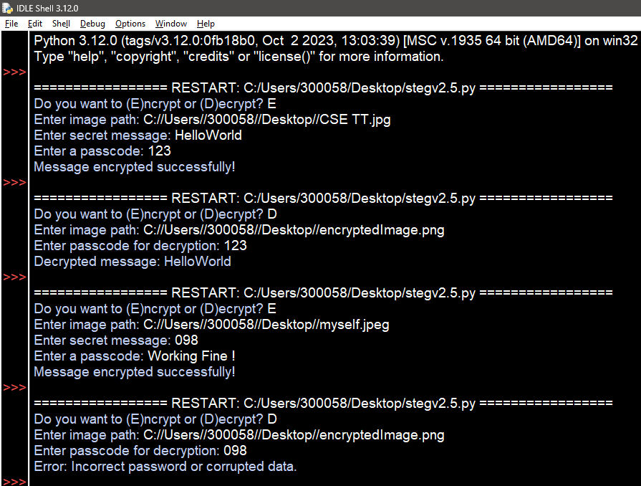
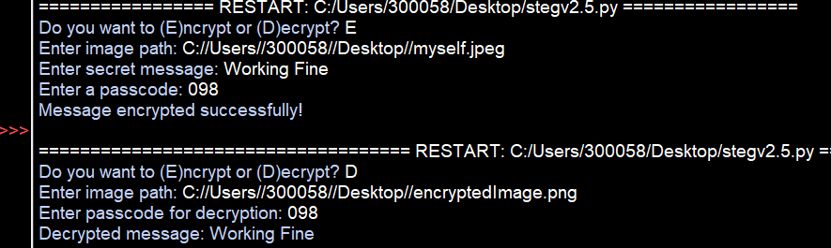
Results

Slide 8
Conclusion
This project successfully implements a secure and efficient steganography system for hiding sensitive data within images. By leveraging Least Significant Bit (LSB) encoding and password-protected decryption, it ensures covert communication without compromising image quality. The solution addresses the growing need for data privacy and security, making it a valuable tool for cybersecurity, intelligence agencies, businesses, and privacy-conscious individuals. Ultimately, this project demonstrates a reliable approach to secure data hiding, offering a practical and undetectable means of communication in an era of increasing digital threats.

Slide 9
GitHub Link
https://github.com/UraniumUtkarsh/AICTE_Internship_Project

Slide 10
Future scope(optional)
Enhanced Encryption – Integrating AES or RSA encryption for an added layer of security before embedding the data.
AI-Based Steganalysis Resistance – Implementing adaptive embedding techniques to evade detection by AI-powered steganalysis tools.
Increased Storage Capacity – Using advanced encoding techniques like bit-plane slicing to store more data without compromising image quality.
Multi-Format Support – Extending functionality to support video, audio, and document steganography for broader applications.
Web & Mobile Integration – Developing a user-friendly app or web-based tool for seamless encryption and decryption on various platforms.
Blockchain for Tamper-Proof Security – Embedding hidden messages within blockchain transactions for immutable and secure communication.

Slide 11
THANK YOU

