Slide 1
Explanation why we need to know 3D geometry for channel simulation

Slide 2



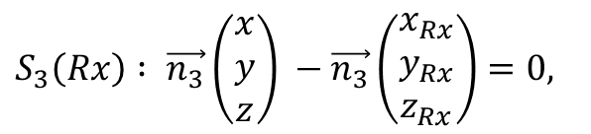











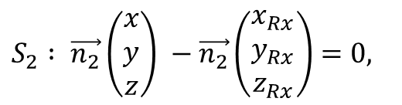
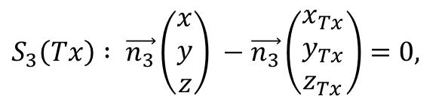




























$$\vec{LoS}= \frac{Rx−Tx}{\left\|Rx−Tx\right\|}$$
$\vec{n_{2}}=\frac{\left[\vec{LoS}, \vec{n_{1}}\right]}{\left\|\left[\vec{LoS}, \vec{n_{1}}\right]\right\|}$ ,
Line of Sight
$${Rx=(x}_{R} y_{R} z_{R})$$
$$S_{2} : \vec{n_{2}}\left(\begin{matrix}x \\ y \\ z\end{matrix}\right) −\vec{n_{2}}\left(\begin{matrix}x_{Rx} \\ y_{Rx} \\ z_{Rx}\end{matrix}\right)=0,$$
$$z$$
$$\vec{n_{1}}$$
$$\vec{n_{3}}=\left[\vec{n_{1}},\vec{n_{2}}\right],$$
Coordinates of
Transmitter – ,
Receiver –
and the plane
are given information
$$S_{3}\left(Rx\right) : \vec{n_{3}}\left(\begin{matrix}x \\ y \\ z\end{matrix}\right) −\vec{n_{3}}\left(\begin{matrix}x_{Rx} \\ y_{Rx} \\ z_{Rx}\end{matrix}\right)=0,$$
$$Tx$$
$$\vec{LoS}$$
$$\vec{NLoS}$$
$$S_{3}(Rx)$$
$$\vec{n_{1}}$$
$$Rx$$
$$S_{1}$$
$$S_{3}\left(Tx\right) : \vec{n_{3}}\left(\begin{matrix}x \\ y \\ z\end{matrix}\right) −\vec{n_{3}}\left(\begin{matrix}x_{Tx} \\ y_{Tx} \\ z_{Tx}\end{matrix}\right)=0,$$
$$\vec{n_{2}}$$
$$P_{S_{1}}(Rx)$$
$$\vec{n_{1}}$$
$$S_{1}$$
$${Tx=(x}_{T} y_{T} z_{T})$$
$\vec{n_{1}}$, $\vec{n_{2}}$, $\vec{n_{3}}$ - orthonormal basis
$$K$$
$$\vec{n_{3}}$$
$$\vec{n_{2}}$$
$$Rx$$
$$y$$
$$S_{2}$$
$$P_{S_{1}}(Tx)$$
$$Tx$$
$$\vec{LoS}$$
$$S_{3}(Tx)$$
$$c_{2}$$
$$a_{2}$$
$$a_{1}$$
$$c_{1}$$
$$\vec{n_{1}}$$
$$\vec{n_{3}}$$
$$K$$
$$S_{2}$$
$$P_{S_{1}}(Tx)$$
$$b_{1}$$
$$b_{2}$$
$$P_{S_{1}}(Rx)$$
$$x$$

Slide 3

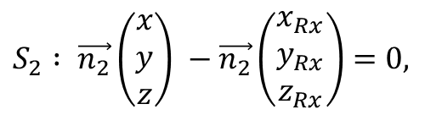

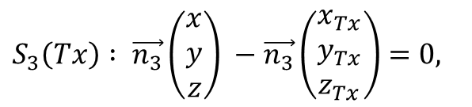







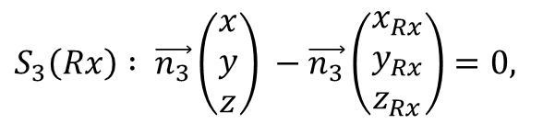


















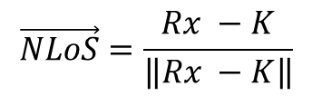

$$Rx$$
$$S_{2}$$
$$Tx$$
$$\vec{LoS}$$
$$\vec{NLoS}$$
$$P_{S_{1}}\left(Tx\right)=S_{1}∩S_{2}∩S_{3}\left(Tx\right)$$
$$c_{2}$$
$$a_{2}$$
$$P_{S_{1}}\left(Rx\right)=S_{1}∩S_{2}∩S_{3}\left(Rx\right)$$
$$a_{1}$$
$$c_{1}$$
$$\vec{n_{1}}$$
$$a_{1}=‖Tx −P_{S_{1}}\left(Tx\right)‖$$
$$\vec{n_{3}}$$
$$K$$
$$a_{2}=‖Rx −P_{S_{1}}\left(Rx\right)‖$$
$$P_{S_{1}}(Tx)$$
$$b_{1}$$
$$d$$
$$b_{2}$$
$$P_{S_{1}}(Rx)$$
$$d=‖P_{S_{1}}\left(Tx\right)−P_{S_{1}}\left(Rx\right)‖$$
$$b_{1}+b_{2}=d$$
$$S_{2} : \vec{n_{2}}\left(\begin{matrix}x \\ y \\ z\end{matrix}\right) −\vec{n_{2}}\left(\begin{matrix}x_{Rx} \\ y_{Rx} \\ z_{Rx}\end{matrix}\right)=0,$$
$$\frac{b_{1}}{b_{2}}=\frac{a_{1}}{a_{2}}$$
$$b_{1}=\frac{a_{1}d}{{a_{1}+a}_{2}}$$
$$⇒$$
$$\vec{n_{3}}=\left[\vec{n_{1}},\vec{n_{2}}\right],$$
$$S_{3}\left(Rx\right) : \vec{n_{3}}\left(\begin{matrix}x \\ y \\ z\end{matrix}\right) −\vec{n_{3}}\left(\begin{matrix}x_{Rx} \\ y_{Rx} \\ z_{Rx}\end{matrix}\right)=0,$$
$$K=P_{S_{1}}\left(Tx\right)+b_{1} \vec{n_{3}}$$
$$\vec{NLoS}=\frac{Rx −K}{\left\|Rx −K\right\|}$$
$$S_{3}\left(Tx\right) : \vec{n_{3}}\left(\begin{matrix}x \\ y \\ z\end{matrix}\right) −\vec{n_{3}}\left(\begin{matrix}x_{Tx} \\ y_{Tx} \\ z_{Tx}\end{matrix}\right)=0,$$

Slide 4


Plane Waves vs Spherical Waves
BS
BS
Plane
Waves
Spherical
Waves
Massive MIMO is sensitive to a propagation model!

Slide 5



Simulation of Plane Waves Propagation
Reflector
$$\vec{NLoS}$$
BS
$$\vec{LoS}$$
Tx

Slide 6


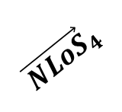

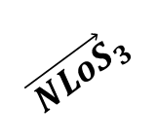
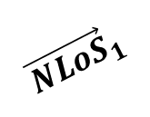
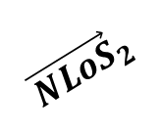

Simulation of Spherical Waves Propagation
Image of the Tx
d
Reflector
$${\vec{NLoS}}_{1}$$
$${\vec{NLoS}}_{2}$$
BS
$${\vec{NLoS}}_{3}$$
d
$${\vec{NLoS}}_{4}$$
$$\vec{LoS_{1}}$$
$$\vec{LoS_{2}}$$
$$\vec{LoS_{3}}$$
$$\vec{LoS_{4}}$$
Tx

