Slide 1
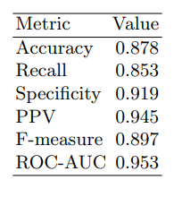
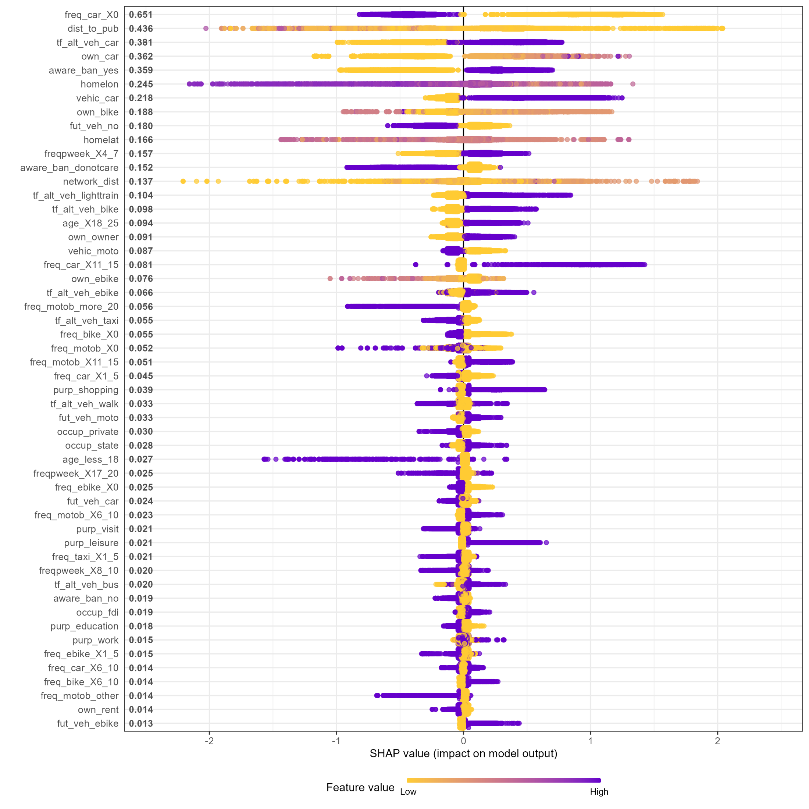




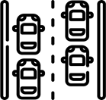
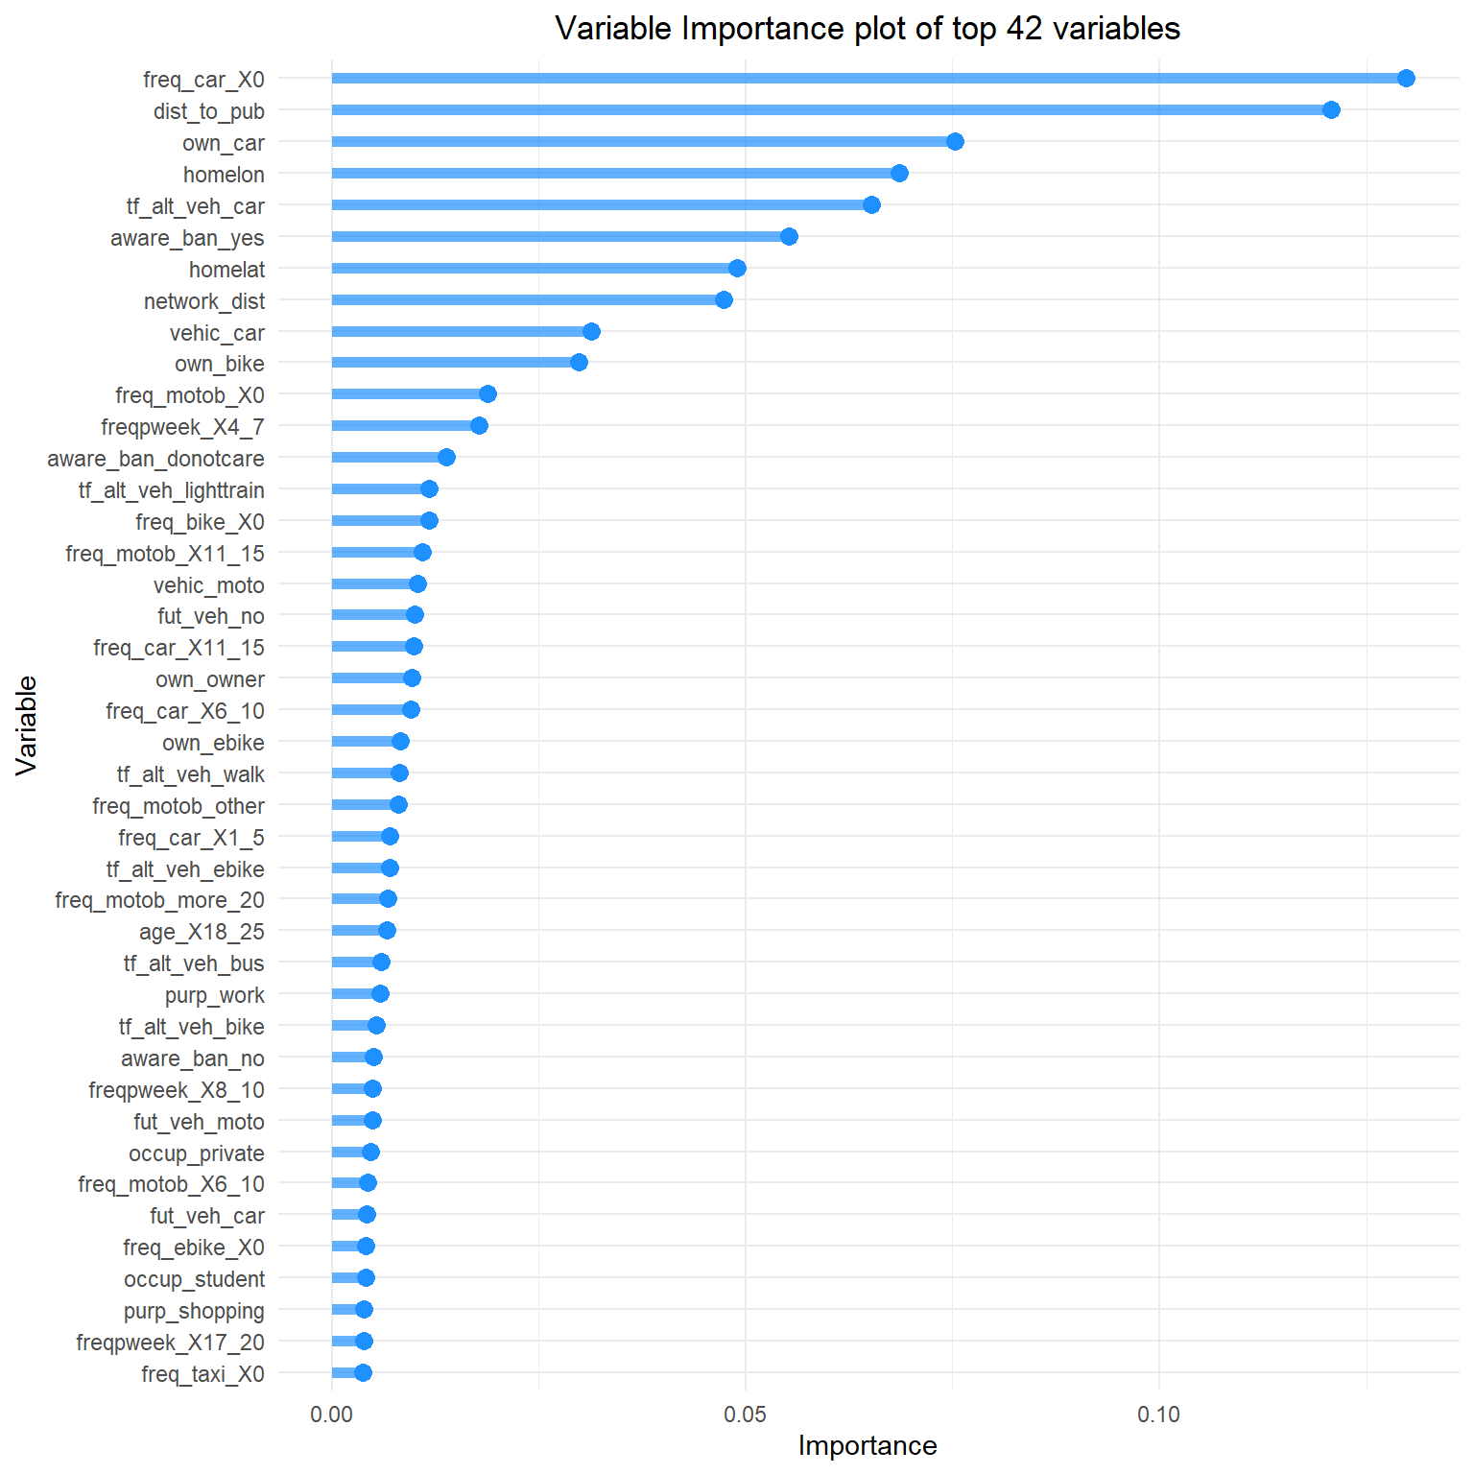
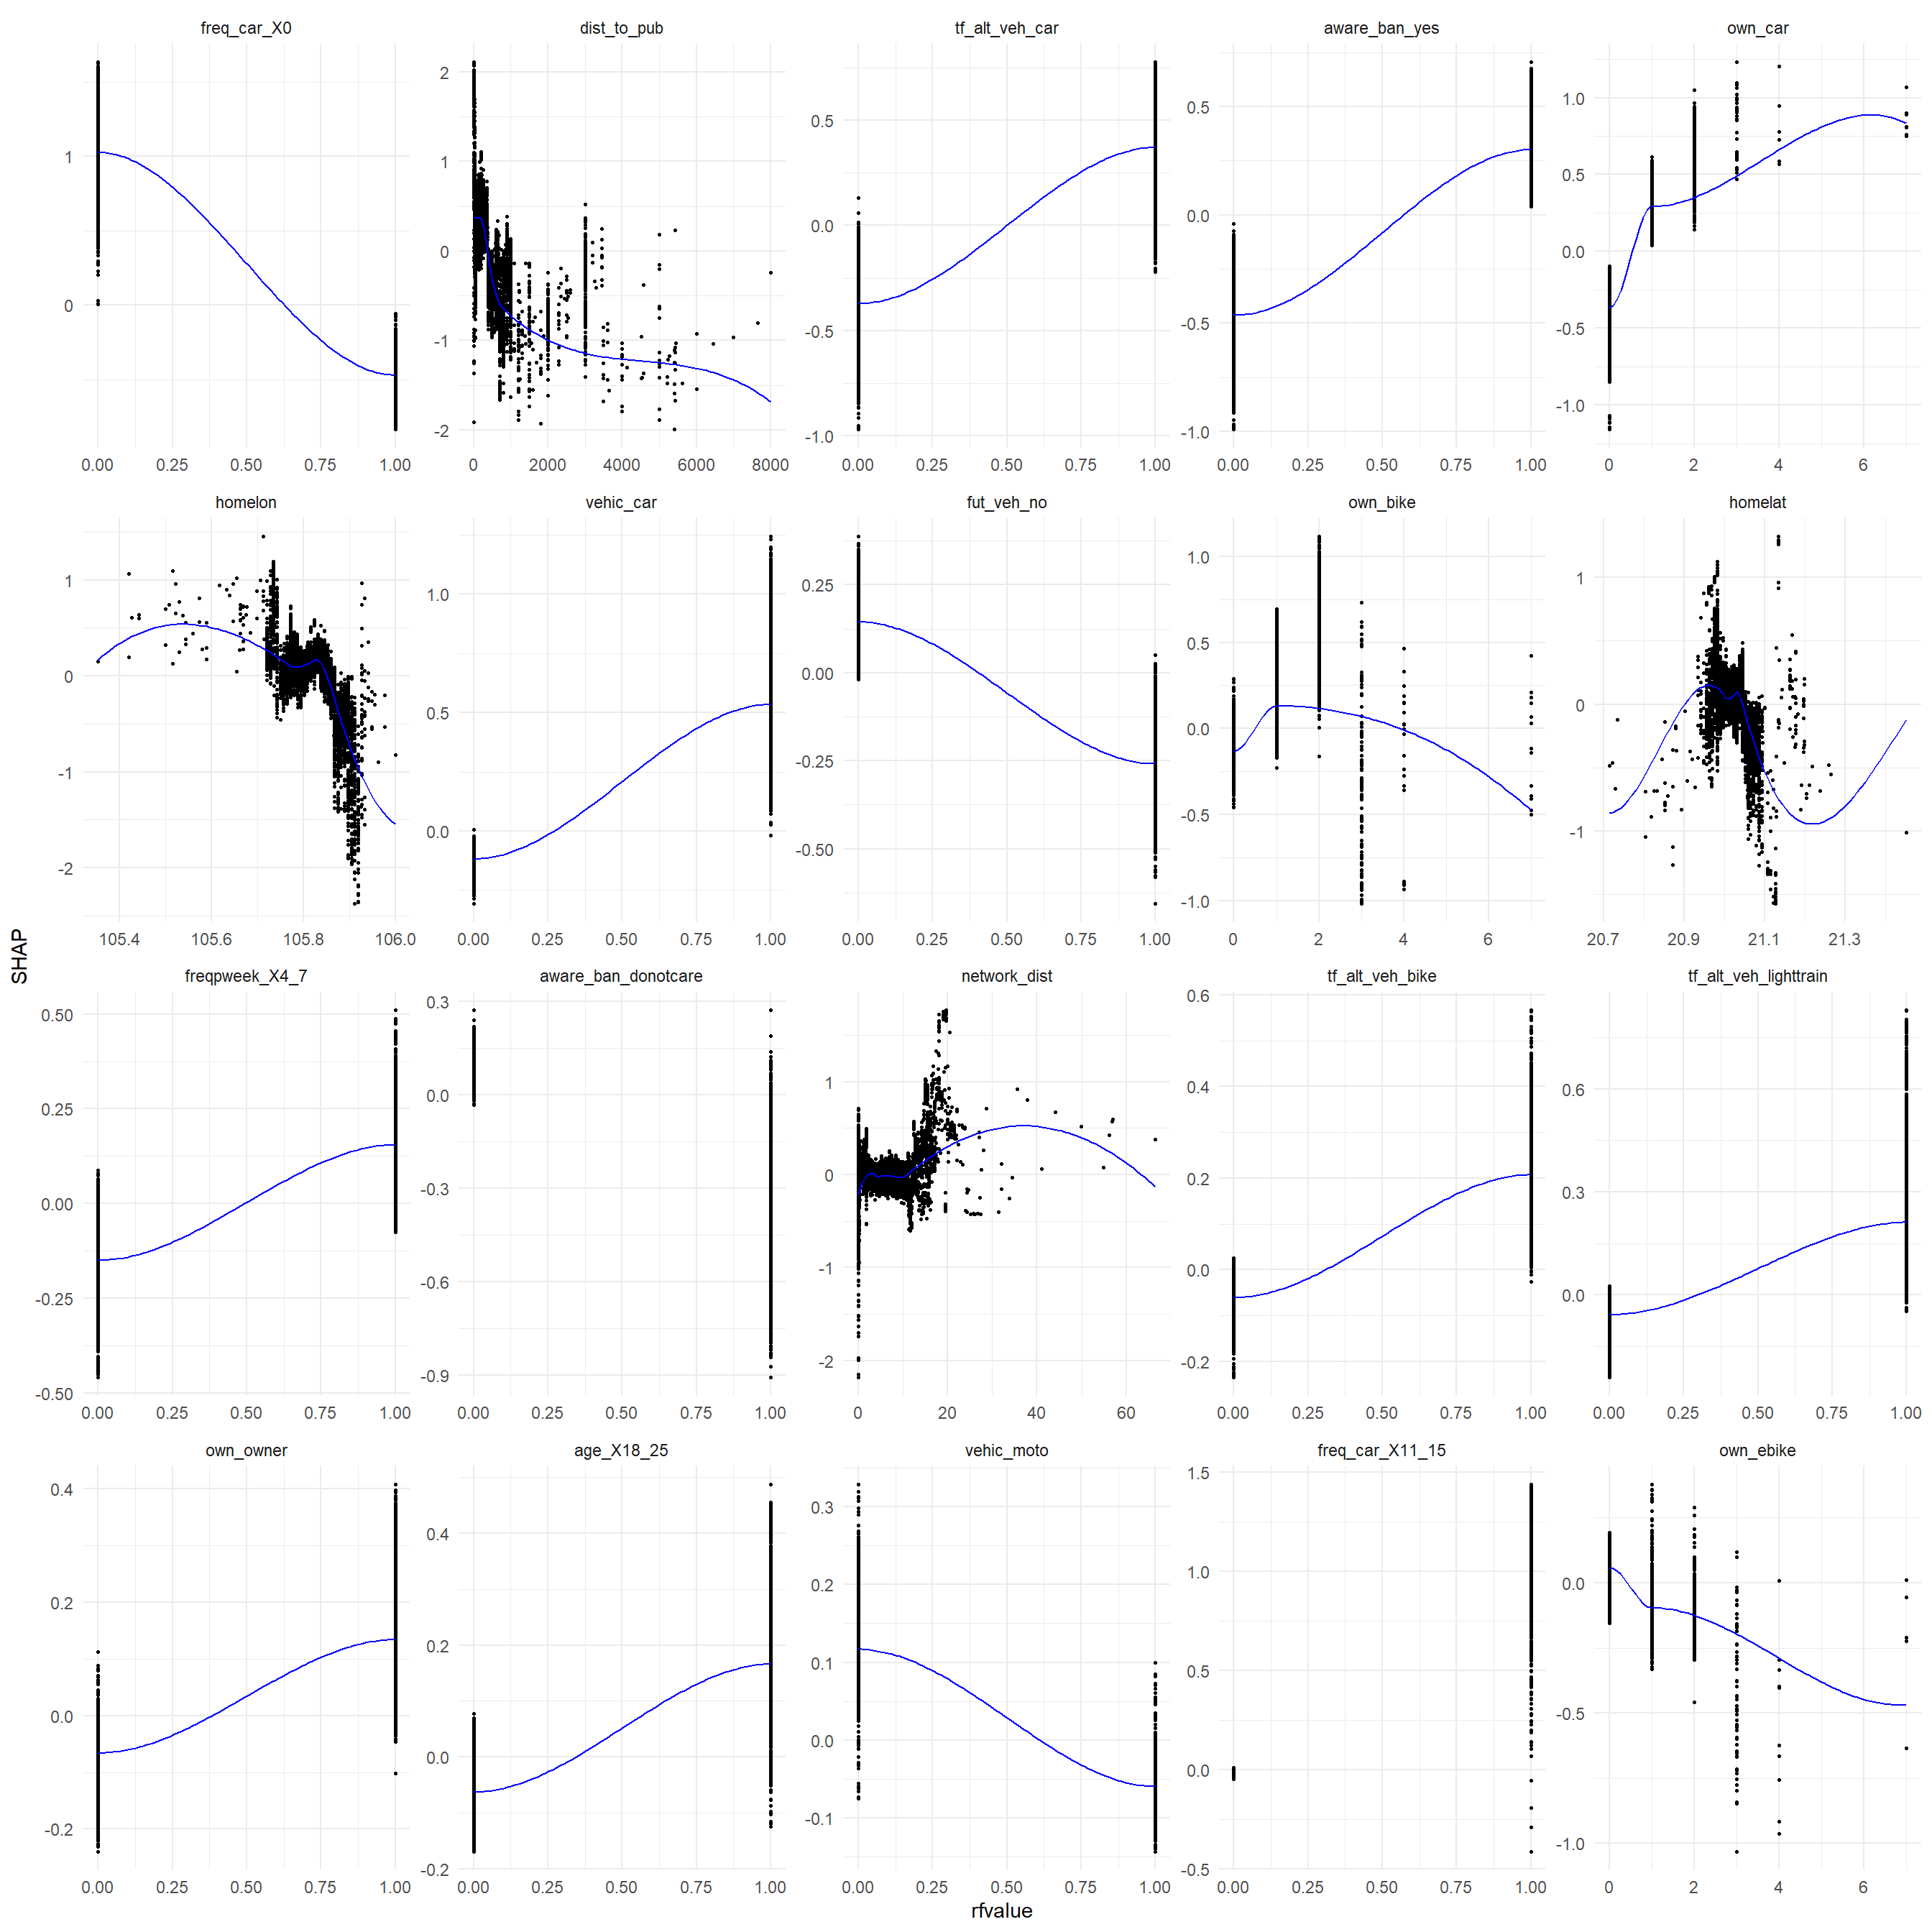







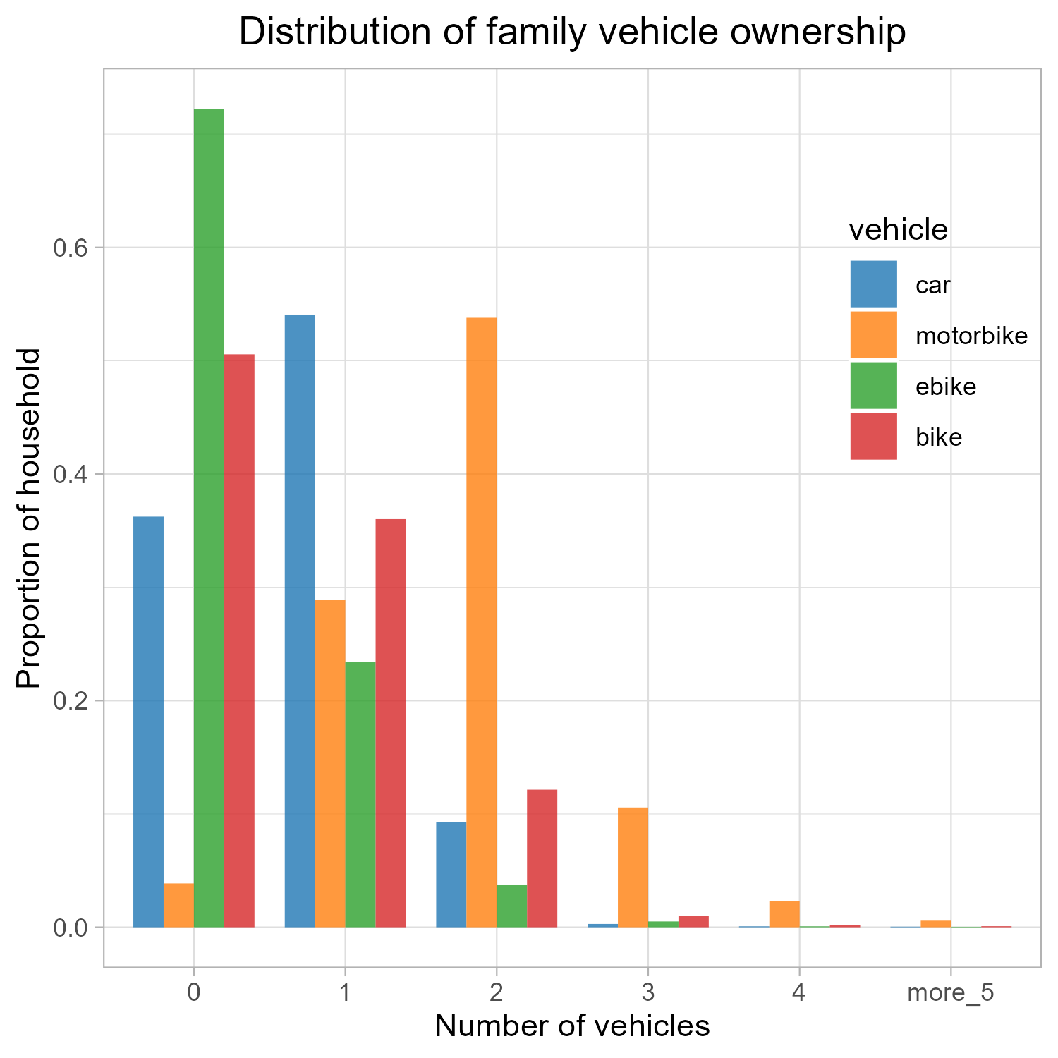
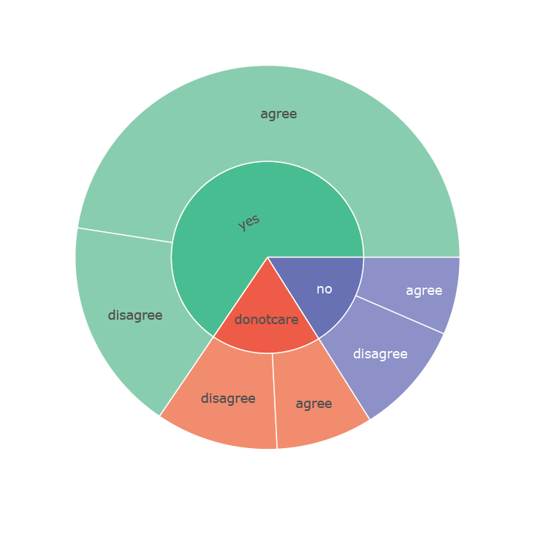


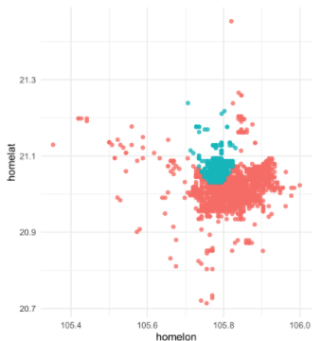
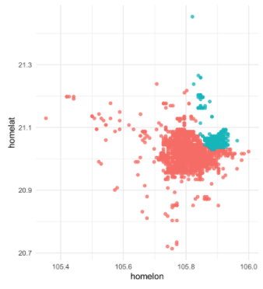

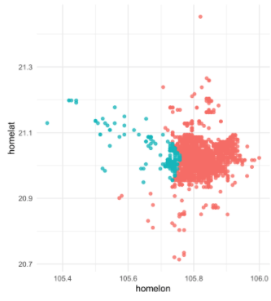
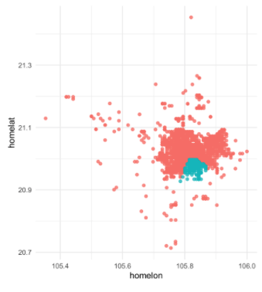
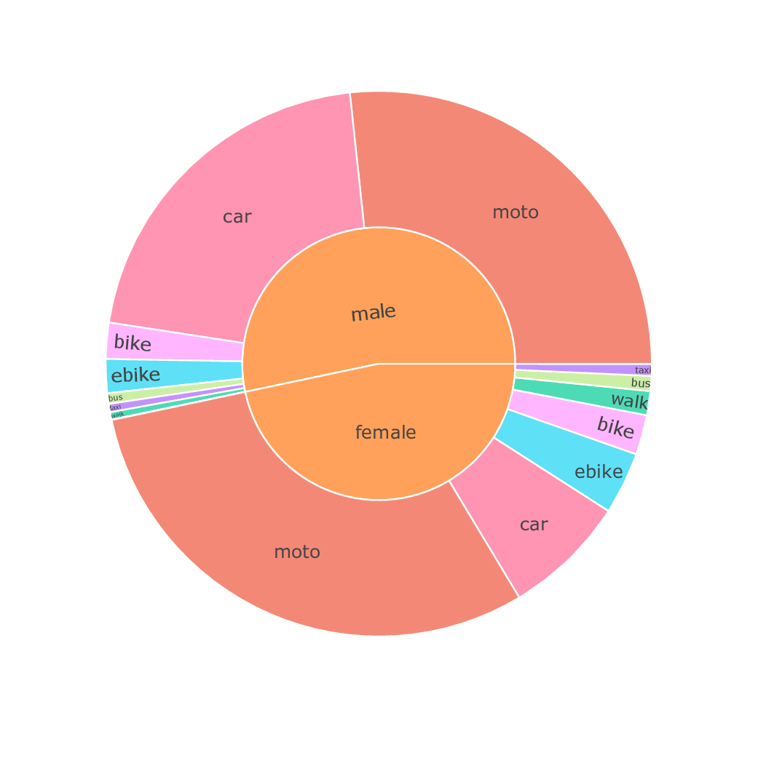
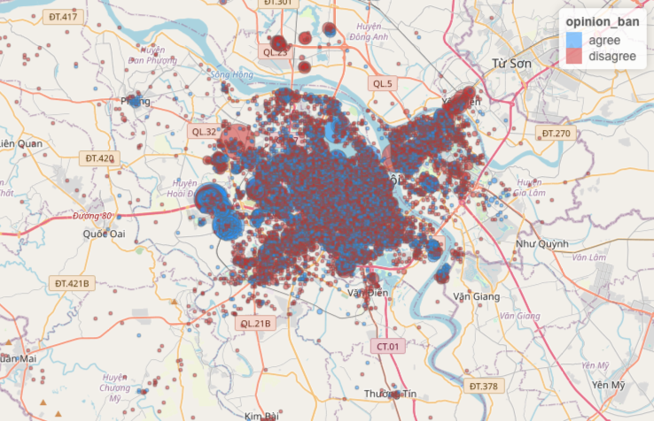
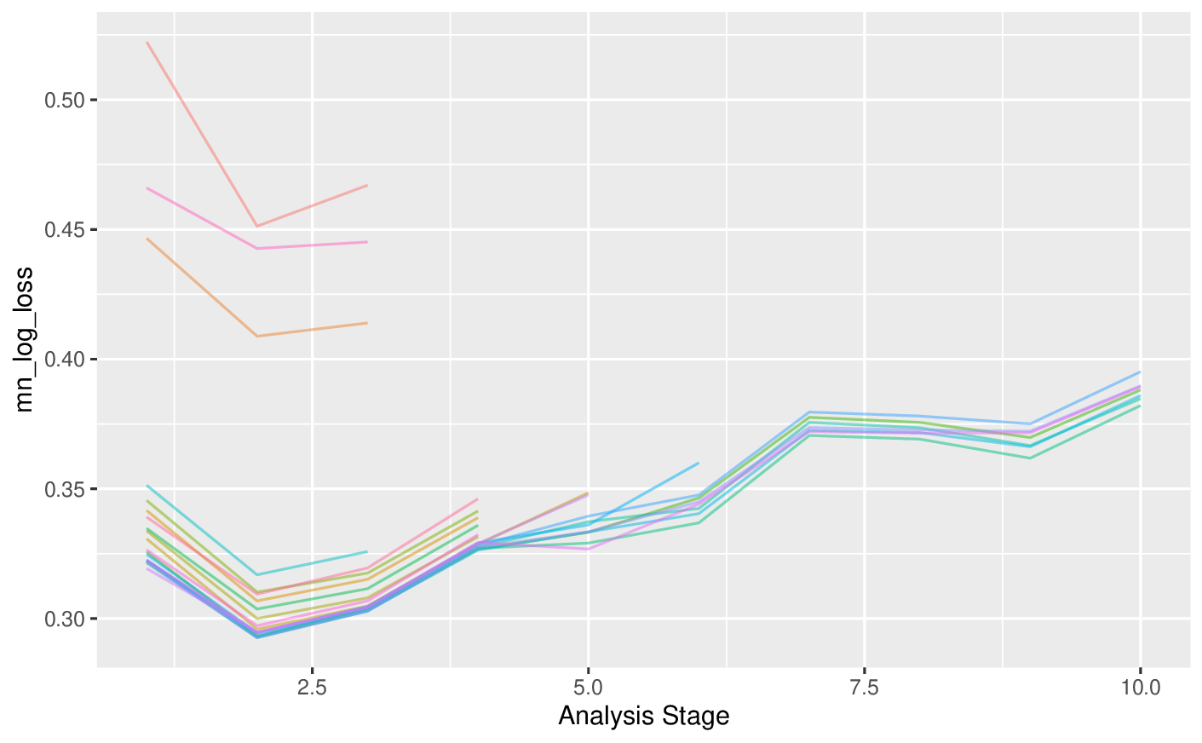
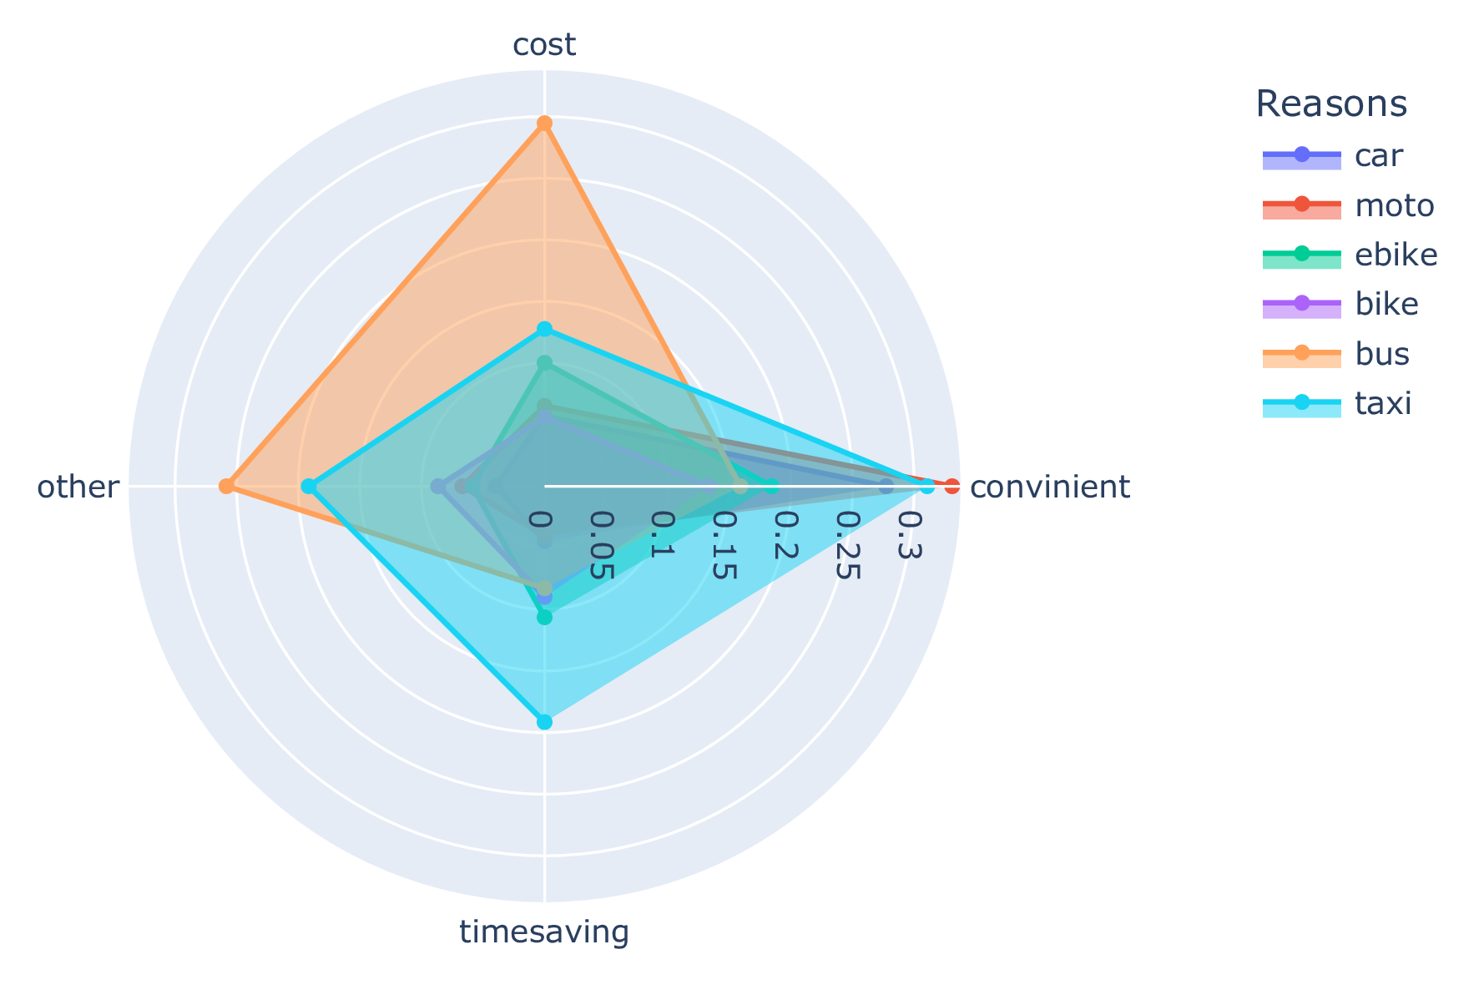



A BOOSTED GLIMPSE: USING A GRADIENT BOOSTING MACHINE MODEL TO UNRAVEL THE FACTORS INFLUENCING TRANSPORT IN HANOI
Eric Wanjau¹, Minh Kieu⁴, Nick Malleson^{1, 2}, Alexis Comber², Kristina Bratkova¹,Phe Hoang Huu³, Thanh Bui Quang⁵ and Hang Nguyen Thi Thuy⁶
¹Leeds Institute for Data Analytics, University of Leeds, UK | ²School of Geography, University of Leeds, UK | ³R&D Consultants, Hanoi City, Vietnam | ⁴Faculty of Engineering, University of Auckland, New Zealand | ⁵Faculty of Geography, VNU University Science, Hanoi, Vietnam | ⁶VNU Vietnam Japan University, Vietnam National University, Hanoi
4. Model results, VIP, SHAP summary plot, Partial Dependence Plots
6. Preliminary Model Interpretation
Objective 1:
freq_car_X0, a “dummy variable” that has a value of 1 if a respondent does not travel using a car and 0 otherwise, is the most predictive variable in this model.
1. Introduction
Exploratory Data Analysis
An overwhelming majority in Hanoi city use motorbikes as their primary means: around 2 motorbikes per person.
Respondents who do not use a car (freq_car _X0 == 1) are associated with low SHAP values which pushes the model towards classifying their response as “disagree”.
:
Objective 2:
Disagree
Agree
The second most important variable is the distance to public transport (dist_to_pub), a numeric variable.
It appears that larger distances to public transport are associated with the disapproval of the motorbike ban.
Implications are serious traffic congestion, air and noise pollution
Predict attitudes towards ban
Dummy variable
0
1
Transport survey which currently has 30K responses has been undertaken to capture:
Demographics: age, gender, location
Travel behavior: origin, destination, transport mode, purpose
Attitudes toward a motorbike ban: opinion, awareness,alternative vehicle
Respondents who would consider using cars and lighttrains (tf_alt_veh_car, tf_alt_veh_lighttrain) in case of a motorbike ban are more likely to agree with the motorbike ban.
Objective 3:
Awareness of the ban (aware_ban_yes) increases the probability of agreeing with the motorbike ban.
Variable importance analysis
See more model metrics, model interpretation techniques, and explore what-if scenarios at: bit.ly/utm_hn_model
Dummy variables
Tokenization of text variables
Near zero variance filtering
Pooling infrequent observations
Upsampling
3. Modelling: Agree/Disagree with motorbike ban
Dummy variables
Tokenization of text variables
Near zero variance filtering
Pooling infrequent observations
Upsampling
3. Modelling: Agree/Disagree with motorbike ban
7.Preliminary policy implications
Feature Engineering
Cars instead of active or public transport may be the most likely alternative means of transport if a motorbike ban were to be implemented. This is however undesirable.
Feature Engineering
Awareness of ban vs opinion
Routing public means of transport close to where people live/work could increase their adoption as a means of transport. This can be guided by other important variables such as home location.
2.EDA
People would be open to other alternative means such as trams and bikes. It will be worth investing in these modes of travel.
Spatial k-fold CV
xgboost
Spatial k-fold CV
xgboost
The need for public sensitization and involvement in the formulation of policies is vital if they are to be widely accepted and adopted.
ANOVA-based grid search: Incremental elimination of tuning parameters
8.Future works/Ongoing works
ANOVA-based grid search: Incremental elimination of tuning parameters
Project’s website: bit.ly/utm_hn_intro
XGBoost Hyperparameter Tuning
British Academy project undertaking urban transport modelling in Hanoi [grant number UWB190190].
Opinion on ban based on home location
XGBoost Hyperparameter Tuning
Gender vs mode for primary trip
Reason for choosing a travel mode
e.wanjau@leeds.ac.uk

