Slide 1
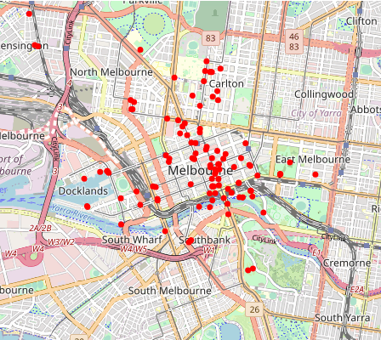
Melbourne Pedestrian Counts What do have? What can we do with this?
Jack Liddle
University of Leeds
What do we have?
91 locations.
Hourly pedestrian count at each location.
Between 2019 and 2023.
Not all sensors on at the same time.
Over 4 million records in total.
Examine the distributions
Count data: Implies Poisson statistics.
Dimensional reduction
Can we see a set of usage behaviours?
Clustering
Can we group the behaviours together?
We do have the location names to guide us!
Forecasting
Can we build forecasting models?
Highly seasonal data. Days/Weeks/Years.
What resolution to work at?
Hours / Days / Weeks?
https://github.com/jackliddle/melbourne-timeseries

Slide 2
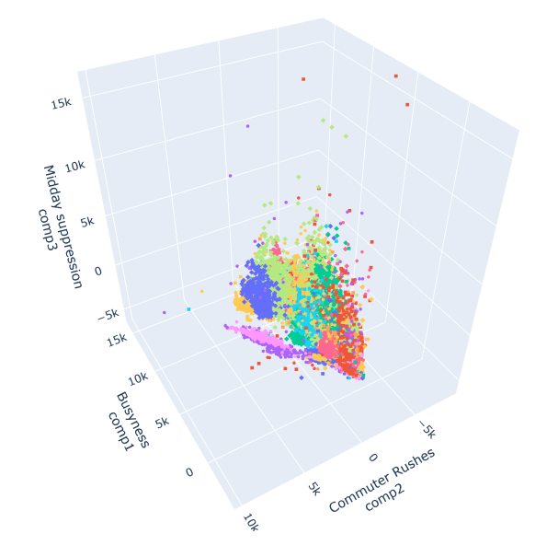
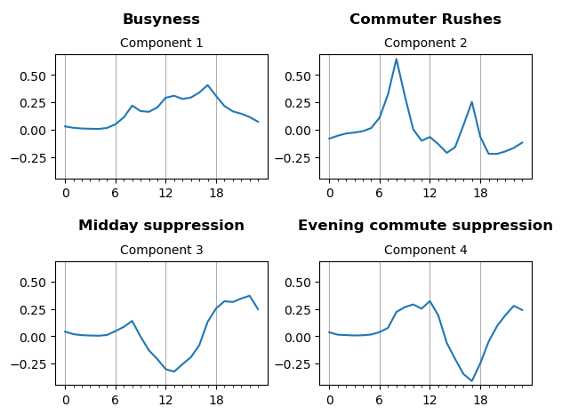
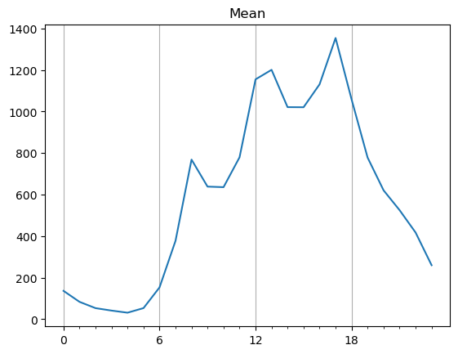
Reduction of data Can we see a set of usage behaviours?
Put all the locations into one pot.
Aggregate days together.
No scaling of the data (for now).
Apply Principal Component Analysis.
Look at the different locations in Urban Usage Space.
Urban Usage Space
Transport hubs
As they get busier:
Commuter rushes increase.
Midday behaviour remains flat.
This is a lot more fun/insightful with a rotatable plot

