Slide 1

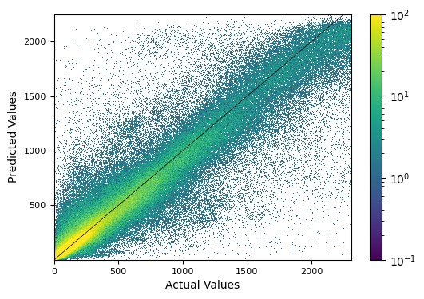

Predicting Pedestrian Counts using Machine Learning
Molly Asher¹, Mark Trigg¹, Cathryn Birch², Steven Böing²
1. School of Civil Engineering, University of Leeds,
2. School of Earth and Environment, University of Leeds
Designing functional cities requires understanding of the mobile population
Data on this population is scarce
The population exhibits non-linear behaviour and so is difficult to capture
Can we use machine learning to better understand this population?
Random forest regression model of the pedestrian population in Melbourne
Data from footfall sensors and contextual factors: weather, date/time, built environment
Molly Asher, Yannick Oswald, Nick Malleson
Notes:
Skip

Slide 2
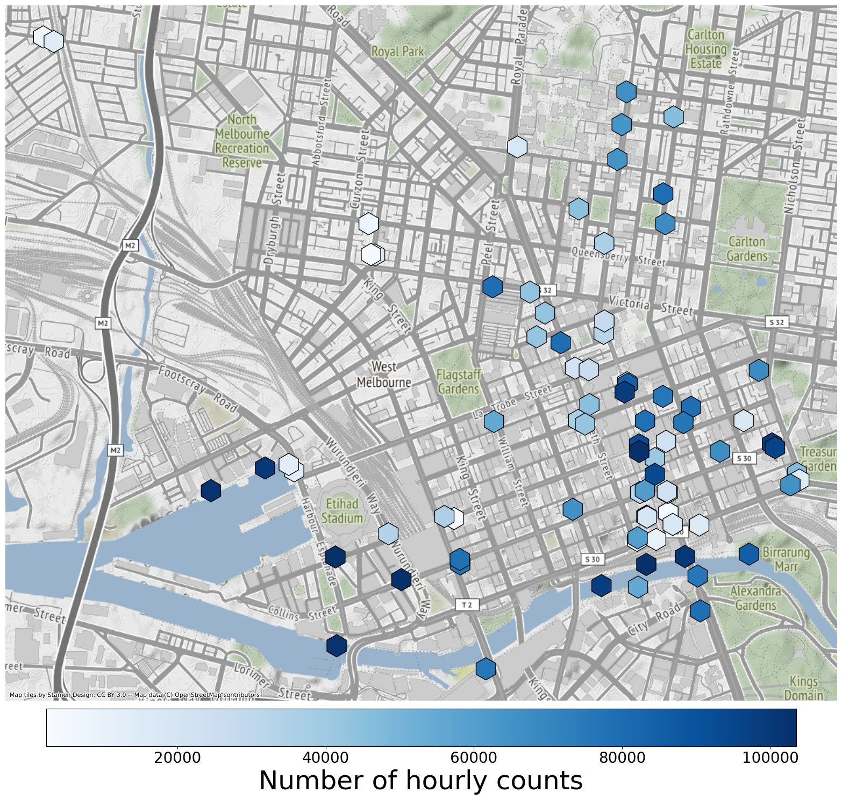
Predicting Pedestrian Counts using Machine Learning
Molly Asher¹, Mark Trigg¹, Cathryn Birch², Steven Böing²
1. School of Civil Engineering, University of Leeds,
2. School of Earth and Environment, University of Leeds
Machine learning models:
learn (generalisable) patterns/relationships from training data
apply these to make predictions on unseen data
BUT: Need to avoid overfitting
CHALLENGES: Spatial data leakage
Spatially correlated points in both testing and training
Invalidates assumption that testing data is new and unseen
Solutions?
Ensure correlated sensors are not split between testing and training sets – how?
Molly Asher, Yannick Oswald, Nick Malleson
Notes:
Skip

