Slide 1


Molly Asher¹, Mark Trigg¹, Cathryn Birch², Steven Böing²
1. School of Civil Engineering, University of Leeds,
2. School of Earth and Environment, University of Leeds
Using Approximate Bayesian Computation to Infer Disease Parameter Uncertainty in a COVID-19 Microsimulation
Molly Asher¹, Yannick Oswald², Nick Malleson²
¹ School of Earth and Environment, University of Leeds
² School of Geography, University of Leeds
This work: https://www.nature.com/articles/s41598-023-35580-z
Title image: https://www.camecon.com/blog/modelling-the-local-economic-impacts-of-the-coronavirus/

Slide 2
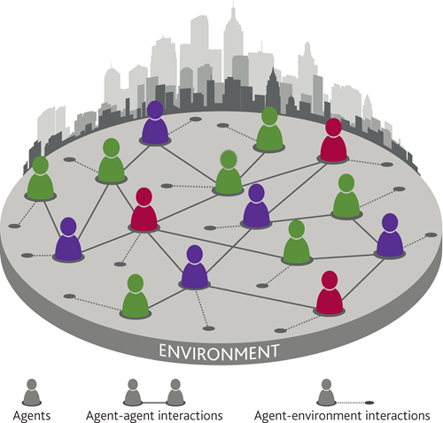
Individual based models
e.g. Agent-based models, dynamic microsimulation
Oxford model, Imperial model
A hope for escaping uncertainty that Covid-19 brought!

Slide 3

Challenges!
Model uncertainty
Structural model uncertainty
System complicated
Scenario uncertainty
Pandemic constantly evolving dynamics
Changing vaccination rates
New variants
Different testing approaches
Policy interventions
Stochastic uncertainty
Even a perfectly calibrated model will diverge from reality
Parameter uncertainty
Behaviour of Covid unknown; data limited

Slide 4
Challenges!
Challenges!
Parameter uncertainty
Behaviour of Covid unknown; data limited

Slide 5

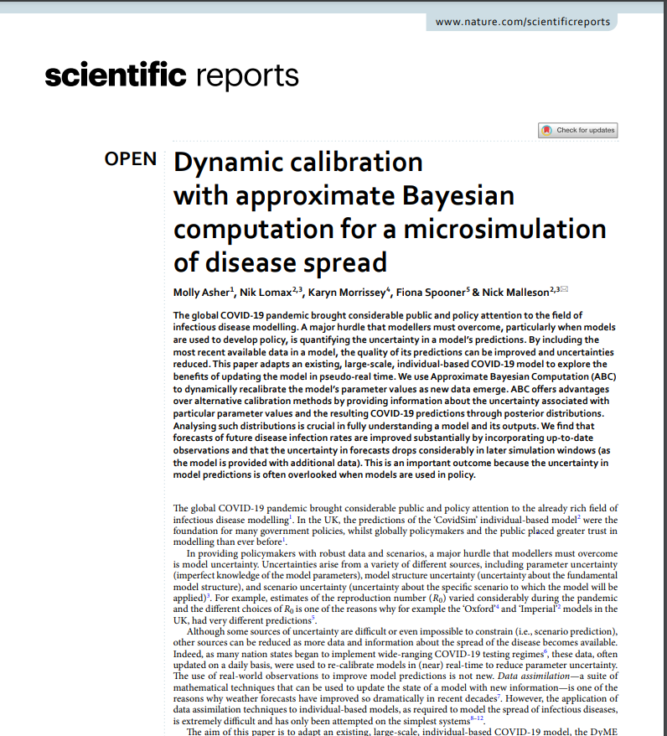
Challenges!
Challenges! Solutions?
Parameter uncertainty
Behaviour of Covid unknown; data limited
increasingly available
Approximate Bayesian Computation:
Use data as it arises
Better understand parameters and uncertainty
Better quantification of uncertainty in predictions

Slide 6
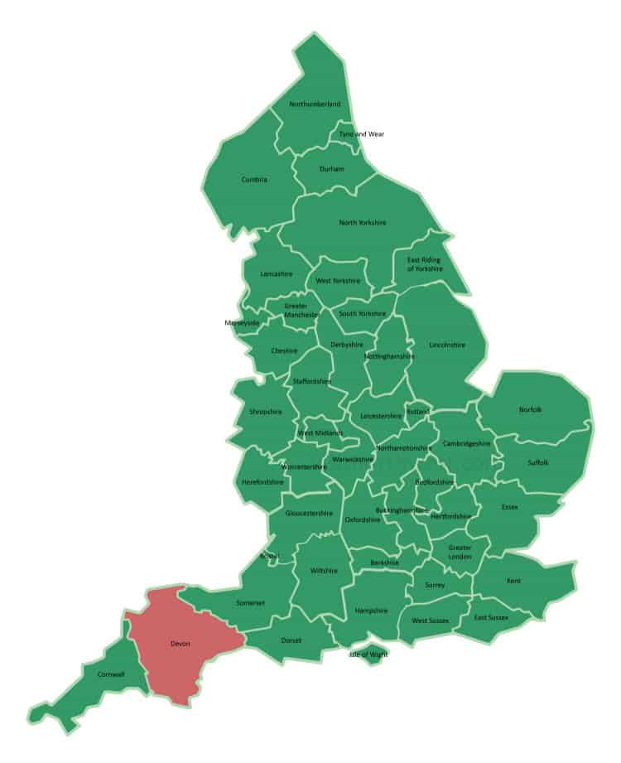
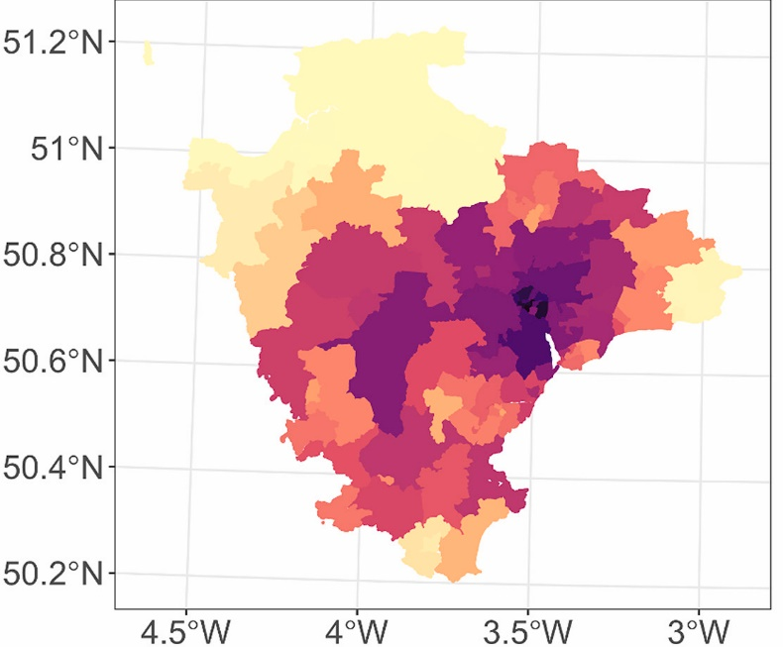
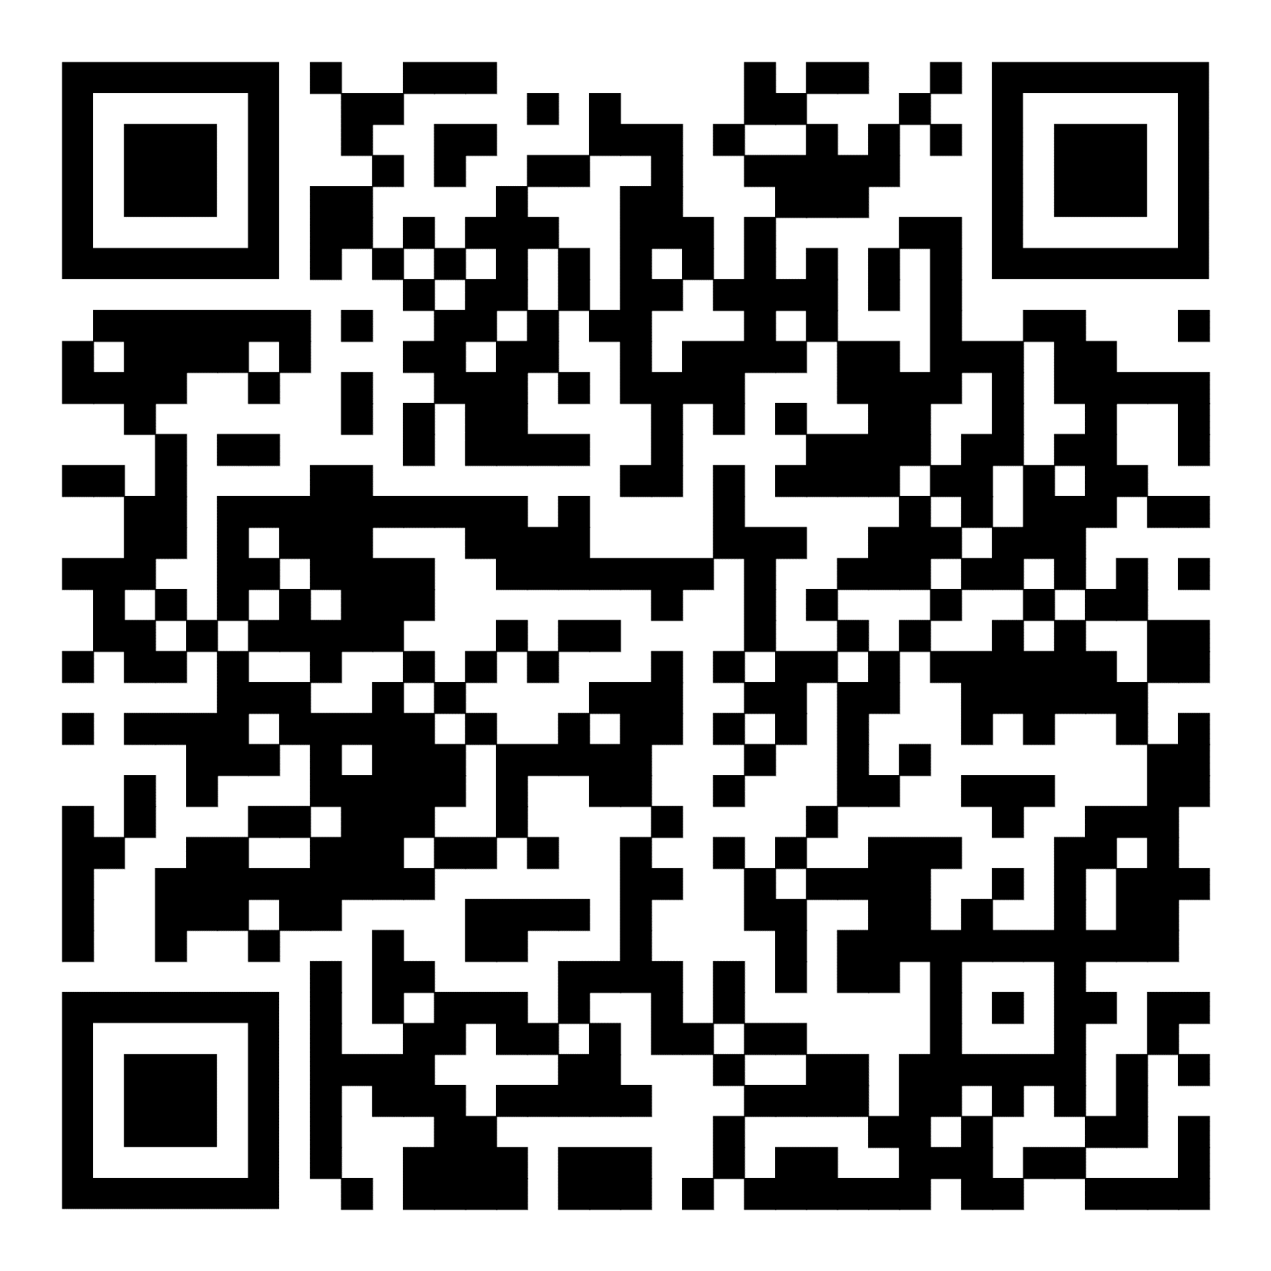
DyME
Dynamic Model of Epidemics (DyME)
Spooner, F., Abrams, J.F., Morrissey, K., Shaddick, G., Batty, M., Milton, R., Dennett, A., Lomax, N., Malleson, N., Nelissen, N. and Coleman, A., 2021. A dynamic microsimulation model for epidemics. Social Science & Medicine, 291, p.114461.

Slide 7
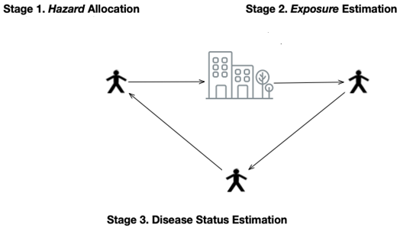
DyME
Dynamic Model of Epidemics (DyME)
Produce a synthetic population
Using census data
Give the population characteristics
Using travel + health surveys
Each model day…
Individuals visit locations (home, work, retail, school)
They give/receive risk
New disease states calculated daily
Spooner, F., Abrams, J.F., Morrissey, K., Shaddick, G., Batty, M., Milton, R., Dennett, A., Lomax, N., Malleson, N., Nelissen, N. and Coleman, A., 2021. A dynamic microsimulation model for epidemics. Social Science & Medicine, 291, p.114461.

Slide 8
DyME
Dynamic Model of Epidemics (DyME)
Location parameters:
Retail
Primary school
Secondary school
Work
Home
Individual hazard parameters:
Presymptomatic
Symptomatic
Asymptomatic
Spooner, F., Abrams, J.F., Morrissey, K., Shaddick, G., Batty, M., Milton, R., Dennett, A., Lomax, N., Malleson, N., Nelissen, N. and Coleman, A., 2021. A dynamic microsimulation model for epidemics. Social Science & Medicine, 291, p.114461.

Slide 9
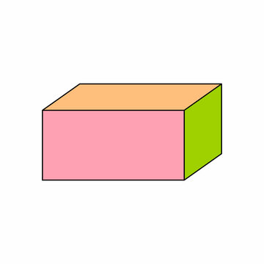
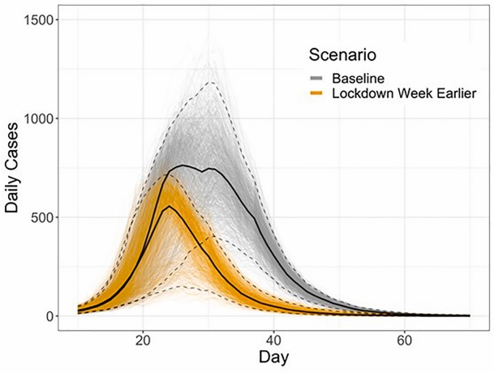
DyME: Process
Retail: 0.2 Primary school: 0.5
Secondary school: 0.5 Work: 0.1
Parameters
e.g. location parameters (but there are more)
DyME: Covid transmission model
Generative model
Data
Spooner, F., Abrams, J.F., Morrissey, K., Shaddick, G., Batty, M., Milton, R., Dennett, A., Lomax, N., Malleson, N., Nelissen, N. and Coleman, A., 2021. A dynamic microsimulation model for epidemics. Social Science & Medicine, 291, p.114461.

Slide 10
Dynamic recalibration: ABC
Approximate Bayesian Computation (ABC)
A method for estimating unknown parameter values, given the data
Retail: 0.2 Primary school: 0.5
Secondary school: 0.5 Work: 0.1
Parameters
e.g. location parameters (but there are more)
DyME: Covid transmission model
Generative model
Median values
Data
Notes:
This approach is called Approximate Bayesian Computation.

Slide 11

Dynamic recalibration: ABC
Unknown parameter values
Our model
X + 5 – Y = 15
10 + 5 – 0 = 15
20 + 5 – 5 = 15
100 + 5 – 90 = 15
20 + 5 – 10 = 15
12 + 5 – 1 = 15
…
Actual data
A “guess” of possible parameter values
Predicted value

Slide 12
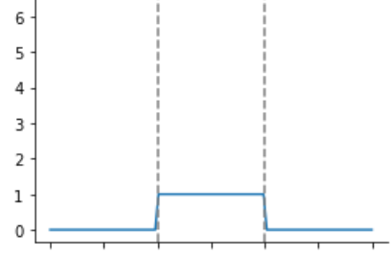


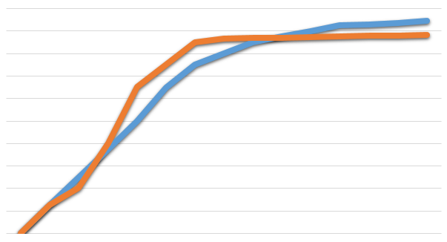
Dynamic recalibration: ABC
A “guess” of possible parameter values
Retail
Pri. school
Sec. school
Work
Priors
Retail: 0.2
Primary school: 0.5
Secondary school: 0.5
Work: 0.1
Location parameters: a multiplier describing how likely someone is to get covid in that location
DyME: Covid transmission model
Accept or reject parameters based on similarity to observed data
Similarity? Based on Euclidean distance

Slide 13
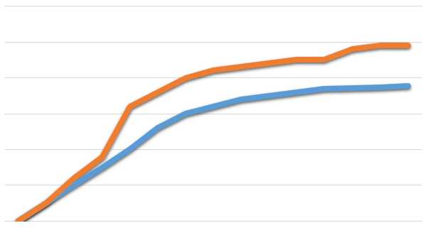
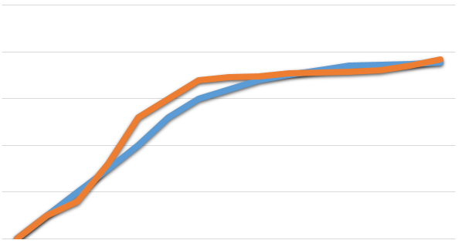
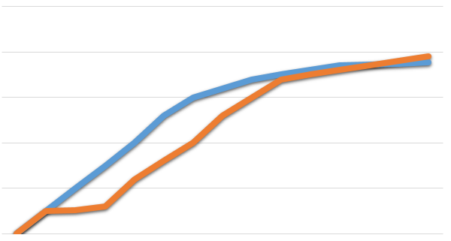
Dynamic recalibration: ABC
A “guess” of possible parameter values
Retail
Pri. school
Sec. school
Work
Priors
Retail: 0.2
Primary school: 0.5
Secondary school: 0.5
Work: 0.1
Retail: 0.3
Primary school: 0.4
Secondary school: 0.4
Work: 0.03
Retail: 0.1
Primary school: 0.8
Secondary school: 0.8
Work: 0.05
Retail: 0.1
Primary school: 0.2
Secondary school: 0.3
Work: 0.4
Retail: 0.7
Primary school: 0.3
Secondary school: 0.5
Work: 0.1
DyME: Covid transmission model
DyME: Covid transmission model
DyME: Covid transmission model
DyME: Covid transmission model
DyME: Covid transmission model
Similarity? Based on Euclidean distance

Slide 14
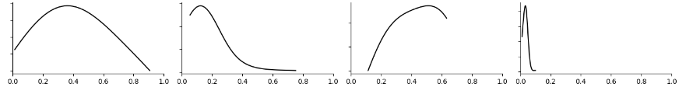
Dynamic recalibration: ABC
A “guess” of possible parameter values
Retail
Pri. school
Sec. school
Work
Priors
Retail: 0.2
Primary school: 0.5
Secondary school: 0.5
Work: 0.1
Retail: 0.3
Primary school: 0.4
Secondary school: 0.4
Work: 0.03
Retail: 0.1
Primary school: 0.8
Secondary school: 0.8
Work: 0.05
Retail: 0.1
Primary school: 0.2
Secondary school: 0.3
Work: 0.4
Retail: 0.7
Primary school: 0.3
Secondary school: 0.5
Work: 0.1
ABC-SMC (sequential monte carlo)
DyME: Covid transmission model
DyME: Covid transmission model
DyME: Covid transmission model
DyME: Covid transmission model
DyME: Covid transmission model
Retail
Pri. school
Sec. school
Work
Posteriors

Slide 15
Uncertain parameters
Each parameter value is:
A multiplier describing how likely someone is to get covid in that location
Retail
Pri. school
Sec. school
Work
Posteriors
Likelihood of a multiplier of this size being accurate
Size of multiplier
Demonstrate how uncertain and how important each of the parameter values is

Slide 16
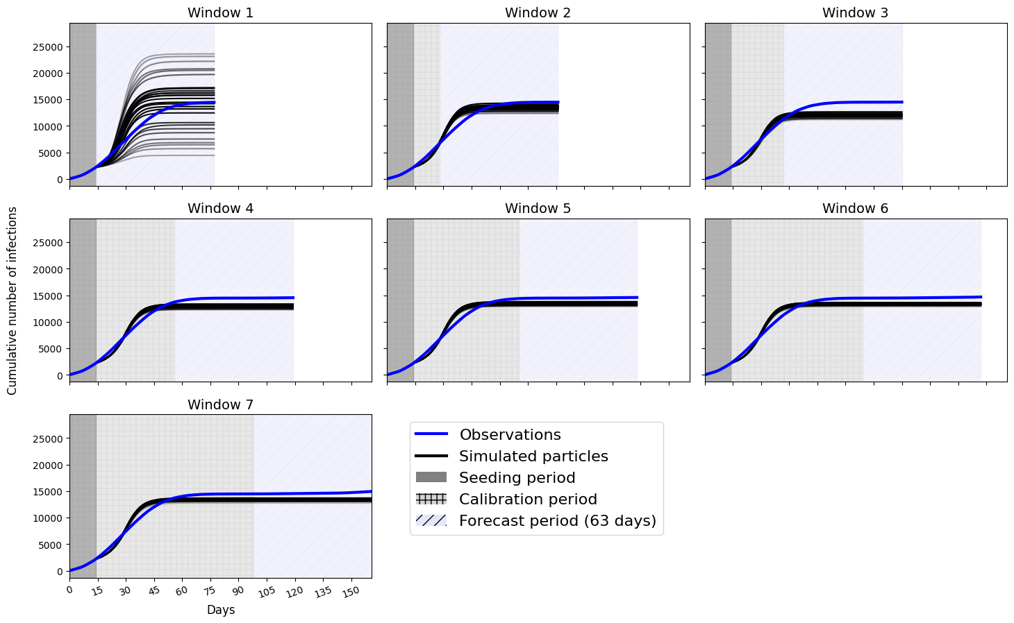
Uncertain predictions
Spread of possible predicted values
14 days of data:
ABC period of parameter calibration
Demonstrate how uncertain our predictions are

Slide 17
Uncertainty evolution
14 days
28 days
42 days
56 days
70 days
84 days
98 days
ABC period of parameter calibration

Slide 18
Uncertainty evolution
14 days
28 days
42 days
Spread of possible predicted values
56 days
70 days
84 days
98 days
ABC period of parameter calibration
Illustration of how uncertainty changes over time (very uncertain at first, less certain as we get more data)

Slide 19
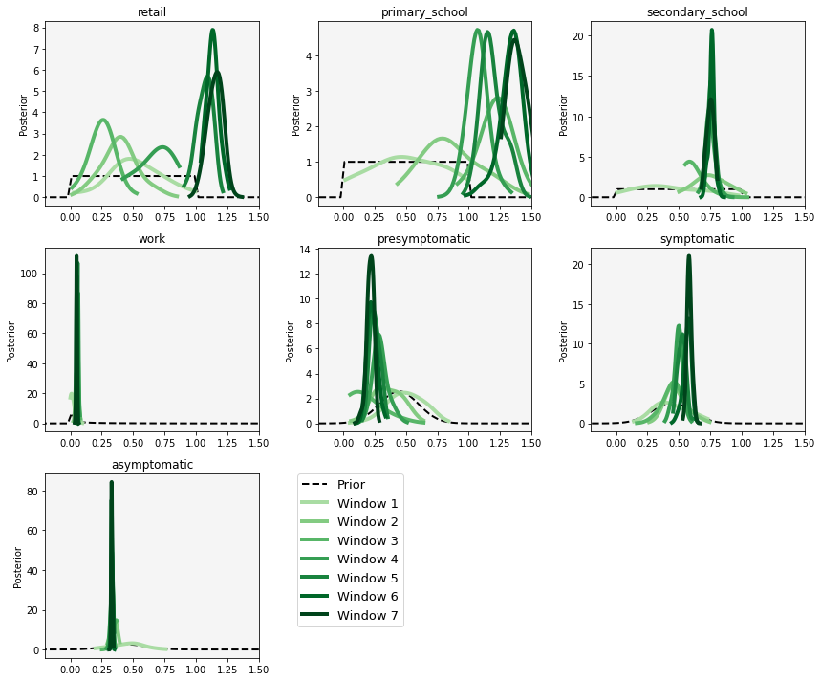
Parameter evolution
Values becoming bigger
Show how importance of parameters change over time
14 days of data
…
90 days of data

Slide 20
Parameter evolution
Distribution gets narrower
Show how importance of parameters change over time
Allow quantification of parameter uncertainty
14 days of data
…
90 days of data

Slide 21
Parameter evolution
Distribution gets narrower
Show how importance of parameters change over time
Allow quantification of parameter uncertainty
14 days of data
…
90 days of data

Slide 22
Conclusions
Dynamic recalibration of an individual based model is possible, and:
Preliminary results, but, proof of concept that ABC with ABM:
Allow new data to be used as it arises
Allows us to understand uncertainty in our predictions and the parameter values driving the model behind them

