Slide 1
Competitive Analysis for Points of Interest KDD-20 Research Track Paper
王肇南
SUSTech Reading Group
11/18/2020

Slide 2
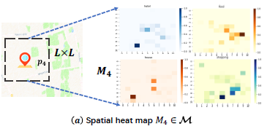
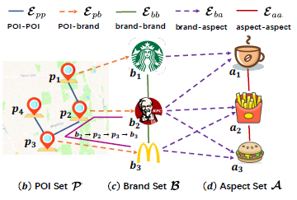
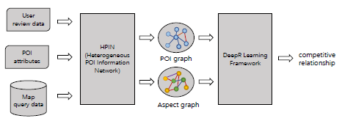
Problem Definitions
问题定义：
推断POI间的竞争关系 i.e. Competitive Relationship Prediction: 给定一个POI集合P与其异构信息网络𝐺 (HPIN - Heterogeneous POI Information Network)，学习函数𝑓 : (P ×P |𝐺) →𝑌， 𝑦 ∈ {0, 1} (𝑦=1: POI对(𝑝_{𝑖}, 𝑝_{𝑗})呈竞争关系). 问题本质：链接预测 i.e. link prediction.
HPIN定义：
𝐺 = (P∪B∪A∪M, E_{𝑝𝑝}∪E_{𝑝𝑏}∪E_{𝑏𝑏}∪E_{𝑏𝑎}∪E_{𝑎𝑎}), in which
Node: P – POI, B – brand, A – aspect, M – heatmap
Edge: E_{𝑝𝑝} – POI~POI, E_{𝑝𝑏} – POI~brand,
E_{𝑏𝑏} – brand~brand (由bppb元路径定义),
E_{𝑏𝑎} – brand~aspect, E_{𝑎𝑎} – aspect~aspect
E_{ba} – top-k in reviews
E_{aa} – mutual relevance
E_{𝑝𝑏}, M
E_{𝑝𝑝} – POI co-query
竞争&互补
Inputs
Output

Slide 3
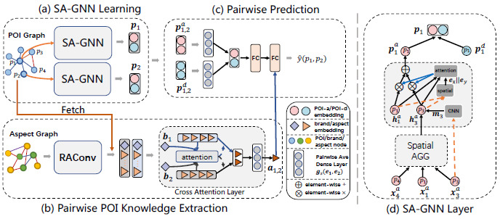
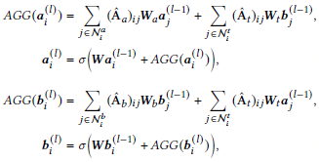
Methodology
Framework: DeepR
= Spatial Adaptive GNN (SA-GNN) + POI Knowledge Extraction (PKE) Module
空间角度 + 语义角度
SA-GNN Break-down见下页
Relation-aware Aspect Convolution (RAConv)
Notes:
Cross attention: to pick up the important aspects and de-emphasize the noisy aspects

Slide 4
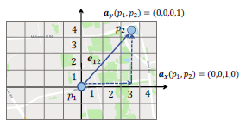
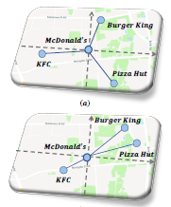

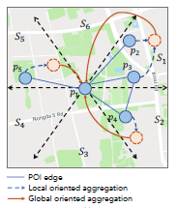
Methodology
SA-GNN Break-down
解决2个普通GNN的缺陷: (1) POI空间信息缺失/邻居等价; (2) 空间长距离依赖性
互补: Affinity Graph
竞争: Diffusion Graph
Spatial-dependency (Location-aware) Attentive Propagation Layer
衡量距离&相对位置
GAT-like Multi-head Attention
CNN on Heat Map
Spatial Oriented Aggregation Layer

Slide 5
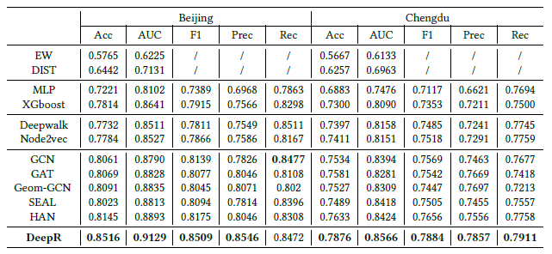
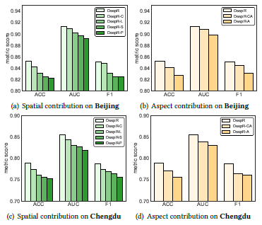
Experiments
Loss function: Binary Cross-Entropy
Metrics: Accuracy, AUC, Recall, Precision, F1-score
Baselines: simple rule-based, featured-based,
graph embedding, SOTA GNNs (HAN for HIN)
数据：2018年8月北京/成都
百度地图Query
构建GT: (1) POI对<10km
(2) POI类别相同
(3) 2018年7月中打卡率>5%
Baselines:
Ablation Study:

