Slide 1
Pandas
Matplotlib
Read csv
Column filer
group by
Histogram
Notebook/ Py
Notebook/ Py
pd.read_csv( )
df.filter

Slide 2
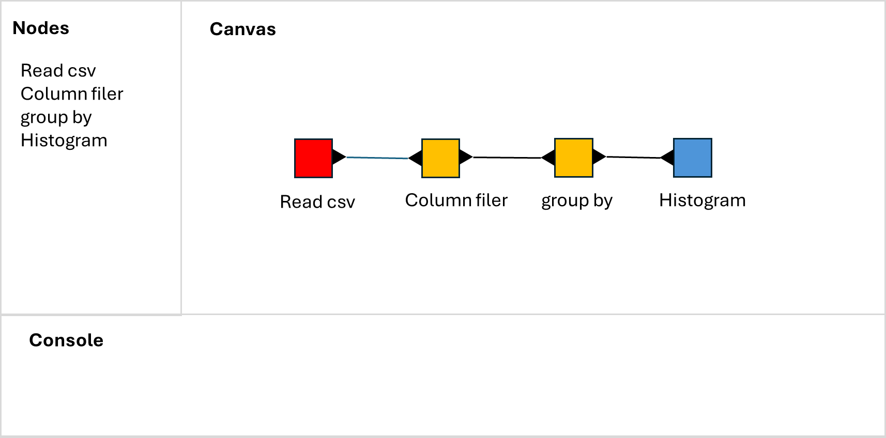
Nodes
Canvas
Read csv
Column filer
group by
Histogram
Read csv
Column filer
group by
Histogram
Console

