Slide 1
How do we access confidential data in the federal system?
Privacy and Confidentiality
Request
Request
Privacy Expert
Data
Maintainer
Data
User
Summary Tables /
Statistics
Public
Microdata
SDC
Original Data
AND/OR

Slide 2
How do we access confidential data in the federal system?
Privacy and Confidentiality
Request
Request
Privacy Expert
Summary Tables /
Statistics
Public
Microdata
SDC
Original Data
Results
Statistics
AND/OR

Slide 3


Why is it hard to implement this framework?
Privacy and Confidentiality
Access to low income.
Public
Data
How do we measure utility (usefulness) and disclosure risk of the data?
Original Data
$$𝓜$$
User
What is the average income?
Interface
How much noise should be added and how do you limit the number of queries?
Original Data
$50K
$$𝓜$$
$45K
User

Slide 4
User Interface
Layer
Privacy
Layer
Data Access Layer
Queries
Queries
Data
User
Privacy Expert
Data
Maintainer
Data
User
Data
User
Public Use File
SDC
Original Data
Interface for Queries
Results
Statistics
AND/OR
Interface for DP Queries
Differentially Private Synthetic Data
DP Mech.
Results
Statistics
AND/OR

Slide 5
Privacy and Confidentiality
Administrative Tax Data
Master File: A massive tax database of about 145 million unedited tax returns for 2012, but cannot be used in its current state due to:
Size
Timing of completion (e.g., late filers)
Item content
Potential data inconsistences
INSOLE: Stratified sample with weights to represent the U.S. taxpayer population.
Notes:
Graham

Slide 6
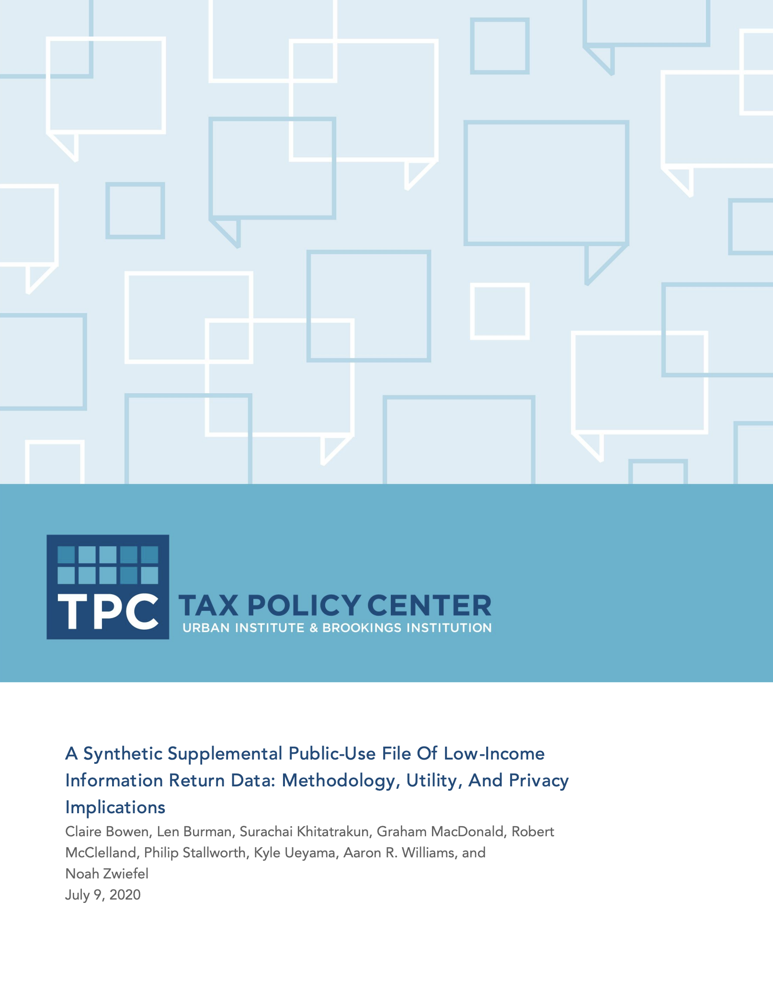
Privacy and Confidentiality
Synthetic Supplemental PUF
Any U.S. resident who did not file a federal tax return, had no obligation to file, and was not claimed as a dependent in 2012 but had income reported to the IRS on at least one information return for the 2012 tax year:
10-in-9,999 sample of the confidential data
Some variables are excluded and others are top-coded and/or recoded
About 26,000 records
19 variables after data preprocessing
Notes:
Graham

Slide 7
Privacy and Confidentiality
User Interface
Layer
What are other ways to
access confidential data?
The goal of developing a validation server is to significantly expand access to restricted and confidential government data for researchers and analysts, while ensuring individual privacy and complying with all applicable regulations.
Tier I – Public Use Data
Tier II – Validation Server
Tier III – Confidential Data
Data
User
Data
User
Data
User
Interface for Queries
Public Use Data
AND/OR
Interface for DP Queries
Differentially Private Synthetic Data
AND/OR
32

