Slide 1
THE DATAGOOD(R) PACKAGE: AN open science approach to data engineering
Jesse Lecy
Associate Professor ::: Public Affairs (ASU)
Data Scientist ::: The Urban Institute

Slide 2
CUSTOMIZING LAYOUTS

Slide 3
Flexible Layouts
The RG and DD QMD templates include a built-in style sheet that divides the page into sections
Each section is populated by variable attributes (text descriptors for dictionary elements or data summaries)
Each data type leverages different sections of the layout to organize content
Positions of content and transformer functions are defined in the layout object
The layout object will be embedded within the QMD template file so that users can adapt as needed
Custom formatting functions can be defined by the user

Slide 4
layout <-
c( "div2 ;; vlabel ;; LABEL ;; v_to_txt",
"div3 ;; vtype ;; DATA TYPE ;; v_to_txt",
"div3 ;; scope ;; SCOPE ;; v_to_txt",
"div4 ;; desc ;; DESCRIPTION ;; v_to_txt",
"div4 ;; flevels ;; LEVELS ;; f_to_txt",
"div4 ;; glevels ;; '' ;; v_to_txt",
"div4 ;; loc ;; LOCATION CODE ;; v_to_txt",
"div5 ;; v ;; STATS ;; get_properties" )
|DIV |VARIABLE |LABEL |FORMATTING FUNCTION |
|:----|:---------|:-------------|:--------------------|
|div2 |vlabel |LABEL |v_to_txt |
|div3 |vtype |DATA TYPE |v_to_txt |
|div3 |scope |SCOPE |v_to_txt |
|div4 |desc |DESCRIPTION |v_to_txt |
|div4 |flevels |LEVELS |f_to_txt |
|div4 |glevels |'' |v_to_txt |
|div4 |loc |LOCATION CODE |v_to_txt |
|div5 |v |LABEL |get_properties |

Slide 5
CSS Elements Controlling Layouts
.parent {
display: grid;
grid-template-columns: repeat(3, 1fr);
grid-template-rows: auto;
grid-column-gap: 20px;
grid-row-gap: 10px;
grid-template-areas:
"a a a"
"b b b"
"c d d"
"e f g"
"h h h"
"i i i"
"j k k"
"m o o"
"n o o"
"p p p";
}
.div1 {
grid-area: a;
padding-bottom: 15px;
}
.div2 {
grid-area: b;
padding-left: 30px;
}
.div3 {
grid-area: c;
padding-left: 30px;
}

Slide 6
Data Dictionary Format
Accelerate the documentation and sharing of a dataset.
The DGF provides a quick list-style template for providing the most important features of a dataset:
variable name
label
description / details
data types
factor level definitions
custom attributes (e.g. SCOPE)
The data dictionary (DD) version limits documentation to dataset and variable definitions
The research guide (RG) version includes data profiles

Slide 7
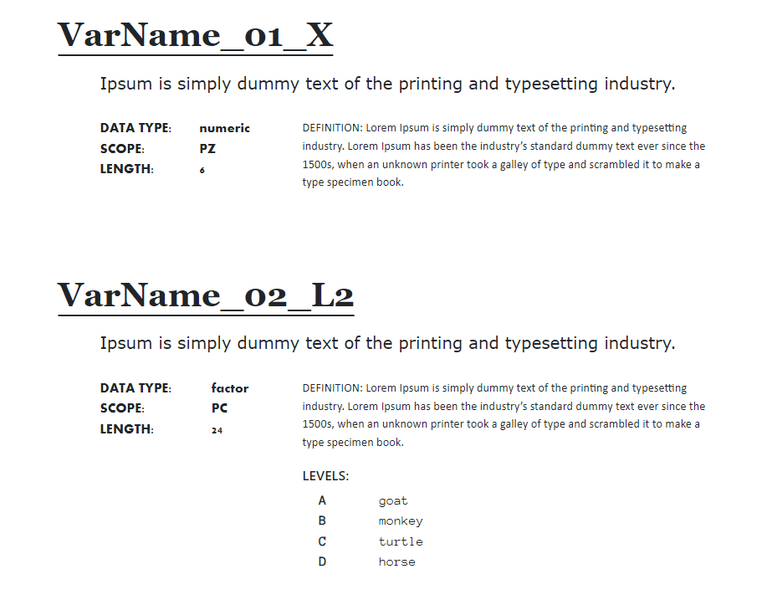
data
dictionary
format

Slide 8
data
dictionary
format
div1
div2
create_dd( dgf )
+
layout
div3
div4

Slide 9
Research Guide Format
The research guide provides more thorough documentation of a dataset than dictionary files
The package manages data profiling functionality
The QMD document can be turned into a true data user guide or public use file codebook that documents the data generation process and transformation
sampling framework, response rates, weights
survey questions or raw data fields
cleaning, standardization, normalization, and transformation processes applied
privacy protecting steps
etc

Slide 10
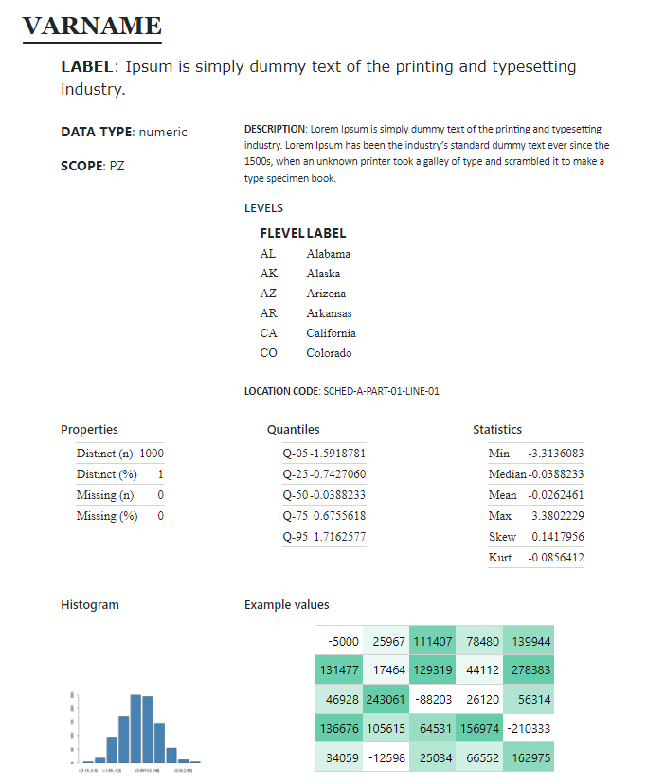
div1
div2
data profiling
layouts in the
RG.qmd file
div3
div4
div5
div6
div7
data
profiling
div8
div9

Slide 11
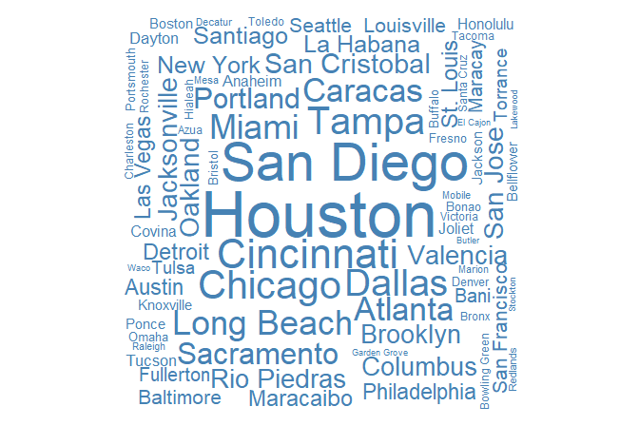
div1
div2
data type:
character
div4
div3
div8
div9
preview
data quality
div10
div11
word cloud
stats
min, ave, max
string length

Slide 12
div1
div2
data type:
factor
div3
div4
div12
data quality
div14
treemap
div13
topN table

Slide 13
div1
div2
data type:
logical (Boolean)
div3
div4
div5
div6
stats
div7
barchart
data quality

Slide 14
div1
div2
data type:
dates / time
div4
div3
div9
histogram of dates / barchart of months or days
div8
data quality
div10
preview
div11
calendar heatmap

Slide 15
ITERATIVE WORKFLOW

Slide 16
create_dgf( df.raw ) Create the DGF (user edits, adds labels and rules)
inspect_dgf( dgf ) Ensure json ok, rules are defined, etc.
ingest_raw( df.raw, dgf ) Apply the raw_convert rules, keep desired types.
data is
altered
update_dgf() Call after changes are made to data to ensure stored values are correct (e.g factor levels the same, update stored descriptive stats for numeric vars).
standardize( df.v2, dgf ) Apply standardization rules,
update_dgf() called silently
data is
altered
create_vr( df.v3, dgf ) Create a data validation report using dgf_validate rules.
can be gener-ated
any
time
once
DGF
exists
create_dd( df.v3, dgf ) Create a data dictionary from dgf fields.
create_rg( df.v3, dgf ) Create a research guide qmd, annotated before rendering.
format( df.v3, dgf ) Apply formatting rules to make data pretty.
df.share
some context where the data is read, not analyzed, also used in dd & rg

Slide 17
raw data
user edits dgf:
add variable descriptions
add cleaning rules
create_dgf( df )
DGF.csv
ingest_raw( df, dgf )
inspect_dgf( dgf )
update_dgf()
format( df.v3, dgf )
standardize( df.v2, dgf )
gooder data
additional data
enrichment
update_dgf( df.vx+1 )
apply_dgf( df.vx )
create_dd( dgf )
data-dictionary.html
gooder documentation
create_rg( df.vk, dgf )
research-guide.html

Slide 18
Default Graphical Summaries

Slide 19
Customized Graphics

Slide 20
Flexible Layouts
Update the layout object by adding or substituting a section (div) label and function name
Make the function available to the QMD template (not yet implemented)
Package will automatically try to source a DG.R script when rendering files. It will contain some of the default formatting and graphing functions for the user to customize, and they can add their own
Functions can be added directly to the QMD document and managed there

Slide 21
layout <-
c( "div2 ;; vlabel ;; LABEL ;; v_to_txt",
"div3 ;; vtype ;; DATA TYPE ;; v_to_txt",
"div3 ;; scope ;; SCOPE ;; v_to_txt",
"div4 ;; desc ;; DESCRIPTION ;; v_to_txt",
"div4 ;; flevels ;; LEVELS ;; f_to_txt",
"div4 ;; glevels ;; '' ;; v_to_txt",
"div4 ;; loc ;; LOCATION CODE ;; v_to_txt",
"div5 ;; v ;; STATS ;; get_properties" )
|DIV |VARIABLE |LABEL |FORMATTING FUNCTION |
|:----|:---------|:-------------|:--------------------|
|div2 |vlabel |LABEL |v_to_txt |
|div3 |vtype |DATA TYPE |v_to_txt |
|div3 |scope |SCOPE |v_to_txt |
|div4 |desc |DESCRIPTION |v_to_txt |
|div4 |flevels |LEVELS |f_to_txt |
|div4 |glevels |'' |v_to_txt |
|div4 |loc |LOCATION CODE |v_to_txt |
|div5 |v |LABEL |get_properties |

Slide 22
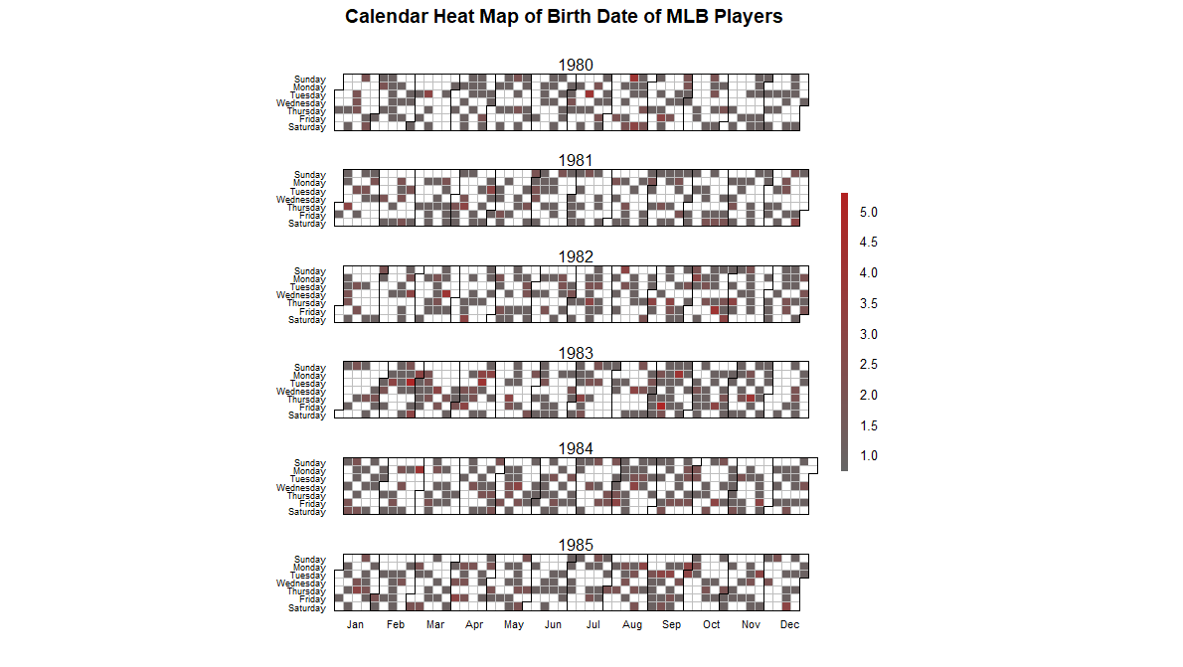
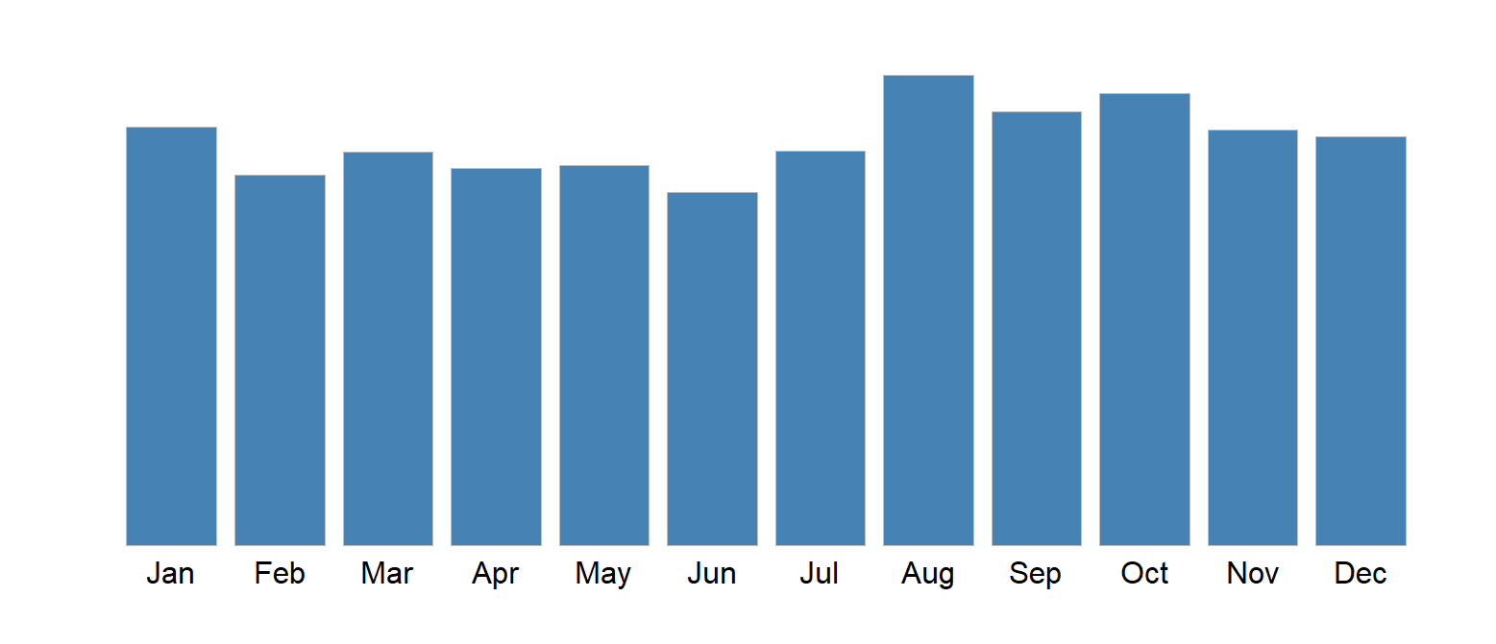
Visualizations for date might be contingent upon the type. Heatmap makes sense for time.

Slide 23
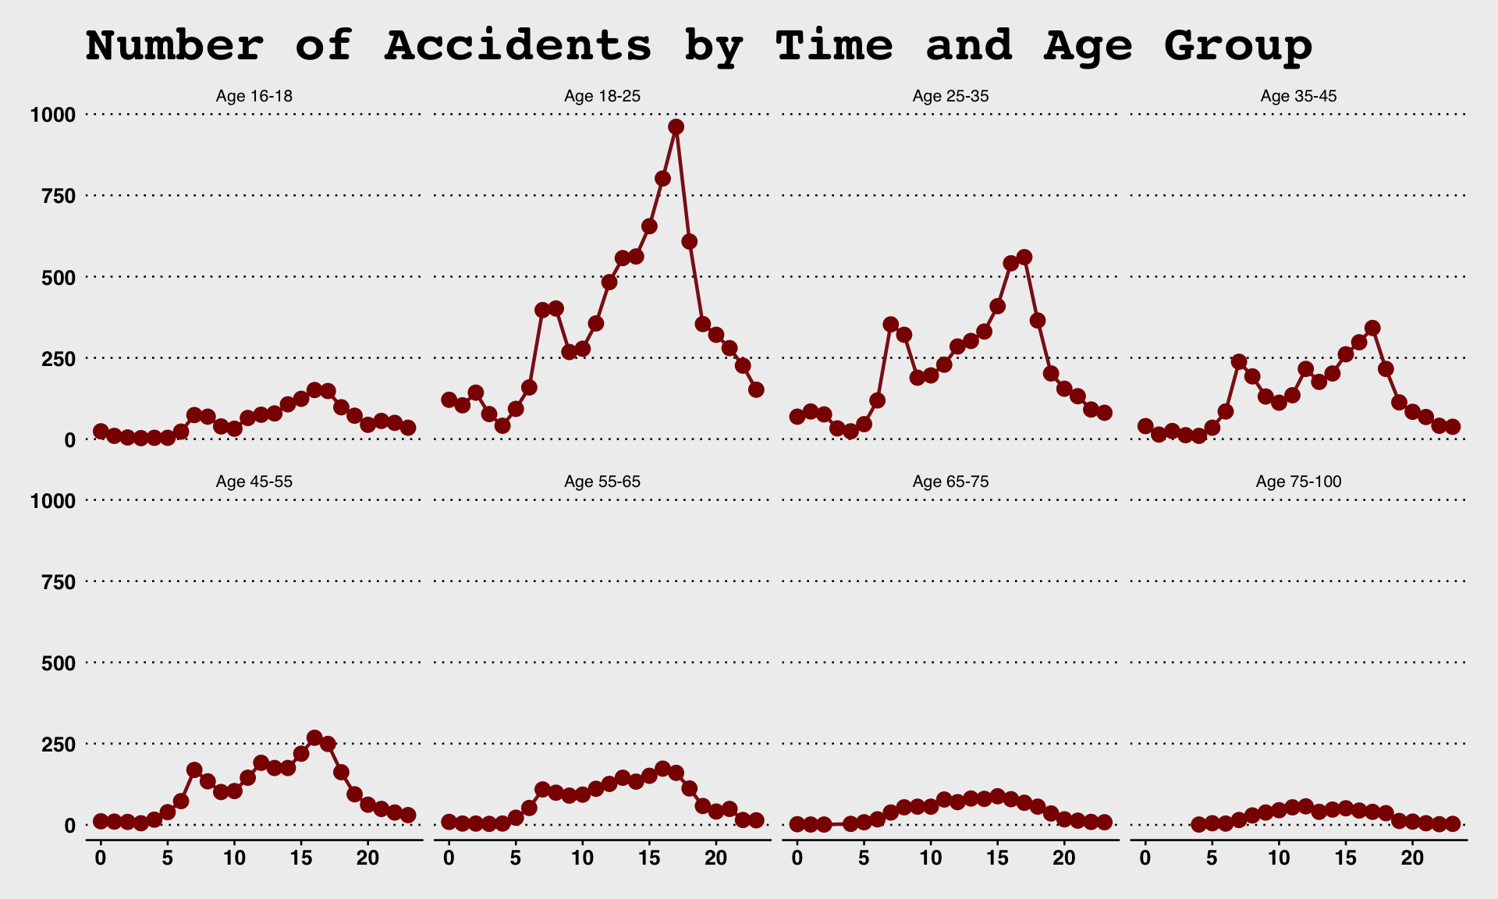
Days of week and hours of the day

Slide 24
thank you

Slide 25
Formatting Experiments

Slide 26
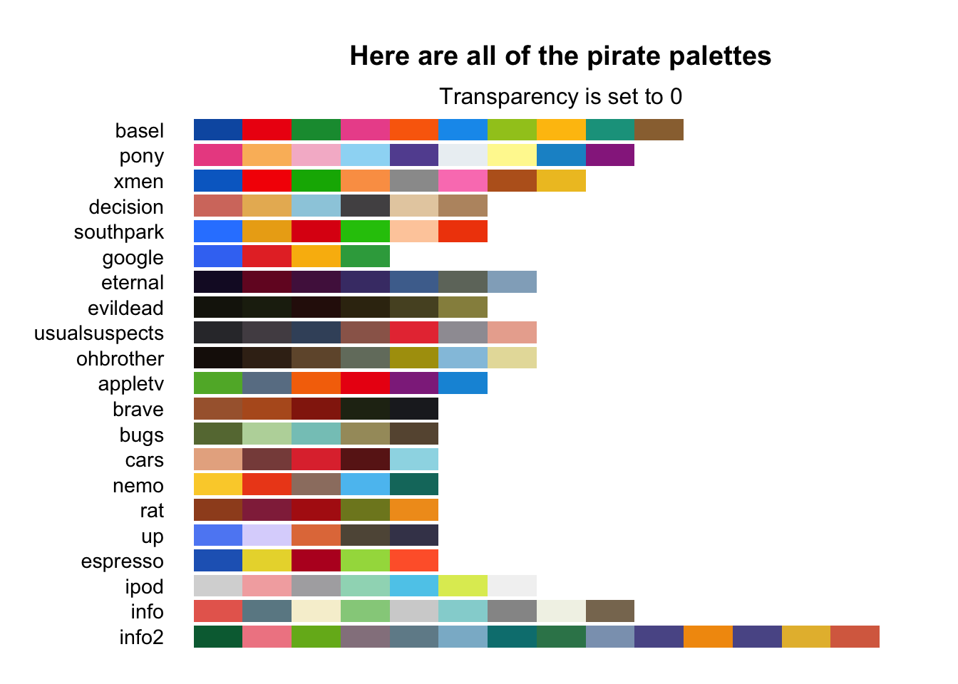

Slide 27
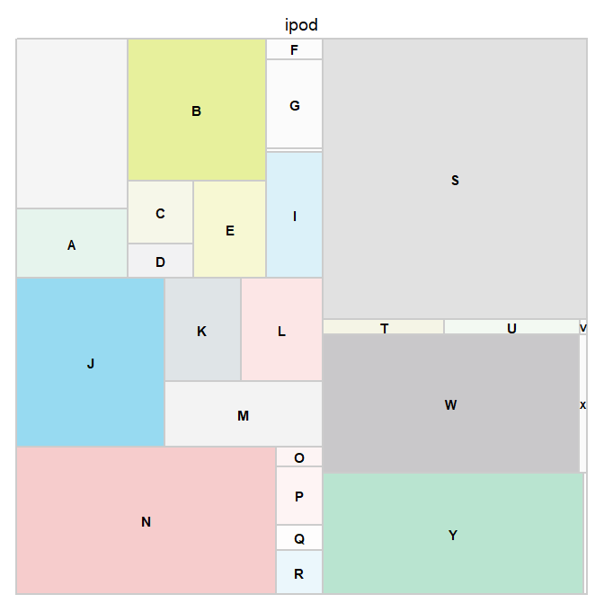

Slide 28
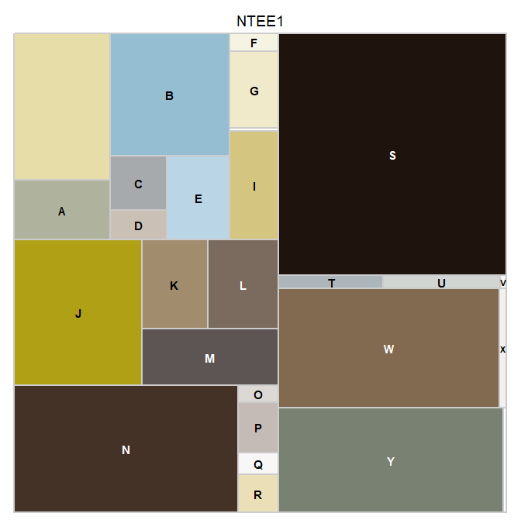
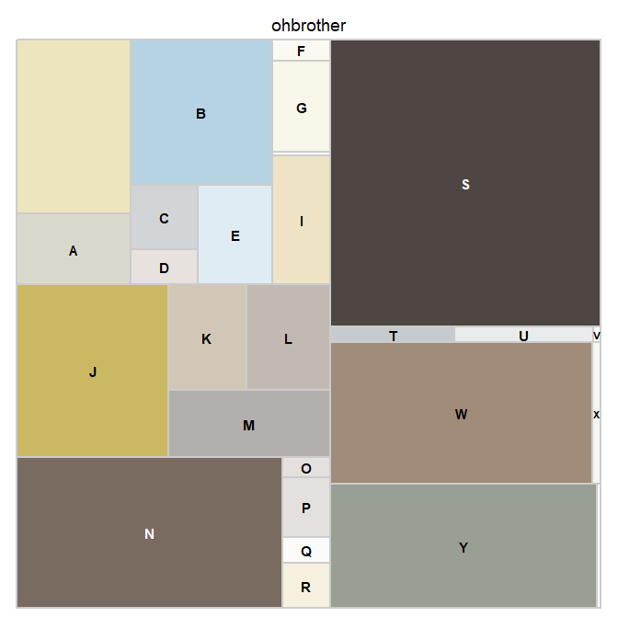
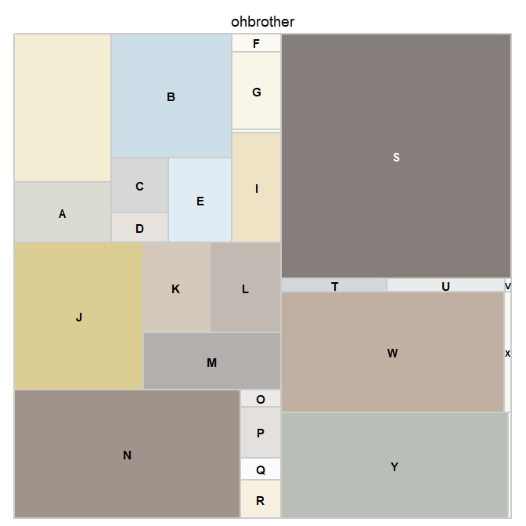
ohbrother

Slide 29
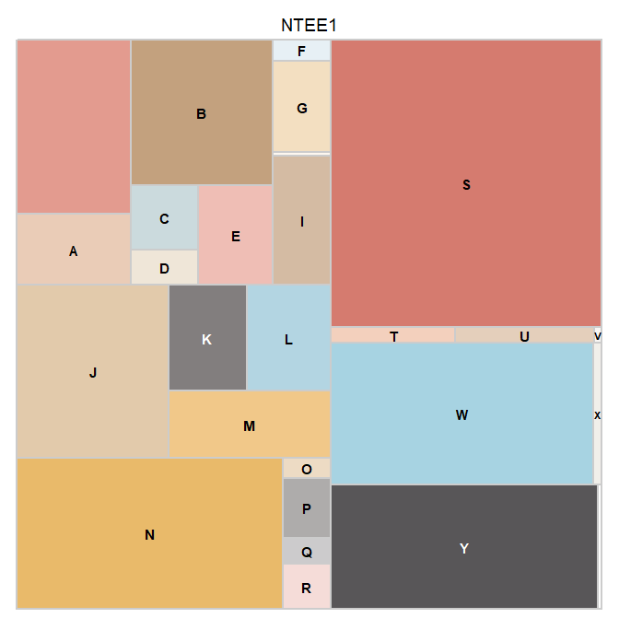
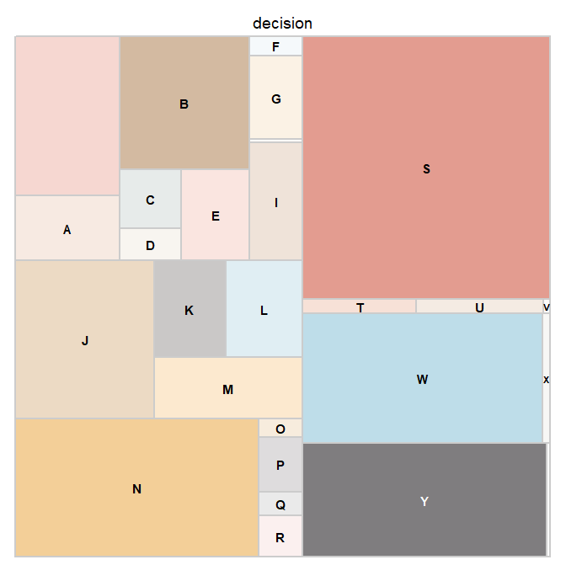
decision

Slide 30
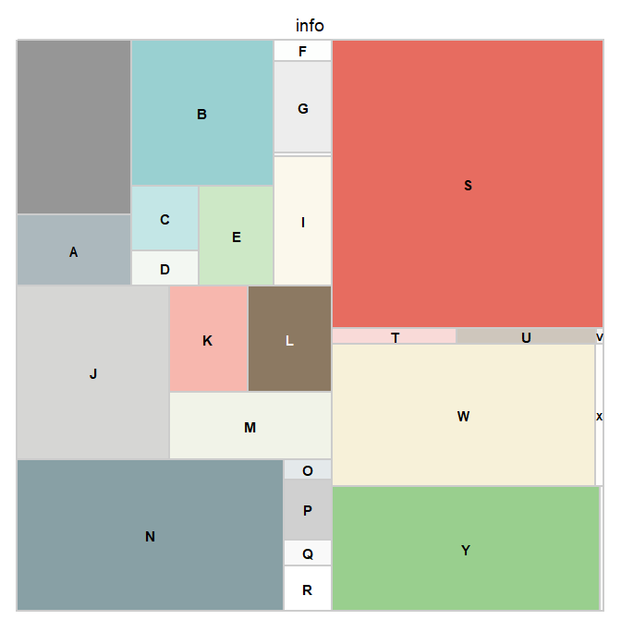
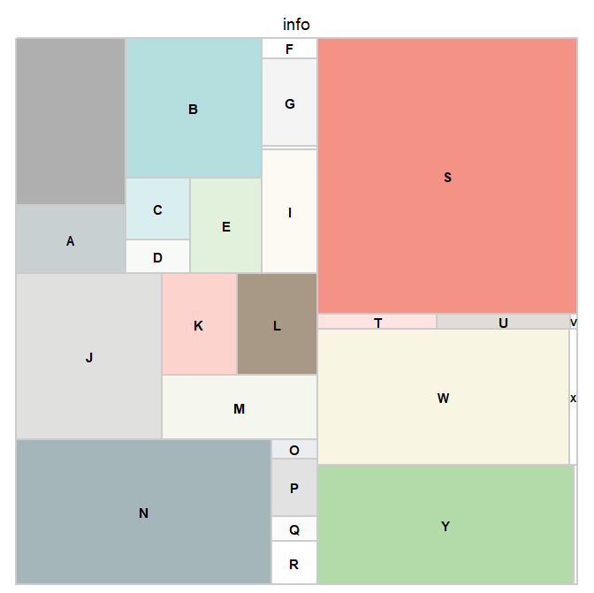
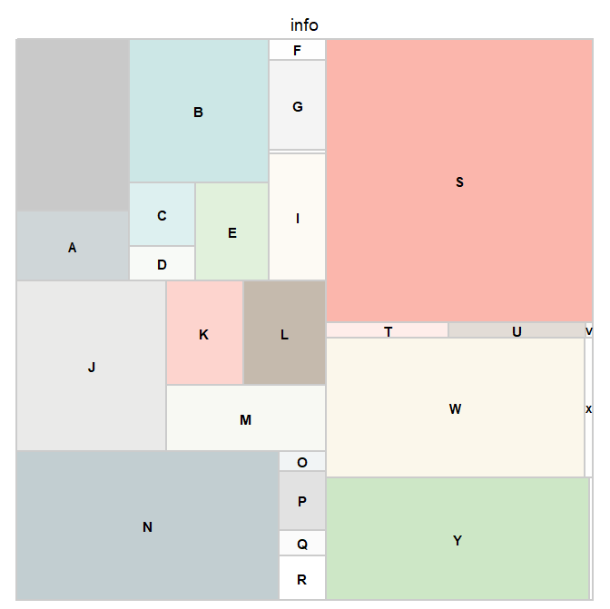
info

Slide 31
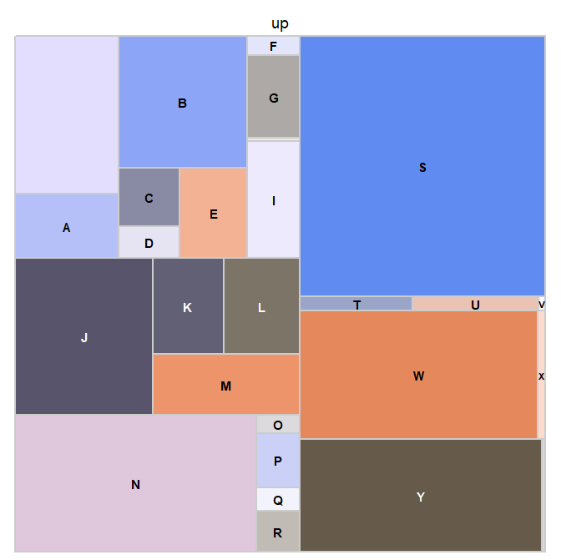
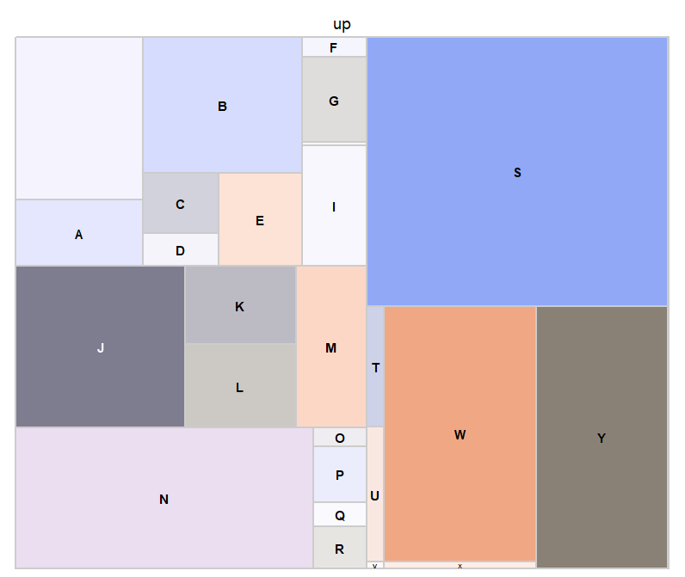
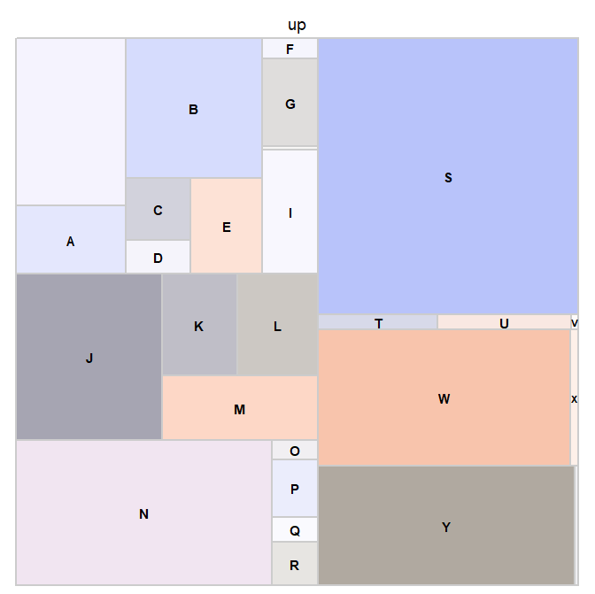

Slide 32
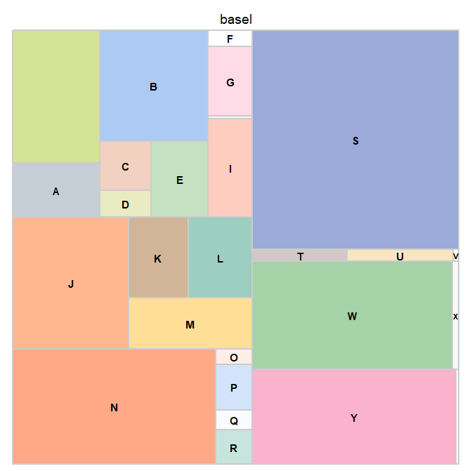
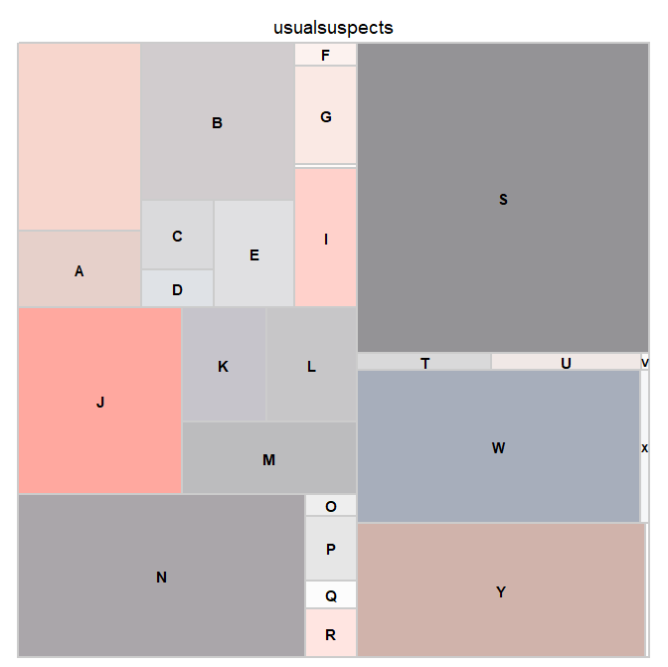

Slide 33
