Slide 1
THE DATAGOOD(R) PACKAGE: AN open science approach to data engineering
Jesse Lecy
Associate Professor ::: Public Affairs (ASU)
Data Scientist ::: The Urban Institute

Slide 2
CUSTOMIZING LAYOUTS

Slide 3
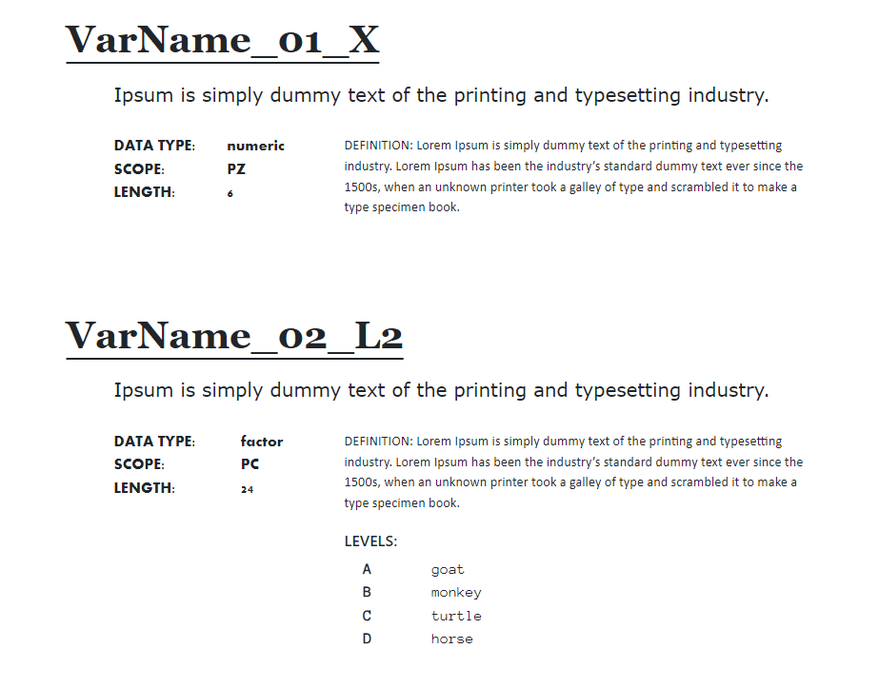
data
dictionary
format
div1
div2
create_dd( dgf )
+
layout
div3
div4

Slide 4
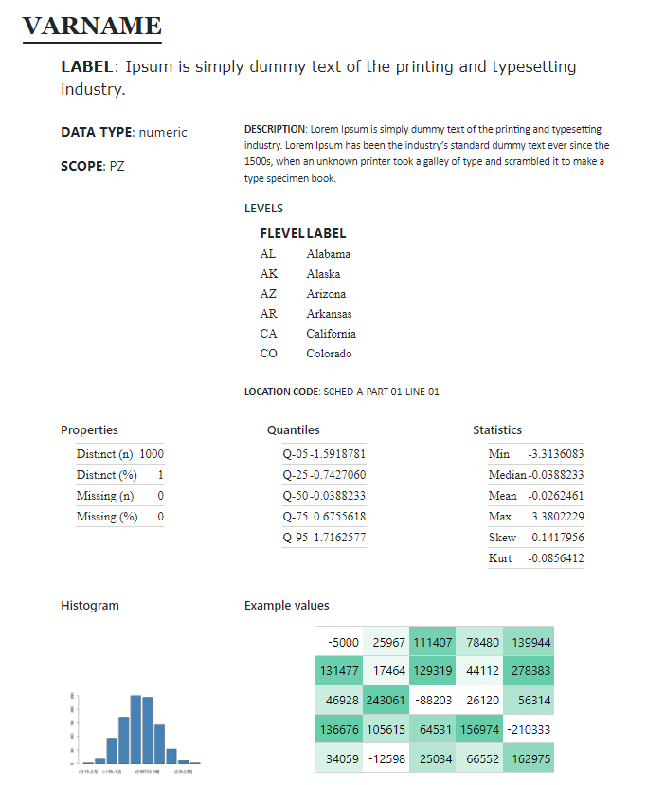
div1
div2
research
guide format
div3
div4
div5
div6
div7
data
profiling
div8
div9

Slide 5
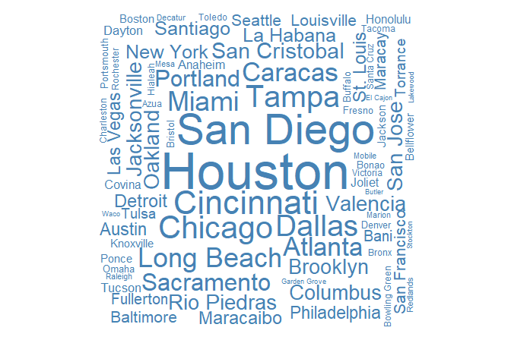
div1
div2
character
div4
div3
div8
div9
preview
data quality
div10
div11
word cloud
stats
min, ave, max
string length

Slide 6
div1
div2
factor
div3
div4
div12
data quality
div14
treemap
div13
topN table

Slide 7
div1
div2
logical
div3
div4
div5
div6
stats
div7
barchart
data quality

Slide 8
div1
div2
dates / time
div4
div3
div9
histogram of dates / barchart of months or days
div8
data quality
div10
preview
div11
calendar heatmap

Slide 9
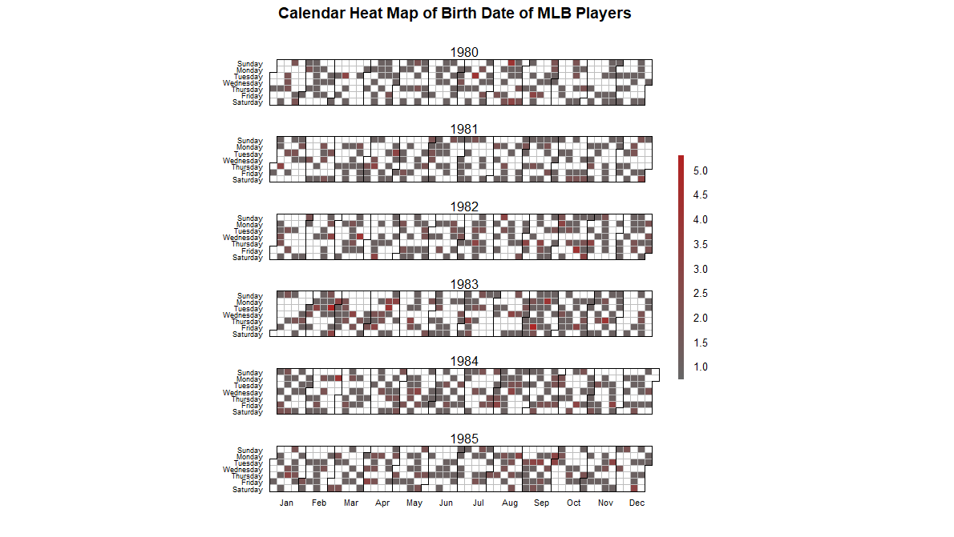
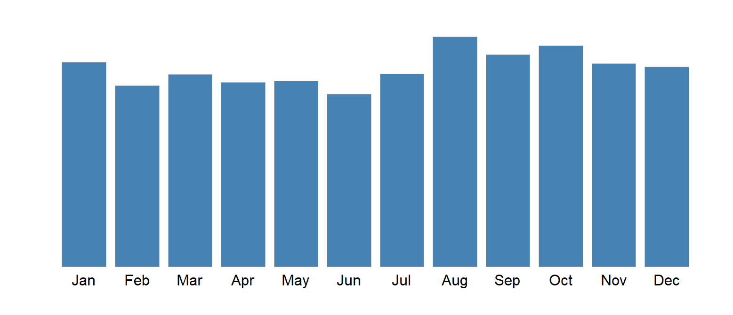
Visualizations for date might be contingent upon the type. Heatmap makes sense for time.

Slide 10
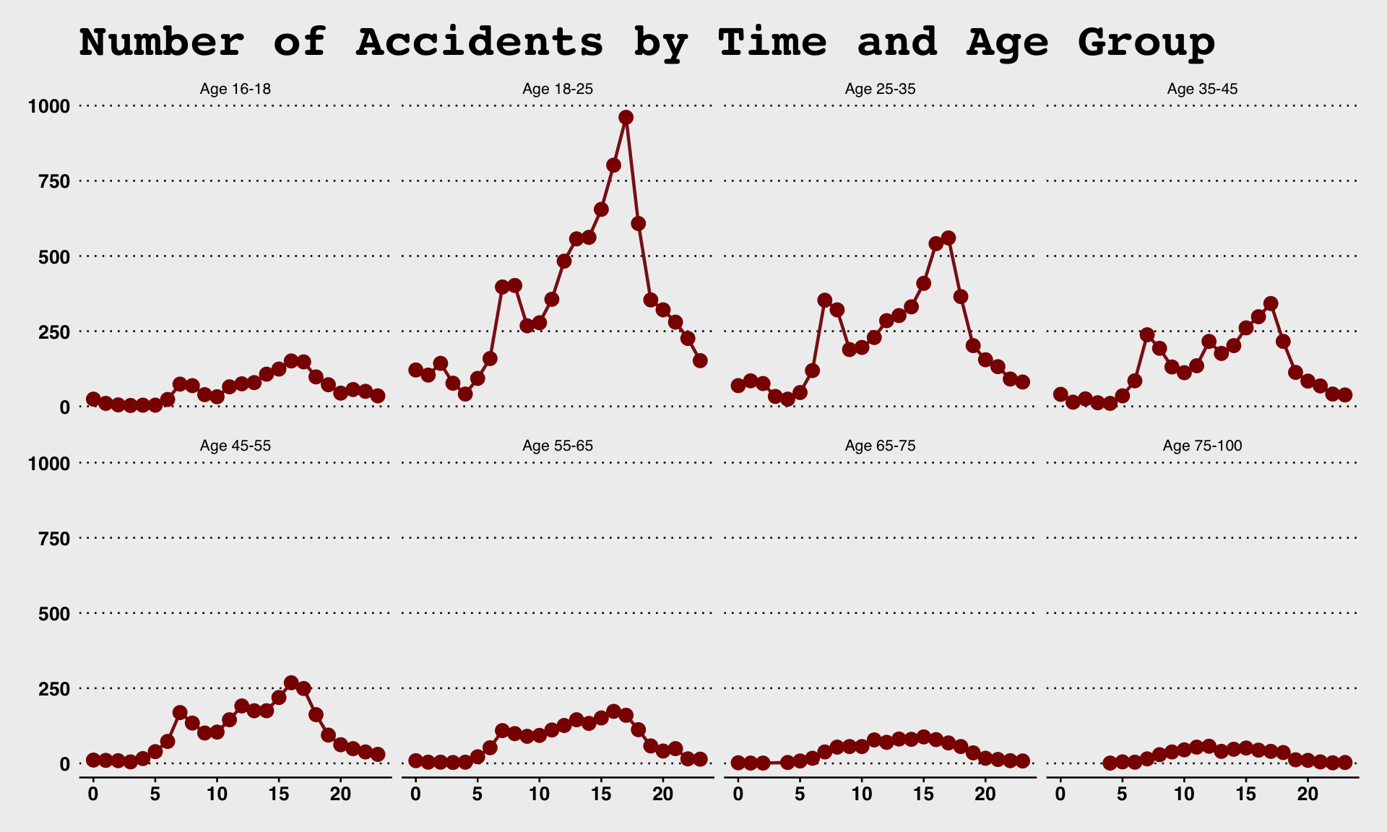
Days of week and hours of the day

Slide 11
layout <-
c( "div2 ;; vlabel ;; LABEL ;; v_to_txt",
"div3 ;; vtype ;; DATA TYPE ;; v_to_txt",
"div3 ;; scope ;; SCOPE ;; v_to_txt",
"div4 ;; desc ;; DESCRIPTION ;; v_to_txt",
"div4 ;; flevels ;; LEVELS ;; f_to_txt",
"div4 ;; glevels ;; '' ;; v_to_txt",
"div4 ;; loc ;; LOCATION CODE ;; v_to_txt",
"div5 ;; v ;; STATS ;; get_properties" )
|DIV |VARIABLE |LABEL |FORMATTING FUNCTION |
|:----|:---------|:-------------|:--------------------|
|div2 |vlabel |LABEL |v_to_txt |
|div3 |vtype |DATA TYPE |v_to_txt |
|div3 |scope |SCOPE |v_to_txt |
|div4 |desc |DESCRIPTION |v_to_txt |
|div4 |flevels |LEVELS |f_to_txt |
|div4 |glevels |'' |v_to_txt |
|div4 |loc |LOCATION CODE |v_to_txt |
|div5 |v |LABEL |get_properties |

Slide 12
Graphical Summaries

Slide 13
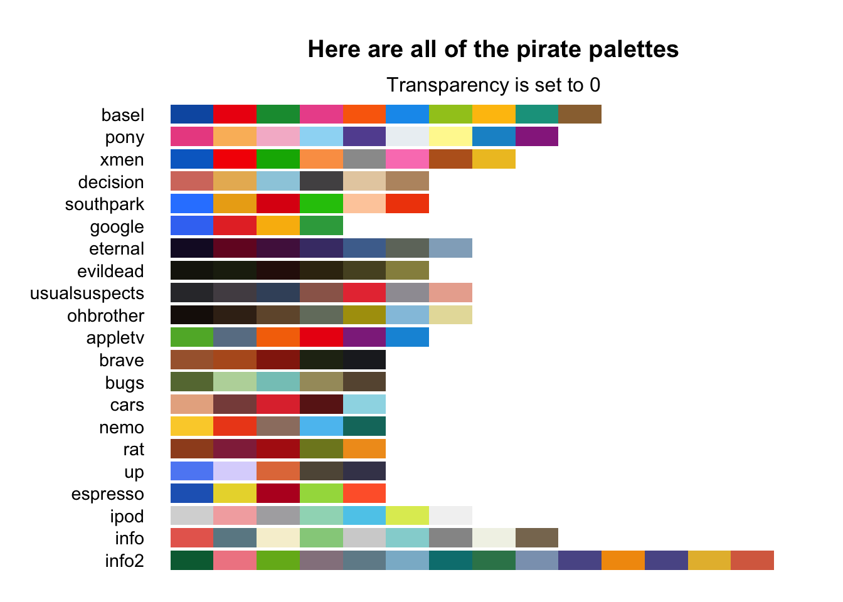

Slide 14
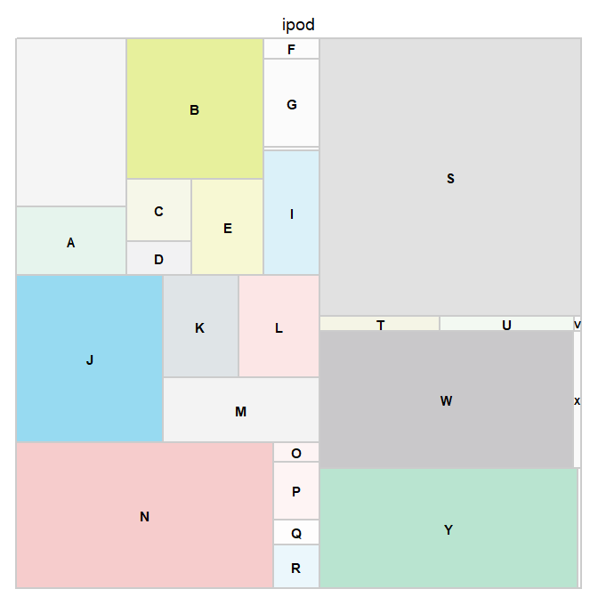

Slide 15
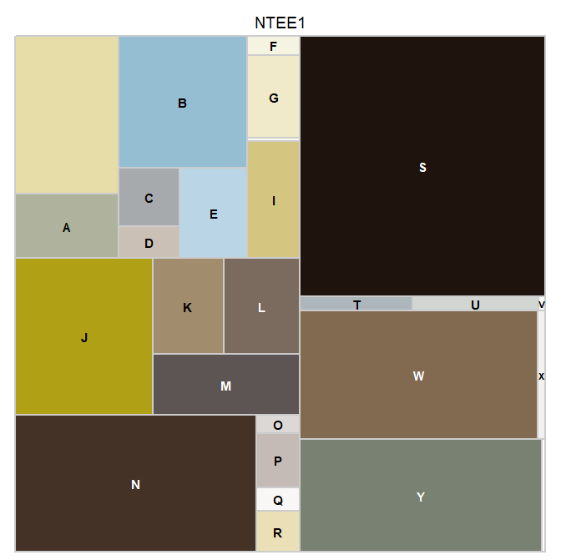
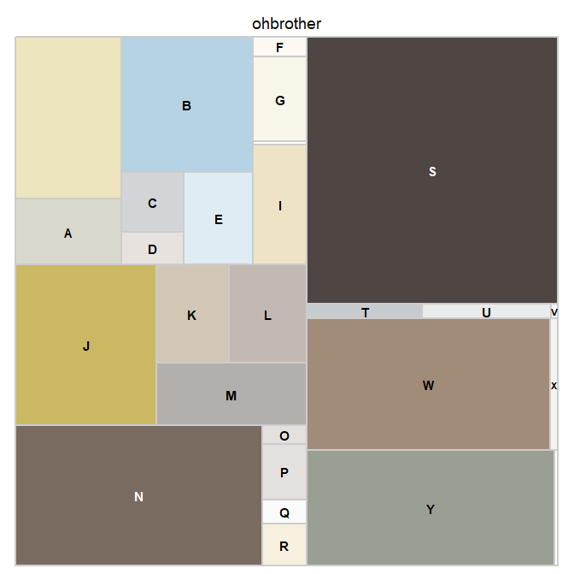
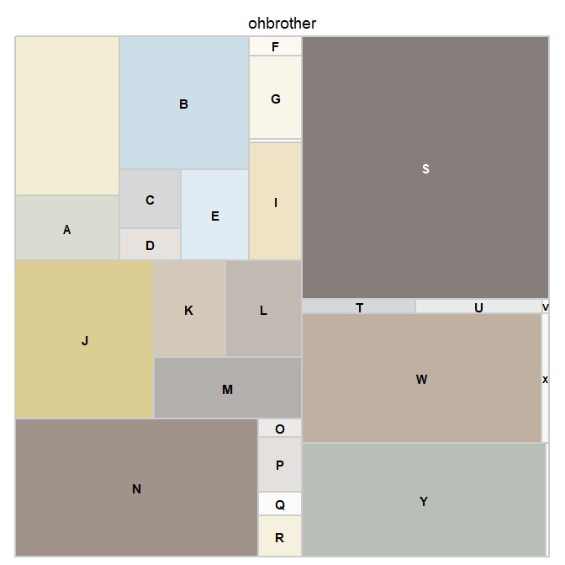
ohbrother

Slide 16
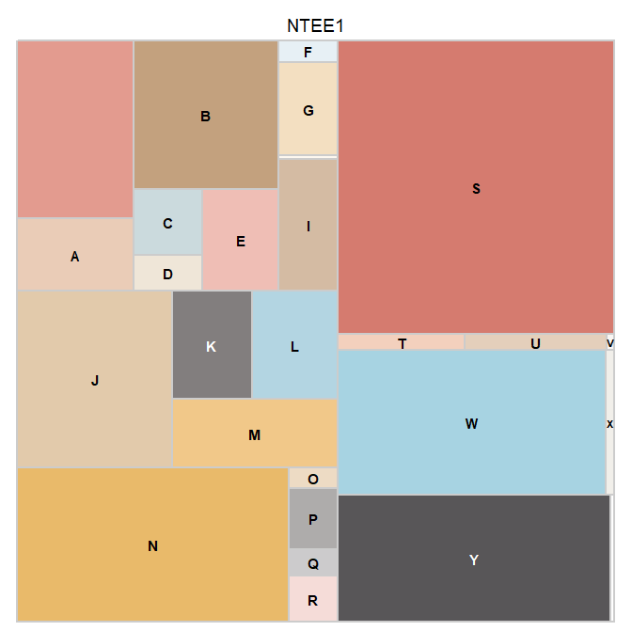
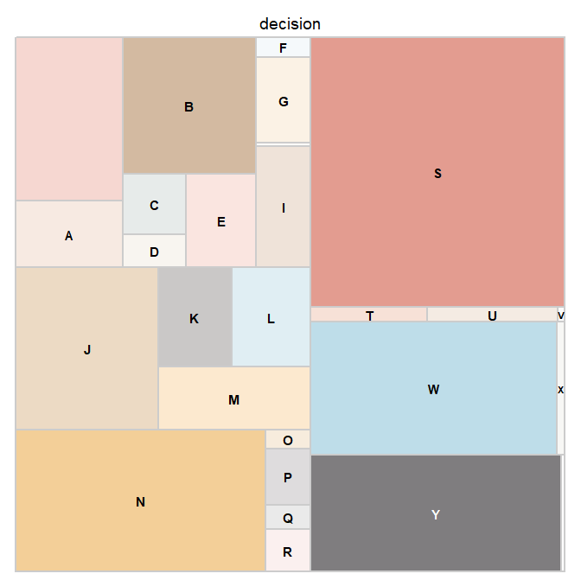
decision

Slide 17
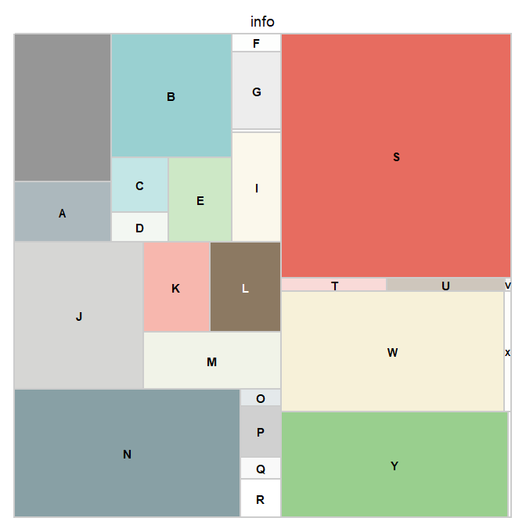
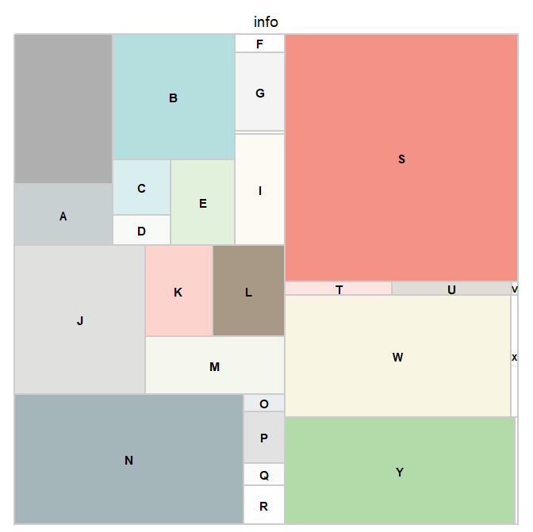
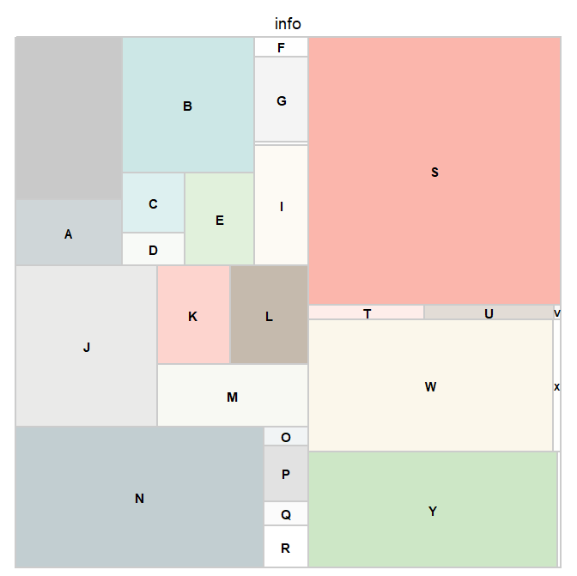
info

Slide 18
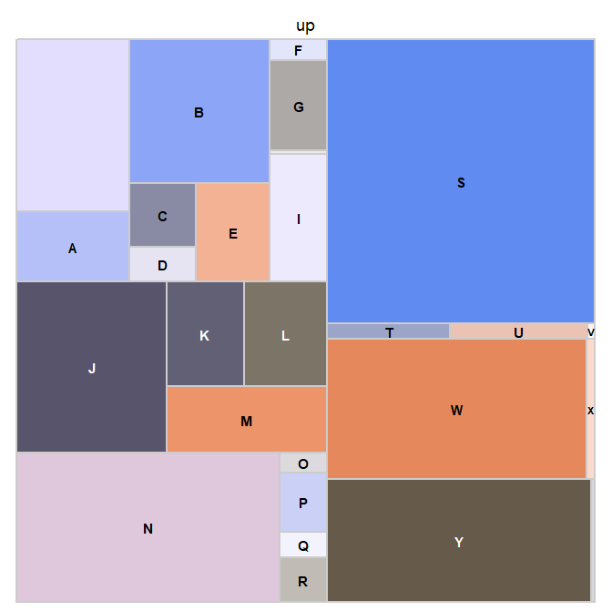
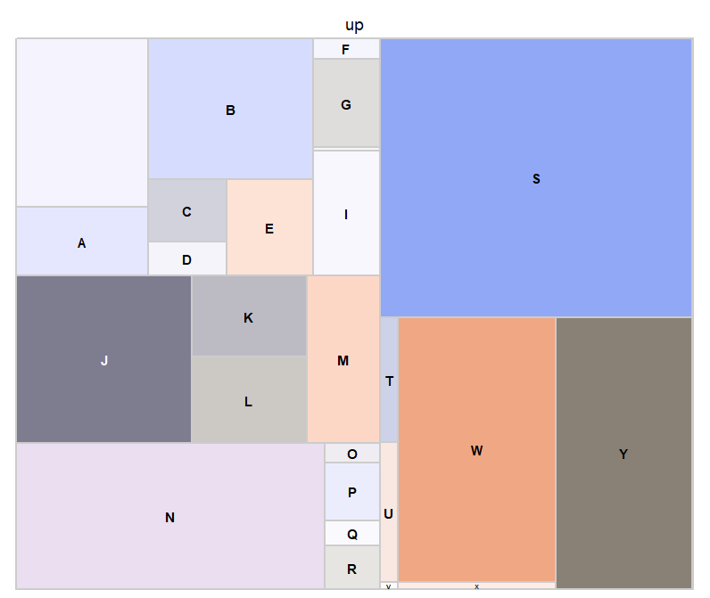
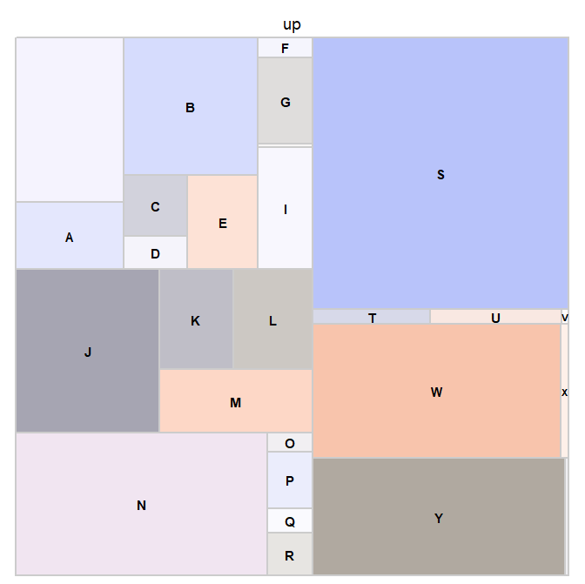

Slide 19
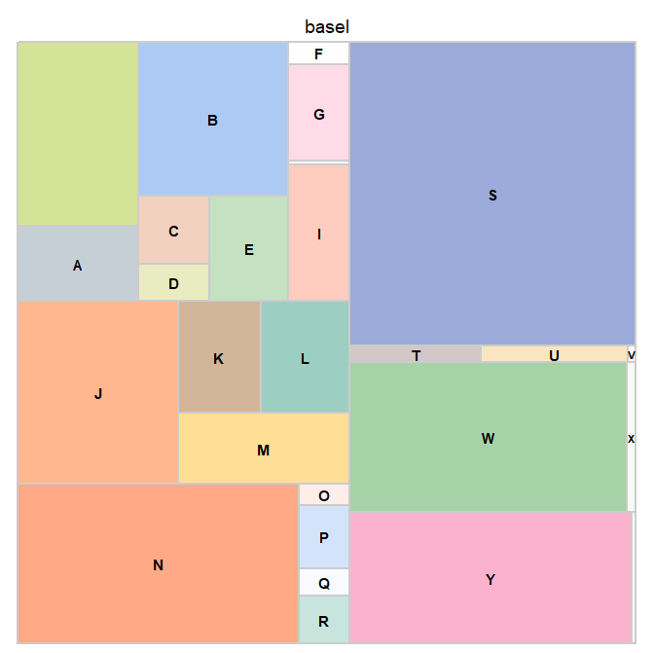
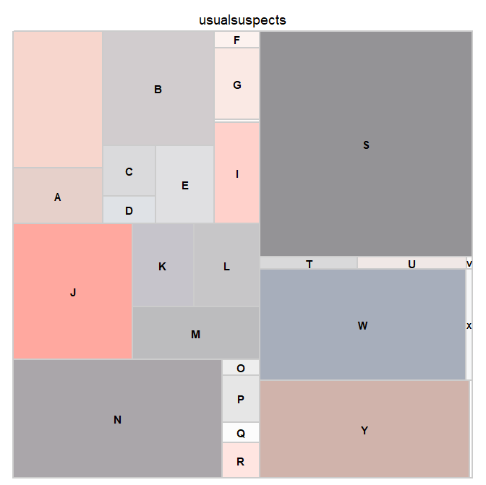

Slide 20
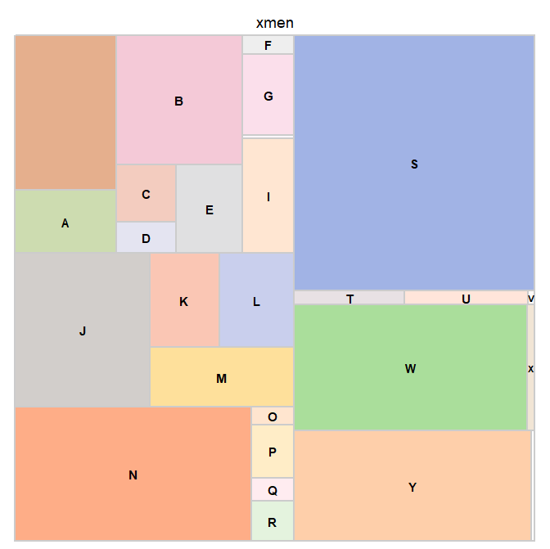
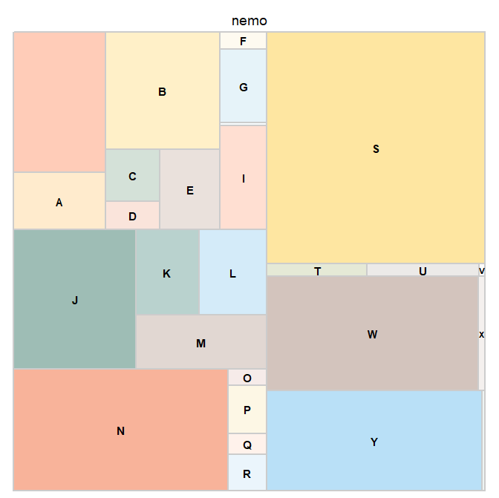

Slide 21
WORKFLOW

Slide 22
create_dgf( df.raw ) Create the DGF (user edits, adds labels and rules)
inspect_dgf( dgf ) Ensure json ok, rules are defined, etc.
ingest_raw( df.raw, dgf ) Apply the raw_convert rules, keep desired types.
data is
altered
update_dgf() Call after changes are made to data to ensure stored values are correct (e.g factor levels the same, update stored descriptive stats for numeric vars).
standardize( df.v2, dgf ) Apply standardization rules,
update_dgf() called silently
data is
altered
create_vr( df.v3, dgf ) Create a data validation report using dgf_validate rules.
can be gener-ated
any
time
once
DGF
exists
create_dd( df.v3, dgf ) Create a data dictionary from dgf fields.
create_rg( df.v3, dgf ) Create a research guide qmd, annotated before rendering.
format( df.v3, dgf ) Apply formatting rules to make data pretty.
df.share
some context where the data is read, not analyzed, also used in dd & rg

Slide 23
raw data
user edits dgf:
add variable descriptions
add cleaning rules
create_dgf( df )
DGF.csv
ingest_raw( df, dgf )
inspect_dgf( dgf )
update_dgf()
format( df.v3, dgf )
standardize( df.v2, dgf )
gooder data
additional data
enrichment
update_dgf( df.vx+1 )
apply_dgf( df.vx )
create_dd( dgf )
data-dictionary.html
gooder documentation
create_rg( df.vk, dgf )
research-guide.html

Slide 24
data
dictionary
format

Slide 25
thank you

Slide 26
Package Documentation

Slide 27
