Slide 1
Deep Learning with Turing server
Xin Zhang

Slide 2
WPI Turing Sever
Turing is a Linux server
You can connect Turing server via SSH connection
Create Python script and submit to Turing server

Slide 3
A Demo of running job on ACE
In this demo, we use:
Turing server
Visual Studio Code
Contents:
Set up connection
Set up Turing environment
Download data
Build model
Submit jobs and run

Slide 4

Set up connection
Download VS code from https://code.visualstudio.com/
Go to “Extensions” , search and install “Remote-SSH”
Press F1 and run “Remote-SSH: connect to host”
Select “Add New SSH Host” and fill your username and server address and connect
More tutorial on https://code.visualstudio.com/docs/remote/ssh

Slide 5
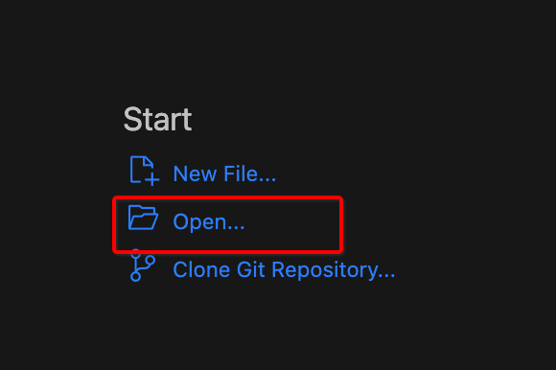
Set up Turing environment
Connect to Turing server. Make sure that you have connected to WPI VPN if you are off-campus.
Open remote folder (your own root folder on the server)

Slide 6
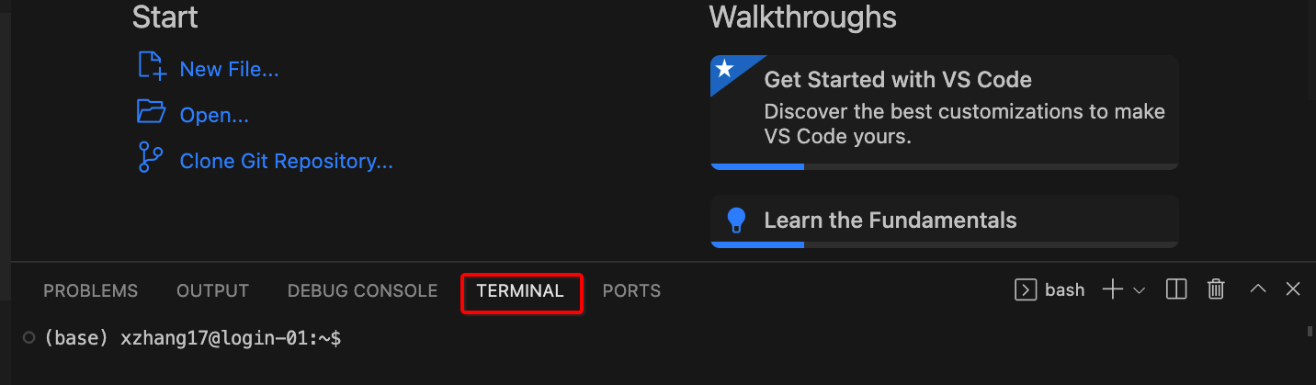
Set up Turing environment
Create a new terminal
Load anaconda3, CUDA and cudnn using “module load” command
Create new conda env using “conda create –n NAME”
Activate new env using “source activate NAME”
Install Pytorch using “conda install pytorch==1.2.0 torchvision==0.4.0 cudatoolkit=9.2 -c pytorch ”

Slide 7
Download data
Download data from Google Drive and extract them to your local folder
Drag and drop into the folder panel in your VS code
Wait them to be uploaded

Slide 8
Build model and run jobs
Write Python code using VS Code
Write a shell script with slurm configurations
Submit jobs using “sbatch” command

Slide 9
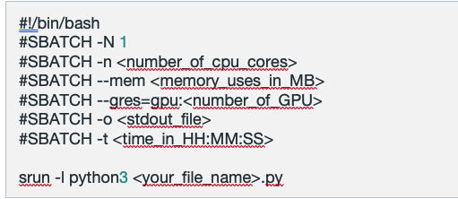
Submitting Jobs on Turing
Submit jobs using “sbatch” command is preferred so works can run in the background and does not require an active terminal.
Create a run.sh file, <your_file_name>.py is the code you want to run. Submit job with the command ‘sbatch run.sh’

Slide 10
Reference
Slurm documents: https://slurm.schedmd.com/tutorials.html
WPI ARC website: https://arc.wpi.edu/slurm-commands/
Pytorch: https://pytorch.org/tutorials/
TF: https://www.tensorflow.org/learn

