Slide 1
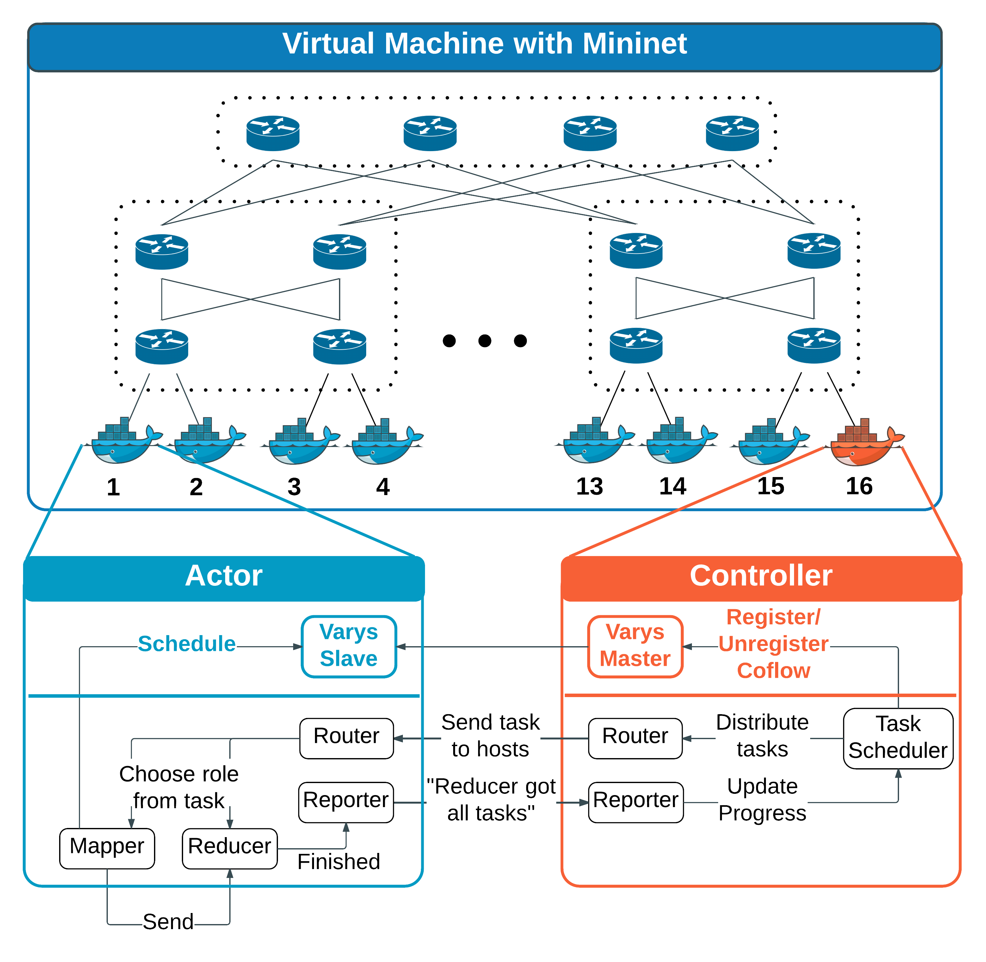
CSE 222A Fall 2015 Group 6 – Coflow Scheduling
Amit Borase, Stas Mushits, Ruby Pai, Sreejith Unnikrishnan, Ritvik Jaiswal
Coflow Abstraction [1], [2]
Experiment
Results
Motivation: Data parallel application-aware cluster network scheduling.
Definition: A collection of flows that have a common goal. The application cannot proceed until all flows in the coflow have been received.
Examples: Shuffle in Map-Reduce, bulk synchronous processing
Coflow completion time (CCT) is what matters to application.
Motivation: Current coflow schedulers require applications to identify coflows to the scheduler via an API. Automatic coflow identification would ease programmer burden. These will be less than 100% accurate, so it is useful to evaluate the performance of state-of-the-art coflow schedulers as a function of knowledge of flows in a coflow.
We evaluate the impact of a large coflow with increasing number of flows unidentified to the scheduler on a smaller flow contending for the same resources.
Coflow Schedulers [1], [2]
Inter-coflow scheduling is NP-hard; use heuristics
Varys (2014):
Shortest effective bottleneck first
Exploit differences between flow lengths in a coflow – do not allocate more bandwidth than necessary to meet minimum possible CCT
Ave. 3.16x faster coflow completions
Aalo (2015):
No prior knowledge of coflow characteristics
Multilevel queue with thresholds based on observed coflow size
Generalize least attained service to coflows
Ave. 1.93x faster coflow completions
Simulation Setup
• Fat tree topology created using mininet
• Mininet hosts were deployed on Docker containers so that hosts would have unique hostnames as required by scheduler
Flow
Threshold = X
Coflow
Level 1 Queue
…
…
…
Threshold = X
Level N Queue
[1] Chowdhury, Mosharaf and Ion Stoica, Efficient Coflow Scheduling Without Prior Knowledge, SIGCOMM 2015
[2] Chowdhury, Mosharaf, Yuan Zhong and Ion Stoica, Efficient Coflow Scheduling with Varys, SIGCOMM 2014

