Slide 1
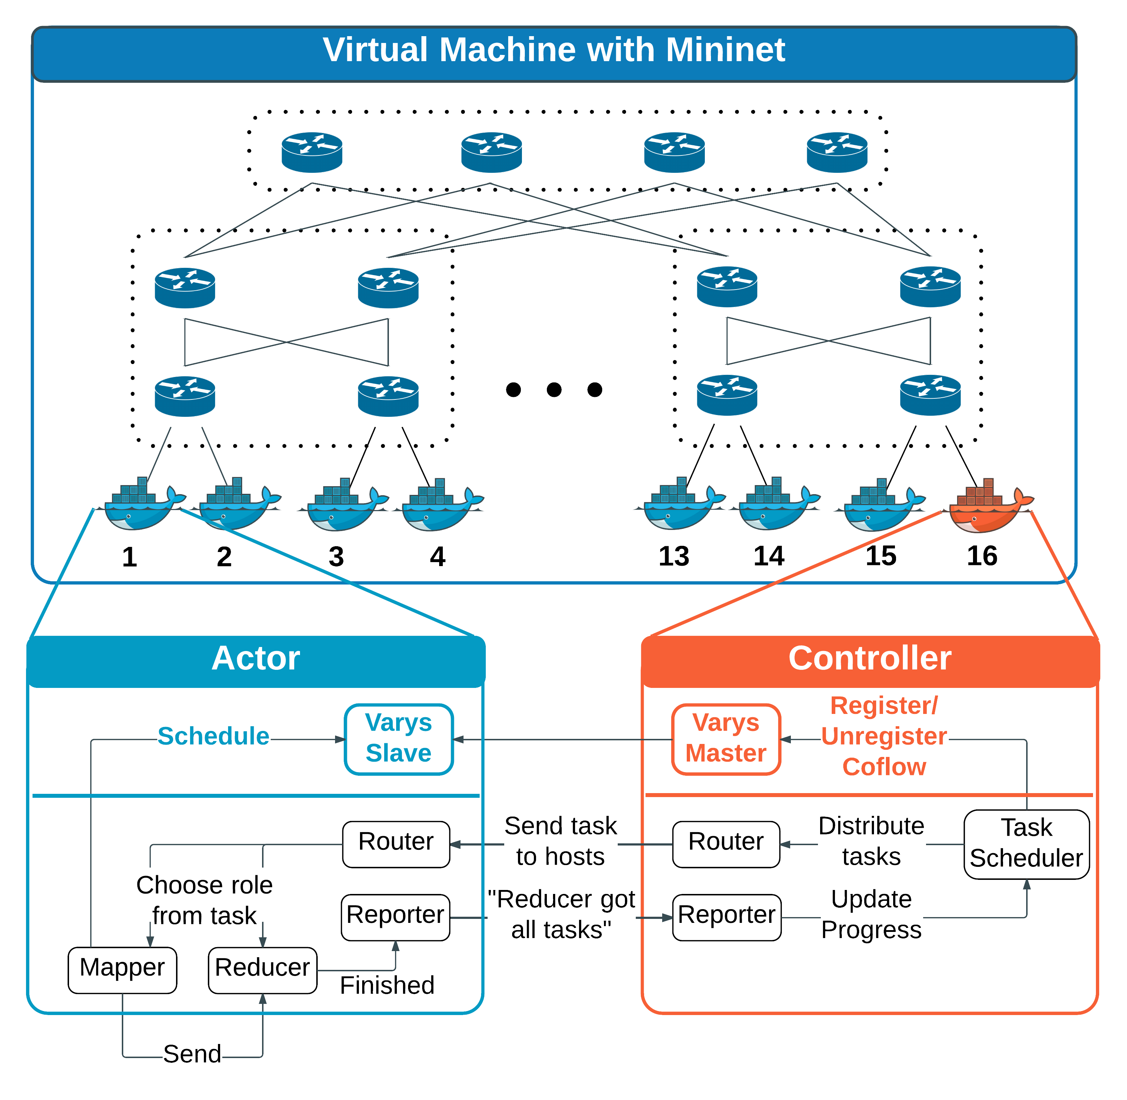
CSE 222A Fall 2015 Group 6 – Coflow Scheduling
Amit Borase, Stas Mushits, Ruby Pai, Sreejith Unnikrishnan, Ritvik Jaiswal
Coflow Abstraction [1], [2]
Experiment
Results
Motivation: Data parallel application-aware cluster network scheduling.
Definition: A collection of flows that have a common goal. The application cannot proceed until all flows in the coflow have been received.
Examples: Shuffle in Map-Reduce, bulk synchronous processing
Coflow completion time (CCT) is what matters to application.
Motivation: Current coflow schedulers require applications to identify coflows to the scheduler via an API. Automatic coflow identification would ease programmer burden. These will be less than 100% accurate, so it is useful to evaluate the performance of state-of-the-art coflow schedulers as a function of knowledge of flows in a coflow.
We evaluate the impact of a large coflow with increasing number of flows unidentified to the scheduler on a smaller flow contending for the same resources.
Coflow Schedulers [1], [2]
Inter-coflow scheduling is NP-hard; use heuristics
Varys (2014):
Shortest effective bottleneck first
Exploit differences between flow lengths in a coflow – do not allocate more bandwidth than necessary to meet minimum possible CCT
Ave. 3.16x faster coflow completions
Aalo (2015):
No prior knowledge of coflow characteristics
Multilevel queue with thresholds based on observed coflow size
Generalize least attained service to coflows
Ave. 1.93x faster coflow completions
Simulation Setup
• Fat tree topology created using mininet
• Mininet hosts were deployed on Docker containers so that hosts would have unique hostnames as required by scheduler
Conclusion and Future Work
We expected CCT’s for smaller coflows to be delayed gradually when number of unlabeled flows within larger coflows were increased
Results showed sharp increase in the CCT’s of smaller coflows for first insertion of unlabeled flow, after which it levelled off for additional unlabeled larger flows.
Multi-threading based solution coupled with many software abstractions (JVM, Mininet, Docker) resulted in increased aberrations.in fat-tree topology.
Flow
Threshold = X
Coflow
Level 1 Queue
…
…
…
Evaluations and Limitations
Threshold = X
Conduct experiments beyond the two coflow example.
More real-time approach for multi-threading socket level packet transfers.
Take full advantage of multiple equal cost paths available in fat-tree topology.
Level N Queue
[1] Chowdhury, Mosharaf and Ion Stoica, Efficient Coflow Scheduling Without Prior Knowledge, SIGCOMM 2015
[2] Chowdhury, Mosharaf, Yuan Zhong and Ion Stoica, Efficient Coflow Scheduling with Varys, SIGCOMM 2014

