Slide 1

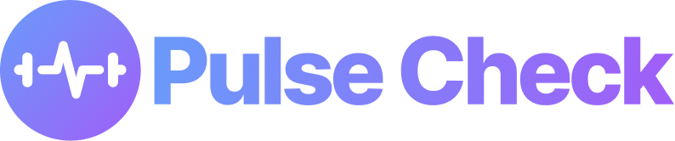
PULSE INTELLIGENCE LABS
THE HUMAN PERFORMANCE COMPANY
We build AI systems that measure and train human performance. Pulse Check is our flagship platform for college athletics.
PRE-SEED
FOUNDER
PRODUCT
$1.4M
Tremaine Grant
$10M pre-money
Founder & CEO
Mental performance OS
DETECT → TRAIN → ROUTE → MEASURE

Slide 2
THE PROBLEM
Pressure gets seen too late.
Athlete pressure rises before any support system responds.
4x
60%
10%
CRISIS RISK
COMPETITION ANXIETY
COACH VISIBILITY
more likely to face a mental health crisis.
of athletes experience anxiety leading up to competition.
reach out to a coach before crisis hits.
Sources: NCAA Student-Athlete Well-Being Study (n=23,000+); Center on Sport Policy & Conduct, 2024.

Slide 3




WHY SCHOOLS MUST ACT
Mental health support is now required.
The NCAA mandates that every member school provide student-athlete mental health support. Pulse Check is how schools meet it.
THE 4 REQUIRED COMPETENCIES
Healthy environment
2022
NCAA Constitution requires mental health access for every member school.
Screening for distress
Aug 2024
Best Practices became legislatively effective across all divisions.
Action plans
Nov 2025
First Division I attestation deadline. Compliance is now reported.
Care from licensed providers
Pulse Check delivers all four.

Slide 4


WHY THIS IS DIFFERENT
Not a vitamin. A prescription.
Most performance tools are optional upgrades. Compliance makes Pulse Check a line item schools already have to fund.
THE OLD WAY
PULSE CHECK
A vitamin
A prescription
Nice to have, easy to cut
Required, already in the budget
Sold on motivation
Sold on compliance
Competes for discretionary budget
Funded as a mandate line item

Slide 5




THE SOLUTION
Train the mind before the moment.
Pulse Check builds composure ahead of competition, supports the athlete in the moment, and routes to real care when needed.
TRAIN
SUPPORT
ROUTE
Athletes chat with Nora, their AI coach, through a personalized curriculum of cognitive simulations on their phones, rehearsing composure, focus, and decisioning before they reach competition
When Nora detects symptoms of a mental crisis brewing, Pulse Check connects the athlete to a human clinician through AuntEDNA.ai's HIPAA-compliant clinical pathway.
On game day, passive biometrics catch the signal early and Nora reinforces the trained skills in real time.
Athletes train the response before competition, so the body remembers how to perform under pressure.

Slide 6
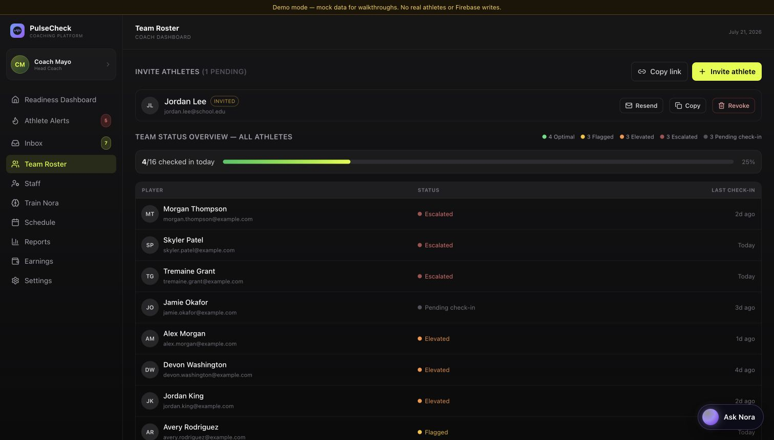
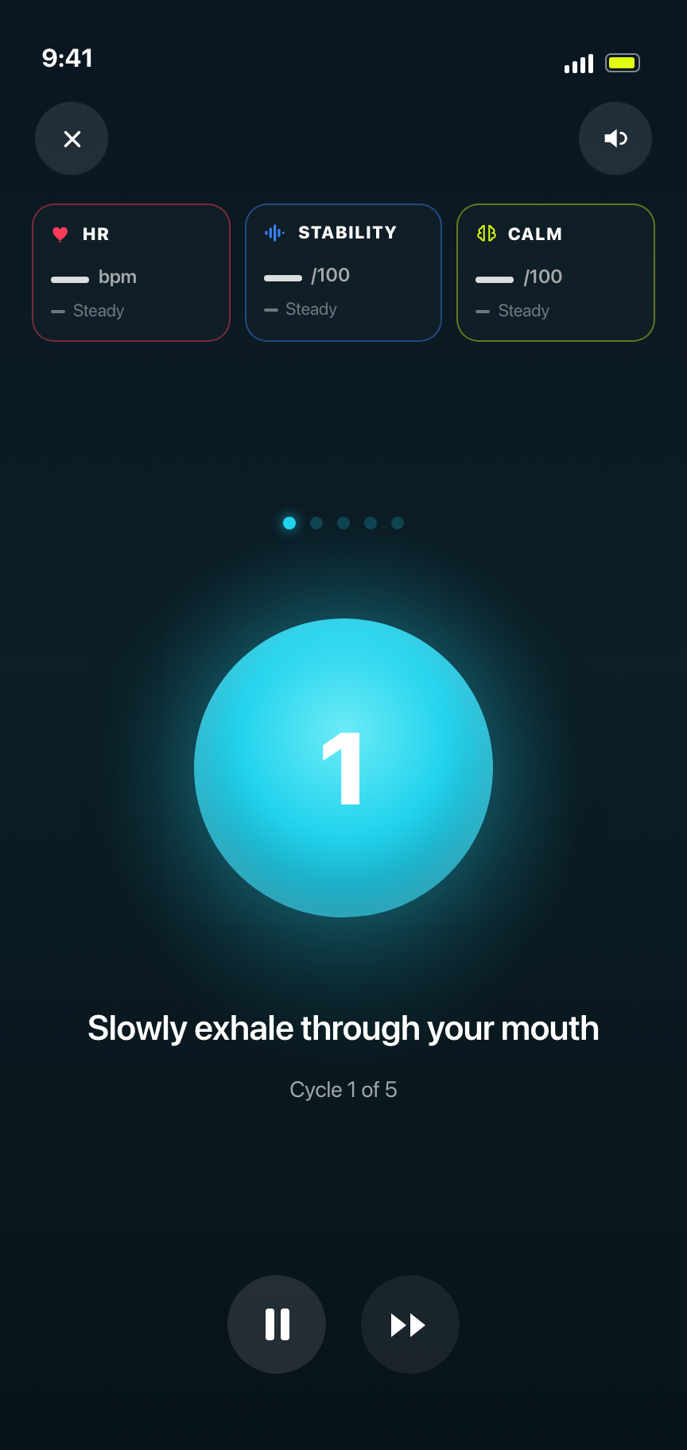
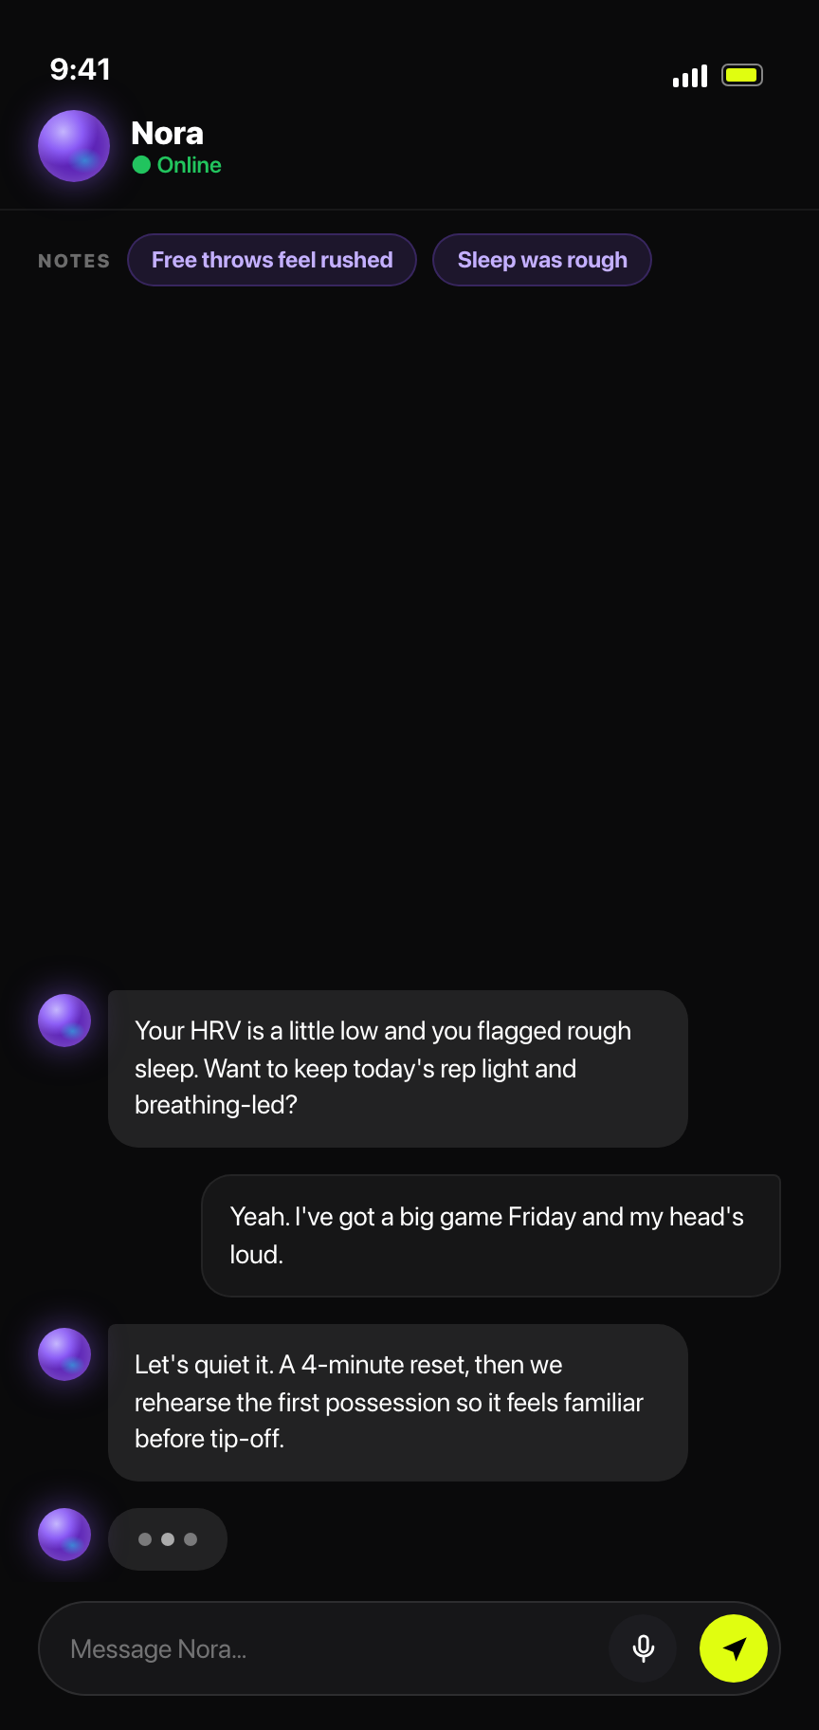
HOW IT WORKS
What the athlete actually sees.
DETECT
TRAIN
SUPPORT
Passive biometrics detect the signal, Nora trains and settles the response, and Sports Intel reads each athlete in context — inside the app they already open.
Passive biometrics read each athlete in context.
Guided box-breathing trains the body to settle.
In the moment, Nora settles the trained response.

Slide 7
HOW IT WORKS
What the coaches see.
One roster shows who’s ready, who needs attention, and who hasn’t checked in — with athlete profiles, readiness status, and recent signals in one coach-first view.
Notes:
Coach roster screenshot captured from the PulseCheck demo dashboard on July 21, 2026. Mock walkthrough data only.

Slide 8
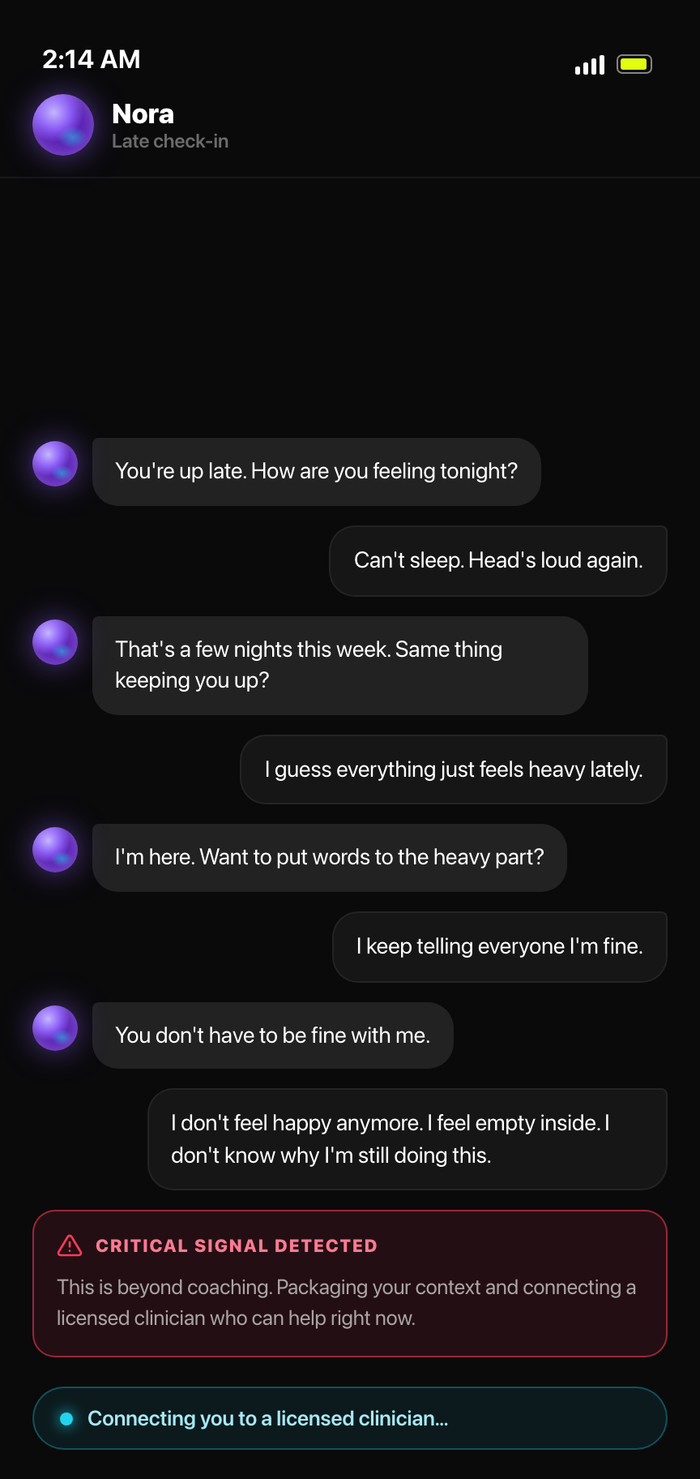
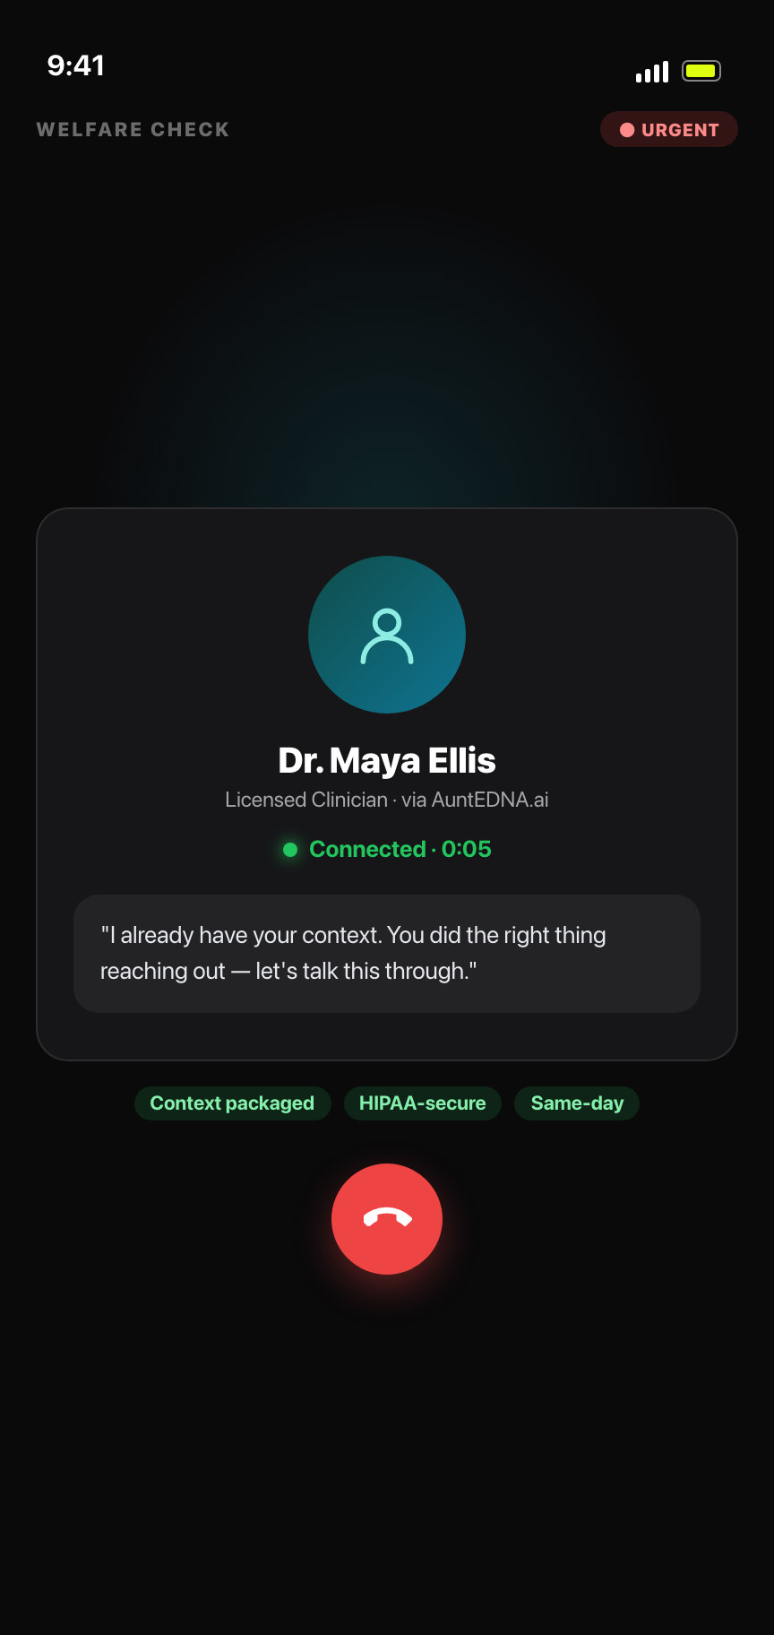
THE ROUTE
Not a chatbot. A real human.
We catch the moment, package the context, and hand off to a licensed human through AuntEDNA.ai — including a same-day welfare check.
NORA FLAGS IT
A HUMAN ANSWERS
Trigger
1
Flagged chat + biometric snapshot the instant Nora detects a critical signal.
Route
2
The signal layer packages the full context and hands off to AuntEDNA.ai over a HIPAA-secure pathway.
Human
3
A licensed clinician runs a same-day welfare check — a real person, not a bot.
The difference: chatbot “therapy” stops at the AI. Pulse Check never pretends to be the clinician — it routes to one, with the context already packaged.

Slide 9



THE MOAT
The Sports Intelligence Layer.
Competitors own one slice. Pulse Check ties the whole workflow into one institutional system.
Athlete biometrics
Cognitive game library
Sport-specific signal, not a generic wellness score.
Proprietary sims that train focus, composure, decisioning.
Clinical partner routing
Institutional workflow
A real care pathway through AuntEDNA.ai.
Built for how athletic departments actually buy and run.

Slide 10
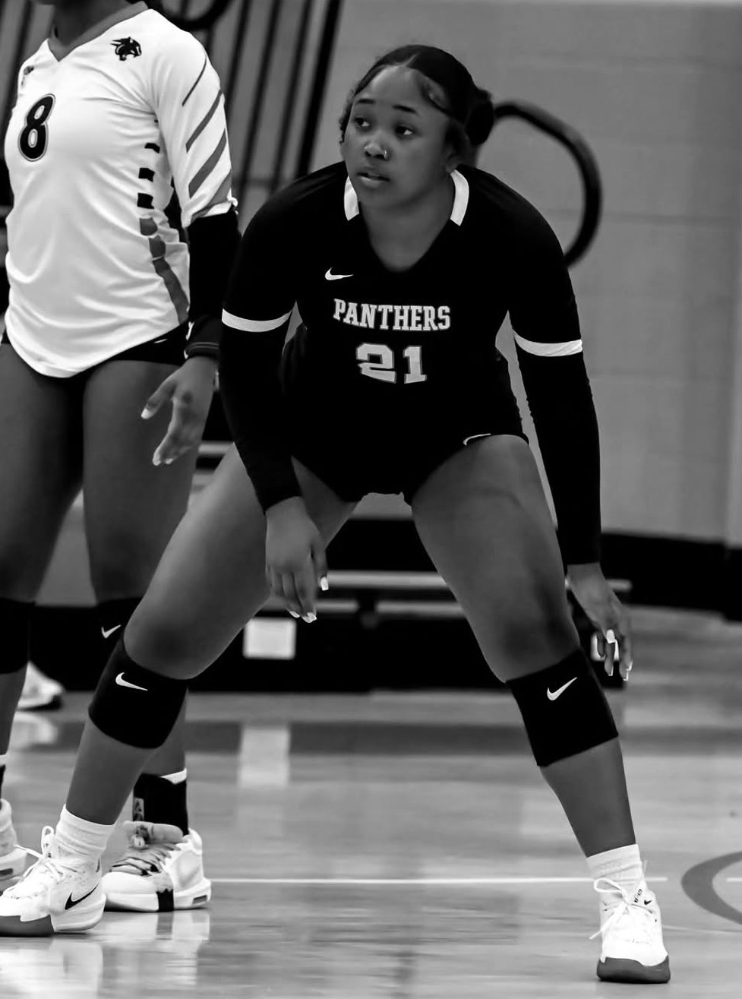
PROOF IN MOTION
Three paid pilots, on real campuses.
Three approved paid pilots — Clark Atlanta, DePaul, and UMES. Worcester State and the New England Patriots are in active conversation.
3
$355
$229
approved paid pilots
per athlete · first 90 days
per athlete · annual continuation
Why it matters. Three approved pilots prove the product, compliance, and commercial story at once.
NAKYALA · CLARK ATLANTA

Slide 11



THE MARKET
We start where compliance is mandatory.
Every NCAA school is a required buyer. We land schools first, then expand to the pro and federation tiers.
PRIMARY FOCUS · NCAA INSTITUTIONS
1,100+
520K+
100%
NCAA member schools
student-athletes
require mental health support
LATER EXPANSION
Professional teams
Federations & NGBs
Leagues
After NCAA proof
National team pipelines
League-wide deals

Slide 12
GO-TO-MARKET
A clear path into every athletic department.
Pilots are paid contracts. We conform the platform to each school, then convert to a continuation contract.
1
2
3
4
Paid pilot
Conform
Prove
Convert
$355 per athlete for the first 90-day pilot.
Tune Pulse Check to the school's sport and workflow.
90 days of adherence and compliance evidence.
$229 per athlete annually, department-wide.
Three approved pilots — Clark Atlanta, DePaul, and UMES — with Worcester State and the New England Patriots in conversation.

Slide 13
CONTRACT ECONOMICS
The units that compound.
Average annual contract value across the NCAA buyer tiers, with pro and federation deals above.
TIER 1
TIER 2
TIER 3
TIER 4
TIER 5
D2 / D3
Mid-Major
Power Four
Pro Team
Federation
$5–10K
$10–20K
$40–80K
$100K
$100–250K
Fastest close, highest volume
~350–450 athletes
~600–700 athletes
Roster + practice squad
Scales with athlete pool
NCAA schools are the beachhead. Pro and federation tiers carry the path to scale.

Slide 14
BEACHHEAD
The first $1M is already visible.
Our 12–24 month beachhead is the set of collegiate contracts already in motion, all required buyers.
D2 / D3
Mid-Major
Power Four
30 × $10K
20 × $20K
4 × $75K
$300K
$400K
$300K
SEGMENT TOTAL
SEGMENT TOTAL
SEGMENT TOTAL
$1.0M
54 CONTRACTS · 12–24 MONTH BEACHHEAD

Slide 15
REVENUE ROADMAP
A visible path to $100M ARR.
Prove Pulse Check in every NCAA tier in Years 1–2, then scale through pro, federation, and league deals.
YEARS 1–2 · PROVE IT
YEARS 3–5 · SCALE
~$1.0M ARR
$100M+ ARR
Land anchor contracts across every NCAA tier. Validate the product, build case studies, establish compliance credibility.
Saturate the NCAA (~1,000 schools, ~$15M ARR), then layer the high-ACV tiers — ~150 pro teams, ~80 federations, and league-wide platform deals — to clear $100M+.
54 contracts
NCAA ~$15M · pro + federation + league ~$85M

Slide 16
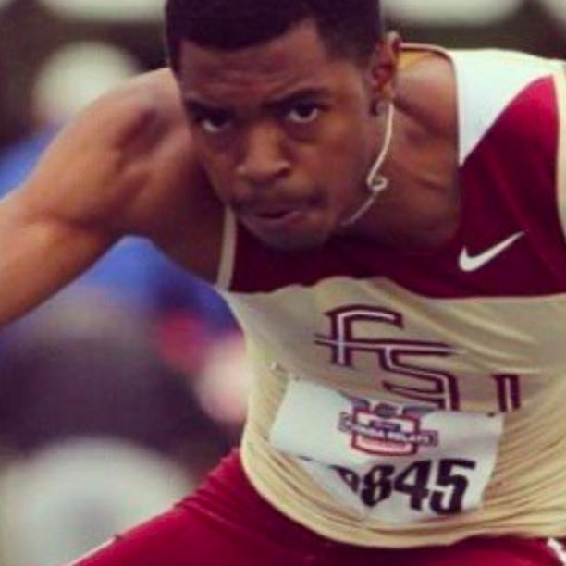
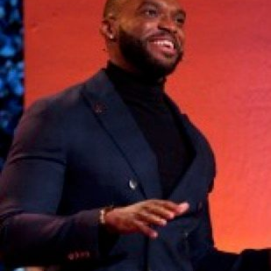
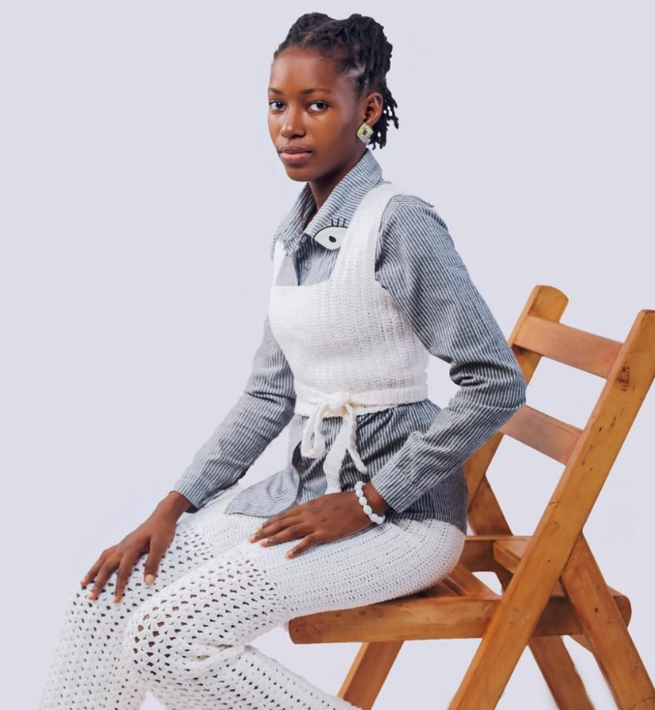


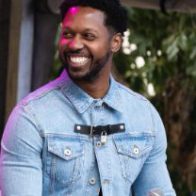
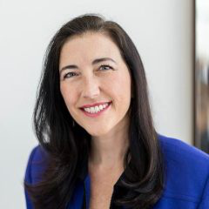
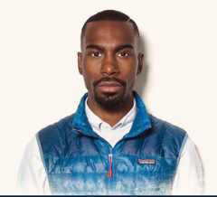
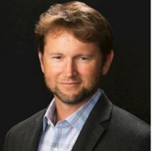
THE TEAM
Operators who know software, athletes, and clinical trust.
Tremaine Grant
Bobby Nweke
Lola Oluwaladun
FOUNDER & CEO
CHIEF OF STAFF
HEAD OF DESIGN
Principal full-stack engineer, deep in AI, with a decade in clinical research. D1 athlete at FSU.
10 years in human performance across training, athletics, and education.
Owns product experience and athlete-facing UX across Pulse.
ADVISORS & BACKING
Lead investor — LAUNCH ▲
Marques Zak
Valerie Alexander
DeRay Mckesson
Erik Edwards
CMO, ACC
Enterprise & IPO Attorney
Organizing · HBCU reach
Partner, Cooley

Slide 17
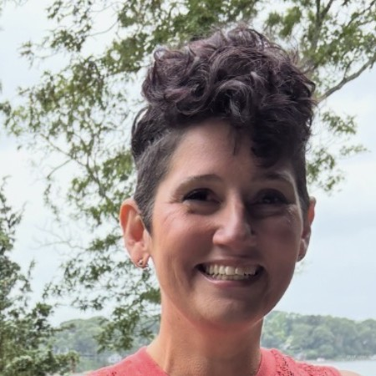
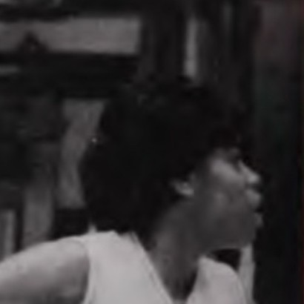
CLINICAL PATHWAY
AuntEDNA.ai validates the care layer.
Pulse Check owns the detection, scoring, and routing. AuntEDNA.ai handles the clinical handoff.
AUNTEDNA.AI CO-CEOS
Jelanna Salas Olivera
Dr. Tracey Hathaway
Co-CEO
Co-CEO
NSF Phase I grant
Independent validation through scientific peer review.
80% adherence
AuntEDNA.ai evidence across 1,000+ student-athletes.
Shared research layer
Models trained on a validated, peer-reviewed athlete dataset.

Slide 18

WHO SUPPORTS US
We are not building in isolation.
Strategic support already spans clinical pathway, hardware, legal, capital, institutional access, infrastructure, and research.
CLINICAL PATHWAY
HARDWARE
LEGAL COUNSEL
AuntEDNA.ai
POLAR
COOLEY
Strategic clinical pathway partner for escalation and care routing.
Wearable hardware partner for biometric and recovery signals.
LLP · EST. 1920
CONFERENCE
VENTURE NETWORK
ACC
AWS
ATLANTIC COAST CONFERENCE
STARTUPS
NETWORK WE REACH THROUGH THIS PARTNERSHIP
Conference-level marketing and institutional access.
Technical backing & credits.
NCAA®
College athletics ecosystem access
VENTURE NETWORK
LEAD INVESTOR
techstars
LAUNCH▲
NSF
Scientific research network
Founder network and support.
FOUNDER UNIVERSITY
Investor backing and Founder University network.
⚡
Clinical, hardware, legal, capital, and institutional infrastructure. The support around us is real — and already in motion.

Slide 19
THE ASK
Raising $1.4M to own the mandate.
Pre-seed on a $10M pre-money. Capital funds the team and product velocity to convert the visible beachhead.
USE OF FUNDS
CURRENT RAISE
Engineering
$450K
$1.4M
Partnerships
$150K
Athlete performance science
$150K
$10M pre-money
Product R&D
$100K
Ladder: $1.4M → $5M → $12M → $25M, pre-seed through Series B.
GTM and marketing
$300K
Operating runway
$250K

Slide 20
PULSE CHECK MAKES ATHLETES
HIGHER-PERFORMING WITHOUT
BEING HOLLOWED OUT.
The compliance-required platform for college athlete mental performance, with a visible path from the first school to $100M ARR.
DETECT → TRAIN → ROUTE → MEASURE
Tremaine Grant tre@fitwithpulse.ai
$1.4M PRE-SEED · $10M PRE-MONEY

