Slide 1
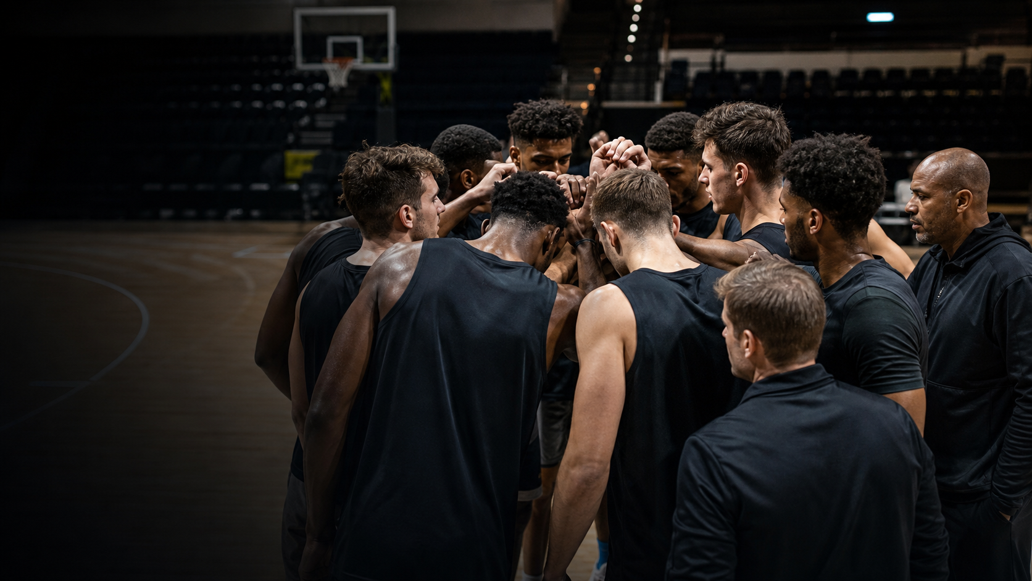
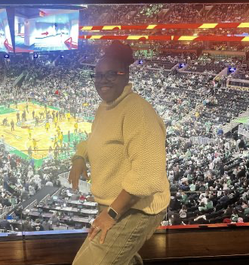
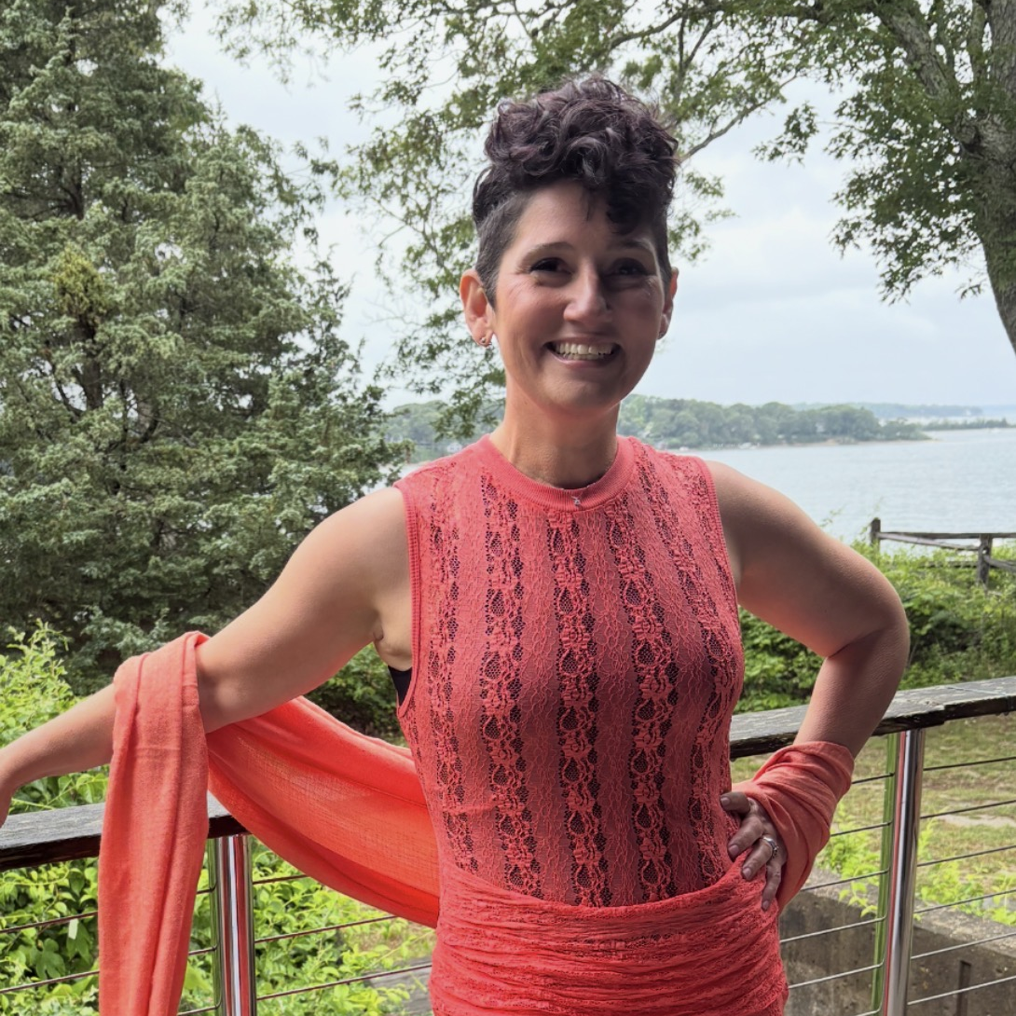
STRATEGIC PARTNERSHIP
AuntEDNA.ai brings clinical care + an
active NCAA pipeline.
PulseCheck owns detection, scoring and routing. AuntEDNA adds clinical escalation, research validation and institutional access.
Dr. Tracey Hathaway
Jelanna Salas Olivera
CO-FOUNDER • ATHLETICS ACCESS
CO-FOUNDER • ENTERPRISE EXECUTION
ATHLETE → COACH → ATHLETIC DIRECTOR
BIG FOUR → BIG PHARMA → DIGITAL HEALTH
Former Division I women’s basketball player, University of Rhode Island
Transformation consulting across EY and KPMG
Former women’s basketball coach and athletic director
Big Pharma experience at Eli Lilly
Doctorate in Higher Education, Worcester State University
Former cheerleader with enterprise, product and healthcare fluency
Deep, active relationships across college athletics.
THE ACCESS ENGINE
6 YEARS OF NCAA-BACKED WORK
2
CO-FOUNDED
ORGANIZATIONS
Together, they co-founded AuntEDNA.ai and the Alfreeda Goff Foundation—pairing clinical infrastructure with athlete development.
Athletic departments • coaches • student-athletes
Trusted relationships create direct access and a qualified pilot pipeline for PulseCheck.
RESEARCH + COMMERCIALIZATION LEVERAGE
$275K
NSF Phase I
funded research
80%
adherence evidence
across 1,000+ athletes
$1.4M
Phase II proposal preparation
PulseCheck included for commercialization, pilot subsidy + integrations
Notes:
Tracey and Jelanna bring two connected assets to PulseCheck: AuntEDNA.ai’s clinical and research infrastructure, and the Alfreeda Goff Foundation’s trusted access across college athletics. Their six years of NCAA-backed programming have built relationships with athletic departments, coaches, administrators, and student-athletes. That access strengthens implementation and feeds qualified pilot opportunities into PulseCheck’s go-to-market motion.
The NSF Phase II amount is a proposal target, not an awarded grant.
[Sources]
- Existing slide and user-provided direction, 2026-07-28.
- https://www.uri.edu/magazine/issues/spring-2023/ensuring-student-athlete-success-on-and-beyond-the-field/
- https://www.ncaa.org/news/2022/11/22/media-center-arise-program-opening-new-doors-ideas-for-hbcu-student-athletes.aspx
- https://auntedna.ai/about-us-2/
- User-provided information: six-year NCAA relationship; 80% adherence; PulseCheck inclusion in Phase II preparation.
- /Users/tremainegrant/Documents/GitHub/QuickLifts-Web/public/dr-tracey.png
- /Users/tremainegrant/Documents/GitHub/QuickLifts-Web/public/jelanna.jpg
[/Sources]

