Slide 1
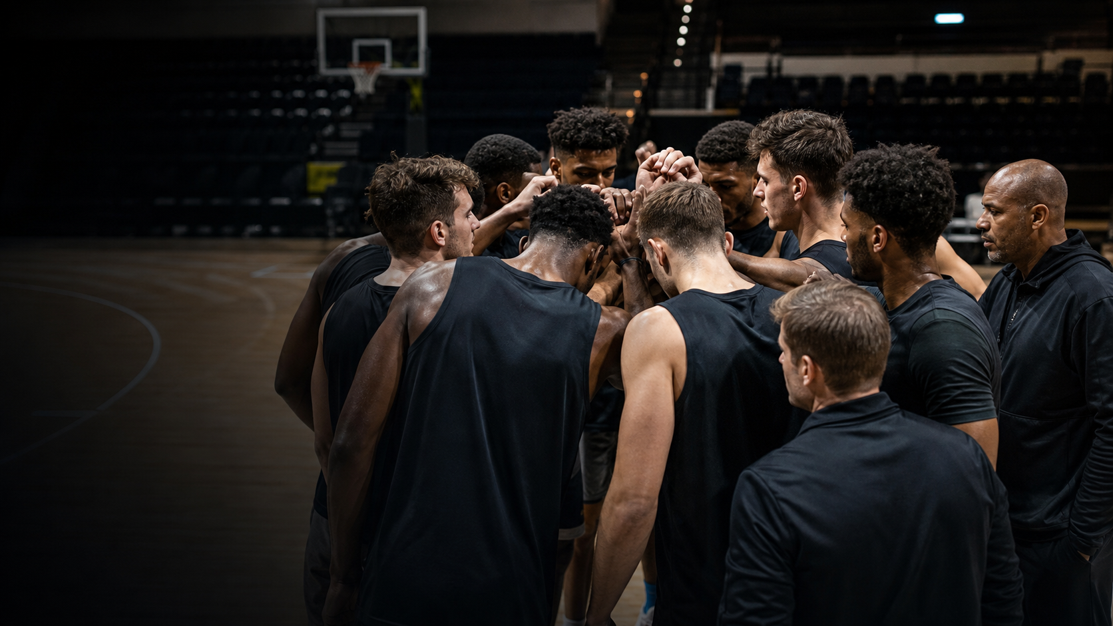
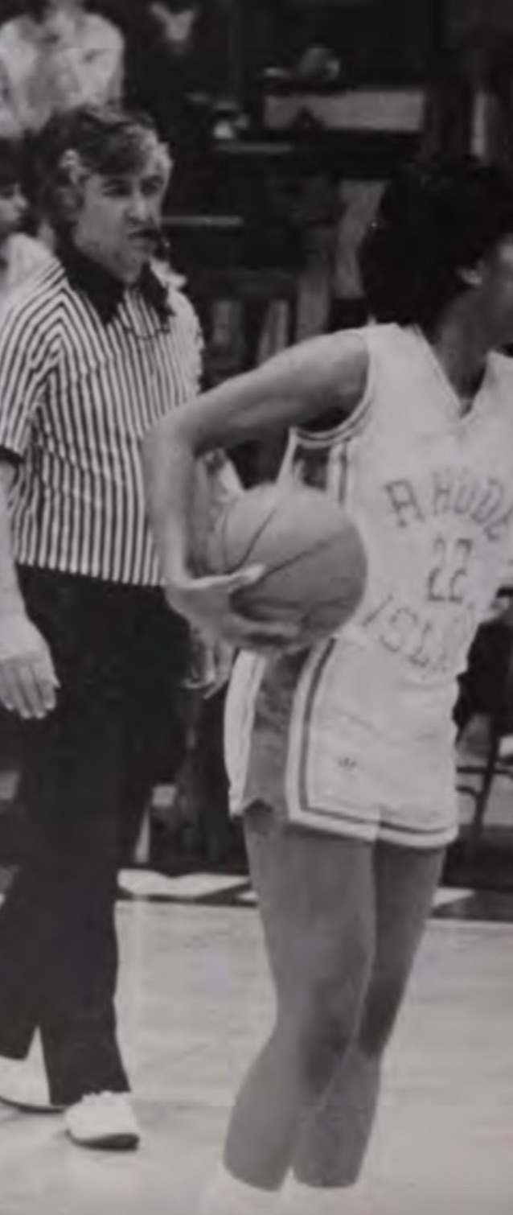
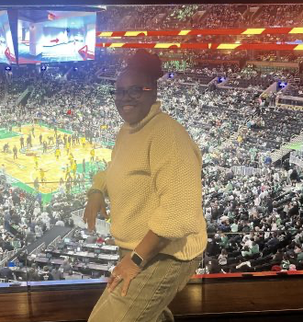
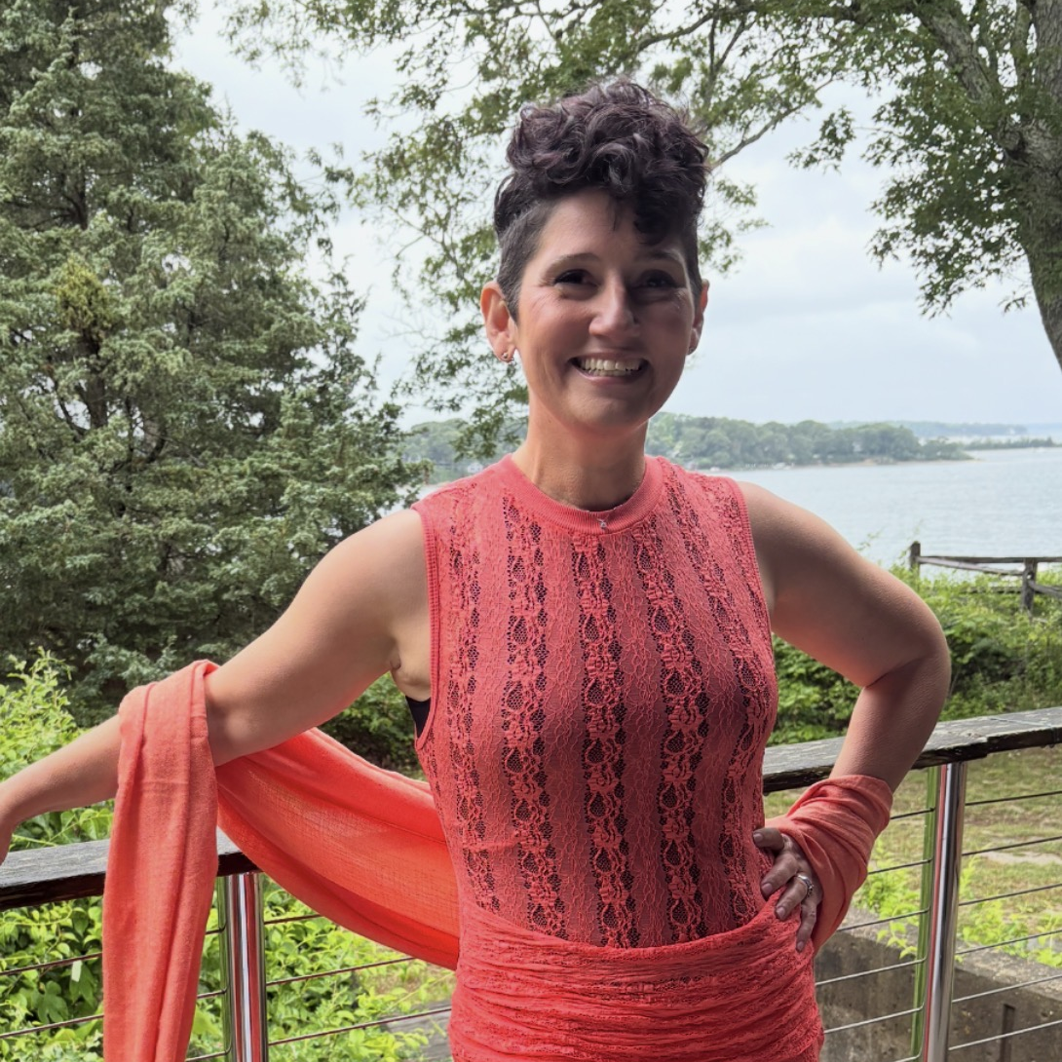
CLINICAL + GTM PATHWAY
AuntEDNA.ai brings clinical care + an
active NCAA pipeline.
PulseCheck owns detection, scoring and routing. AuntEDNA adds clinical escalation, research validation and institutional access.
Dr. Tracey Hathaway
THE SHARED ADVANTAGE
CO-FOUNDER • ATHLETICS ACCESS
6 YEARS
building with the NCAA
ATHLETE → COACH → ATHLETIC DIRECTOR
Jelanna Salas Olivera
Together they co-founded athLEDA, now the Alfreeda Goff Foundation—developing athletes for life after sport through NCAA-backed programming.
Former D1 women’s basketball player, University of Rhode Island
CO-FOUNDER • ENTERPRISE EXECUTION
Two decades across coaching and collegiate athletics administration
BIG FOUR → BIG PHARMA → DIGITAL HEALTH
Former women’s basketball coach, athletic director and NCAA committee contributor
ACTIVE RELATIONSHIPS → PILOT PIPELINE
Transformation consulting across EY and KPMG
Hampton • UMES • Claflin • Clark Atlanta
Big Pharma experience at Eli Lilly
Deep, active relationships across college athletics.
Their nonprofit trust, athletics network and campus access feed directly into PulseCheck’s GTM motion.
Former cheerleader with enterprise, product and healthcare fluency
RESEARCH + COMMERCIALIZATION LEVERAGE
$275K
NSF Phase I
funded research
80%
adherence evidence
across 1,000+ athletes
$1.4M
Phase II proposal preparation
PulseCheck included for commercialization, pilot subsidy + integrations
Notes:
AuntEDNA.ai contributes three forms of leverage to PulseCheck: clinical escalation infrastructure, evidence-building capacity, and an established institutional channel into college athletics. Tracey should lead the verbal story: she brings lived athlete experience plus two decades of coaching and athletics administration. Jelanna complements that with Big Four transformation and Big Pharma execution. Together, their Alfreeda Goff Foundation relationship with the NCAA creates direct access and a credible pilot pipeline.
Public sources describe the Alfreeda Goff Foundation as formerly athLEDA and state that the NCAA partnership began in 2020. The six-year label reflects the current 2026 deck date. Public AuntEDNA materials describe the NSF Phase I award as $275K. The 80% adherence figure and PulseCheck's planned inclusion in a $1.4M Phase II proposal are company-provided figures and should be presented as evidence/preparation, not as an awarded Phase II grant.
[Sources]
- https://www.uri.edu/magazine/issues/spring-2023/ensuring-student-athlete-success-on-and-beyond-the-field/
- https://www.ncaa.org/news/2022/11/22/media-center-arise-program-opening-new-doors-ideas-for-hbcu-student-athletes.aspx
- https://rwuhawks.com/sports/womens-basketball/roster/coaches/tracey-hathaway/36
- https://auntedna.ai/about-us-2/
- https://hamptonpirates.com/news/2025/9/11/general-hampton-university-athletics-joins-with-athleda-org-for-student-athlete-programming.aspx
- https://www.linkedin.com/in/jelanna-salas-olivera-she-ella-316a0521
- https://www.linkedin.com/posts/auntedna-ai_mentalhealthtech-responsibleai-collegeathletes-activity-7336391390999781377-RZ0e
- User-provided information: 80% adherence result; Jelanna's former cheerleading background; PulseCheck's planned Phase II participation and $1.4M proposal target.
- /Users/tremainegrant/Documents/GitHub/QuickLifts-Web/public/investor/july-2026/hero-basketball-huddle.png
- /Users/tremainegrant/Documents/GitHub/QuickLifts-Web/public/dr-tracey-basketball.jpeg
- /Users/tremainegrant/Documents/GitHub/QuickLifts-Web/public/dr-tracey.png
- /Users/tremainegrant/Documents/GitHub/QuickLifts-Web/public/jelanna.jpg
[/Sources]

