Slide 1
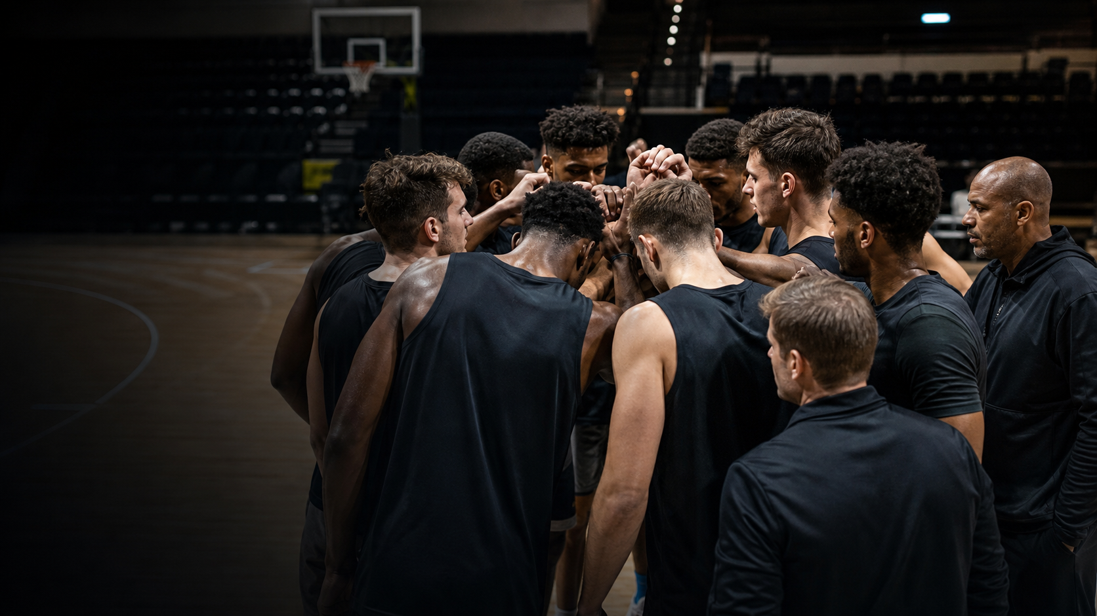
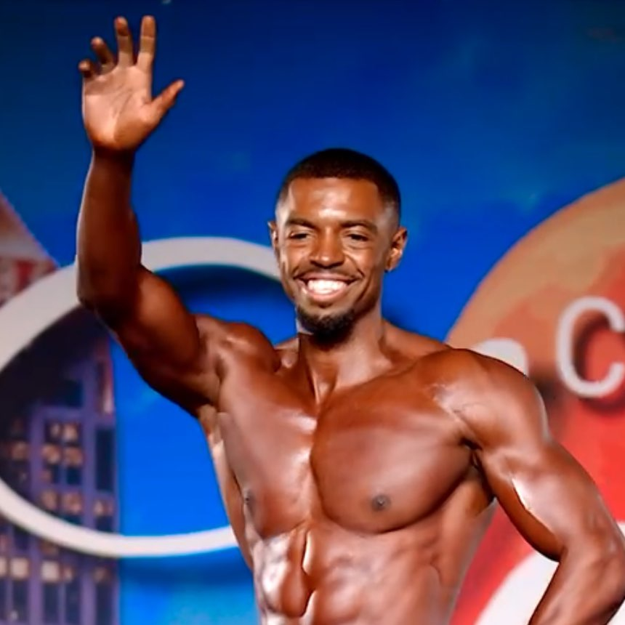
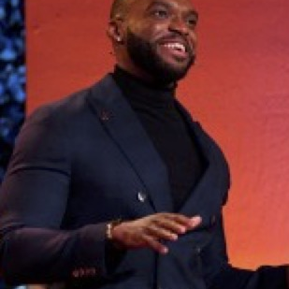

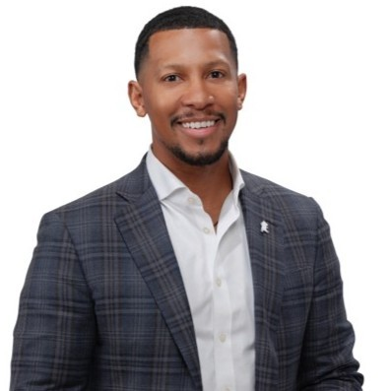
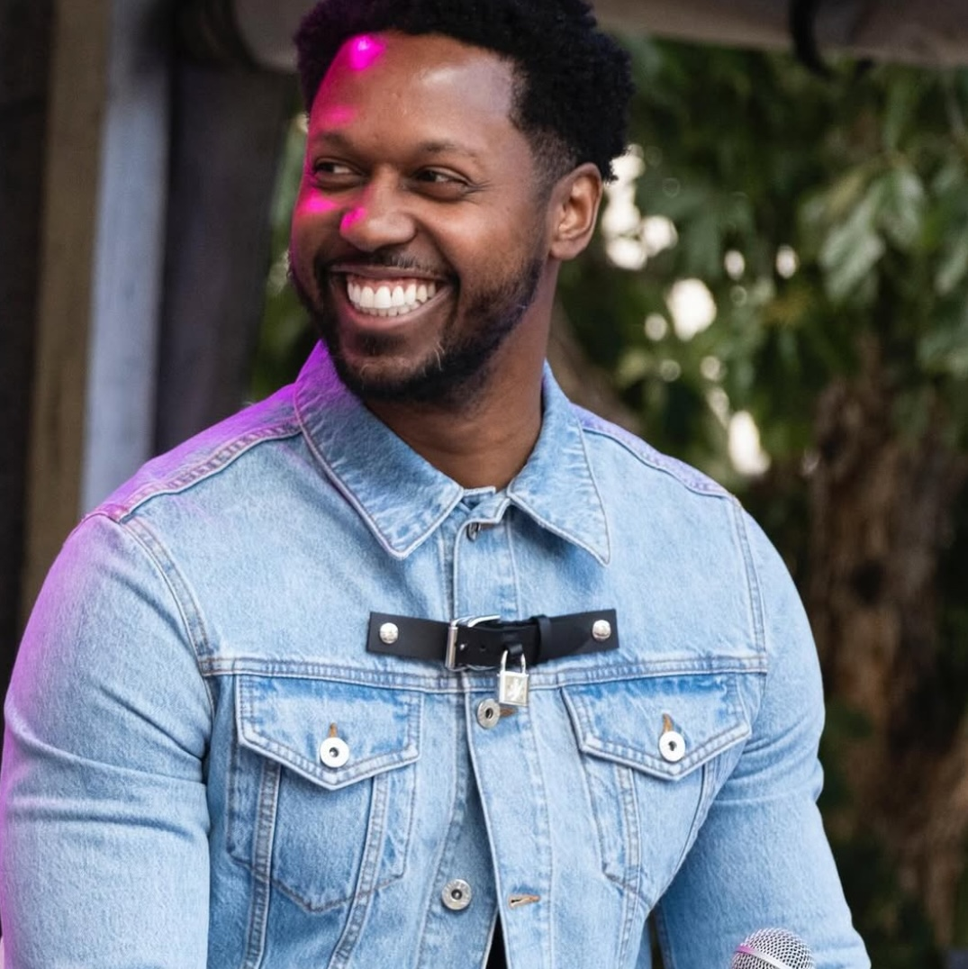
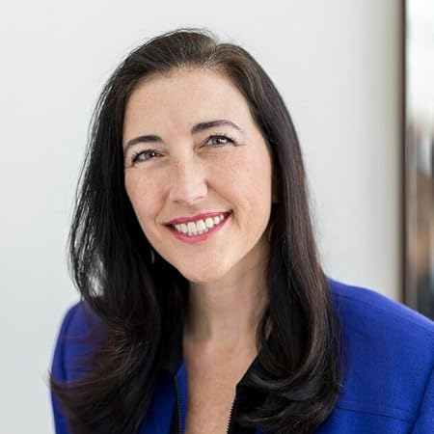
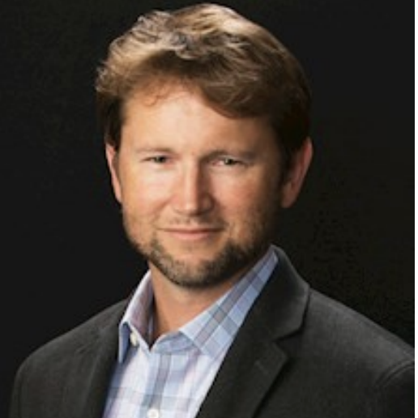
CORE TEAM
Operators who know
software, athletes,
clinical trust, and enterprise sales.
Tremaine Grant
Bobby Nweke
Lola Oluwaladun
Will Watkins
FOUNDER & CEO
CHIEF OF STAFF
HEAD OF DESIGN
HEAD OF SALES
Full-stack engineer and AI builder with a decade in clinical research. Former D1 athlete at FSU.
10 years in human performance across training, athletics, and education.
Owns product experience and athlete-facing UX across Pulse.
Salesforce Global Director of Sales. Former professional player in the Boston Red Sox organization.
ADVISORS
Marques Zak
Valerie Alexander
Erik Edwards
CMO, ACC
Entrepreneur in Residence • Former IPO Attorney
Partner, Cooley
Notes:
Will Watkins joins Pulse as Head of Sales. Public sources identify Watkins as Global Director of Sales at Salesforce. The baseball background and Boston Red Sox organization experience are based on company-provided biographical information.
[Sources]
- User-provided portrait: /Users/tremainegrant/Downloads/1668718172755.jpeg
- User-provided biographical information for Will Watkins.
- https://www.linkedin.com/in/will-watkins-78238127
- https://myemail.constantcontact.com/CAU-Alumni-Newsletter-Issue-7-April-2025.html?aid=2YpslLU8Fck&soid=1139227680712
- /Users/tremainegrant/Documents/GitHub/QuickLifts-Web/public/investor/july-2026/hero-basketball-huddle.png
- /Users/tremainegrant/Documents/GitHub/QuickLifts-Web/public/tre.jpg
- /Users/tremainegrant/Documents/GitHub/QuickLifts-Web/public/bobbyAdvisor.jpg
- /Users/tremainegrant/Documents/GitHub/QuickLifts-Web/public/lola.jpg
- /Users/tremainegrant/Documents/GitHub/QuickLifts-Web/public/zak.jpg
- /Users/tremainegrant/Documents/GitHub/QuickLifts-Web/public/Val.jpg
- /Users/tremainegrant/Documents/GitHub/QuickLifts-Web/public/ErikEdwards.png
[/Sources]

