Slide 1
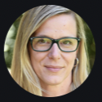
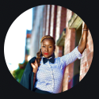
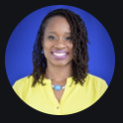
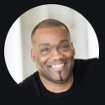
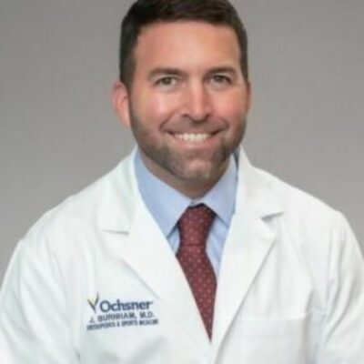
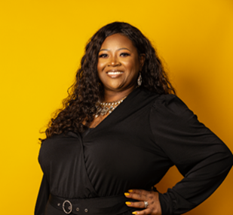
COUNCIL OPERATORS
The council brings reach, implementation, and clinical depth.
Operators connect communications, youth sport, technology, sports medicine, campus care, and HBCU networks to accelerate adoption.
Jill Geer
Amber Camp
Talia Mark
COMMUNICATIONS + OLYMPIC MOVEMENT
YOUTH SPORT + FUNDRAISING
SPORT MARKETING + GOVERNING BODIES
USA Gymnastics Chief Communications & Marketing Officer; nearly 20 years across the Olympic movement.
Youth basketball coach with school and sports fundraising experience at Snap! Raise.
Former USA Swimming multicultural marketing director and NASCAR diversity affairs manager.
Tram Holloway
Dr. Jeremy Burnham
Dr. Malkia Johnson
PERFORMANCE TECHNOLOGY + CLINICS
SPORTS MEDICINE + RESEARCH
CAMPUS MENTAL HEALTH + CLINICAL WORKFLOW
HyperCharge Health CTO with nearly 30 years in human performance, wellness technology, and clinic implementation.
Ochsner Baton Rouge Medical Director of Sports Medicine; dual board-certified surgeon, former LSU football player, and clinical-trials investigator.
UMES Counseling Services Director and East Coast lead for AuntEDNA’s Clinical Directors Council.
ADOPTION REQUIRES MORE THAN PRODUCT: STORY • TRUST • CLINICAL WORKFLOW • INSTITUTIONAL ACCESS
PULSE INTELLIGENCE LABS / Q2 2026 ADVISORY BOARD REVIEW
Sources: Ochsner Health; UMES; HyperCharge Health; USA Gymnastics; council-provided backgrounds
12
Notes:
The council’s operating reach now includes sports medicine and campus clinical workflow. Dr. Jeremy Burnham brings orthopedic sports medicine leadership, research and athlete perspective. Dr. Malkia Johnson brings UMES campus counseling leadership and East Coast clinical-director coordination through AuntEDNA.
Dr. Burnham is not presented as LSU’s current head team physician. Public sources support that he is a former LSU football player, Ochsner Baton Rouge Medical Director of Sports Medicine, a dual board-certified orthopedic surgeon, and a clinical-trials investigator. Dr. Johnson’s UMES title is Director of Counseling Services; the East Coast Clinical Directors Council role comes from council/company-provided materials.
[Sources]
- https://www.ochsner.org/doctors/jeremy-burnham/
- https://www.ochsner.org/services/sports-medicine-baton-rouge/
- https://lsusports.net/sports/fb/roster/player/jeremy-burnham/
- https://www.sportsmed.org/research/sports-medicine-research-grants/playmaker-grant-lab
- https://wwwcp.umes.edu/student/emse-leadership-team/
- /Users/tremainegrant/Documents/GitHub/QuickLifts-Web/src/pages/PIL/TheAthleticMindCouncil.tsx
- https://www.hyperchargehealth.com/tram-holloway
- User-provided slide screenshot for Jill Geer, Amber Camp, Talia Mark and Tram Holloway portraits and existing biography copy.
- https://www.sportsmed.org/uploads/main/images/general/06-Headshots/_square/Burnham-Jeremy.jpg
- /Users/tremainegrant/Documents/GitHub/QuickLifts-Web/public/malkia-advisor.png
[/Sources]

