Slide 1
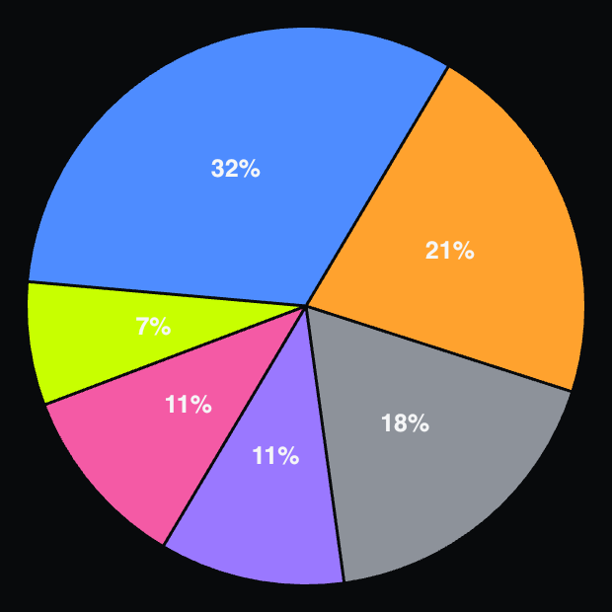
● THE ASK
PRE-SEED • $10M PRE-MONEY
Raising $1.4M to validate the model and reach $1M ARR.
This round funds the product, evidence and GTM engine required to establish a repeatable college-athletics beachhead.
USE OF FUNDS
MILESTONES THIS ROUND UNLOCKS
Engineering
$450K · 32%
01
Validate the product
Deploy an institution-ready platform across three paid pilots with repeatable onboarding, reporting and implementation.
GTM + marketing
$300K · 21%
Operating runway
$250K · 18%
02
Prove measurable outcomes
Establish institutional case studies and credible athlete-engagement benchmarks.
Partnerships
$150K · 11%
Performance science
$150K · 11%
03
Reach $1.05M ARR
Convert 14 athletic departments and approximately 3,500 athletes into paid contracts.
Product R&D
$100K · 7%
04
Build a $5M qualified pipeline
$1.4M TOTAL
Create repeatable acquisition through the Council, industry conferences and elite youth events.
NEXT-ROUND TRIGGER • $1M+ ARR • VALIDATED OUTCOMES • REPEATABLE GTM • $5M QUALIFIED PIPELINE
The next round funds scale—not validation.
Notes:
[Sources]
- User-provided Pulse raise terms and use-of-funds allocations totaling $1.4M.
- User-approved operating assumptions from the revenue roadmap: 14 athletic departments, 250 athletes per department, $300 per athlete annually, $1.05M ARR, and a $5M qualified pipeline target.
[/Sources]

