Slide 1
JAVASCRIPT CHARTING LIBRARIES

Slide 2
hola!
Grupo T4
Urbano José Villanueva Rodríguez
Martina Andrea Palomino Berrocal
Alberto Cabrera Plata
José Daniel Navarro Sierra
Fernando García Fernández

Slide 3
4.Fuentes de información
Cursos no gratuitos

Slide 4

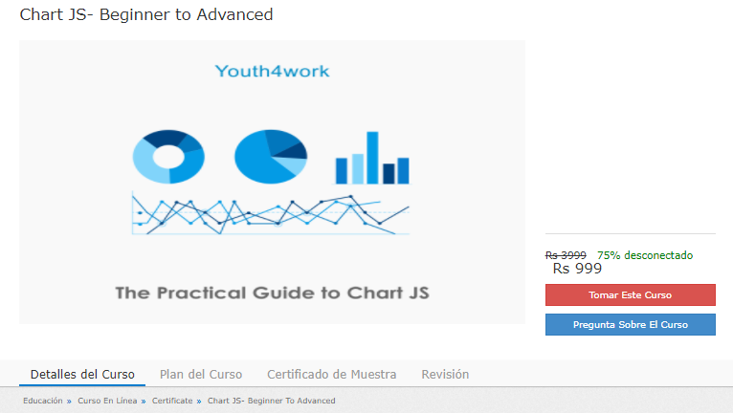
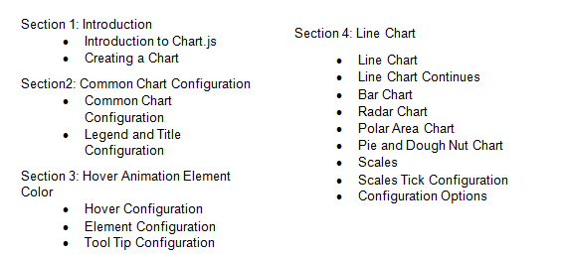
4.2 cursos no gratuitos sobre chartjs
https://www.ed.youth4work.com/es/Course/1628-Chart-JS-Beginner-to-Advanced-

Slide 5

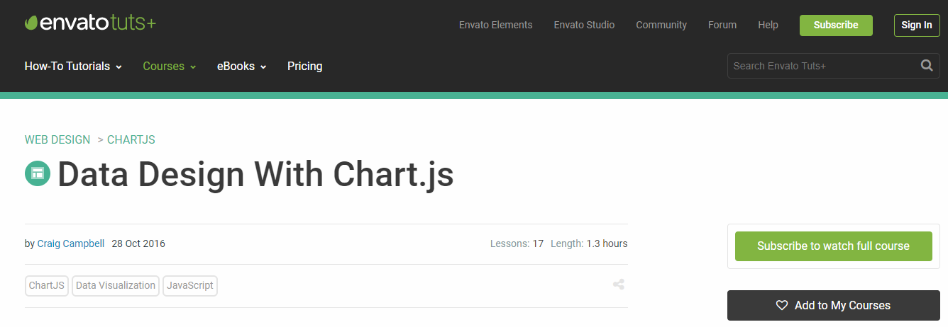
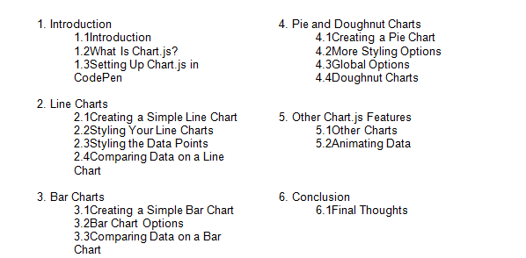
4.2 cursos no gratuitos sobre chartjs
https://webdesign.tutsplus.com/courses/data-design-with-chartjs?ec_promo=teaser_post_long

Slide 6
5.Fuentes de información
Cursos gratuitos

Slide 7

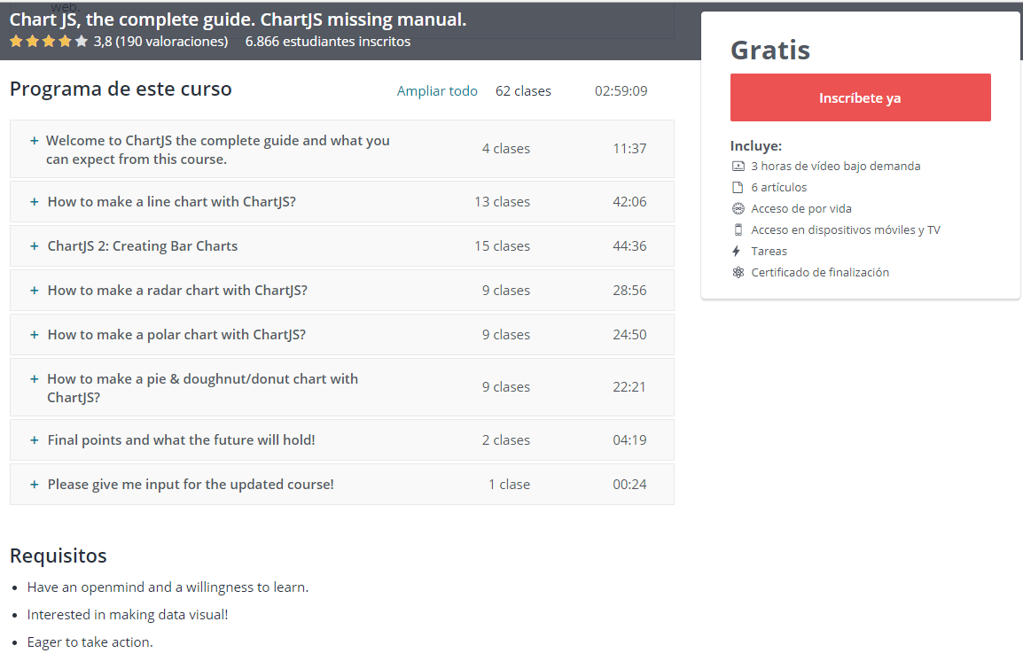
5.2 cursos gratuitos sobre chartjs
https://www.udemy.com/chart-js/

Slide 8

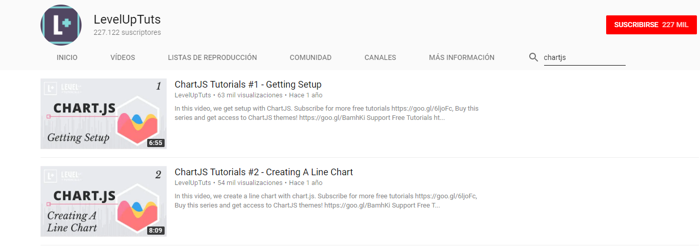
5.2 cursos gratuitos sobre chartjs
ChartJS Tutorials Series Introduction
ChartJS Tutorials #1 - Getting Setup
ChartJS Tutorials #2 - Creating A Line Chart
ChartJS Tutorials #3 - Diving Into The Data Object
ChartJS Tutorials #4 - Chart Options
ChartJS Tutorials #5 - Global Configuration Options
ChartJS Tutorials #6 - Writing A Bar Chart From Scratch
ChartJS Tutorials #7 - Radar Charts in ChartJS
ChartJS Tutorials #8 - Polar Area Charts In ChartJS
ChartJS Tutorials #9 - Pie & Doughnut Charts
https://www.youtube.com/user/LevelUpTuts/search?query=chartjs

Slide 9
Muchas Gracias
¿Alguna Pregunta?

