Slide 1
SIEVE (NSDI '24): our replication and an improvement
Kevin Arthur and Urcyle Umurangamirwa | Paper: Zhang, Yang, Yue, Vigfusson, Rashmi, NSDI 2024
What the paper claims
How SIEVE evicts
Our project
A cache eviction algorithm simpler than LRU: one FIFO queue, one hand, one visited bit per object.
Fewer than 20 lines of code changed on average in five production cache libraries.
Lower miss ratio than 9 state-of-the-art algorithms on more than 45% of 1,559 traces (next best: 15%).
Hits need no locking: twice the throughput of an optimized 16-thread LRU.
head (newest)
tail (oldest)
1
Replicate
the results with the authors' simulator, in two independent pipelines
A
B
C
D
E
F
G
2
Explain
every difference from the paper
hand
visited bit = 1
visited bit = 0
New objects enter at the head. The hand scans from the tail: a visited object keeps its place and loses its bit; the first unvisited object is evicted.
3
Improve
SIEVE for tiny caches: SIEVE-G
Where we are
26 of 26
SIEVE points in Fig 4 within 0.002 of the paper (our runs)
68 of 68
Wiki and Tencent cells equal the other pipeline's (0.0005)
13 of 13
public Fig 4 traces run; plus 48 of 54 Twitter clusters
PASS
SIEVE-G, pre-registered test on 29 held-out clusters
Notes:
[Presenter A, about 45 s] SIEVE, from NSDI 2024, is a cache eviction algorithm simpler than LRU: one FIFO queue, one hand, and one visited bit per object. New objects enter at the head; the hand scans from the tail, keeps visited objects in place after clearing their bit, and evicts the first unvisited one. The paper claims fewer than 20 lines of change in five production libraries, a lower miss ratio than nine state-of-the-art algorithms on more than 45 percent of 1,559 traces, and twice the throughput of an optimized 16-thread LRU. Our project has three parts: replicate the results with the authors' simulator in two pipelines, explain every difference, and improve SIEVE for tiny caches. Since the last presentation we ran the remaining public traces of Figure 4, including Tencent Photo: all 13 now run, and SIEVE is within 0.002 of the paper's dot on all 26 points. The new Wiki and Tencent cells equal the other pipeline's to 0.0005 on 68 of 68 deterministic cells. We ran 48 of the 54 Twitter clusters, and our improvement, SIEVE-G, passes a pre-registered test on 29 held-out clusters.

Slide 2
28 of 36 paper items run: 11 replicated, 15 partial, 2 adapted
Fig 1
P
Fig 2
R
Fig 3
P
P
Fig 4
R
R
Fig 5
P
P
Fig 6
A
A
Mean reduction, 7 algorithms
SIEVE vs FIFO-Reinsertion
Panels c, f. Twitter box plots
Panels a, b. Per-trace reduction
Panels a, b. Best algorithm per dataset
Panels a, b. Throughput, own harness
Fig 7
R
Fig 8
R
P
Fig 9
R
P
P
Fig 10
R
R
Fig 11
R
R
Fig 12
P
P
P
Panels a. Sifting illustration
Panels a, b. Zipf: miss, popular ratio
Panels a, b, c. Skew sweep; hand
Panels a, b. Workload change
Panels a, b. Instructions per request
Panels a, b, c. LRU replaced by SIEVE
Fig 13
P
P
Table 1
R
Table 2
P
Table 3
P
R
Replicated (11)
Panels a, b. Byte miss ratio, 3 traces
Dataset inventory
Lines changed, 4 libraries
Lines of code, metadata
P
Partial / subset / scaled (15)
A
Adaptation, own harness (2)
Not run (8 panels), and why
Fig 3 a, b, d, e
CDN1 and CDN2 are 1,492 proprietary traces (96% of the paper's 1,559) and are not released.
Fig 7 b, c
The paper's two production traces are unnamed (the artifact gives only "week-long Trace 1 / 2"). We show two public traces instead (in the repository).
Fig 14 a, b
Needs LRB and its Wiki2018/2019 traces: found in the author archive but over our storage budget, and LRB (training, features) was not built. Our Wiki trace is a different workload, so we do not substitute it.
Gaps inside items we ran
Twitter: 48 of 54 clusters. Fig 12: no S3-FIFO. CACHEUS on Wiki 2019u: memory check. Tencent: only 4 of 11 algorithms fit at full size and 10% cache; the rest use the paper's 10% sample.
Notes:
[Presenter A, about 50 s] The paper has 36 graph and table items. We ran 28: 11 replicated, 15 partial, on a subset or scaled, and 2 adapted to our own harness, which is Figure 6. Green is replicated, amber partial, blue an adaptation. Eight panels we did not run, each for a concrete reason. Figure 3 a, b, d and e need the proprietary CDN1 and CDN2 traces, 96 percent of the paper's traces. Figure 7 b and c use two production traces the paper does not name, so we use two public traces. Figure 14 needs LRB and its Wiki traces, which exceed our storage budget, and we do not substitute our own Wiki trace because it is a different workload. The last card lists the gaps inside items we did run: 48 of the 54 Twitter clusters, no S3-FIFO in Figure 12, CACHEUS on Wiki 2019u, and for Tencent Photo only a few algorithms fit in memory at full size and the 10 percent cache, so the rest use the 10 percent sample that the paper also used.

Slide 3
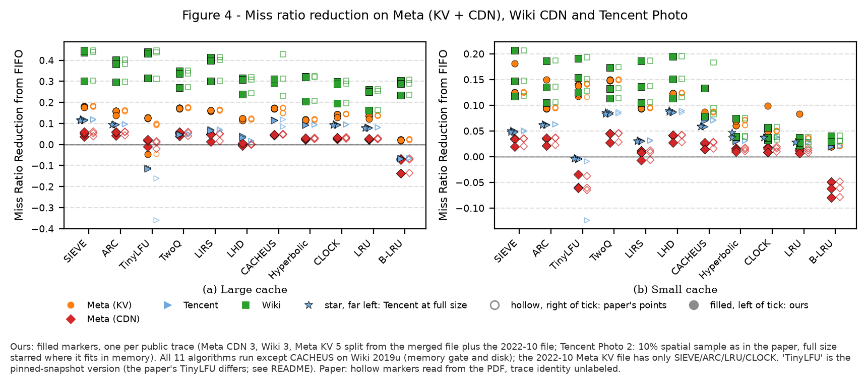
Fig 4: SIEVE matches the paper on all 26 points, Tencent included
Reading the figure: filled markers are our runs, hollow ones the paper's dots; each marker is one trace (Meta CDN 3, Meta KV 5, Wiki 3, Tencent 2). Closer pairs mean a better match.
SIEVE: within 0.002 of the paper's dot on all 26 points. The other pipeline, with a finer reading of the paper's plot, is within 0.0001.
Tencent, 10% sample (as in the paper): all 36 deterministic cells equal the other pipeline's to 0.0005. Full size changes the answer by a median of 0.0001 over 28 cells; Hyperbolic and CACHEUS move more (they are randomized).
Largest gaps: TinyLFU (the pinned simulator has a later fix and is sensitive to 2 objects of cache size) and CACHEUS (seeded from the clock).
26 of 26
SIEVE points within 0.002 of the paper (our runs)
36 of 36
Tencent sample cells equal the other pipeline (0.0005)
0.0001
median gap, full trace vs 10% sample (28 cells)
Notes:
[Presenter A, about 50 s] Figure 4 is our strongest validation. Filled markers are our runs and hollow ones the paper's dots, one marker per trace. We have now run all 13 public traces, including the two Tencent Photo traces, which are 35 to 37 gigabytes each. SIEVE is within 0.002 of the paper's dot on all 26 points; the other pipeline, which reads the paper's plot more finely, is within 0.0001. On the Tencent 10 percent sample, which the paper also used, all 36 deterministic cells equal the other pipeline's to 0.0005. We also ran Tencent at full size: the answer moves by a median of 0.0001, so the sample is a fair proxy; Hyperbolic and CACHEUS are randomized and move more. The chart on the right shows, for the other pipeline, the largest gap to the paper per algorithm on a log scale: nine of eleven are within 0.006. The outliers are TinyLFU, because the pinned simulator snapshot has a later bug fix and is sensitive to two objects of cache size, and CACHEUS, which seeds its random generator from the clock.

Slide 4
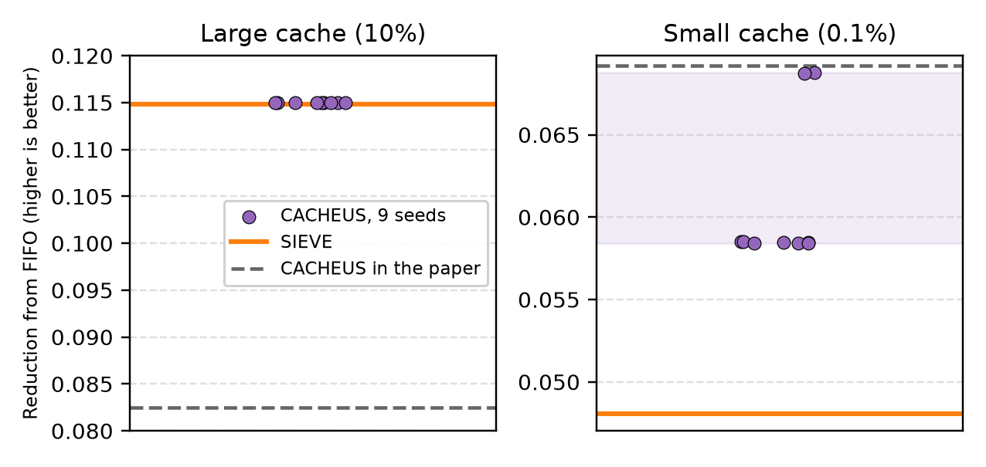
Fig 5: the Tencent difference is not a random seed
OURS vs PAPER | Figure 5: share of traces where SIEVE is the best algorithm
OURS | CACHEUS on Tencent, 9 random seeds
Our guess, written down before the runs: the flip is a lucky CACHEUS draw. It would count only if the 9-seed range were wider than 0.01 and covered the paper's 0.0825.
Result: not supported. At the 10% cache CACHEUS gives 0.1150 on every seed (SIEVE 0.1148); the paper's 0.0825 is far outside.
The seed does work: at the small cache the same seeds spread over 0.0584 to 0.0688.
So: the flip reproduces exactly in both pipelines. Why the paper's CACHEUS is lower is open.
Match: SIEVE's share of wins equals the paper's on 7 of 8 public bars (Wiki, Meta CDN, Meta KV, Tencent; two cache sizes).
Difference: Tencent, large cache: SIEVE wins one trace, CACHEUS the other by 0.0002 (0.1150 vs 0.1148); the paper has SIEVE on both.
Twitter: ours 0.16 vs the paper's 0.30 at the large cache, from sampled clusters, not the full set.
Notes:
[Presenter A, about 50 s] This slide is about the one place where our Figure 5 disagrees with the paper: Tencent Photo at the large cache. On the left, the paper's bars are faded on top and ours are below. SIEVE's share of wins equals the paper's on seven of the eight public bars; the exception is Tencent at the large cache, where CACHEUS beats SIEVE by 0.0002 on one of the two traces. Our first guess was that this is a lucky draw of CACHEUS's random generator, which the simulator seeds from the clock. We wrote the test down before running it: the guess counts only if CACHEUS's range over nine seeds is wider than 0.01 and covers the paper's value of 0.0825. The right chart is the result. At the 10 percent cache, CACHEUS gives 0.1150 on every one of the nine seeds, SIEVE gives 0.1148, and the paper's 0.0825 is far outside. So the guess is not supported. The seed does work: at the small cache the same seeds spread over 0.058 to 0.069. The flip is deterministic in both pipelines, and we do not yet know why the paper's CACHEUS is lower.

Slide 5
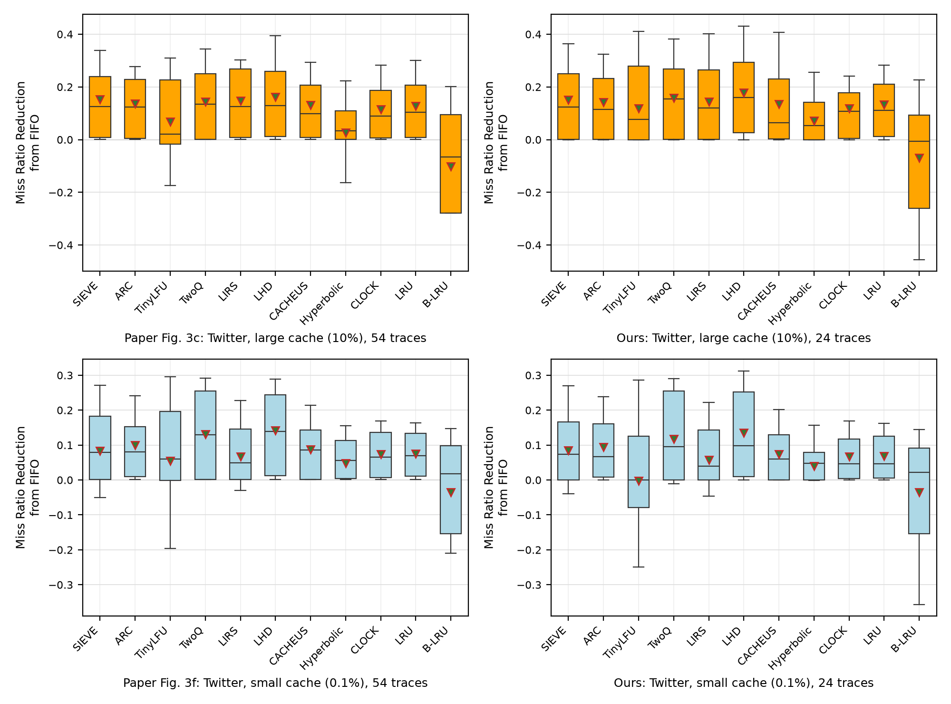
Twitter (Fig 3c, f): same ranking with 47 to 48 of 54 clusters
Rank correlation with the paper: 0.991 (10%) and 0.982 (0.1%); SIEVE mean 0.160 and 0.093 vs the paper's 0.153 and 0.083.
On clusters both pipelines ran (3, 7, 8, 10, 13, 21) they agree within 0.0014, except SIEVE on 1%-sampled cluster 13 (0.0052).
On Twitter SIEVE is competitive, not best: LHD is above it in the paper too.
Left: paper (54 traces). Right: 24 scaled-down clusters from one pipeline.
Notes:
[Presenter A, about 40 s] Figure 3 panels c and f are the Twitter results; a, b, d and e are the proprietary CDN panels, which we leave out. On the left is the paper next to one pipeline's 24 scaled-down clusters; on the right, the mean reduction for all 11 algorithms against the paper's, using the combined set of 47 clusters at the large cache and 48 at the small cache. Rank correlation with the paper is 0.99 and 0.98, and SIEVE's mean is 0.160 and 0.093 against 0.153 and 0.083. Earlier, with only our 7 full-size clusters, SIEVE's small-cache mean was about zero; that subset was not representative. Where both pipelines ran the same clusters they agree to 0.0014. SIEVE is not the best on Twitter, in the paper or here: LHD is above it.

Slide 6
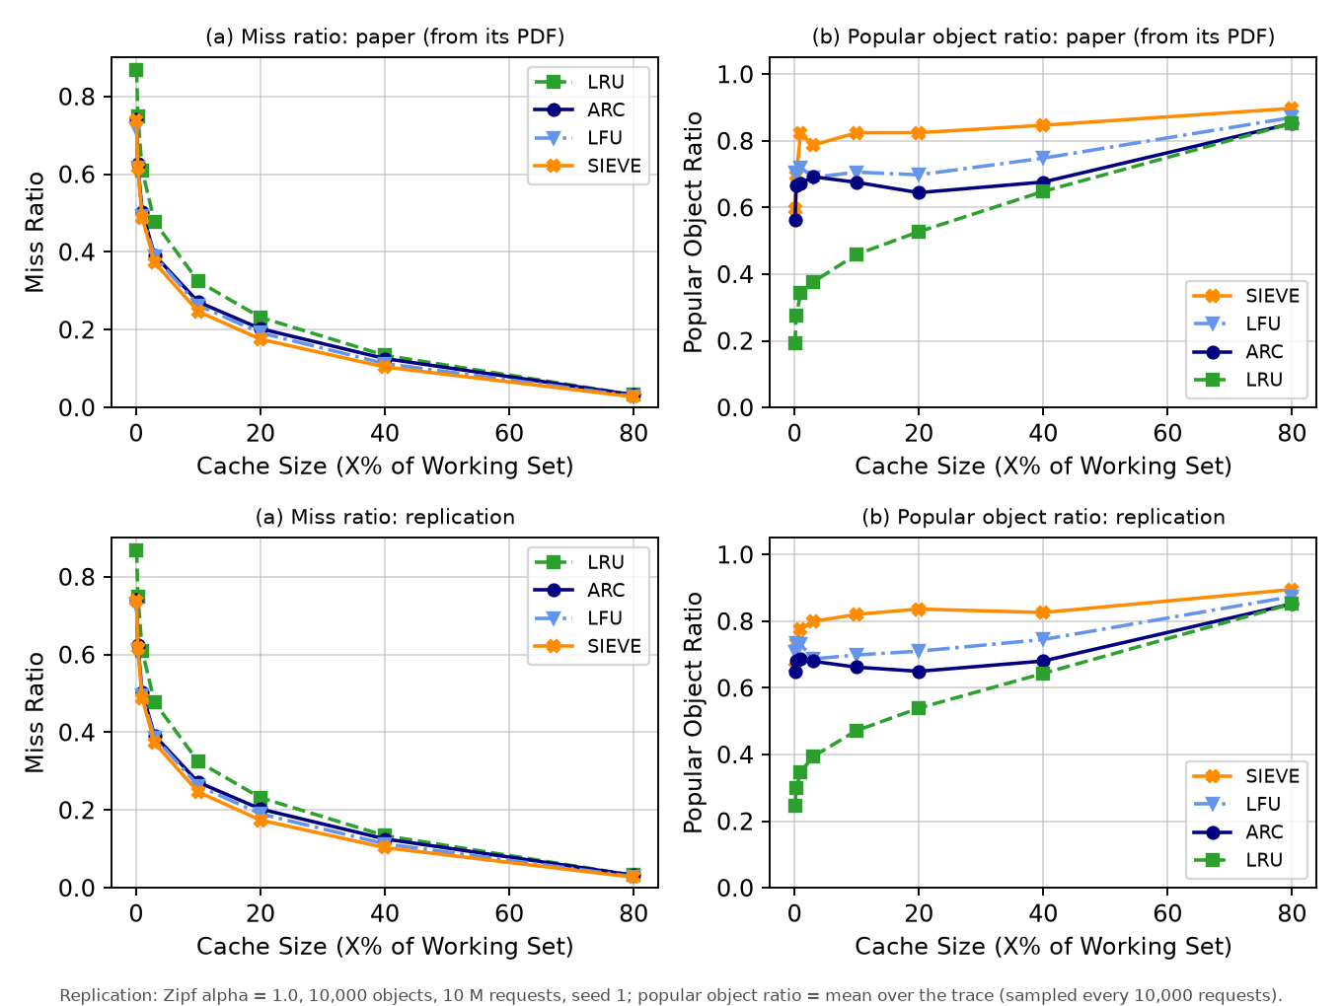
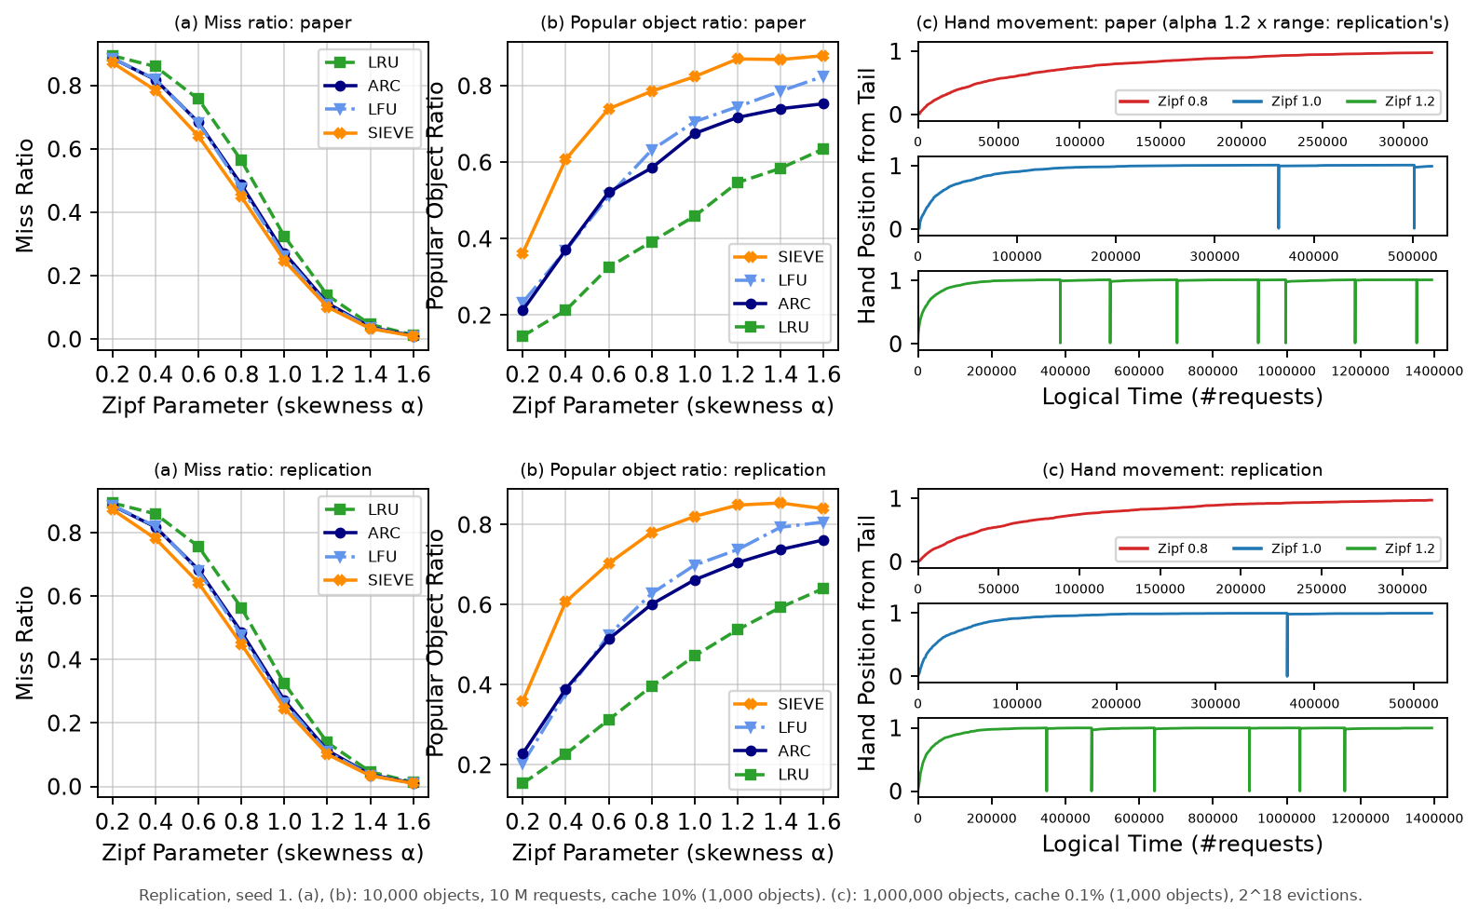
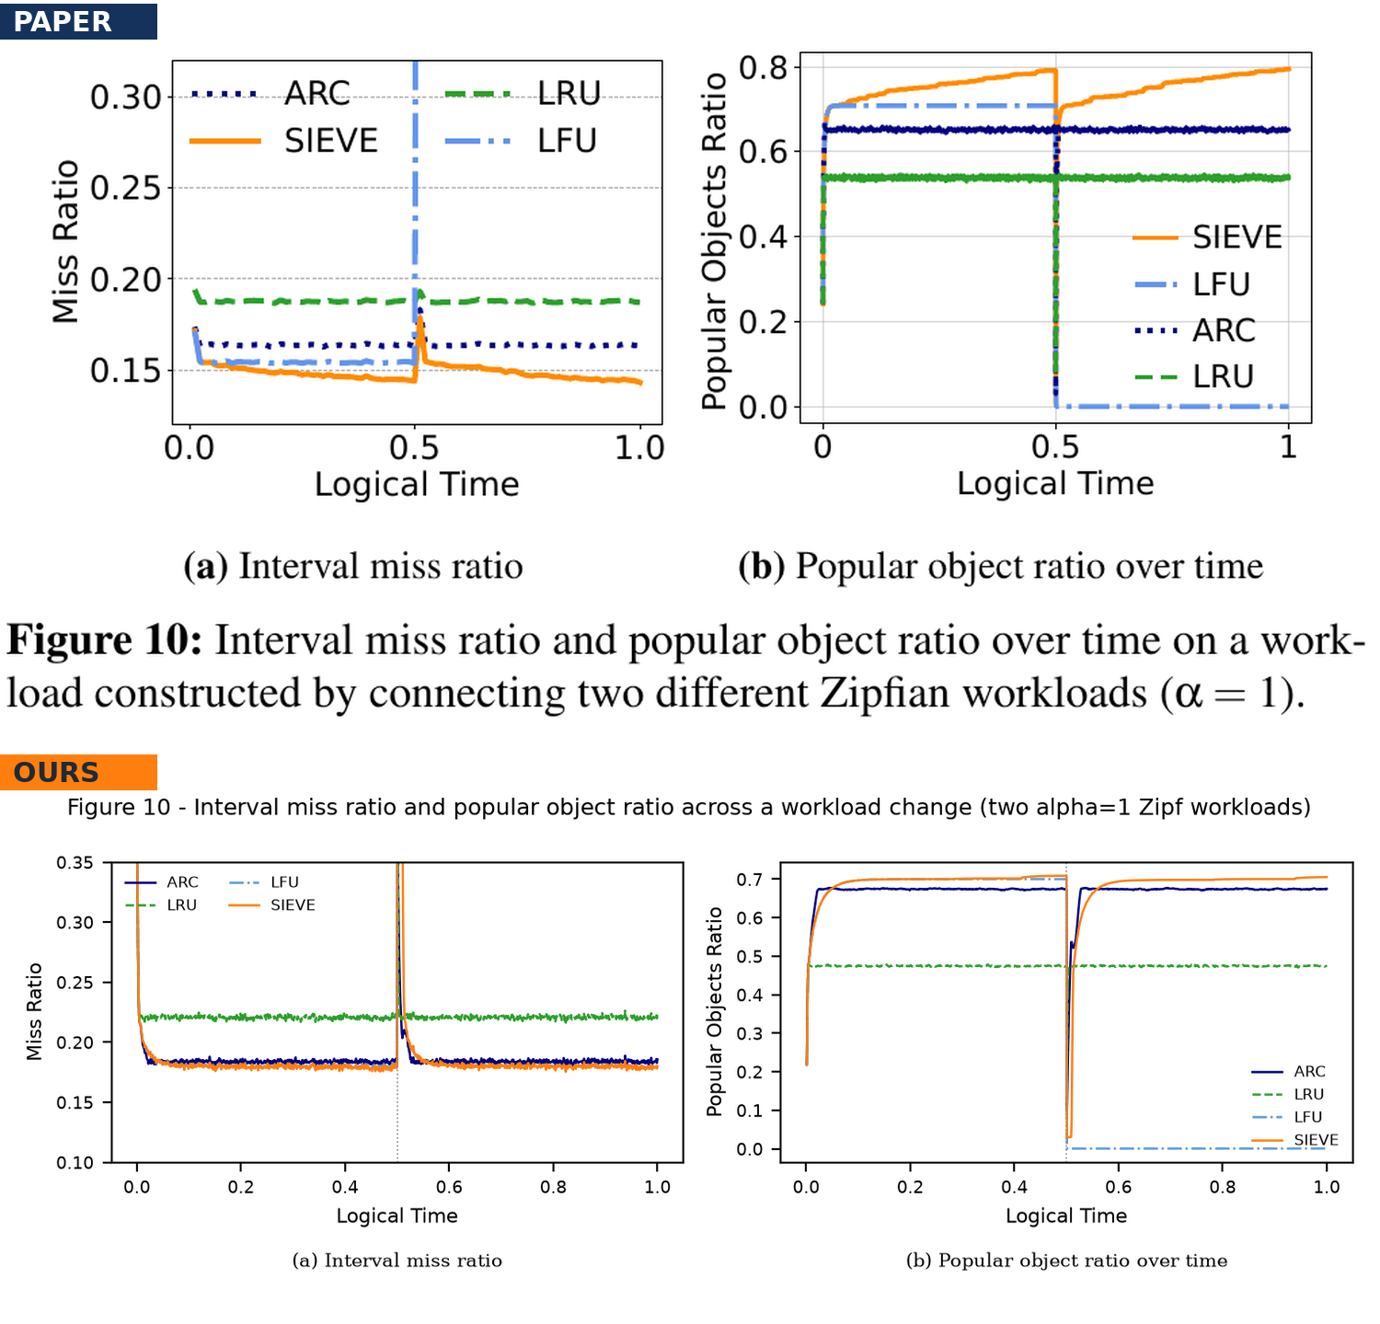
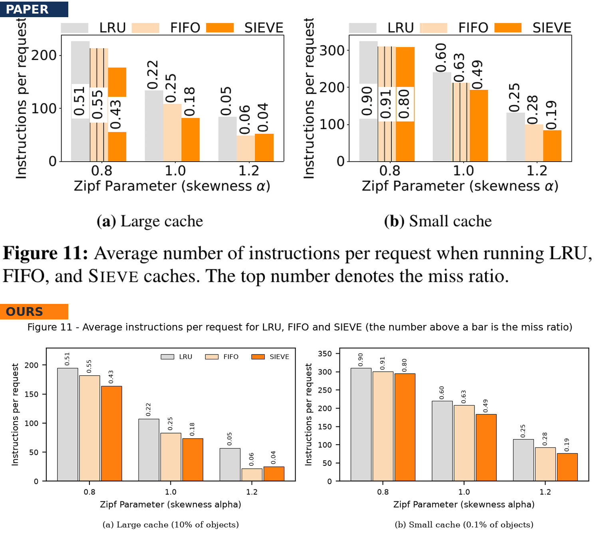
Zipf workloads (Figs 8 to 11): miss ratios within 0.003 of the paper
Fig 8
R
P
Fig 9
R
P
P
LRU, ARC, SIEVE within 0.0014 at all 8 sizes; the re-run agrees within 0.0008 (24 of 24 points). The paper gives no workload size: 10,000 objects reproduces its LRU 0.87 (our first 1 M gave 0.60). (b) ordering at 7 of 8 sizes, about 0.02 off.
(a) within 0.002, SIEVE lowest at every skew. (b) ordering holds, mean gap 0.011. (c) hand wraps 0 / 1-2 / 5-7 vs the paper's 0 / 2 / 7; that setup was found by search, so it shows reproducibility, not prediction.
Fig 10
R
R
Fig 11
R
R
LFU never recovers; SIEVE's dip exceeds LRU's and ARC's, then recovers. The bump scales with 1 / plotting interval: at 500,000 requests it is +0.033 (LRU +0.003, ARC +0.006), as in the paper. The 3,000-object cache is fitted.
All 18 printed miss ratios equal ours at two decimals, with 1 M objects and 100 M requests (not Fig 8's 10,000). SIEVE needs the fewest instructions except alpha 1.2, large cache, the paper's own exception.
Notes:
[Presenter A, about 50 s] Figures 8 to 11 use synthetic Zipf workloads; in each picture the paper is on top and ours below. Figure 8: LRU, ARC and SIEVE are within 0.0014 of the paper at all eight cache sizes, and the independent re-run agrees to 0.0008. The paper never states the workload size; our first design used one million objects and got LRU 0.60 instead of 0.87, and ten thousand objects reproduces it. The popular-object ratio keeps the paper's ordering but is about 0.02 off, and no averaging choice we tried explains that. Figure 9: miss ratios within 0.002, SIEVE lowest at every skew, and the hand wraps 0, 1 to 2, and 5 to 7 times against 0, 2 and 7. Figure 10: LFU never recovers and SIEVE's bump after the switch depends on the plotting interval; at the paper's interval it matches. Figure 11: all 18 printed miss ratios equal ours, but only with one million objects, so the paper used different sizes for different figures.

Slide 7
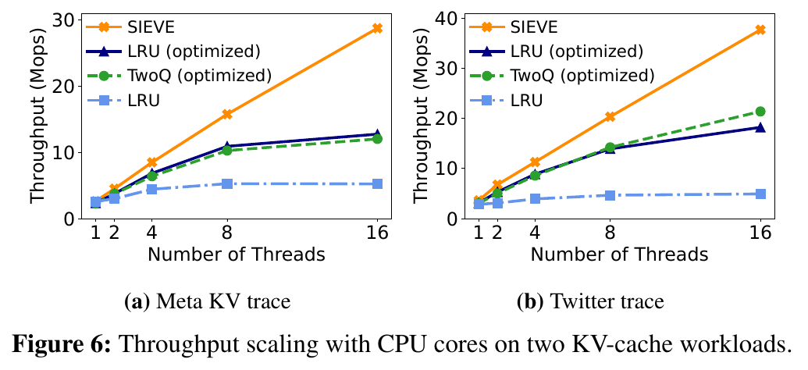
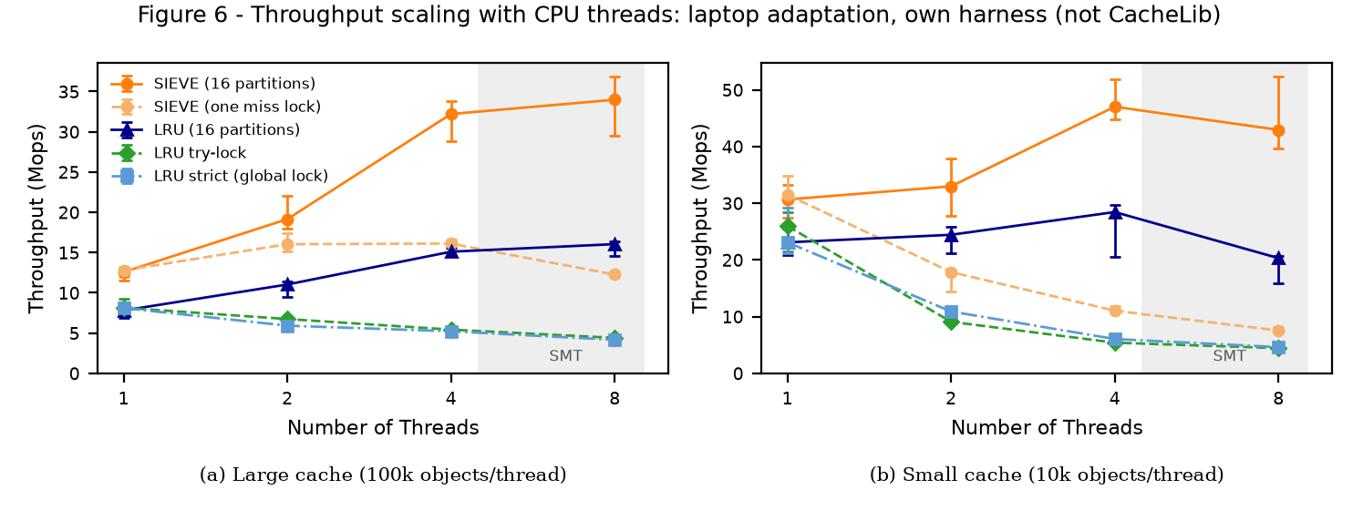
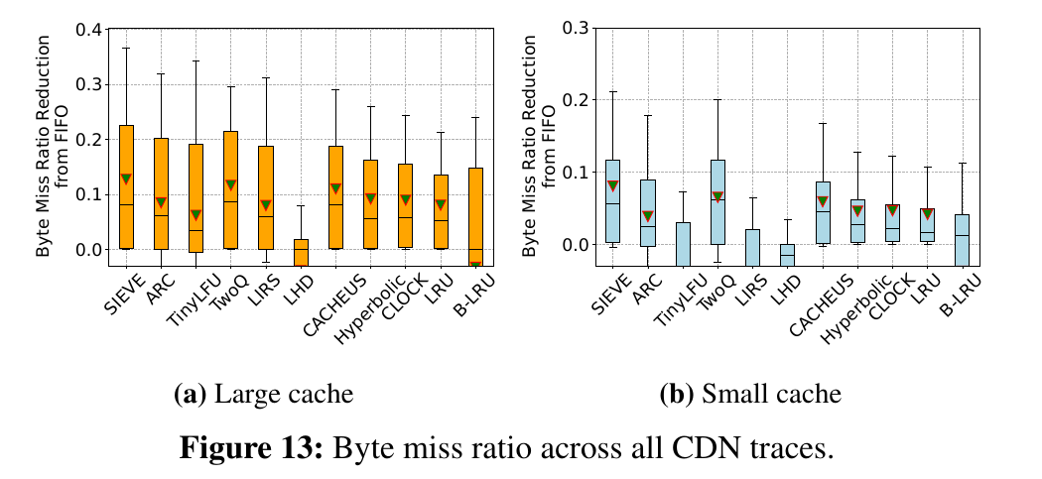
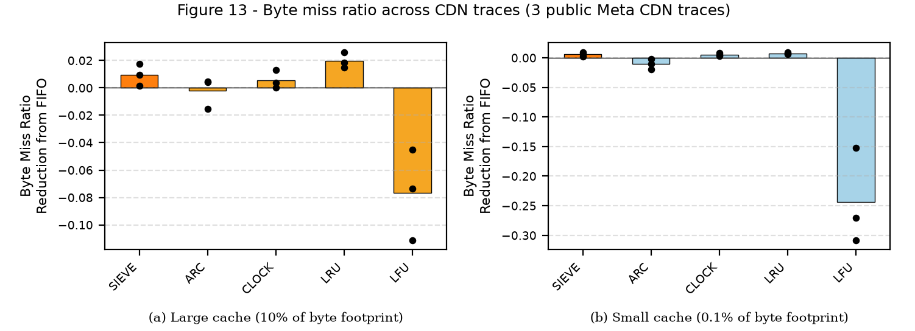
Figs 6 and 13: SIEVE scales best; three byte-mode traces are too few
PAPER | Figure 6 (CacheLib, 16 threads)
OURS | Figure 6 adapted: own C++ harness, 4-core laptop
Fig 6: adapted
SIEVE's lead over 16-partition LRU: 1.6x at 1 thread, 2.1x at 4 to 8 (large cache); paper: over 2x at 16. Threads 5 to 8 are SMT (efficiency 0.64 at 4, 0.34 at 8). Our LRU lacks CacheLib's delayed promotion; synthetic Zipf, not KV traces. Equals libCacheSim at 1 thread; ThreadSanitizer-clean; 280 runs.
PAPER | Figure 13 (all CDN traces)
OURS | Figure 13 on 3 public Meta CDN traces, 5 policies
Fig 13: partial
Byte miss ratio, cache = 10% / 0.1% of the byte footprint. SIEVE's byte reduction is small and positive at both sizes (about +0.01 at 10%); LRU is slightly higher at 10% (about +0.02); LFU is far worse. Three points cannot test the paper's boxes, most of whose traces are proprietary.
Source: Kevin's pipeline, figures as presented in our earlier deck. Their raw CSVs are not in the shared repository yet; absolute Mops are not comparable to the paper's.
Notes:
[Presenter B, about 50 s] Figure 6 is an adaptation: we could not build CacheLib or use a 16-core server, so it is our own C++ harness on a four-core laptop with 1 to 8 threads. The direction matches: SIEVE scales best, and its lead over a 16-partition LRU grows from 1.6 times at one thread to 2.1 times at 4 to 8, comparable to the paper's more than 2 times at 16. Our one-thread gap is larger than the paper's because our LRU lacks CacheLib's delayed promotion, and scaling flattens past four threads because those are SMT siblings. The harness equals libCacheSim at one thread and is ThreadSanitizer-clean. Figure 13, the byte miss ratio, is partial: the paper's boxes are over all CDN traces, mostly proprietary, and we have three public Meta CDN traces. SIEVE's byte reduction is small and positive, LRU's is slightly higher at the large cache, so three points cannot confirm or refute the paper here.

Slide 8
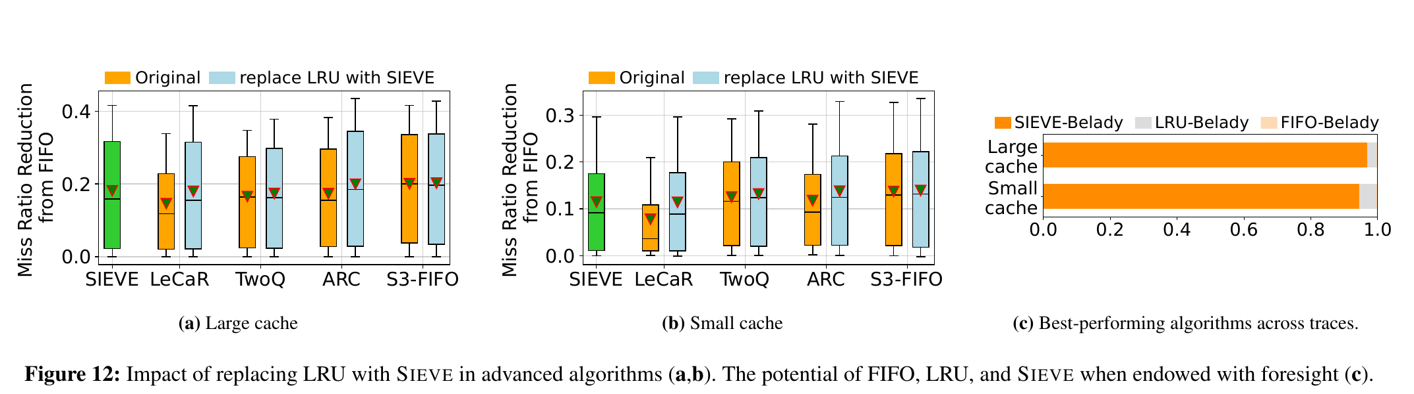
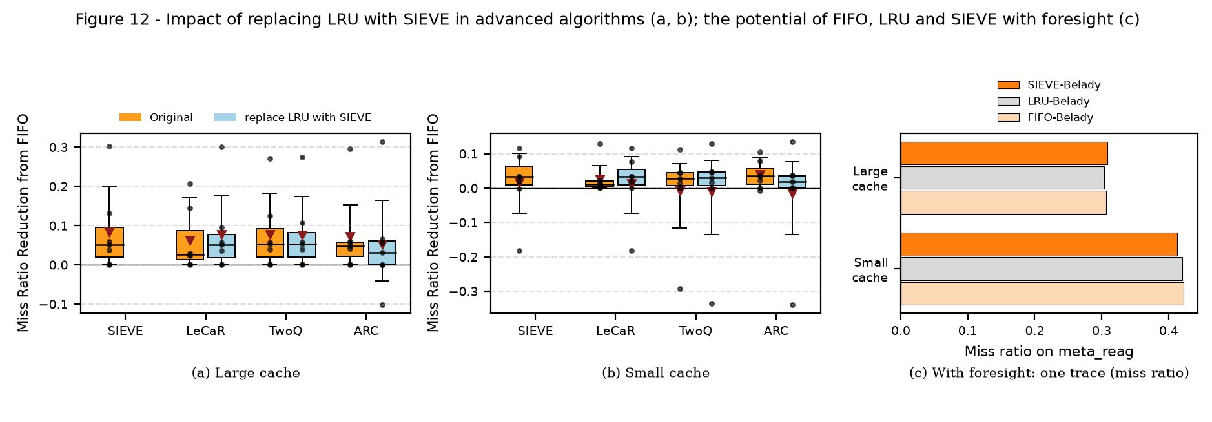
Fig 12: LRU to SIEVE helps on CDN/Wiki traces, hurts on Twitter
PAPER | Figure 12 (p. 1239)
OURS | Figure 12 on 7 public traces (every point drawn; S3-FIFO not run)
CDN and Wiki (4 traces): all three substitutions are at or above their LRU originals, as in the paper.
Twitter (3 traces): ARC-SIEVE collapses (0.1% cache: -0.113 vs +0.024). Post hoc, marking promoted objects as visited repairs it.
Our first LeCaR-SIEVE collapse was a bug in our own patch (hand restarted at the newest object after a wrap); a fixed-weight control caught it. Corrected, over all 7 traces LeCaR goes from 6.2% to 7.8% at 10%.
Notes:
[Presenter B, about 45 s] Figure 12 is where we first disagreed with the paper, and this slide is updated. The paper reports that replacing LRU with SIEVE inside ARC, LeCaR and TwoQ improves them. On our four CDN and Wiki traces that holds for all three. On the three Twitter traces ARC with SIEVE collapses. Our earlier result that LeCaR collapsed too was a bug in our own patch: after a wrap, the SIEVE hand restarted at the newest object. A control, LeCaR with the SIEVE expert fixed at weight one must equal plain SIEVE, failed, which is how we found it. Corrected, LeCaR improves at 10 percent. Seven traces are few and S3-FIFO is missing, so this is a difference we are still investigating, not a refutation.

Slide 9
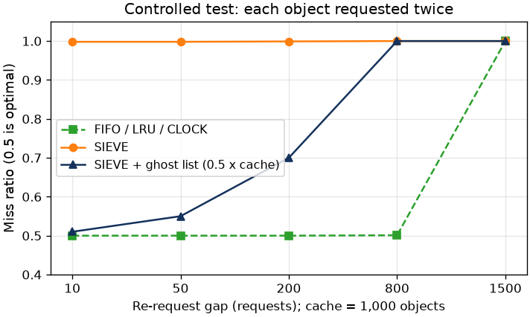
SIEVE fails at tiny caches; a ghost list (SIEVE-G) recovers most of the loss
Mechanism. With few visited objects the hand sits next to the head, so a new object is evicted at the next miss: its lifetime is about one insertion, not a queue length. SIEVE-G keeps a bounded FIFO of evicted ids; a returning id is re-inserted already marked visited. On Twitter cluster 49 at the 0.1% cache: FIFO 0.497, SIEVE 0.904, SIEVE-G 0.620.
19 / 8 / 2
7 / 22 / 0
PASS
better / equal / worse at 0.1% (mean +1.9%)
better / equal / worse at 10% (mean +0.45%)
pre-registered rule at both cache sizes
Gains sit where SIEVE failed (cluster 50: 0.881 to 0.732); the two losses are small (clusters 47 and 30, 0.0014 and 0.0009 in miss ratio).
On the 13 public traces of Fig 4: better on 24 of 26 points, worse on 2 (Wiki 2016u at 0.1%, +0.0059).
Costs: an exact ghost is about 22 B per cached object (SIEVE: 1 bit); slightly worse on synthetic Zipf. A 16-bit fingerprint ghost fails at 10% (12 of 29 worse): ghost size matters.
Controlled test: each object requested twice, 10 to 200 requests apart, 1,000-object cache. FIFO / LRU / CLOCK miss 50% (optimal); SIEVE 99.8%; with a 0.5x ghost list 51 to 70%.
Notes:
[Presenter B, about 55 s] Why SIEVE loses at tiny caches: new objects enter at the head and the hand moves toward the head. When few objects are visited, the hand sits right behind the head, so the object inserted one miss ago is the next one evicted. The controlled test shows it: every object requested twice, 10 to 200 requests apart in a thousand-object cache; FIFO, LRU and CLOCK are optimal at 50 percent misses and SIEVE misses 99.8 percent. SIEVE-G adds a bounded ghost list of recently evicted ids; a returning object is re-inserted already marked visited. The chart is the pre-registered held-out test: 29 Twitter clusters never used for design, each bar the percent drop in miss ratio relative to SIEVE at the 0.1 percent cache. It is better on 19, equal on 8, worse on 2 and never worse at the large cache, so it passes the rule fixed in advance. On the 13 public traces of Figure 4 it is better on 24 of 26 points. Caveats: memory cost, a small loss on synthetic Zipf, and the ghost size matters: a 16-bit fingerprint ghost fails at 10 percent.

Slide 10
Every remaining difference, and what Presentation III will do
Difference from the paper | Mechanism and evidence | Status
Fig 1: means about 2.2x smaller | 82% of the paper's traces are proprietary CDN1; our per-trace Fig 4 points equal the paper's, so only the mix differs. | Explained
Fig 3f: SIEVE mean about 0 on 7 clusters | Unrepresentative subset: with 48 clusters 0.093 vs the paper's 0.083. Real tiny-cache failures remain (slide 9). | Resolved
Fig 5: Tencent, CACHEUS beats SIEVE | Tested on 9 seeds: CACHEUS gives 0.1150 every time (SIEVE 0.1148); the paper's 0.0825 is outside, so not a seed draw. | Open
TinyLFU above the paper (Figs 4, 5) | Pinned snapshot has fix 759f4ca; without it, within 0.0005 (Meta CDN, Wiki; Meta KV at their capacities). Two objects of capacity move 0.2903 to 0.2974. | Confirmed
Fig 6: 1-thread lead 1.6x vs 1.16x | Our LRU has no delayed promotion; threads 5 to 8 are SMT (efficiency 0.64 at 4, 0.34 at 8). | Plausible
Fig 8a: LRU 0.60 vs the paper's 0.87 | Workload size: 10,000 objects gives 0.869; 24 of 24 points within 0.0008. A fit, not a quote. | Resolved
Fig 8b: popular ratio about 0.02 off | Ordering matches; every averaging choice we tried is 0.018 to 0.022 away. | Open
Fig 12: ARC-SIEVE collapses on Twitter | LeCaR case was our own patch bug (fixed, control passes); marking promoted objects visited repairs ARC post hoc. | Open
Wiki totals 5,667 M vs Table 1's 2,863 M | Equal in both pipelines; per-trace points match the paper; Table 1's Wiki row adds up for no combination. | Open
Presentation III: SIEVE-G lean, concurrent and adaptive. Success = the pre-declared rule on unseen traces, at most 2 B per ghost entry, at least 90% of SIEVE's throughput; if it fails, we report that.
1
Lean ghost
16-bit fingerprints pass at 0.1% but fail at 10%: try wider ones or a bucketed filter.
2
Concurrent SIEVE-G
In our harness: hits stay lock-free, ghost updates only on the miss path, 1 to 8 threads.
3
Adaptive switch
Turn the ghost off when its hit rate is near zero (removes the Zipf loss); ghost ratio 0.25 vs 0.5.
4
Held-out evaluation
Untouched traces, same rule at both sizes; byte miss ratio on Meta CDN.
Notes:
[Presenter B, about 60 s] This is every difference left, each with its mechanism and evidence. Closed: the trace mix behind Figure 1, the small-sample Twitter effect, the TinyLFU fix, which is also sensitive to two objects of capacity, and the workload size in Figure 8. Plausible: our Figure 6 hardware and baseline. Open: Figure 8b's popular ratio, about 0.02 off for every averaging we tried; ARC with SIEVE on Twitter traces in Figure 12; the Wiki totals, which do not match the paper's Table 1 in either pipeline; and the Tencent CACHEUS difference, which we tested: it is not a random seed. Presentation III builds on SIEVE-G: shrink the ghost, build it into our concurrent harness with lock-free hits, add an adaptive switch, and evaluate on traces never used for design with a rule fixed in advance. If it fails, we report that.

