Slide 1
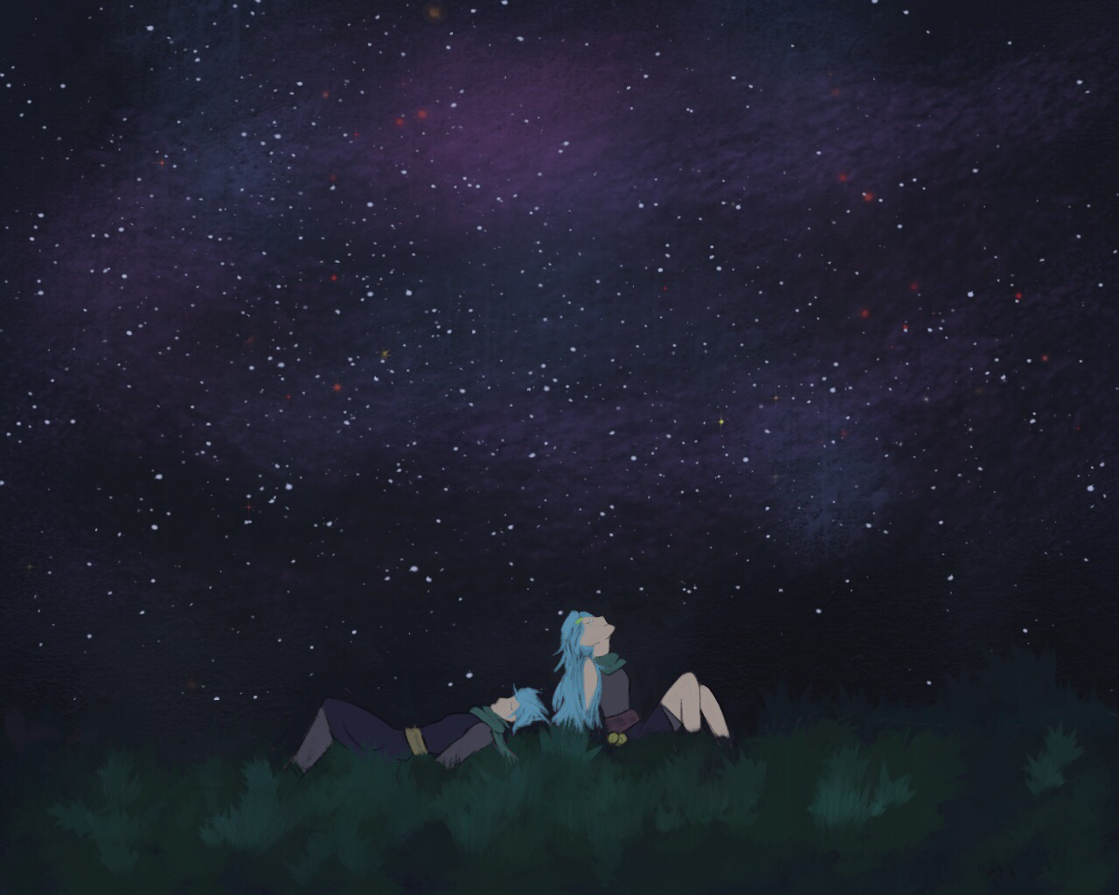

Medusa Hill Feast
Medusa Hill Feast
- A learning of Unity with a game producing approach

Slide 2

Inspiration
Inspired by Stardew Valley, since it is one of the best RPG experience I’ve had.
Plus, I like Open-ended, Simulation, Action and RPG, especially when those elements combines together

Slide 3

Goal
Learning how to develop a RPG from Unity.
Learning a game development procedure.

Slide 4
About Medusa Hill Feast

Slide 5

Expectation and Actual
The expectation from me to this game is a lot.
Time limitation and knowledge limitation

Slide 6
Story
A mercenary was wounded and saved by a villager from Medusa Hill, and decided to stay in this beautiful small village. To stay here, the main character will run a restaurant to serve the travellers and folks in town.

Slide 7
Plot
In the full game, plenty of choices during the game are required, and have different outcomes.
In demo, only the fundamental element, or in another word, tutorial, to tell player the basic of the game.

Slide 8
Elements
Quest
NPC Communication
UI
Cooking
Fishing
Trading
Gathering
Fighting
Inventory
Relationship
GUI

Slide 9
More Elements
Currency
Leveling
Music
Sound Effect
Background
Achievement
In the case of learning the fundamental functions in Unity, only the concept of some elements will be presented.
All those has to built based on the gameplay, and it need to be balanced

Slide 10
Basic Elements in the Project

Slide 11

UI
Canvas
Background
Buttons with proper functionalities:
Enter the game
Exit from the application

Slide 12
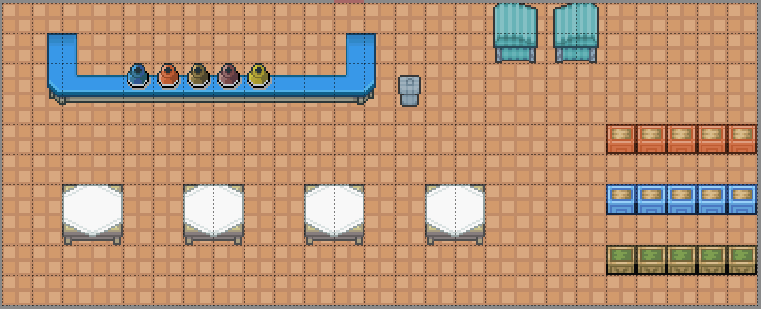
Map & Objects & Figures
Sprites
Animation
Map editor
Tiled Map Editor
Tiled2Unity

Slide 13
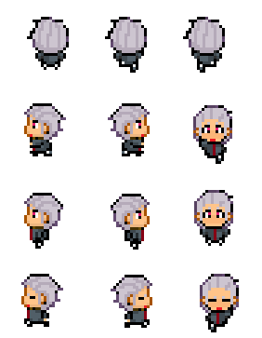
Player Movement
Give player control to the avatar.
Include avatar movement on the screen and animation.
Interaction with the object or other controllers are attached with other systems.

Slide 14
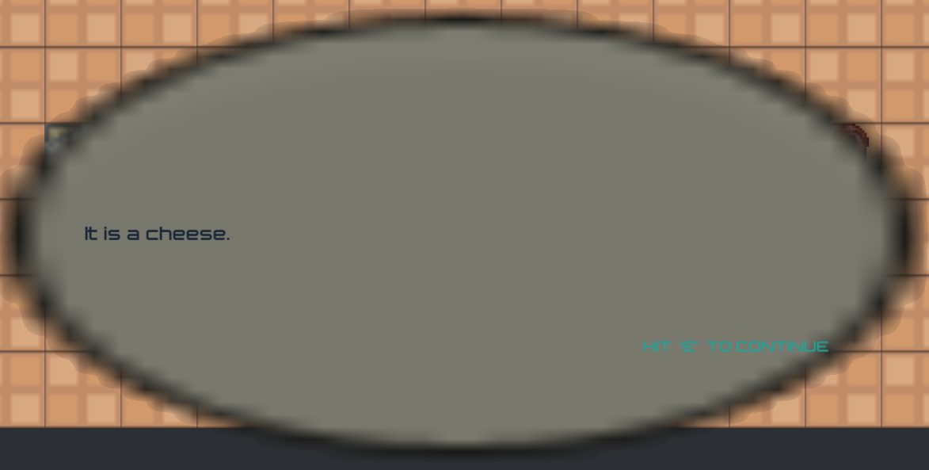
Conversation System & Basic Interaction with Objects
Interaction key with NPC or objects will give player a respond.
A panel is needed
Dialog
Dialog Trigger
Dialog Manager

Slide 15
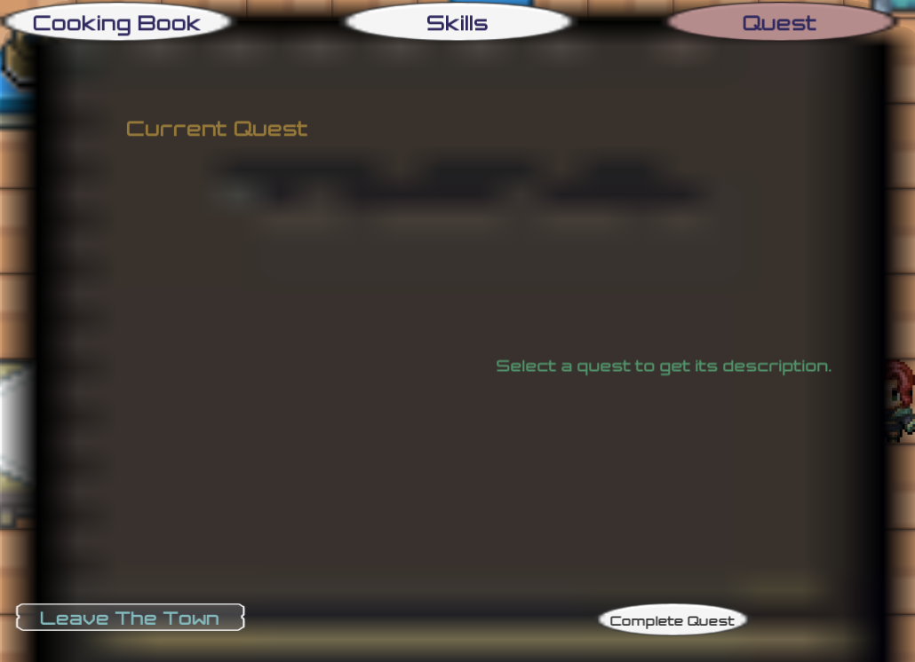
Quests
Use quest items counts to check a quest is able to be completed or not.
Quest stages:
Not Available
Available
Accepted
Complete
Done

Slide 16
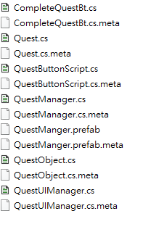
Quests Con.
Quest Object
Quest Trigger => Which is triggered by the conversations
Quest Manager

Slide 17
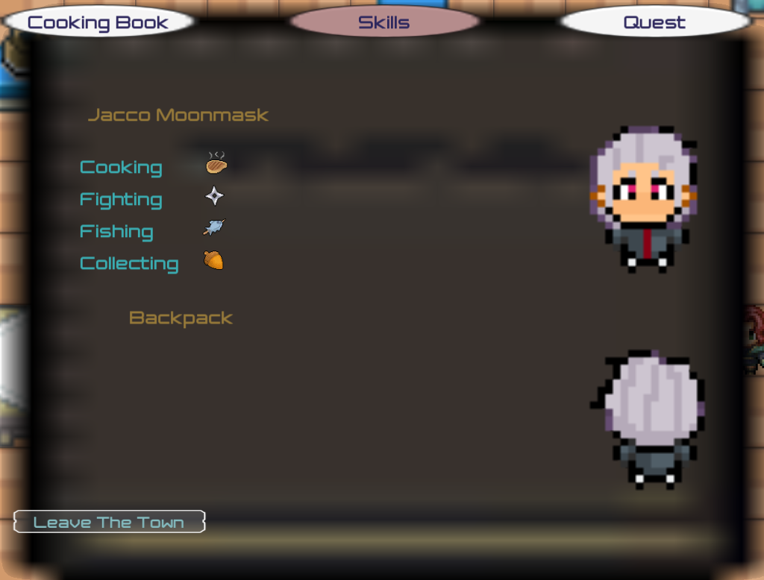
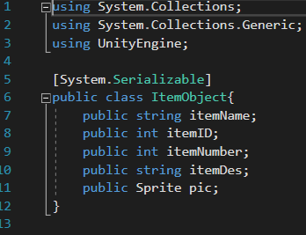


Inventory
The backpack
Item list

Slide 18
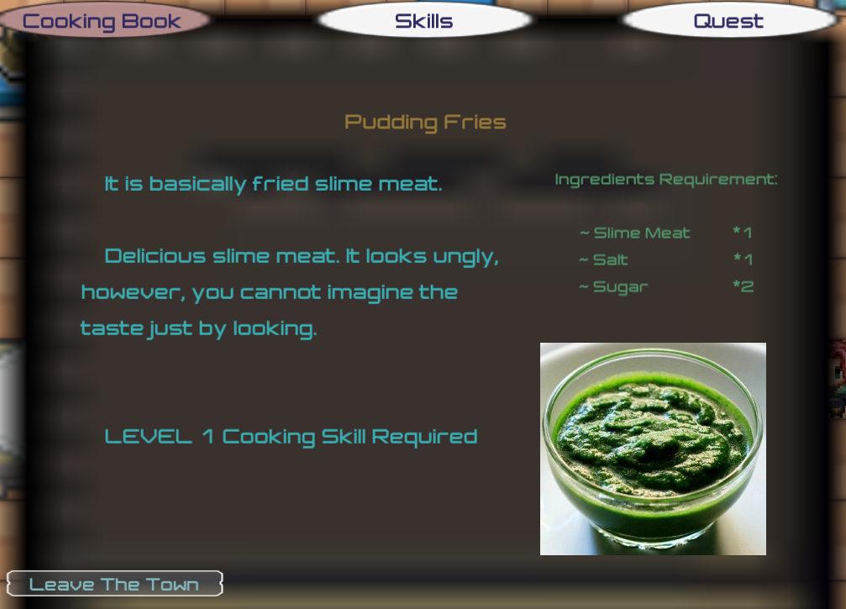
Cooking System
Not complete, only the most basic requirements have been reached
Check if there are enough ingredients in the backpack
Cooking skill level requirement
Cooking book

Slide 19
Demonstration

Slide 20
Improvement & Future Work

Slide 21
More Details on the Instruction
There are not enough instruction in the prototype so far, may cause confusion for starters.
More functions needed for the dialog and quest system
The dialog should be able to trigger again;
NPC should give more reaction towards the player’s state or quest state;
Instructions between quests, and reward acquire.

Slide 22
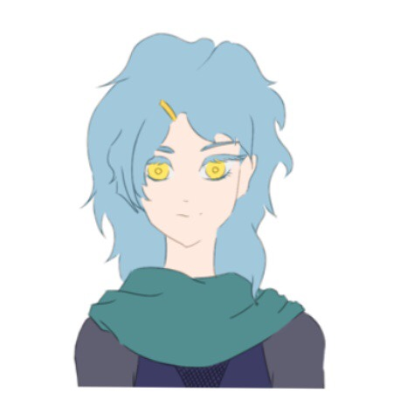
Animation
Add animation during the dialog
Add simple animation to fit the plot
Use self-created spites instead of open source sprites
Art improvement!

Slide 23
Music & Sound Effects
Has to fit the theme of the game
Relaxing
Cheerful
Lightweight
Basic sound effects

Slide 24
Gift System
A part of the relationship system.
Involve with inventory system.

Slide 25
Relationship System
With proper conversation or trigger of the plot, the relationship with certain character will be modified.
Marriage will be apply on certain characters, based on the gender of avatar player chose, the choice of character will be different, and the story as well.

Slide 26
Inventory System & Currency
In the game there is already the fundamental structure that can be implemented
Detailed item list, with description, name, ID, and pictures
Currency exchange, which has to match with the game balance

Slide 27
More controllability towards player
Customizable avatar:
Customizable outfit
Customizable gender (which will affect some of the game plots, and in fighting system different gender will have different hidden passive)
Customizable controller
Different plot based on the relationship or quests have done
Open-ending

Slide 28
Full Gameplay Procedure
The route between get an order (or quest) and complete it.

Slide 29
Game over approaches
Not enough money to run the restaurant at Medusa Hill and lose the game with a bad ending
Happy ending?

Slide 30
Thank you for watching

