Slide 1

A project proposal on
Wind Horse Tours
At
Halftone Designs Pvt Ltd.
Bsc.csit, 8th Semester

Slide 2

Internship
An opportunity offered by an employer to potential employees, called interns, to work at a firm for a fixed, limited period of time.

Slide 3

Halftone designs pvt. Ltd.
Provide services regarding graphic design, website designing, development and maintenance.
Founded in 2011.
Location – Dillibazaar, Kathmandu.

Slide 4

Wind horse tours
Tours, treks and travel operating company.
Officially launched in 1998 in Bhutan.
Operates trek and tour in Nepal, India, Bhutan, Tibet, Sikkim and Darjeeling.

Slide 5

Problem Statement
Absence of live website.
Reservation, Payment problem etc.

Slide 6
Objectives
To bring the company profile online.
To facilitate people with the services of reservation, payment and checking the availability of trips, tours and treks online.

Slide 7
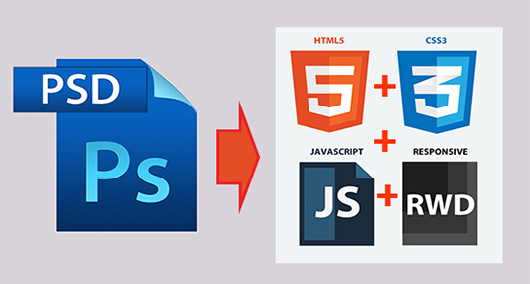
Psd to html conversion

Slide 8
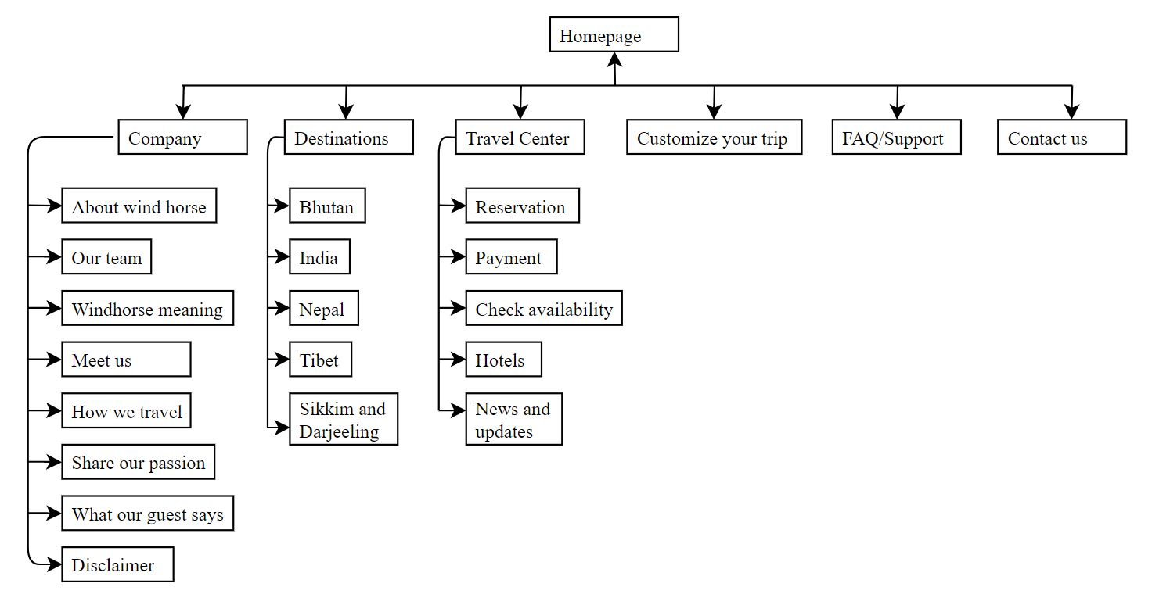
WEBSITE STRUCTURE

Slide 9






IMPLEMENTATION
Photoshop cc 2017
Sublime Text 3
Html5
Css3
Jquery
Javascript

Slide 10
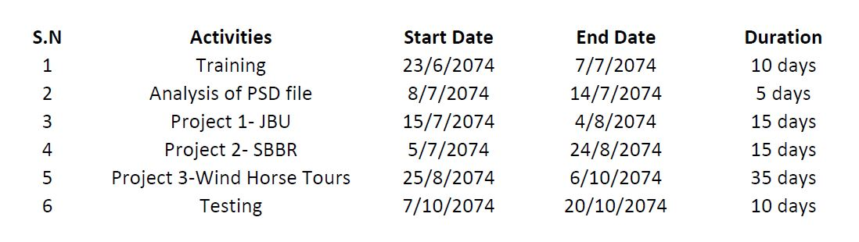
Time schedule

Slide 11
Expected output
Live web application of Wind horse tours.
Services for tours and trek lovers to check availability of treks, reservation, online payment, customization of treks etc.

Slide 12
Thank you!!

