Slide 1
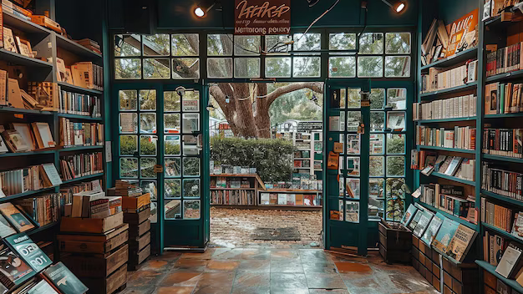
CSE111: Bookstore Database Project
By: Minea Dusanovic & Uriel Martinez-Jimenez

Slide 2

Bookstore Project Description
General Information
Bookstores needs a database that includes:
Physical Books Offered
Book Quantity
Book Information
Orders Made
Customer Information

Slide 3

Bookstore Use Cases: Customers & Employees
Customer Application Action
Employee Application Action
Search Specific Book
Search Specific Author
Search Specific Genre
Purchase Book(s)
Update Book Ratings
Add New Books
Search Specific Book
Search Specific Author
Search Specific Genre
Delete Specific Book
Update Book Prices
Send Restock Requests
Check Order Reports

Slide 4
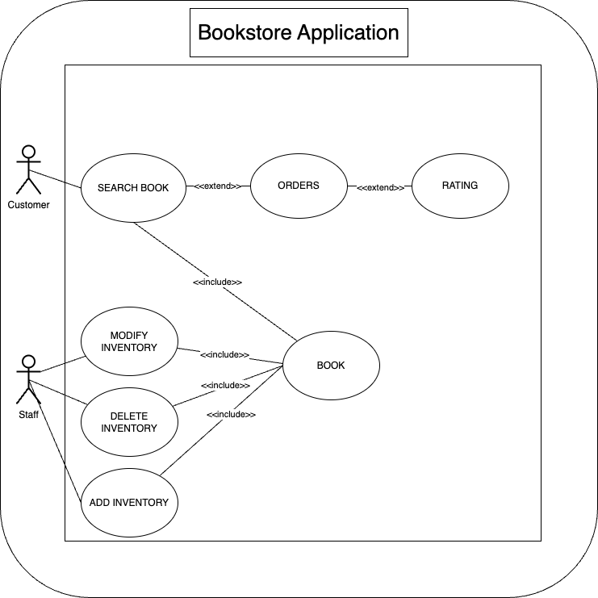
UML Use-Case Diagram

Slide 5
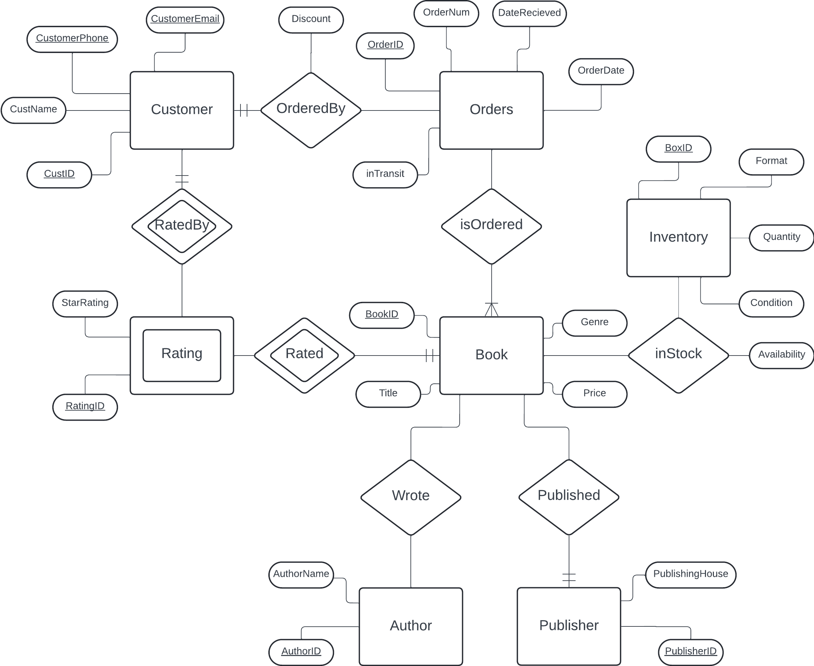
E/R Diagram

Slide 6

Relational Schema
Entities
Relationships
Book(BookID, Title, AuthorID, PublisherID, Genre, Price)
Author(AuthorID, AuthorName)
Publisher(PublisherID, PublishingHouse)
Rating(RatingID, BookID, StarRating, CustID)
Customer(CustID, CustName, CustomerPhone, CustomerEmail)
Inventory(BoxID, BookID, Quantity, Condition, Format)
Orders(OrderID, OrderNum, CustID, BookID, OrderDate, RecieveDate, inTransit)
Wrote(AuthorID, BookID)
Published(BookID, PublisherID)
inStock(BookID, BoxID, Availability)
Rated(BookID, RatingID)
RatedBy(CustID, RatingID)
isOrdered(OrderID, BookID)
OrderedBy(OrderID, CustID, Discount)

Slide 7

THANK YOU FOR LISTENING! Any Questions?

