Slide 1
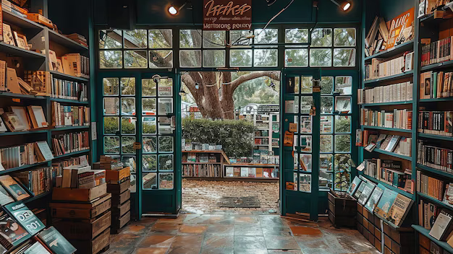
CSE111: Bookstore Database Project
By: Minea Dusanovic & Uriel Martinez-Jimenez
Team 12

Slide 2

Bookstore System Description
General Information
Bookstores needs a database that includes:
Physical Books Offered
Book Quantity
Book Information
Orders Made
Customer Information
Employees can edit this data

Slide 3

Bookstore Use Cases: Customers & Employees
Customer Application Action
Employee Application Action
Search Specific Book
Search Specific Author
Search Specific Genre
See All Book
Search Orders Made
Delete/Update Account
Add New Books
See All Books
Update Book Prices
Update Book Quantity

Slide 4
Bookstore System Implementations
Web Browser
IDE: Visual Studio Code and SQLite Studio.
Database: SQLite3 with sqlite3 Python library.
Languages: Python (Flask), HTML, CSS, JavaScript, SQL.

Slide 5
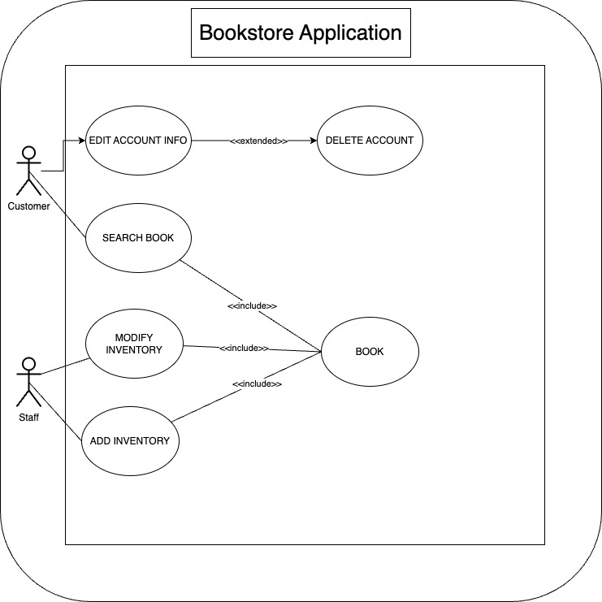
UML Use-Case Diagram

Slide 6
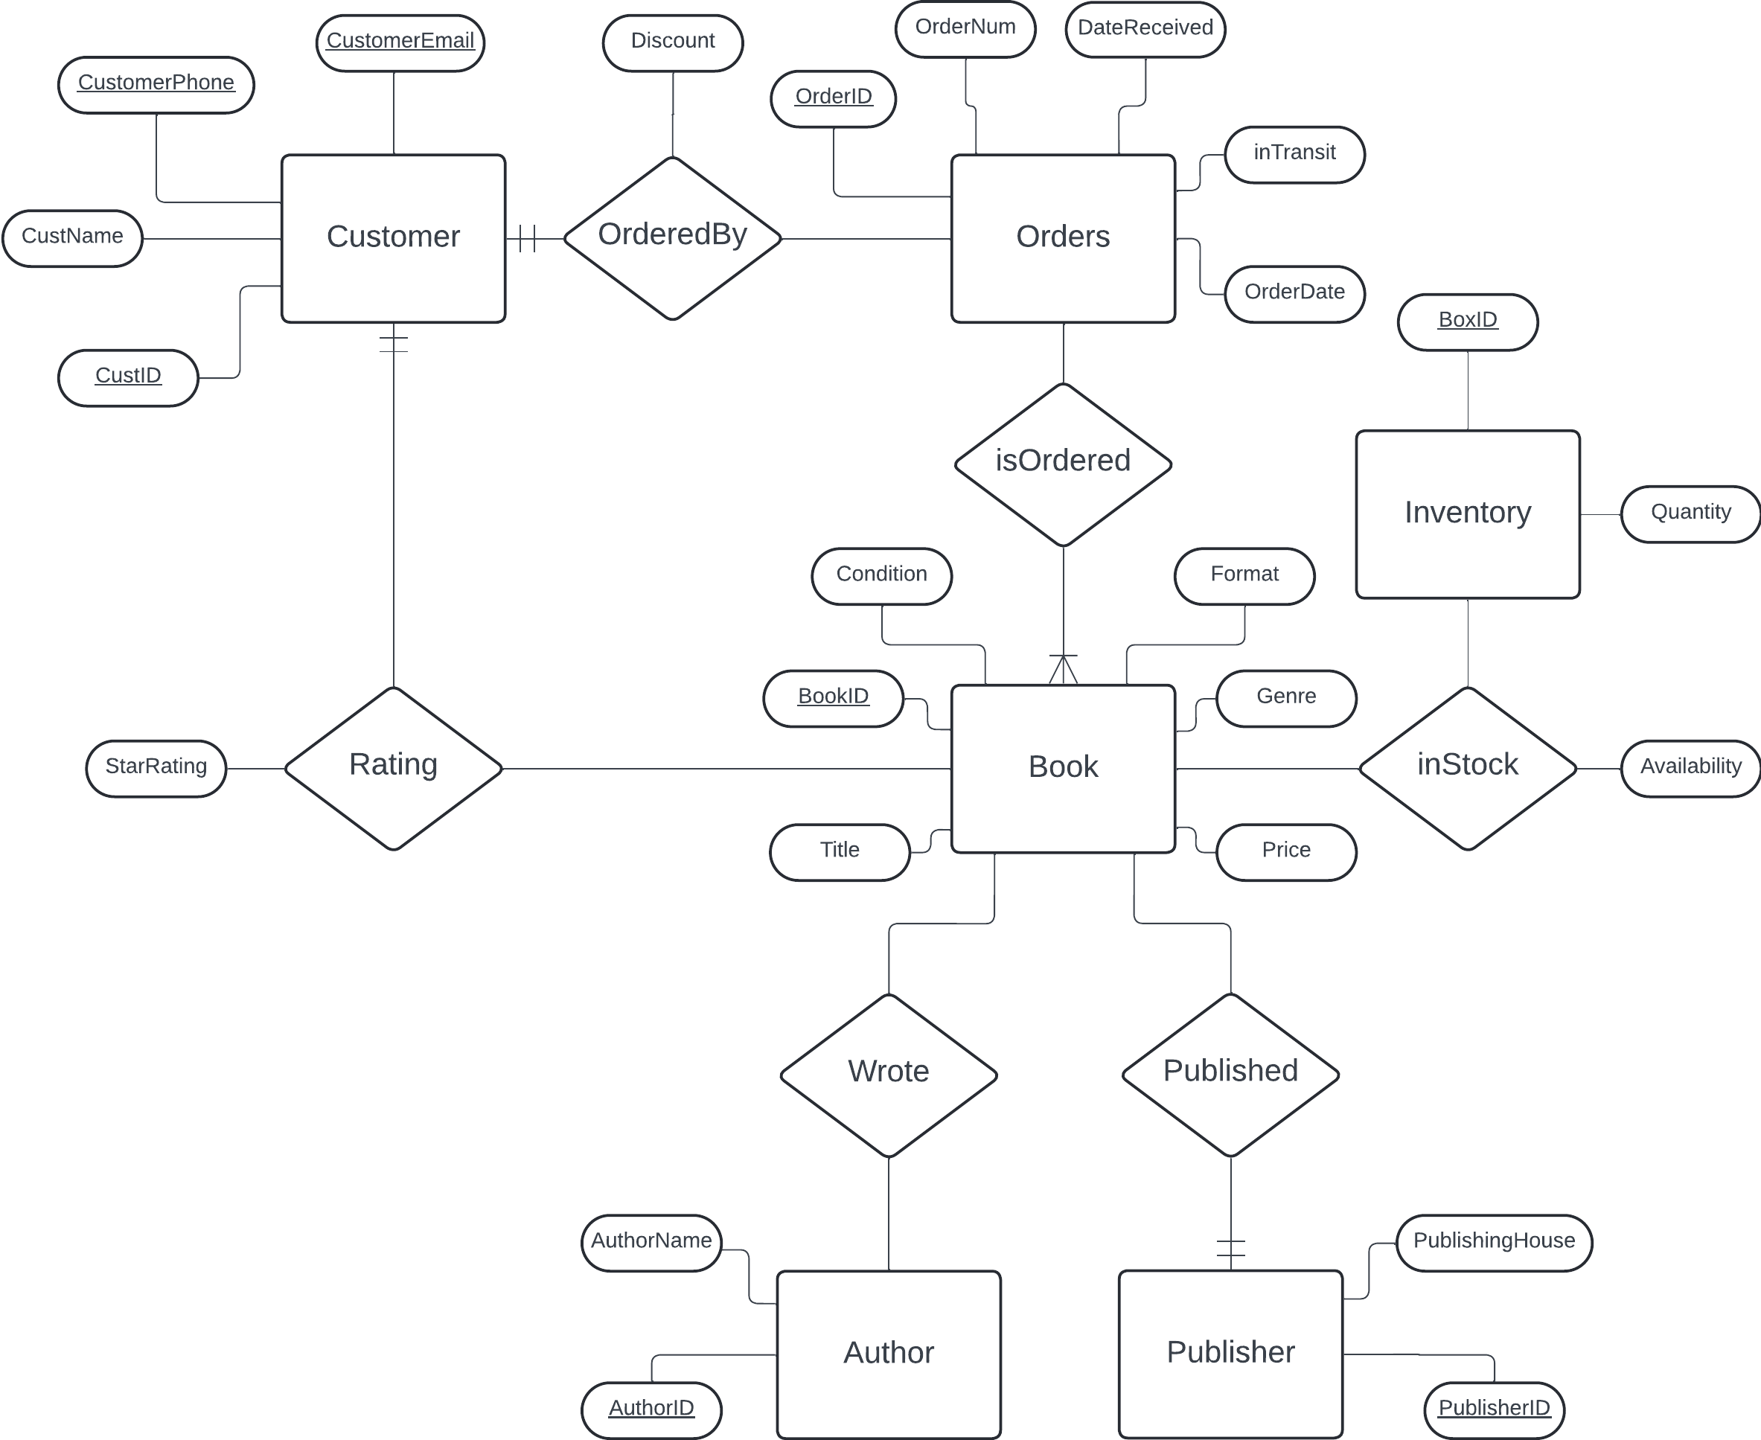
E/R Diagram

Slide 7

Relational Schema
Entities
Relationships
Book(BookID, Title, AuthorID, PublisherID, Genre, Price, Condition, Format)
Author(AuthorID, AuthorName)
Publisher(PublisherID, PublishingHouse)
Customer(CustID, CustomerName, CustomerPhone, CustomerEmail)
Inventory(BoxID, BookID, Quantity)
Orders(OrderID, OrderNum, CustID, BookID, OrderDate, DateReceived, inTransit)
Wrote(AuthorID, BookID)
Published(BookID, PublisherID)
inStock(BookID, BoxID, Availability)
Rating(BookID, CustID, StarRating)
isOrdered(OrderID, BookID)
OrderedBy(OrderID, CustID, Discount)

Slide 8

THANK YOU FOR LISTENING! Now for the demo.

