Slide 1

Using PHP, MySQL and JpGraph to Create Dynamic Graphs
By: Geoffrey Rowland (geoffrey.rowland@noaa.gov)

Slide 2
Why Dynamic?
Less time spent to implement dynamic graphs than to manually create a new graph everytime you need one
Never use PowerPoint / Excel to create graphs again! (okay maybe not)
Useful for data that changes often

Slide 3
Required Software
PHP 4.02 and above
Compiled with GD Library
Jpgraph 1.63 graph class library
MySQL (or database to your liking)

Slide 4
GD Graphics Library
GD allows the ability to use code to quickly draw images complete with lines, arcs, text, multiple colors, and write out the result as a PNG, JPEG, or WBMP file.
Does not support GIF due to patent issues.

Slide 5
Jpgraph Graph Class Library
Object oriented graph library for PHP
Allows creation of bar, line, and plot graphs
Also allows creation of pie charts
Database independent
QPL 1.0 license

Slide 6
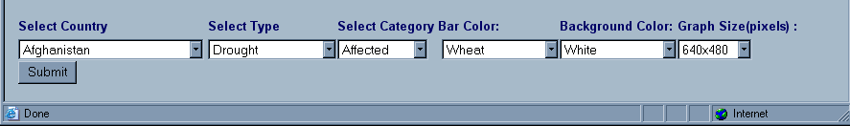
Example Input for Graph Creation

Slide 7
Include Graphing Libraries and Setup Database Connection
<html>
<body>
<?
//make sure default image format is jpeg, not png
DEFINE("DEFAULT_GFORMAT","jpeg");
// include jpgraph graphing libs..
include ("jpgraph/jpgraph.php");
include ("jpgraph/jpgraph_line.php");
include ("jpgraph/jpgraph_bar.php");
//include db connection details
include("/home/em-dat/dbconnect/dbconnect.php");
// connect PHP to MySQL
$linkID=MYSQL_CONNECT($hostname,$username,$password) or die("Unable to connect to database");
mysql_select_db("$dbName", $linkID) or die("Unable to select database");
// query to select our information for the x and y axis for the bar graph
$query4 = "select year,sum($number) AS summedTotal FROM emdat WHERE DisType = '$DisType' AND country = '$country' AND year between '1975' and '2001' group by year order by year";
// execute the query
$result4 = mysql_query($query4,$linkID);

Slide 8
Load Data from Database into X and Y axis Array
$readnext = TRUE;
// use $year value if there is no value for that year in the database
for ($year=1975; $year < 2002; $year++)
{
if ($readnext) $row = mysql_fetch_row($result4);
if ($year==$row[0])
{
// if there is data for that year, load the year and assoc. data into the array.
// xaxis array
$databarx[]=$row[0];
// yaxis array
$databary[] = $row[1];
$readnext=TRUE;
}
else {
// if there isn't data for that year, load the year into the array, but load a 0 value for that year.
// xaxis array
$databarx[] = $year;
// yaxis array
$databary[] = "0";
$readnext=FALSE;
}
}

Slide 9
Set Graph Properties
$graph->img->Image(640,480,"jpeg");
$graph->SetColor("$color_background");
$graph->SetShadow();
// Use text X-scale so we can text labels on the X-axis
$graph->SetScale("textlin");
// Color the two Y-axis to make them easier to associate
// to the corresponding plot (we keep the axis black though)
$graph->yaxis->SetColor("black","black");
// Set title and subtitle
$graph->title->Set("Number $number during $DisType in $country between 1975 and 2000");
// Make the margin around the plot a little bit bigger than default
$graph->img->SetMargin(70,140,70,80);

Slide 10
Create the Bar Graph
// Setup the labels
$graph->xaxis->SetTickLabels($databarx);
$graph->xaxis->SetTextLabelInterval(5);
$graph->xaxis->SetTextTickInterval(1);
// Create the bar graph
$bar1 = new BarPlot($databary);
// set the title of the legend and the color of the bars
$bar1->SetLegend("Number $number");
$bar1->SetFillColor("$color_bar");
// set width of bars on bar graph
$bar1->SetAbsWidth($barwidth);
//show value on top of bar
$bar1->value->Show(true);
// set format of values displayed, %d prints no decimal places
$bar1->value->SetFormat("%d");

Slide 11
Output Bar Graph to Screen
$graph->Add($bar1);
// Finally output the image
// write the image to disk, and call it dynamic-bar.jpg
$graph->Stroke("dynamic-bar.jpg");
// Calculates the MD5 hash of server timestamp and returns that hash to $cachekiller.
// The hash is a 32-character hexadecimal number.
$cachekiller = md5(time());
// output the print icon
echo "<a href=\"javascript:window.print()\"><font color=\"#FFFFFF\">..<img src=\"http://www.em-dat.net/pagepics/printicon.gif\" width=\"16\" height=\"14\" border=\"0\" alt=\"Print this page.\"></font></a><br>";
// output the graph to the screen with cachekiller number that makes the browser refresh the image
echo "<img src=\"dynamic-bar.jpg?cachekiller=$cachekiller\">";
?>

Slide 12
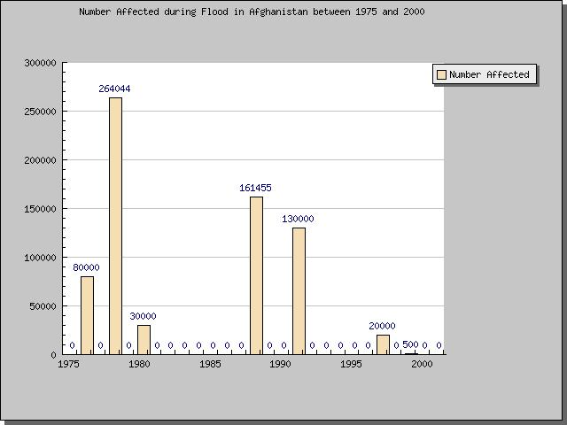
Example Output Bar Graph

Slide 13
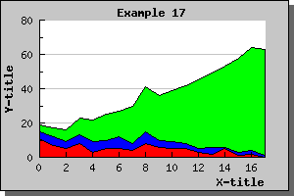
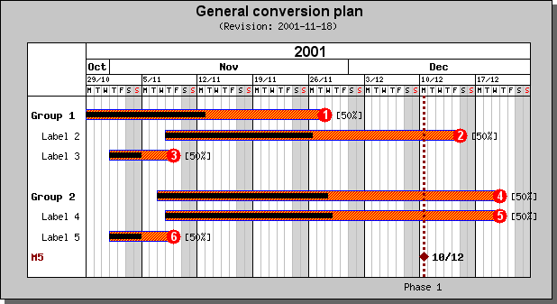
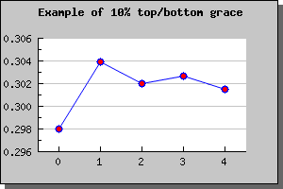
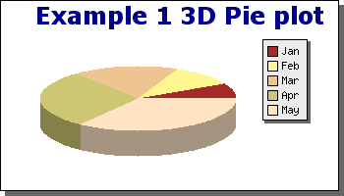
Example Graphs

Slide 14
Additional Information
Climate Information Project
http://www.cip.ogp.noaa.gov
JpGraph
http://www.aditus.nu/jpgraph/
PHP
http://www.php.net
MySQL
http://www.mysql.com
GD Graphics Library
http://www.boutell.com/gd/

Slide 15
Contact Information
Feel free to contact me with any questions!
geoffrey.rowland@noaa.gov

