Slide 1

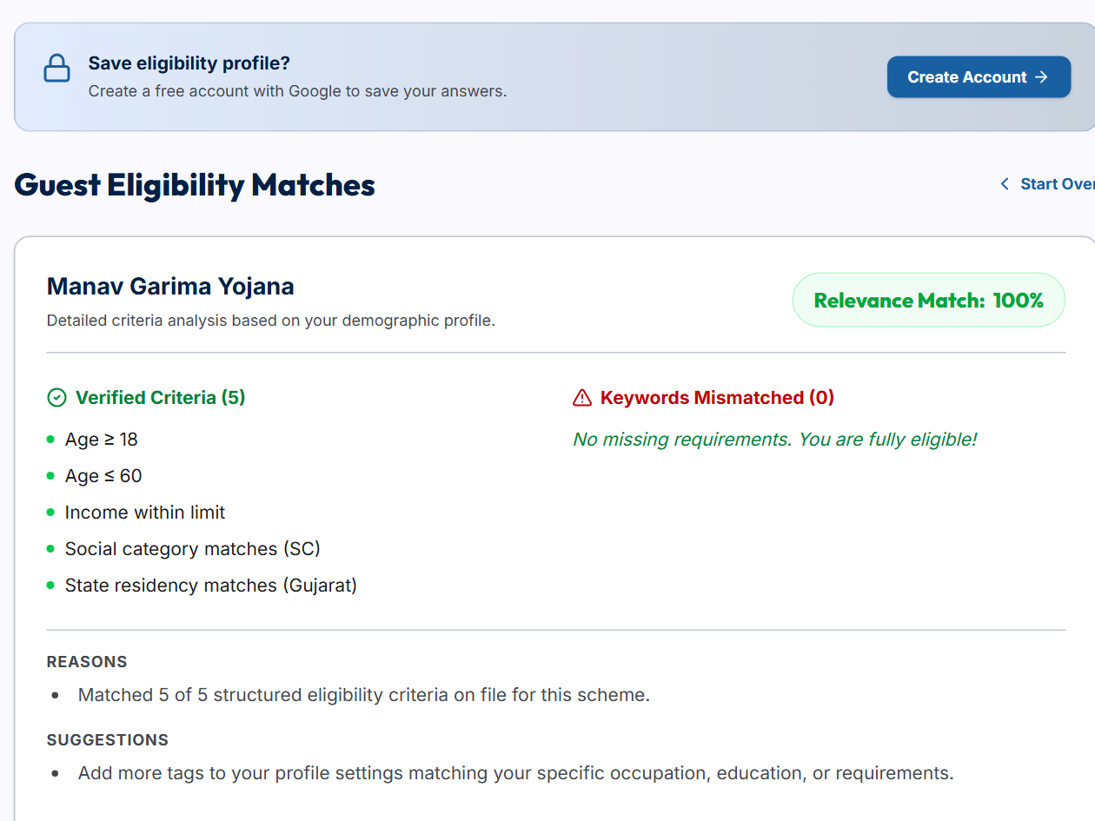
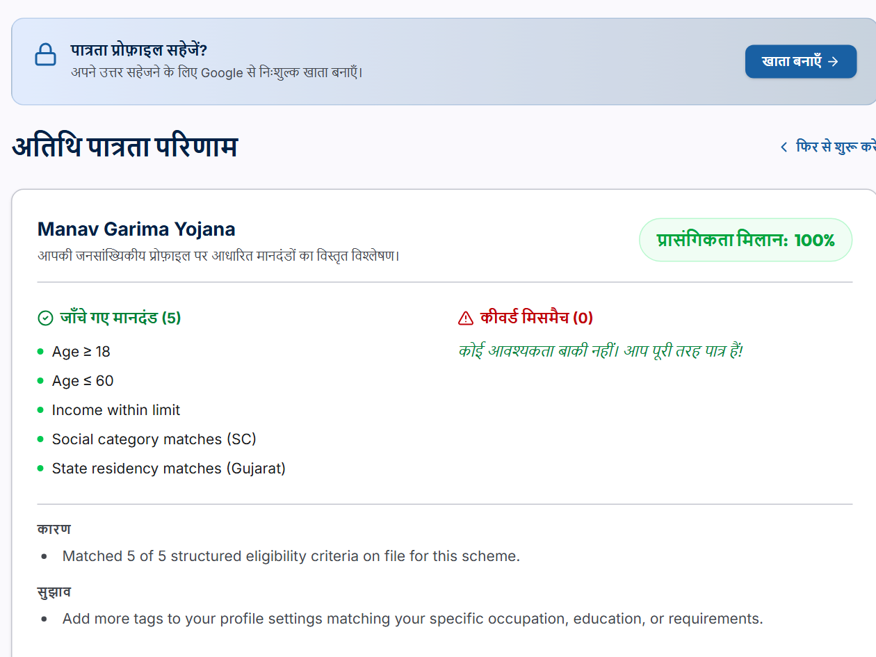
SCHEMESETU
SMART GOVERNMENT SCHEME FINDER
Group Id- CS26015
Search 4,722 Indian government schemes and see, in English or Hindi, which ones you are eligible for.
Sr. | Student Name | Roll No.
1 | Urja Gajera | 24CS021
MENTOR / GUIDE
Dr. Jigar Sarda
CSE Dept., CSPIT
SYSTEM FLOW / ARCHITECTURE
User
React web app (English, हिन्दी)
Express API
Google sign-in, validation, rate limits
Eligibility Engine
Rule checks; unknown never excludes
PostgreSQL
4,722 schemes, 2,987 rule sets (Prisma)
Ranked Results
Match %, 100% matches first
Data pipeline: myScheme.gov.in dataset → parser (cleans text, extracts eligibility rules) → PostgreSQL.
Hindi text is made once by an AI model (Groq) with automatic quality checks, then stored.
TECHNOLOGY STACK
KEY FEATURES
APPLICATIONS
Frontend: React 19, TypeScript, Vite, Tailwind CSS
Backend / DB: Node.js, Express, Prisma, PostgreSQL
Tools: Google OAuth, Zod, Groq AI (Hindi), Vitest (1,035 tests), GitHub Actions CI
Eligibility check with match % and reasons, 100% matches first
Search by 16 topics, state, age, income and occupation
English and Hindi (Hindi labelled as machine-translated)
Profile suggestions, bookmarks, compare up to 3 schemes
Citizens finding the schemes they qualify for
Students and farmers looking for scholarships, subsidies and loans
NGOs and CSC operators helping people apply
APPLICATION SCREENSHOTS
Home – search 4,722 schemes
Eligibility check – 100% matches first
Hindi interface (हिन्दी)
TARGET INDUSTRY / SECTOR : - E-Governance / Social Welfare (GovTech)

