Slide 1
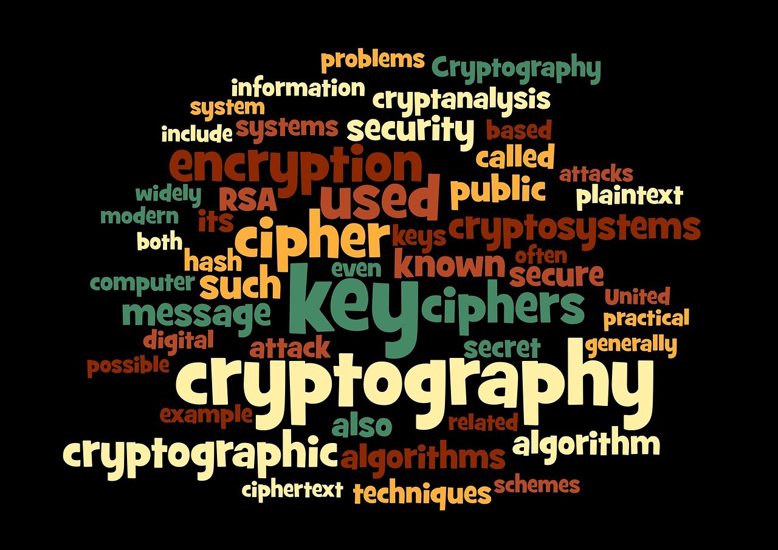
Secure Computing (CP8301)
Final Project - ESTATE
BY: Urmi Patel

Slide 2
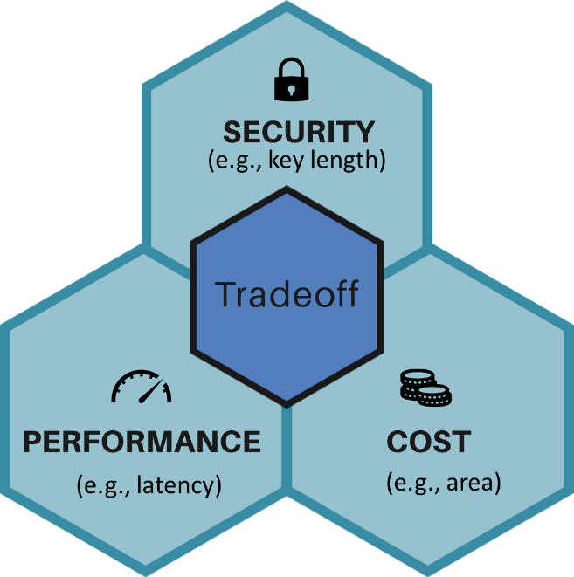
Lightweight Cryptography
Number of rounds and key size of cryptographic algorithm
Efficiency / Speed
Architecture of algorithm
Hardware used /
Style of architecture / Size of system
An encryption method used to run on different devices with very low computing power
Trade-off between lightweightness and security
Extremely hard to achieve all three goals

Slide 3
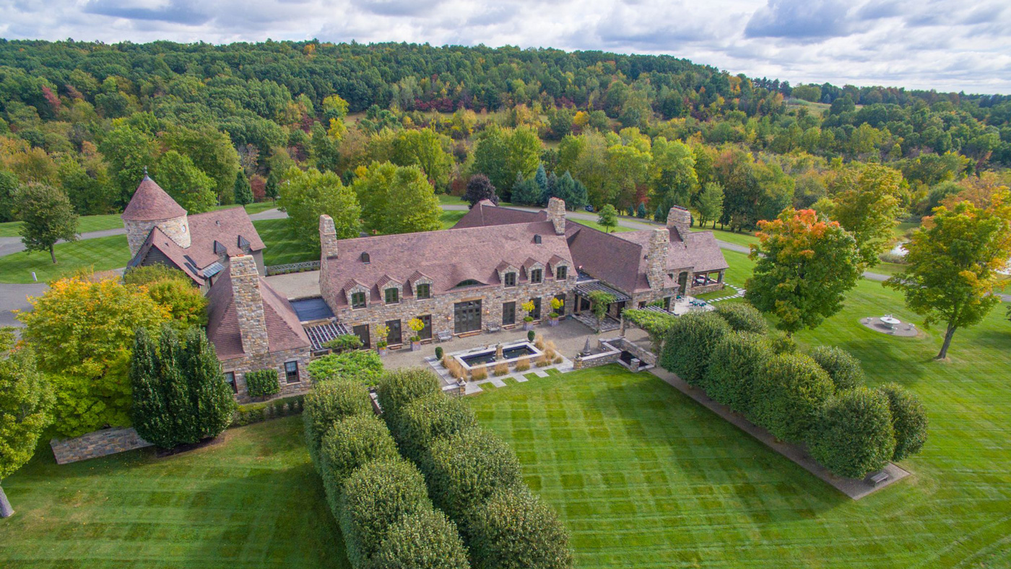
ESTATE
Energy efficient and Single-state Tweakable block cipher based MAC-Then-Encrypt
Improved version of SUNDAE (2018)
ESTATE used:
FCBC -> authentication
OFB -> encryption
TweAES -> tweakable block cipher
TweGIFT -> tweakable block cipher
AEAD -> encryption mode

Slide 4

SUNDAE
Small Universal Deterministic Authenticated Encryption
MAC-then-Encrypt type scheme
MAC -> OMAC
OFB -> encryption
It is nonce-misuse resistant but does not provide RUP security
Also requires an additional primitive calls
SUNDAE designs have little overhead:
Besides an n-bit state, it only requires two XORs block and one
or two finite field multiplications with a constant per message.

Slide 5
Motivation For ESTATE Creation
Goal: Design a block cipher based lightweight AEAD
Optimal state size like SUNDAE
Nonce-misuse resistance like SUNDAE
Additional :
Optimal number of primitive calls
Multiplication free construction
INT-RUP secure
Small as block size
Provides full security even when the nonce can be repeated
Almost zero additional calls
Doesn’t require field multiplication
Adversary should not be able to forge, even when given access to unverified plaintext

Slide 6
Requirement For A Block Cipher Based Lightweight AEAD
Small state size
Helpful in low area hardware implementation
Memory constraint
Energy-efficient design
Energy consumption by algorithm
Efficient process of system
Defense in depth
Construction must be robust
Nonce-misuse resistance
RUP security

Slide 7
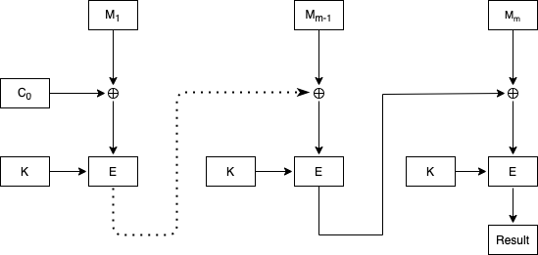
CBC-MAC
Variant of CBC MAC (Cipher Block Chaining Message Authentication Code)
Construct a secure MAC for short and fixed length messages based on any block cipher.
Only the final output is the result, so verification is done by re-computing the result only.
When message lengths vary, the CBC MAC is not secure
CBC MAC must be embellished using EMAC (Encrypted Message Authentication Code)

Slide 8


FCBC
FCBC is the refinement of EMAC
Difference is the number of keys used and how the last block of the message is treated.
Without padding , for last block use key K₂
In case of padding , for a last block use key K₃
Can not add ‘000’ in padding because, message are same after padding zero.
Idea is pad with ‘100..00’ where 1 indicates beginning of pad.
One can also add new dummy block, but for FCBC no dummy blocks are required, ambiguity resolved by use of K₂ and K₃.

Slide 9
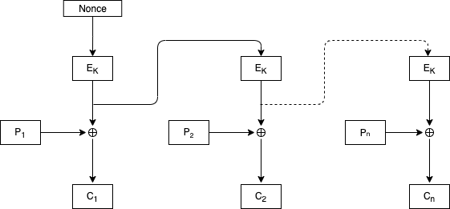
OFB
Output feedback mode
Output of encryption process is directly placed in next stage of shift register without XOR operation.
If there is any bit error out in the output of the encryption algorithm, it will not affect the C.T.
This mode provides confidentiality by use of nonce as an initial vector (IV).
Nonce -> value must be unique for each execution of the algorithm
-> nonce helps to increase the complexity of the algorithm

Slide 10
AEAD
AE
Authenticated encryption
Provides privacy and confidentiality
AE + AD = more security
AD
Associated data
Provides only integrity

Slide 11
AEAD Approach For ESTATE
ESTATE uses AEAD approach and receives:
encryption key, K
a nonce, N
an associated data, A
a message, M
Returns
a ciphertext, C
a tag, T

Slide 12
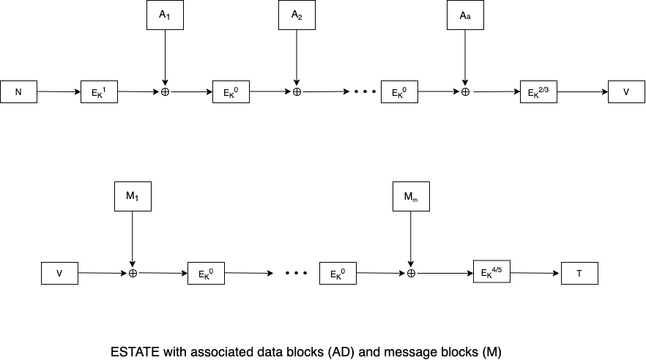
AEAD Approach For ESTATE
Case 1
Associated data
Nonce
Intermediate tag
Message
Final tag
Encrypt the nonce using tweak value 1
0 has been used to process all the associated data and messages
Last call is differentiated with tweaks 2,3 or 4,5 depending upon whether the data is full or partial

Slide 13
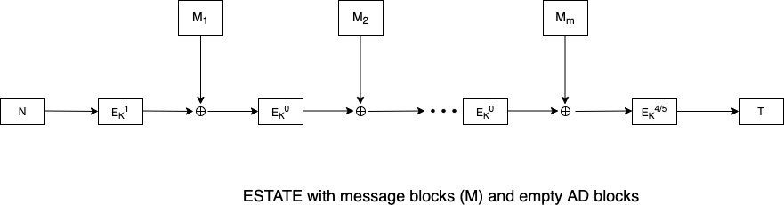


AEAD Approach For ESTATE
Case 2
Case 3
Case 4
Simply use unique tweak 8 to encrypt the nonce and that is the tag value
$$T := {E_{K}}^{8} (N)$$

Slide 14

AEAD Approach For sESTATE
sESTATE is a smaller version of ESTATE
It replaces the full block cipher E with round reduce block cipher F, that always uses tweak 15
But the last block uses full block cipher
Case 1

Slide 15


AEAD Approach For sESTATE
Case 2
Case 3
Case 4
Simply use unique tweak 8 to encrypt the nonce and that is the tag value
$$T := {E_{K}}^{8} (N)$$

Slide 16
Choice Of Tweaks
Tweaks # | Where | Why
0 | To process the bulk of messages | Identical to block cipher
1 | First block cipher call | Ensures RUP security
2 and 3 | Full and partial AD block processing | For Domain separation
4 and 5 | Full and partial final plaintext block processing
6 and 7 | Non-empty AD and empty message
8 | Empty AD and message
ESTATE -> 0 - 8 tweaks
sESTATE -> 0 - 15 tweaks
SUNDAE uses only block cipher, why ESTATE requires tweakable block cipher !
Tweaks use for a domain separation

Slide 17
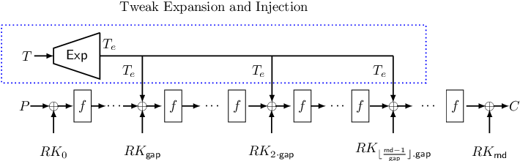
The Elastic-Tweak Framework
Use with any SPN based block ciphers that allows one to efficiently design tweakable block ciphers with short tweak.
SPN – substitution permutation network (ex, AES)
Convert block cipher (BC) to a short tweak tweakable block cipher (tBC)
BC to tBC : BC [t, t_{e}, t_{ic}, gap]
[tweak size, extended tweak size, positions where we insert the tweak bits, no of rounds between each tweak addition]
How it works?
Expand tweak with high distance error correcting code and then we enject it into state.

Slide 18
Tweaks In ESTATE
ESTATE has various constructions for a various application domain
TweAES-128: AES-128 [4, 8, 8, 2]
TweGIFT-128: GIFT-128 [4, 32, 32, 5]
Energy Efficient
Area Efficient

Slide 19
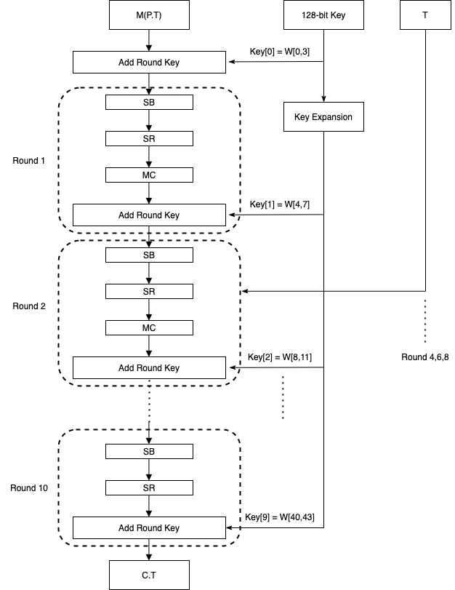
Tweakable Block Cipher (TweAES-128)
Key Size | 128 bits
Tweak | 4-bit
Block Size | 128-bits
Number of Rounds | 10
function TweAES(K, T , M )
(W43, . . . , W0) ← KeyGen(K)
X ← X ⊕ (W3, W2, W1, W0)
for i = 1 to 9 do
X ← SubBytes(X) X ← ShiftRows(X) X ← MixColumns(X) X ← X ⊕ (W4i+3, W4i+2, W4i+1, W4i)
if i%2 = 0 then
X ← AddTweak(X, T )
X ← SubBytes(X) X ← ShiftRows(X) X ← X ⊕ (W43, W42, W41, W40)
return X
AddTweak: the 4-bit tweak first expanded to the 8-bit value with the help of linear code and in next step the 8-bit value is XORed to the state at an interval of 2 rounds (2,4,6,8).

Slide 20
Tweakable Block Cipher (TweAES-128-6)
Key Size | 128 bits
Tweak | 4-bit
Block Size | 128-bits
Number of Rounds | 6
Difference
Number of rounds
Last round (6th round) includes the mix column operation
Function TweAES-6(K,T,X) (W43,...,W0)←KeyGen(K,X) X←X⊕(W3,W2,W1,W0) for i=1 to 6 do X ← SubBytes(X) X ← ShiftRows(X) X ← MixColumns(X) X ← X ⊕ (W4i+3, W4i+2, W4i+1, W4i)
if I % 2 = 0 and I < 6 then
X ← AddTweak(X, T )
return X
Here the AddTweak operation called in round 2 and 4 because the algorithm itself has an if condition for (i < 6) and that is why the 6th round is not performing AddTweak operation.

Slide 21
Tweakable Block Cipher (TweGIFT-128)
Each round of GIFT consists of 3 steps : which is conceptually similar to wrapping a gift
1. Put the content into a box (SubCells) 2. Wrap the ribbon around the box (PermBits) 3. Tie a knot to secure the content (AddRoundKey)
Key Size | 128 bits
Tweak | 4-bit
Block Size | 128-bits
Number of Rounds | 40
C -> The six bits are initialized to zero, and updated before being used in a given round
Each of the 6 bits is xored to a different nibble to break the symmetry
Function TweGIFT(K,T,X)
C ← 000000
for I = 0 to 39 do
X ← SubCells(X)
X ← PermBits(X)
(K,X) ← AddRoundKey(K,X)
(C,X) ← AddRoundConstant(C,X)
if (i+1) % 5 = 0 and I < 39 then
X ← AddTweak (X, T )
return X
Here the 4-bit tweak is expanded to the 32-bit value with the help of linear code and the 32-bit value is XORed to the state at an interval of 5 rounds. Hence, the rounds 4,9,14,19,24,29 and 34 are affected.

Slide 22
ESTATE With Block Ciphers
AEAD scheme defined in ESTATE mode of operation with tweakable block cipher
ESTATE_TweAES-128
Size of the key, nonce and tag are 128 bits
ESTATE_TweGIFT-128
Achieve hardware-oriented ultra-lightweight applications
Size of the key, nonce and tag are 128 bits
sESTATE_TweAES-128-6
Get higher throughput demanding and energy constrained applications
smaller version of ESTATE
Size of the key, nonce and tag are 128 bits

Slide 23
Security
Approaches | Privacy |  | Integrity
 | Time | Data (in bytes) | Time | Data (in bytes)
ESTATE_TweAES-128 | 2¹²⁸ | 2⁶⁴ | 2¹²⁸ | 2⁶⁴
ESTATE_TweGIFT-128 | 2¹²⁸ | 2⁶⁴ | 2¹²⁸ | 2⁶⁴
sESTATE_TweAES-128 | 2¹¹² | 2⁶⁰ | 2¹¹² | 2⁶⁰
All the algorithms are secure in nonce-misusing situation
There are no hidden weaknesses in ESTATE and sESTATE modes of operations
sESTATE_TweAES-128-6 allows a little bit less data and time as compared to ESTATE_TweAES-128 due to the round reduced function.
ESTATE is very efficient for short messages

Slide 24
Obtained Features Of ESTATE And sESTATE
Nonce-misuse Resistant
Multiplication Free
RUP Secure
Robustness
Optimal
Single State

Slide 25
Hardware Security
Primitives | LUTs | FF | Slices | Frequency (MHz) | Clock cycles | Throughput (Mbps)
TweAES-128 | 1617 | 524 | 574 | 328.27 | 11 | 3819.87
ESTATE_TweAES-128 | 2235 | 679 | 1110 | 314.71 | 20 | 2014.14
TweGIFT-128 | 790 | 408 | 336 | 597.59 | 41 | 1865.65
ESTATE_TweGIFT-128 | 1413 | 698 | 616 | 580.11 | 80 | 928.27
Used hardware: Virtex 7 FPGA
LUTs stands for lookup tables that can be prefilled with a bunch of key value pairs that are utilized at some point in the future to quickly find values by key.
With more LUTs, it is very hard to crack any system but at the same time it needs more hardware space to store the data structure.
A greater number of cycles requires more time to perform and also gives a low throughput
ESTATE_TweAES-128 is better in terms of performance

Slide 26
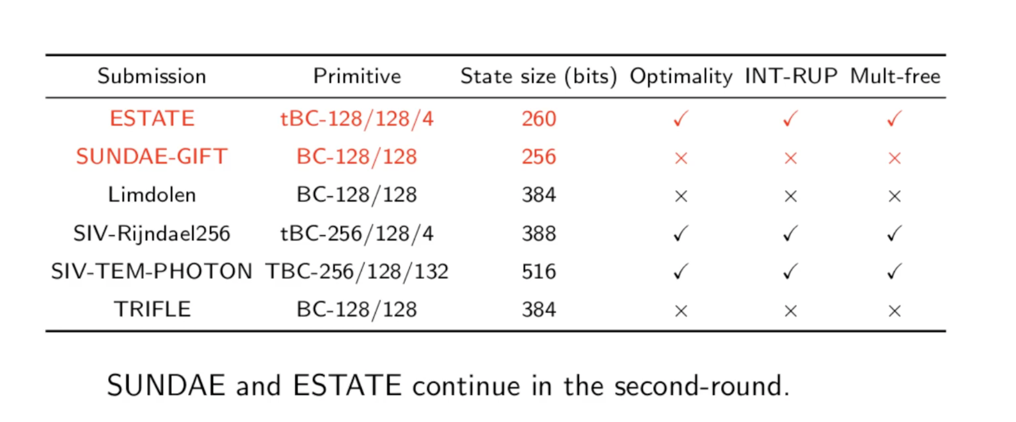
About Competition

Slide 27
Comparison Between SUNDAE and ESTATE
 | SUNDAE - AES | ESTATE -AES
Message length (bytes) | 128 | 128
Cycles | 181 | 171
Throughput (Mbps) | 1713.13 | 1814.46
Throughput for short messages
Primitive calls:
ESTATE -> a + 2m
SUNDAE -> a + 2m + 1
SUNDAE has one additional call to differentiate the emptiness of data
ESTATE uses tweak to differentiate the data which is very efficient for short messages

Slide 28
Future Scope
FCBC is not so desirable, one can use XCBC, where same key is used for all the block cipher.
May be there is a chance of attack in MAC-then-encrypt method, alternative option is use of encrypt-then-MAC.
Design of the algorithm: what if the user wants to verify the encrypted text before decrypting it? It is not possible with this scenario, firstly decrypting the cipher text and second, using FCBC to check the integrity of the message.

Slide 29
References
N. D. A. J. C. M. L. M. N. Y. S. Avik Chakraborti, "ESTATE," p. 22, March 29, 2019.
A. B. A. L. E. T. Subhadeep Banik, "SUNDAE: Small Universal Deterministic Authenticated Encryption for the Internet of Things," p. 35, 2018.
P. W. H. H. Ping Zhang, "The INT-RUP Security of OCB with Intermediate (Parity) Checksum," p. 34.
P. R. John Black, "CBC MACs for Arbitrary-Length Messages: The Three-Key Constructions," p. 19, 2000.
A. R. R. Mohan H.S, "REVISED AES AND ITS MODES OF OPERATION," International Journal of Information Technology and Knowledge Management, p. 8, June, 2012.
M. Dworkin, "Recommendation for Block Cipher Modes of Operation," NIST, p. 65, 2001.
"ADVANCED ENCRYPTION STANDARD (AES)," Federal Information Processing Standards Publication 197, p. 51, November, 2001.
S. K. P. T. P. Y. S. S. M. S. Y. T. Subhadeep Banik, "GIFT: A Small Present Towards Reaching the Limit of Lightweight Encryption," p. 50, 2017.
A. B. A. L. B. M. N. M. a. K. Y. Elena Andreeva, "How to securely release unverified plaintext in authenticated encryption," 20th International Conference on the Theory and Application of Cryptology and Information Security, Kaoshiung, Taiwan, R.O.C., p. 105–125, 2014.
N. D. A. J. C. M. L. M. N. Y. S. Avik Chakraborti, "Elastic-Tweak: A Framework for Short Tweak Tweakable Block Cipher," p. 39.

Slide 30
Thank you

