Slide 1


Slide 2


Report Title: An Overview About Amrita Consumer Food Products Ltd.
Name: Urmi Akter
Roll: 26
Batch No: 46
Department of Political Science
Date: 06-12-2024

Slide 3
Amrita Consumer Food Products Ltd.
Amrita Consumer Food Products Ltd. is a distinguished name in the Indian food manufacturing and distribution industry, renowned for its unwavering commitment to delivering high-quality, consumer-focused food products.
Established with the vision to cater to the evolving tastes and preferences of a diverse population, the company has positioned itself as a trusted brand synonymous with quality, innovation, and customer satisfaction.
With a legacy rooted in excellence, Amrita Consumer Food Products Ltd. has become a household name, serving millions of customers across various segments.

Slide 4
Amrita Consumer Food Products Ltd.
Core Values
Commitment to Quality: Quality is at the heart of everything Amrita Consumer Food Products Ltd. does. The company prioritizes the production of safe, hygienic, and high-standard food products, ensuring customer satisfaction and trust. Every product undergoes rigorous quality control measures to meet international standards.
Integrity and Transparency: Integrity in business practices and transparency in dealings define Amrita’s operations. These values strengthen its relationships with stakeholders, from customers and employees to suppliers and distributors.
Sustainability and Social Responsibility: Amrita is committed to sustainable practices, aiming to minimize its environmental impact through eco-friendly manufacturing processes. The company also supports community initiatives, including programs for local farmers and social development projects.

Slide 5

Introduction to the Company:
Established in 1998
2006 – Amrita Food Product & Amrita Consumer were merged as Amrita Consumer Food Products Ltd.
2009- The Company got ISO certificate
2001- The company got GMP certificate
2012- Company got Health HACCP certificate

Slide 6
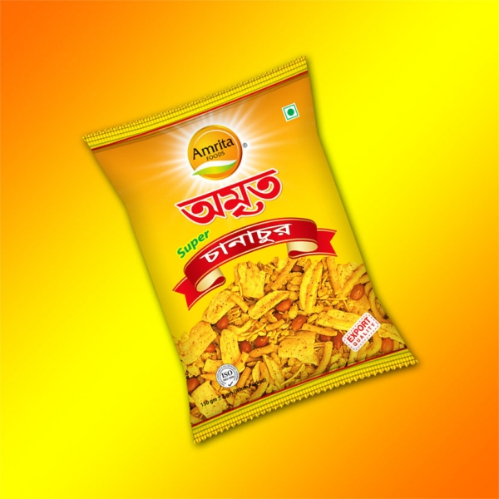

Key Product & Services
Spices
Snaks
Semai
Chatny
Oil
Noodls
Rice
Flour
Fruit Jell
Candy

Slide 7
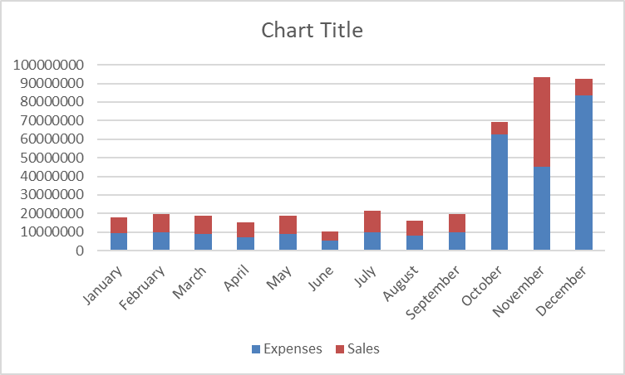
Product Cost & Sales

Slide 8
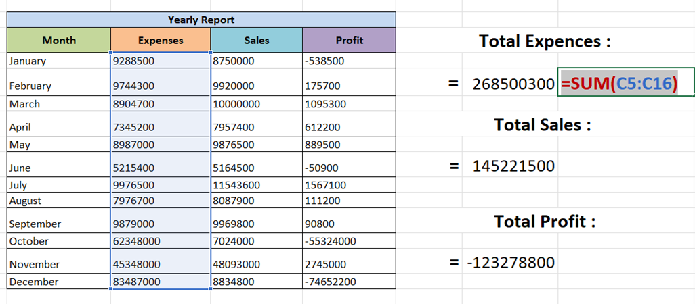
Sum Formula

Slide 9

Thank You Everyone

