Slide 1
Machine Learning ISE-3
Topic: Examine steps in developing a machine learning application with respect to the mini project
Pedagogy: Collaborative learning
Mini Project topic: Sentiment Analysis
Class: TE COMP-B Roll No: 42

Slide 2

Introduction
Sentiment analysis is the process of analyzing digital text to determine if the emotional tone of the message is positive, negative, or neutral.
Use Cases
Improve Customer Service
Brand Monitoring and Market Research
Track Campaign Performance

Slide 3

Data Collection
Data Collection involves gathering a large dataset of text samples along with their corresponding sentiment labels.
Important Points and considerations
Data Size
Data Quality
Dataset Selected: Sentiment140
Data Diversity
Data Balance

Slide 4
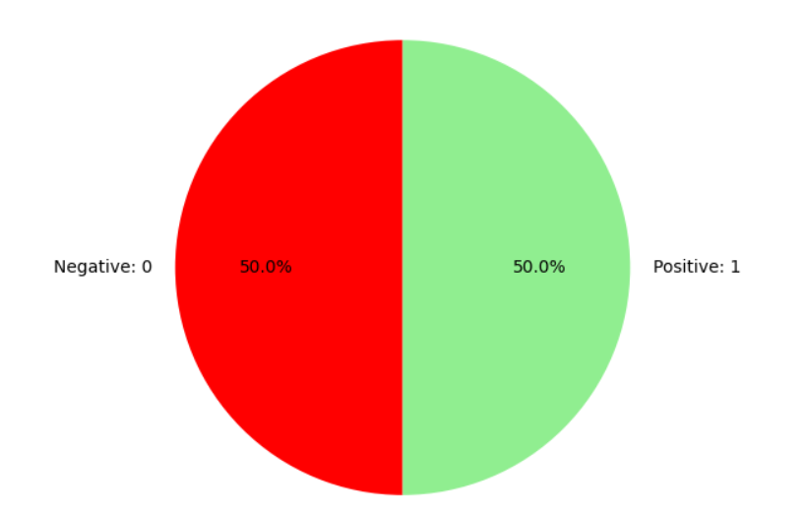
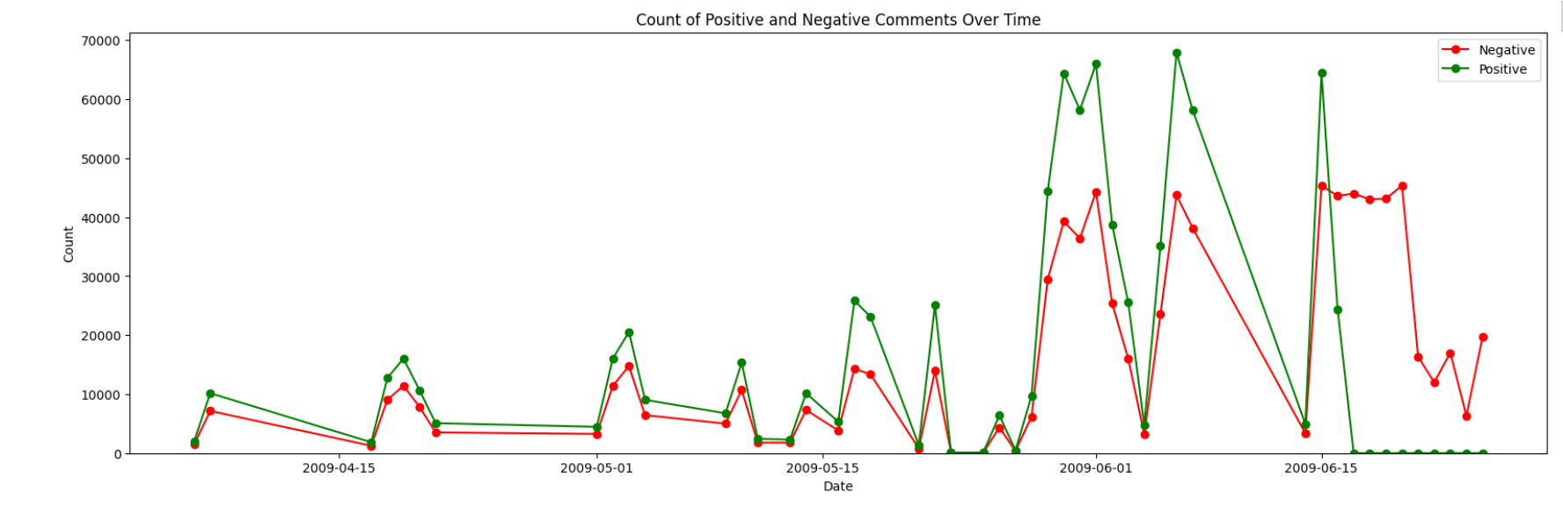
Data Visualization
In Data Visualization there is a representation of data through the use of common graphics, such as charts, plots, and infographics in order to understand the pattern and get deeper insights
Data Visualizations performed
Sentiment Distribution
Sentiments Over Time

Slide 5
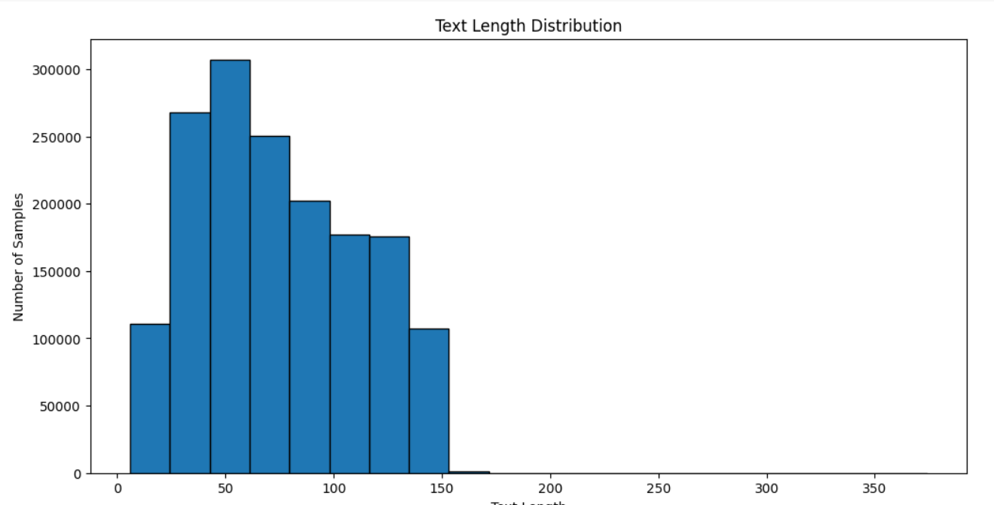
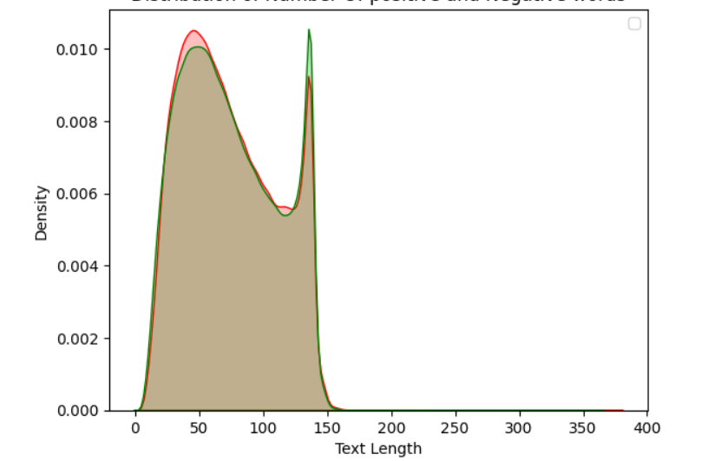
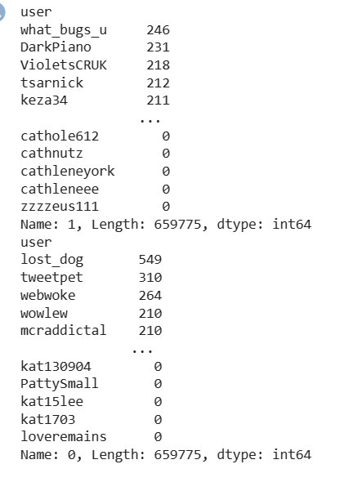
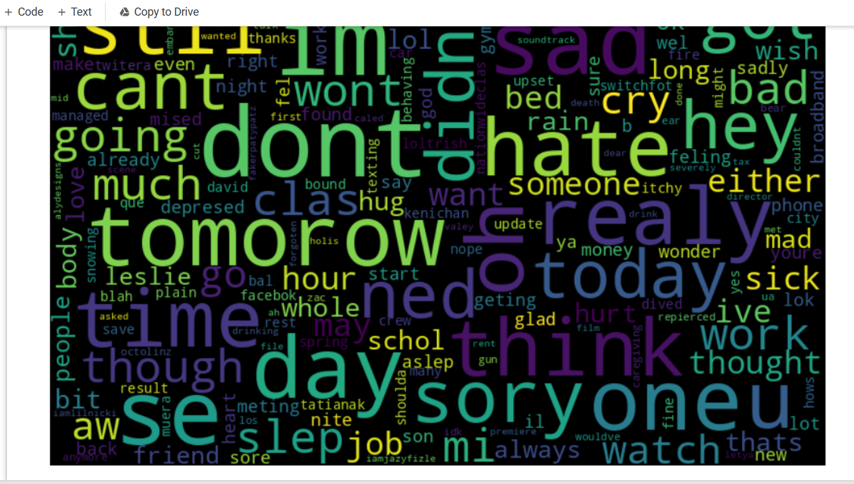
Text Length Distribution
Density Plot of Text Lengths
Sentiment Counts by User
Word Clouds

Slide 6
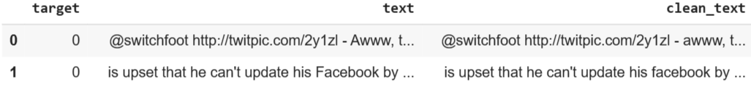
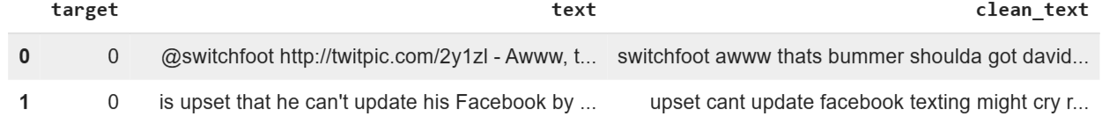
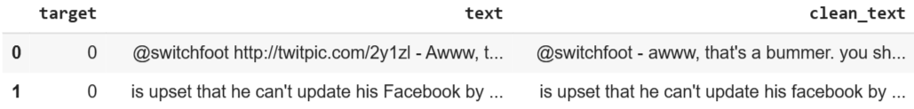
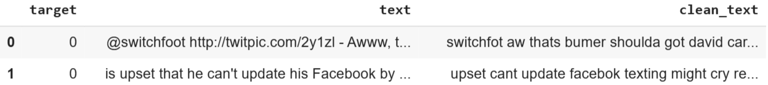
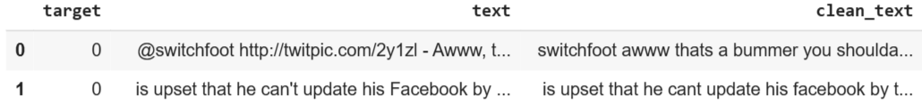
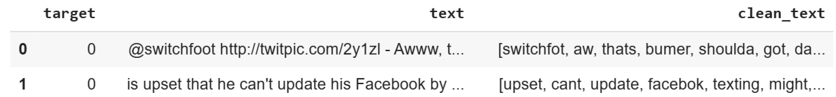
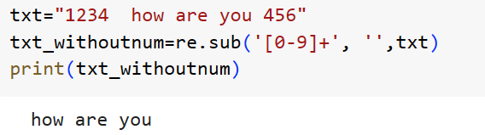
Data Preprocessing
Data Processing involves cleaning raw text data and processing it to make it suitable for analysis
Steps
Converting the text to lowercase
Removing URLs
Removing unnecessary characters
Removing numbers
Removing stop words
Removing repeating characters
Tokenization
Performing stemming or lemmatization

Slide 7
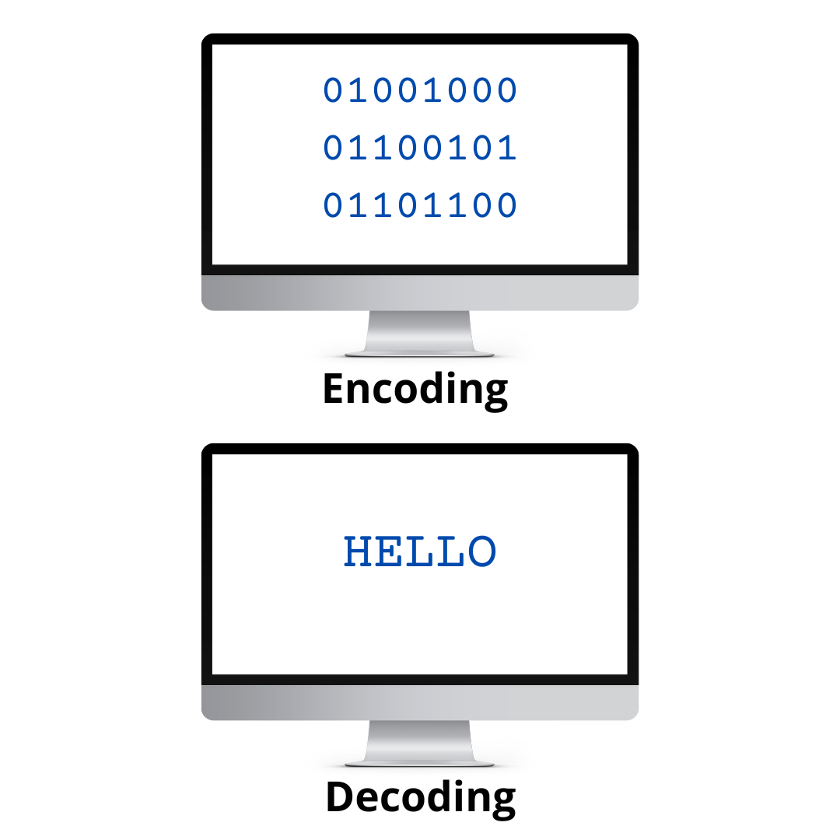

Text-to-Numerical Conversion
Machine learning models require numerical inputs. So in this step the preprocessed text data needs to be transformed into numerical features
Types
Bag-of-Words (BoW) representation
Word embeddings

Slide 8

Model Selection
It involves choosing an appropriate model is critical for the success of the sentiment analysis task
Common choices include:
Logistic Regression
Naive Bayes
Support Vector Machines
K- Nearest Neighbours

Slide 9
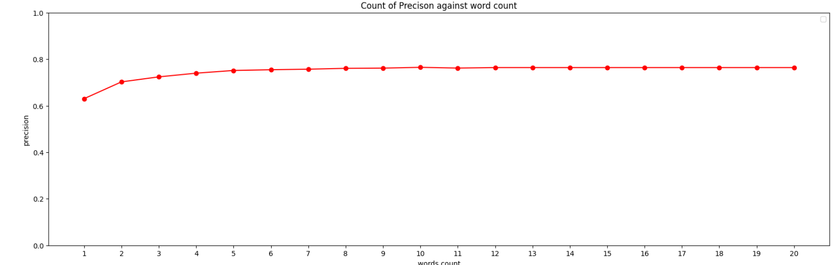
Training Process
Model Training involves learning from the training data to make predictions on new, unseen data.
Steps
Converting Data into a bag of words representation by determining the minimum
features(columns) sufficient for training
Data Splitting
Training the models
Performed Ensemble modeling
Precision vs Wordcount

Slide 10
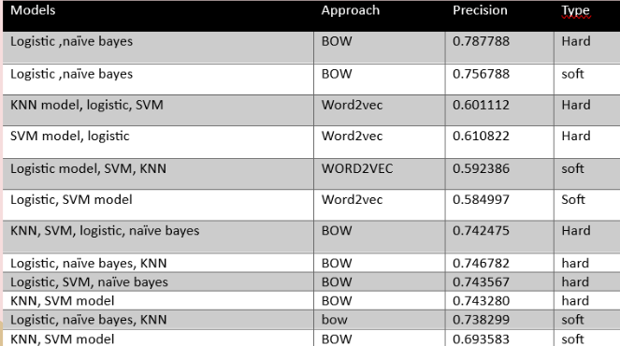
Model Optimization
Model optimization involves improving the model's performance through multiple techniques like fine-tuning hyperparameters, training new models, and ensemble modeling.
Steps
Training New models (KNN and SVM)
Using a different approach
(Word2vec approach)
Ensembling Modelling
Combinations of trained models for ensemble modeling
Selecting the best ensembled model

Slide 11
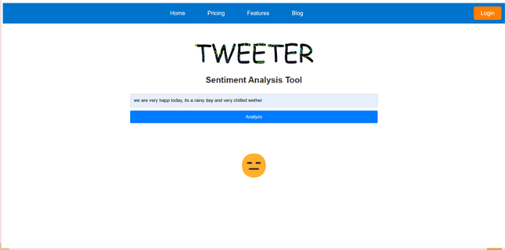
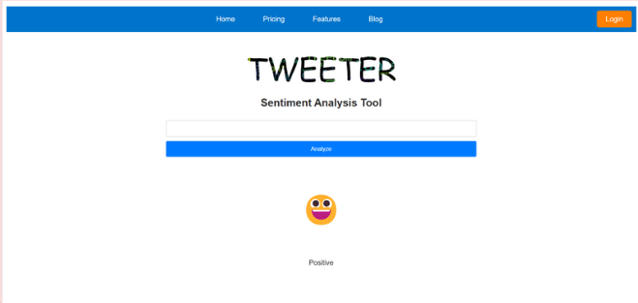
Model Hosting
Model hosting refers to the process of deploying a machine learning model to a server or a cloud-based platform where it can be accessed and used by other software applications or services.
Steps performed
Selecting the best model
Creating an input pipeline
The model was locally hosted using flask

Slide 12
Conclusion
Sentiment analysis is a powerful and valuable tool for understanding public emotions, opinions, and attitudes expressed in text data, especially in social media platforms like Twitter. Building an effective sentiment analysis model involves several key steps, starting with data collection from diverse and reliable sources. Preprocessing the data ensures that it is clean and suitable for analysis, while data visualization provides insights into sentiment distribution and trends. Transforming the text data into numerical features is essential for machine learning models, and techniques like Bag-of-Words and Word Embeddings are commonly used. Selecting the right model for sentiment analysis plays a critical role and Model training and optimization set help assess the model's performance and accuracy.
So, by leveraging these steps an effective sentiment analysis model that provides valuable insights to businesses, researchers, and individuals to make informed decisions can be achieved.

