Slide 1
WELCOME TO MY PRESENTATION

Slide 2

Presented By-
Name : Urmi
Roll : 21 HIS 028
Department : History
University of Barisal.

Slide 3
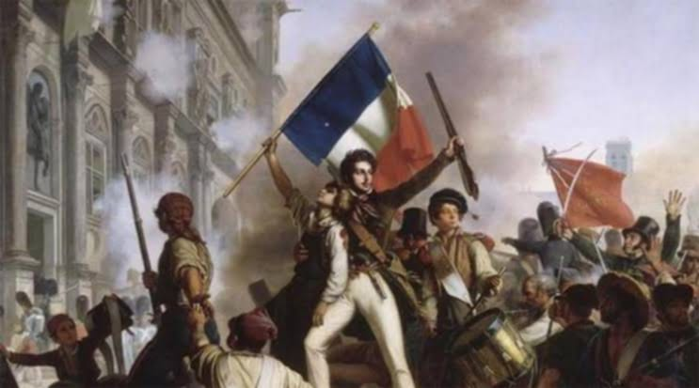
Political causes of the French Revolution

Slide 4
French Revolution
The French people started a revolution in 1789 to get rid of the accumulated social inequality, exploitation and oppression.
There were many reasons for the French Revolution. One of them is for political reasons.

Slide 5
Political causes of the French Revolution
Political factors of the French Revolution include
The Autocratic monarchy
The Lack of competent rulers
The Corrupt Governance and Judiciary
Failure in foreign policy

Slide 6
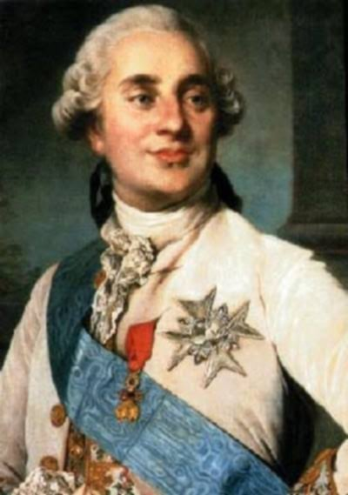
1.The Autocratic monarchy
At the time of the French Revolution, there was a 'divine monarchy' in France. That
is, the power of the king is given by God and the king will be responsible for his
actions only to God and not to the people. In pre-revolutionary France, the king was
the ruler, judge, legislator and the fate of the people.
King Louis XIV used to say, "I am the state."
Louis XVI used to say, "My will is law."
If anyone criticized the king's actions, he was imprisoned.

Slide 7
2.The Lack of competent rulers
In the eighteenth century, the king of France was not only autocratic, but also inefficient. Although Louis XIV was an autocratic ruler, he worked for the welfare of his subjects.
But Louis XV and Louis XVI were luxurious and extravagant rulers. They never thought about their people.

Slide 8
3.The Corrupt Governance and Judiciary
The French judicial system was very corrupt and expensive. Though about right and wrong. In most cases, the punishment was greater than the crime. People of all communities did not get equal status in the eyes of the law.
e judges paved the way for their income by collecting more fines without thinking the French monarchy, the vested bureaucrats were engaged in autocratic activities by establishing all the powers of the administration.

Slide 9
4.Failure in foreign policy
The failure of the French government in foreign policy greatly tarnished the image of the monarchy in the eyes of the people.
France was defeated by the English in America and India in the Seven Years' War in Europe in 1756. As a result of these defeats, French trade and commerce were severely damaged and the French treasury became empty.

Slide 10
From the above discussion, the weakness of the French power in the second half of the eighteenth century is clearly known. The weakness of the monarchy was particularly responsible for the French Revolution.

Slide 11
Thank you

