Slide 1
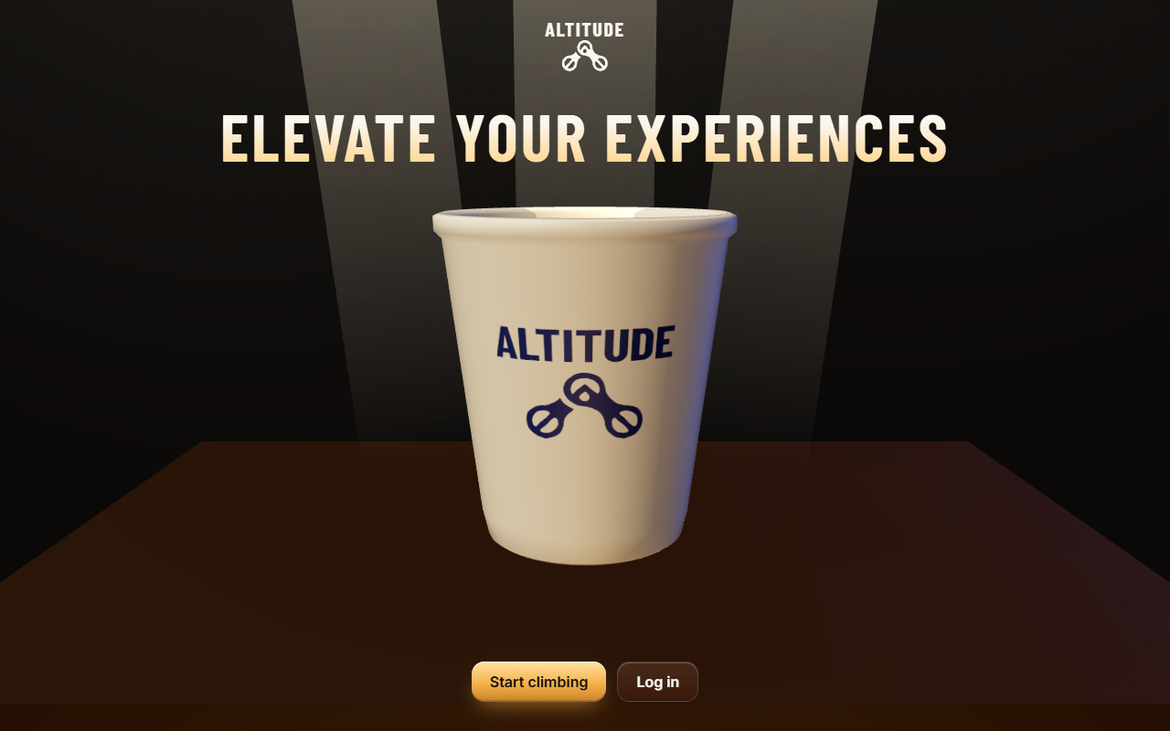
ASCEND
The Altitude app for RIT Dubai
Team Pythons, ideaForge (AIRC x Altitude)
Notes:
Start on the live demo right away. Phone in one hand, barista laptop on the table.

Slide 2
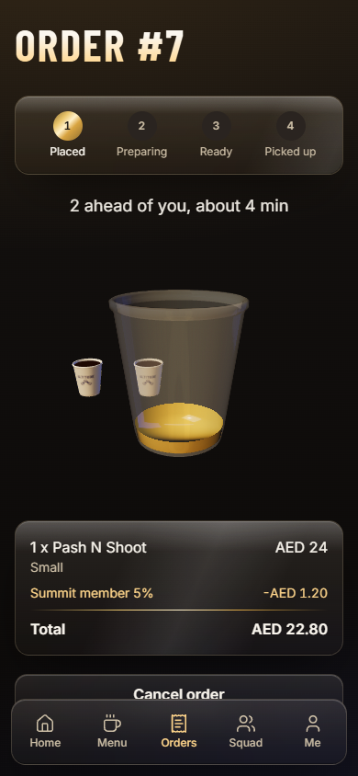
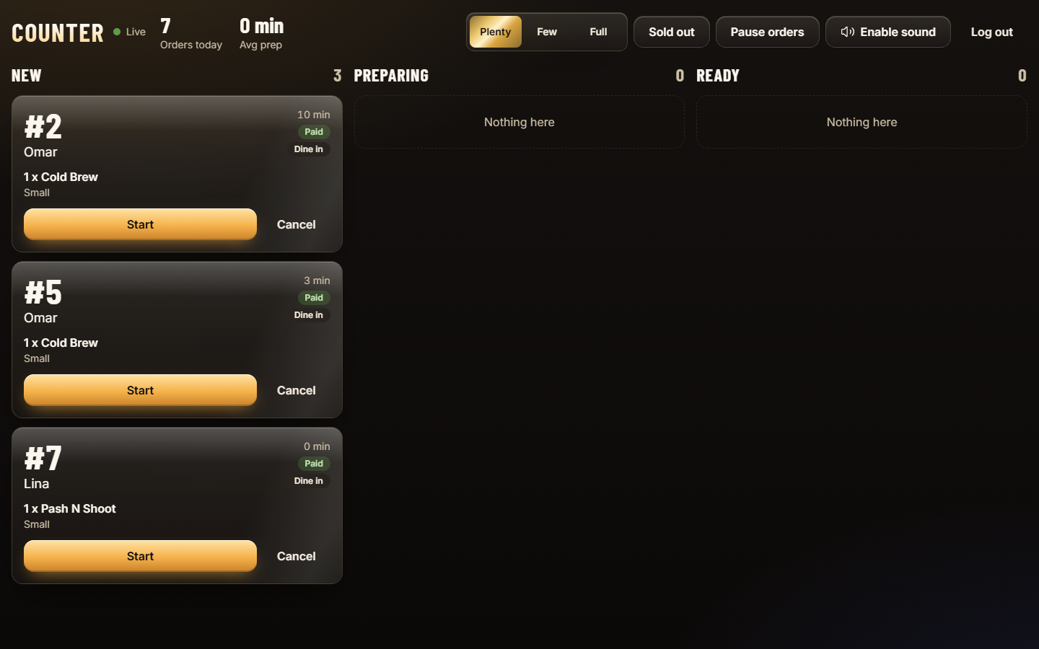
One order, live on both sides of the counter
Live
Realtime updates with a 15-second polling fallback
The student sees the queue and the ETA. The barista taps Start and Ready. The phone alerts the moment it is ready.
Notes:
0:00 to 0:40. Run the demo: order on the phone, tap Start and Ready on the laptop, show the READY alert and meters landing.

Slide 3
Peak hours mean queues and no reason to return
Queues
No rewards
No visibility
Students lose break time waiting at the counter between classes.
Regulars get nothing for coming back. Altitude has no way to reach them.
Staff track orders by hand, and managers cannot see what sells.
Notes:
0:40 to 1:10. Keep it short. Tie each problem to what they just saw in the demo. Check these claims against what your team has seen at the cafe.

Slide 4
Every order is a step up
Social loyalty
Peak
1600 m
Squads: friends earn 10% of your meters
Club Summit: clubs race every month
Drink Lab: students invent and vote on drinks
Summit
10% off and a monthly free drink
800 m
Ridge
5% off every order
300 m
Base Camp
Free extra shot
0 m
Earn meters and spin tickets
Notes:
1:10 to 2:15. Meters are 1 per AED. Tier uses lifetime meters. Squads, clubs and the Drink Lab make it social.

Slide 5
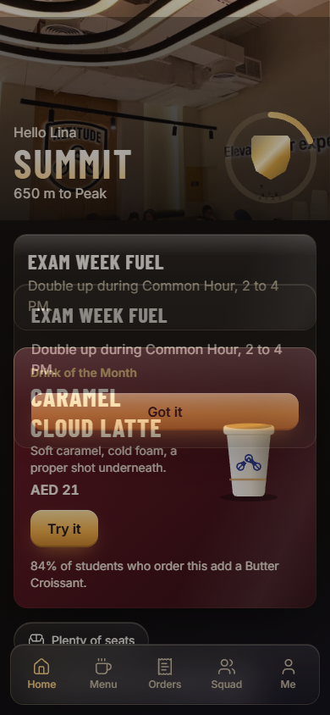
All six brief items work today
Loyalty
Order and queue
Meters, tiers, perks, rewards
Live position, ETA, ready alert
Popular picks
Promo spotlight
From order history
Drink of the Month, offers
Club and event hub
Online payment
Leaderboard, events, RSVP
Demo payment, built to plug into MOBIPOS
Notes:
Say "demo payment" and "built to plug into MOBIPOS". Never say integrated. Prices and historic orders are demo data.

Slide 6
Rules live on the server, not in the browser
31
100%
1x
automated tests pass: 23 unit, 8 end to end
of tables protected by row-level security
meters awarded per order, even on a double tap
Prices, discounts, order numbers and meters all run in database functions. A tampered browser cannot change them. If 3D fails, ordering still works.
Notes:
Technical execution. The golden path test passes with 3D on and off.

Slide 7
Ready to roll out at near-zero cost
1
2
3
4
Confirm
Connect
Harden
Launch
Real prices and menu in the admin screen
MOBIPOS adapter, a 1-2 day vendor task
Email verification on, demo accounts off
Any phone plus the counter laptop
Free hosting tiers. No new hardware. Barista training is one screen.
Notes:
2:15 to 2:45. Be honest: payment is a demo today and the vendor must supply MOBIPOS API access.

Slide 8
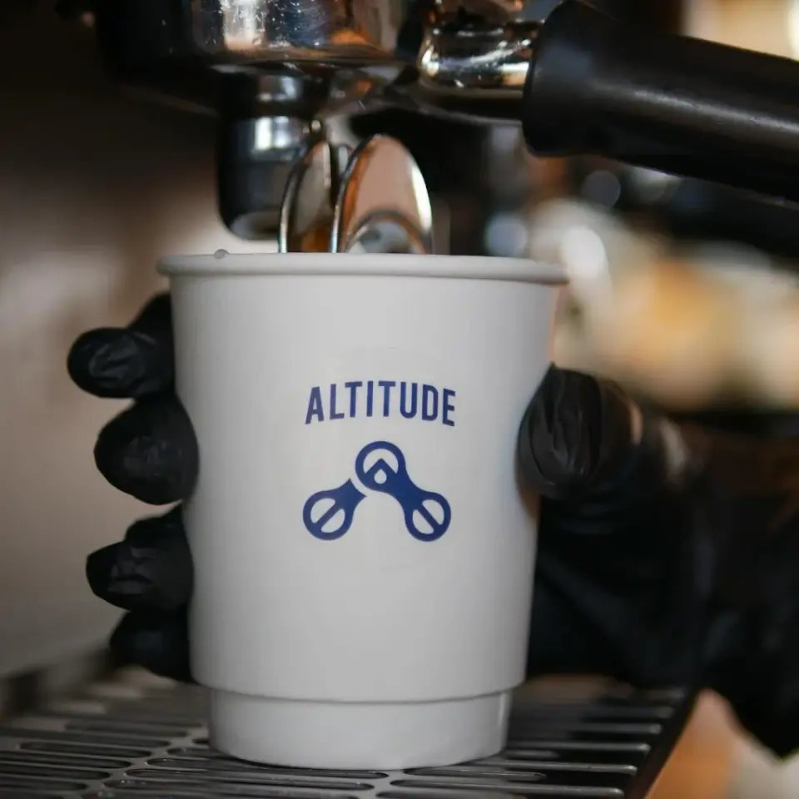
Put it on the menu
Team Pythons
Notes:
2:45 to 3:00. The ask. Stop talking after "Put it on the menu."

