Slide 1
TITLE: GOLD PRICE REGRESSION
Team members: Urooj and Shanza
Team leader: Urooj
15-11-2024

Slide 2

Introduction
To analyze and predict gold price movements using a comprehensive regression dataset.
Project Overview: To develop a model that accurately predicts the daily gold price based on historical data and economic indicators.

Slide 3
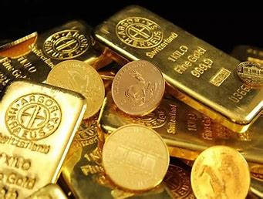
Data Overview:
Key Features:
The dataset includes 2,290 entries with 6 key features, such as the S&P 500 index (SPX), oil prices (USO), silver prices (SLV), and the EUR/USD exchange rate. The Date column was processed to extract Year, Month, and Day for deeper trend analysis.
Time Span: The time period covered in the dataset (2008-2019).

Slide 4
Key Findings from EDA
High Correlation with Economic Indicators: Gold prices often show a strong relationship with inflation rates, interest rates, and USD exchange rates.
Trends & Patterns: There is a clear upward trend in the gold price, often punctuated by spikes during times of economic uncertainty or crises.
Volatility & Seasonality: Gold price volatility is noticeable during certain geopolitical or economic events, and seasonality might appear due to cultural or economic cycles.
Stationarity Issues: Gold prices often exhibit non-stationarity; transformations or differencing may be necessary before applying regression techniques.
With these EDA insights, you can prepare the data for modeling, selecting and engineering features based on trends and correlations. Then, various regression models (e.g., Linear Regression, ARIMA, or LSTM for time series) can be tested to predict gold prices.

Slide 5
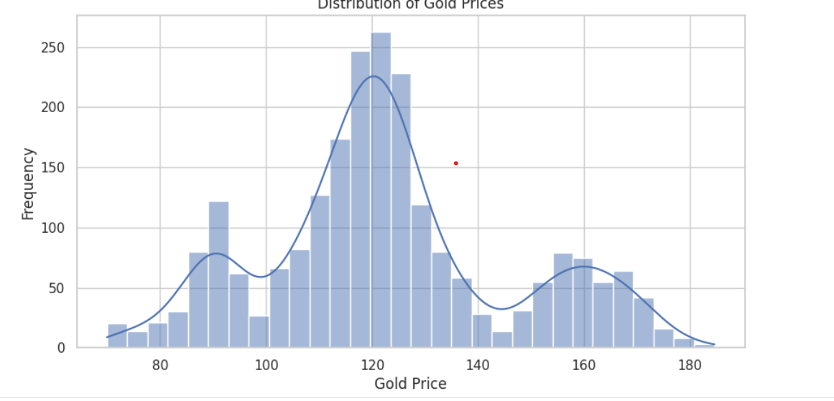
Gold_price_distribution
This histogram shows the distribution of gold prices, with most values clustering around 120 and a secondary peak near 160, suggesting a bimodal distribution. The density curve overlays the bars to highlight these two common price ranges

Slide 6
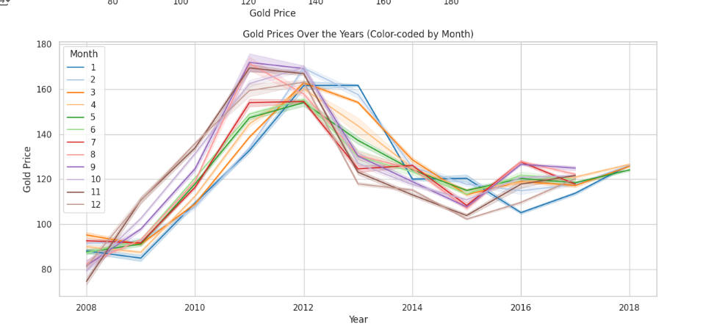
Gold Prices Over the Years (Color-coded by Month)
This line plot shows monthly gold price trends from 2008 to 2018. Prices peak around 2011-2012, decline until 2015, and then stabilize with minor fluctuations. Each color represents a different month, highlighting seasonal patterns in gold prices

Slide 7
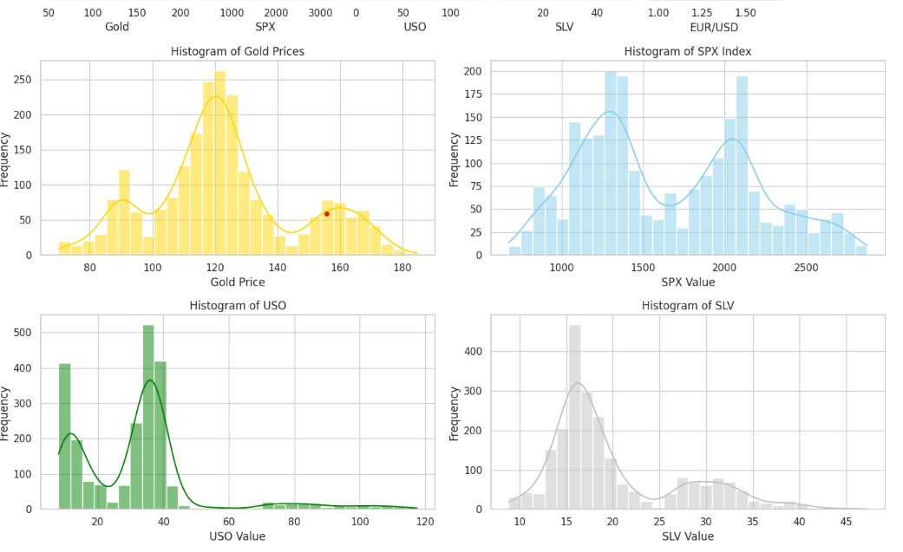
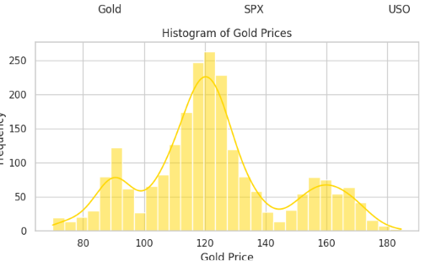
HISTOGRAM
This histogram shows gold price distribution, with a peak around 120, indicating the most frequent price. Smaller peaks at 100 and 160 suggest volatility, hinting at multiple market factors or regimes affecting prices..

Slide 8
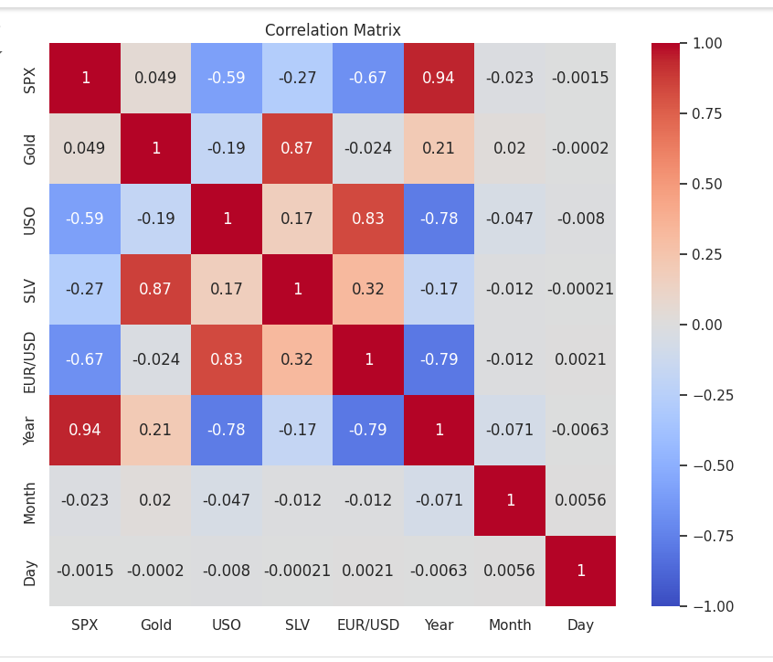
Correlation matrix
This heatmap visualizes the correlation between financial assets and time variables. Values close to 1 (dark red) indicate strong positive correlation, while values near -1 (dark blue) show strong negative correlation. Values near zero suggest little relationship. For example, SPX and Year show a high positive correlation, while SPX and EUR/USD have a strong negative correlation, helping to understand asset dependencies.

Slide 9
Modeling Approach
Linear Regression
Ridge Regression
Support Vector Regression (SVR)
Decision Tree Regression
Random Forest Regression
Best Model:
Random Forest Regression model gave us highest accuracy with less errors.

Slide 10
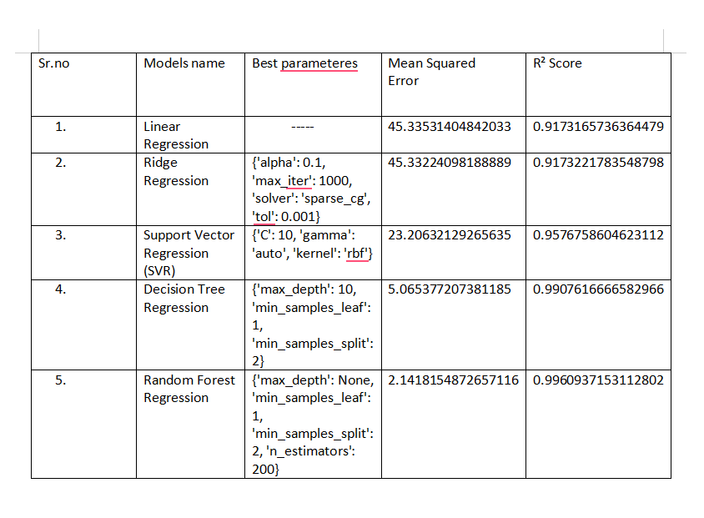

Results

Slide 11
Conclusions
Model Performance: Regression model shows [RMSE, MAE, R² values], indicating [strengths/limitations] in gold price predictions.
Significant Variables: Key predictors include [e.g., inflation rate, USD strength, interest rates].
Insights: Model reveals correlations between gold prices and macroeconomic factors, supporting its role as a hedge against [e.g., inflation, market volatility].
Limitations: Sensitive to market shifts and past trends; may miss unprecedented events (e.g., geopolitical crises).
Future Work
Model Improvement: Explore advanced models like LSTM or XGBoost for better trend capture.
Feature Engineering: Add predictors like geopolitical risk and supply/demand metrics.
Real-Time Updates: Develop a dynamic model for continuous accuracy.
Explainability: Use techniques like SHAP to clarify feature impact for stakeholders.

Slide 12
Thank you!
Thank you! Are there any questions or points you'd like me to elaborate on?

