Slide 1
Phone Chargers: Types, Technology & Best Practices

Slide 2
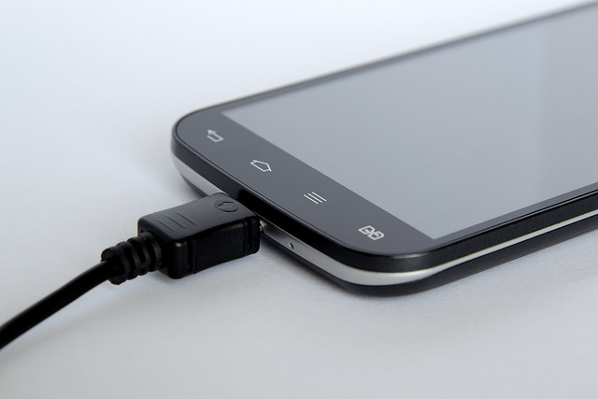
Common Types of Phone Chargers
USB-A: Traditional standard found in older phone models.
USB-C: Universal fast-charging standard for modern smartphones.
Lightning: Legacy proprietary connector used in older iPhones.
Wireless Qi: Cable-free charging using magnetic induction technology.

Slide 3
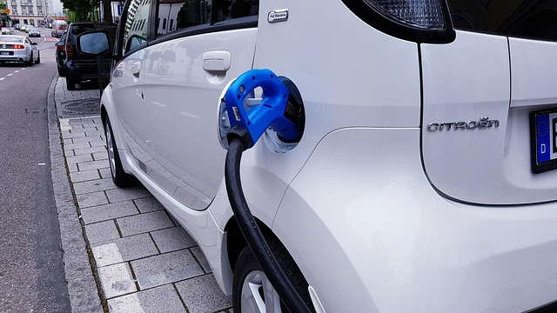
Understanding Fast Charging
Delivers higher wattage to recharge batteries significantly faster.
USB Power Delivery (PD) standardizes high-speed charging safely.
Smart chips adjust power output to prevent battery overheating.
Requires compatible phone, cable, and power adapter together.

Slide 4

Best Practices for Battery Health
Use certified chargers to prevent electrical hazards and damage.
Avoid extreme heat while charging your smartphone device.
Keep battery levels between 20% and 80% routinely.
Unplug cables gently to prevent physical port damage.

