Slide 1
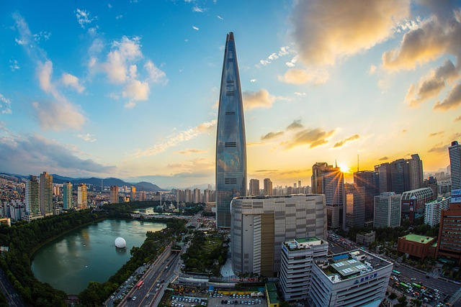
How AI is Changing the World

Slide 2

Revolutionizing Healthcare and Medicine
Accelerating drug discovery through predictive modeling.
Improving diagnostic accuracy with advanced imaging analysis.
Personalizing patient treatment plans for better outcomes.

Slide 3
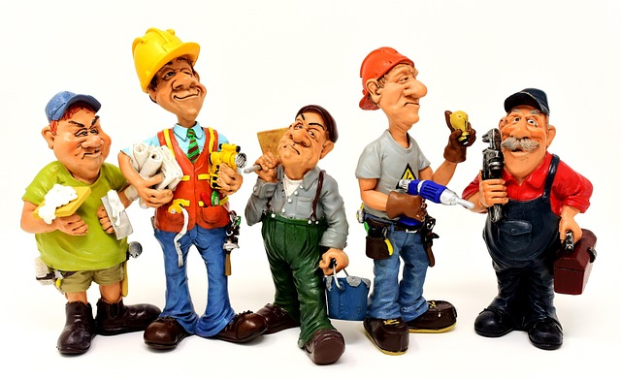
Transforming the Future of Work
Automating repetitive tasks to increase productivity.
Creating new job roles in AI development and oversight.
Enhancing human collaboration with smart virtual assistants.

Slide 4

AI in Everyday Life
Powering smart home devices for increased energy efficiency.
Personalizing streaming and shopping recommendations instantly.
Optimizing daily commutes using real-time traffic analysis.

Slide 5
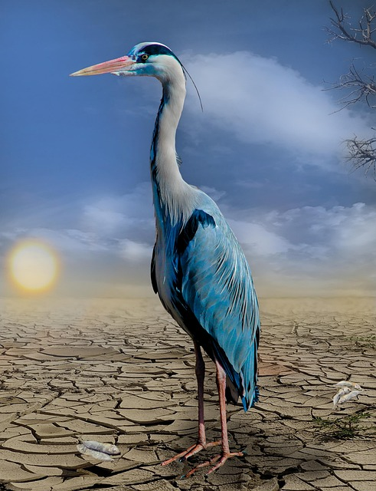
Combating Climate Change
Optimizing power grids to reduce global energy waste.
Monitoring deforestation and wildlife patterns via satellite data.
Predicting natural disasters to improve emergency response times.

Slide 6

Shaping an Ethical AI Future
Addressing algorithmic bias to ensure fair decision-making.
Establishing global regulations for safe AI deployment.
Securing personal data privacy in an automated world.

