Slide 1
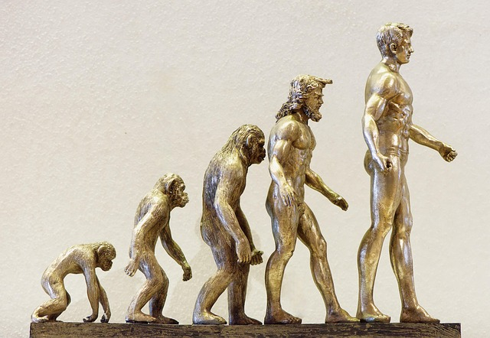
The Evolution and Impact of Computers

Slide 2
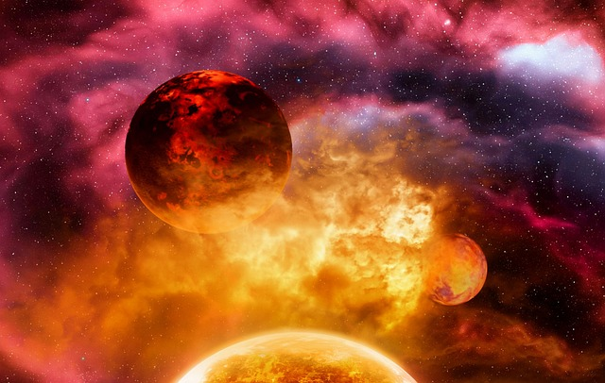
The Evolution of Computing
Early computers filled entire rooms and used vacuum tubes.
Microprocessors enabled the rise of personal home computers.
Today's devices are pocket-sized with immense processing power.

Slide 3
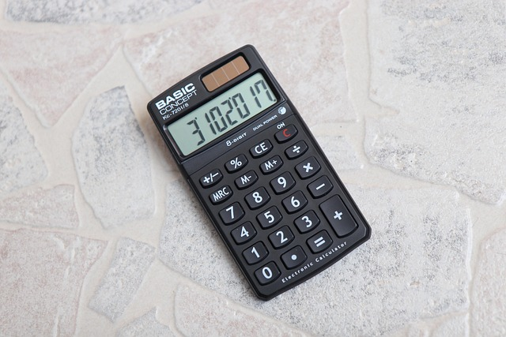
How Computers Work
The CPU acts as the brain, executing instructions.
RAM provides temporary memory for active tasks.
Storage drives permanently save files, operating systems, and programs.

Slide 4

Shaping the Digital Future
Global networks instantly connect billions of people daily.
Cloud computing allows seamless access to data anywhere.
Artificial intelligence is redefining problem-solving and automation.

