Slide 1
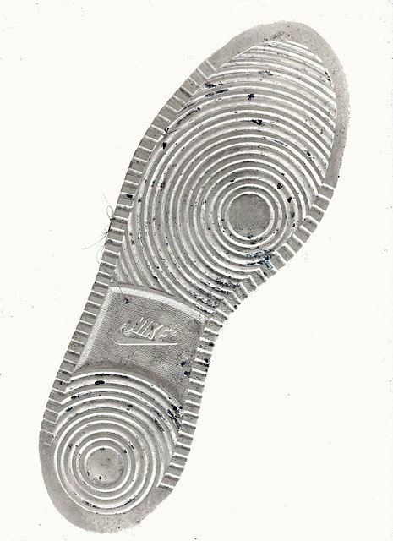
criminology

Slide 2

Introduction
Overview of criminology
Why it matters
What we'll cover

Slide 3

Key Concepts
Main point one
Main point two
Main point three

Slide 4

Applications
Real-world use case 1
Real-world use case 2

Slide 5

Conclusion
Summary
Key takeaways
Questions?

