Slide 1
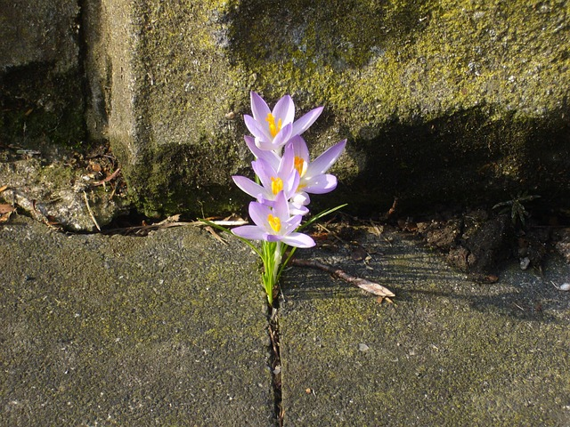
The Wonder of Flowers

Slide 2
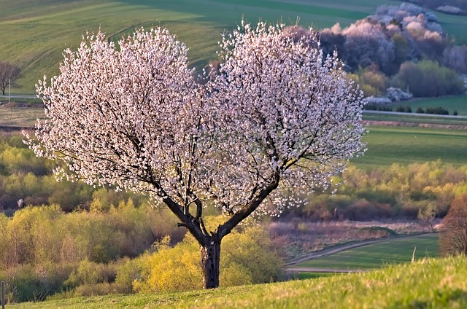
Anatomy of a Flower
Petals attract pollinators with vibrant colors.
The stamen produces pollen for reproduction.
The pistil acts as the female receptive organ.
Sepals protect the bud before it opens.

Slide 3
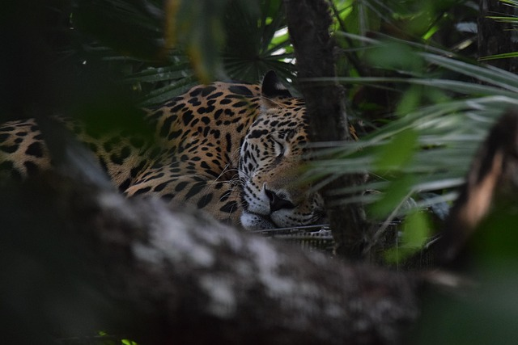
Ecological Importance
Flowers provide essential food for pollinators.
They facilitate plant reproduction and biodiversity.
Many species support global agricultural food chains.

Slide 4

Cultural Significance
Red roses universally symbolize love and passion.
Flowers play key roles in global celebrations.
They supply essential oils for perfumes and medicines.

Slide 5
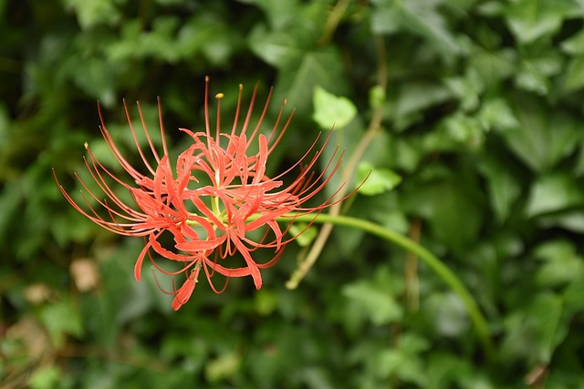
Fascinating Flower Facts
The Rafflesia is the world's largest flower.
Sunflowers track the sun's movement daily.
Some flowers bloom only during the night.

