Slide 1
Empowering Girls: Shaping Our Collective Future

Slide 2

The Power of Girlhood
A unique developmental phase of creativity, growth, and learning.
Diverse cultural experiences shaping identity and voice worldwide.
Unlocking potential creates strong foundations for future communities.

Slide 3
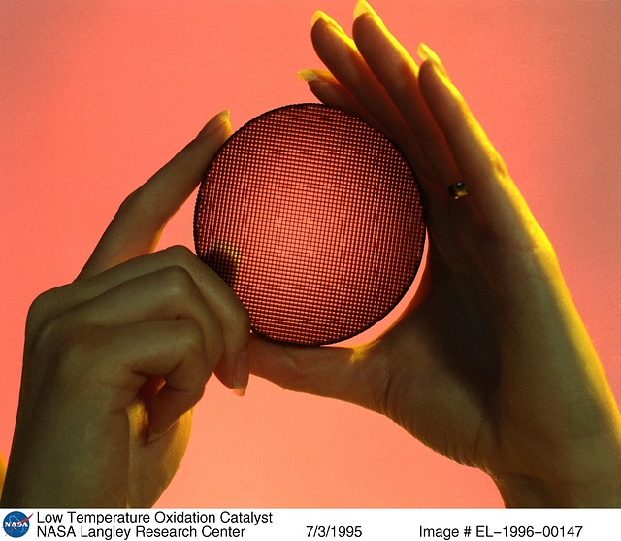
Education as a Catalyst
Educating girls builds stronger families and boosts local economies.
Reduces poverty rates and improves maternal health outcomes globally.
Access to STEM subjects fosters innovative future leaders.

Slide 4
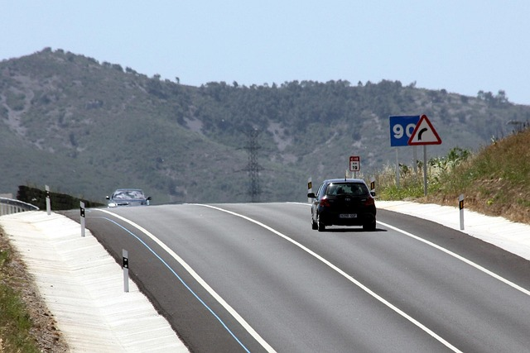
Leading the Change
Young women are spearheading climate action and social justice.
Breaking barriers in sports, science, business, and politics.
Inspirational role models pave the way for future generations.

Slide 5

Investing in Her Future
Ensuring equal access to safe and quality education.
Mentoring young girls to build confidence and leadership skills.
Creating safe spaces and advocating for equal rights.

