Slide 1
Understanding HTML: The Backbone of the Web

Slide 2
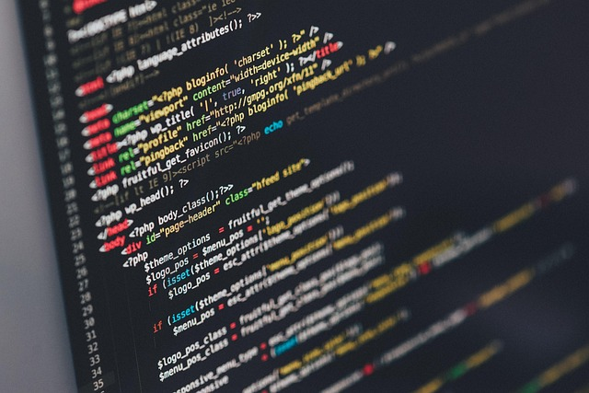
Introduction to HTML
Stands for HyperText Markup Language.
The standard markup language for creating web pages.
Uses elements and tags to structure web content.

Slide 3

Core HTML Elements
Headings and paragraphs organize text content logically.
Anchor tags create hyperlinks to connect web pages.
Image tags embed visual media into the document.

Slide 4

HTML5 and Modern Web
Introduced semantic tags like header, nav, and section.
Supports native audio and video playback without plugins.
Includes advanced form inputs like date pickers and sliders.

Slide 5

The Web Ecosystem
HTML provides structure, CSS adds style, JavaScript adds interactivity.
Browsers parse HTML to build the Document Object Model.
Proper semantic HTML improves SEO and web accessibility.

