Slide 1

The Essence of Humanity

Slide 2

What Defines Humanity?
Capacity for empathy, compassion, and deep emotional connection.
Self-awareness and the pursuit of meaning.
The unique ability to create complex languages and cultures.

Slide 3

Built for Connection
We thrive through cooperation, collaboration, and community.
Shared storytelling binds societies across generations.
Empathy allows us to understand diverse perspectives.

Slide 4

The Creative Spark
Art, music, and literature reflect the human soul.
Scientific curiosity drives innovation and discovery.
Imagination allows us to envision a better future.

Slide 5
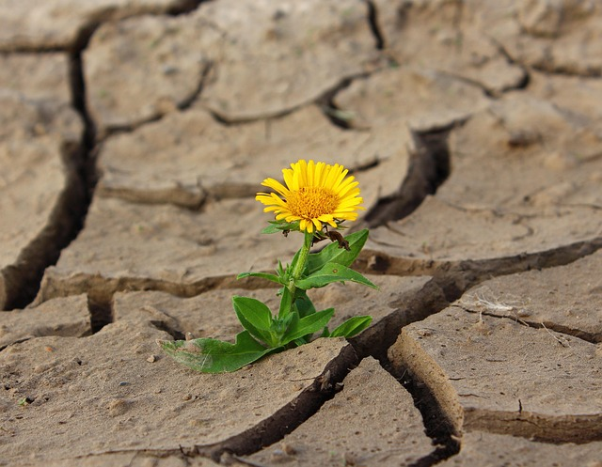
Triumph Over Adversity
The capacity to overcome global crises and hardships.
Remarkable adaptability in the face of changing environments.
An enduring hope that fuels progress through dark times.

Slide 6

Our Shared Responsibility
Safeguarding our planet for future generations.
Advocating for human rights, equality, and justice globally.
Balancing technological progress with ethical moral choices.

Slide 7

Looking to the Horizon
Bridging divides through global cooperation and understanding.
Exploring the cosmos while preserving our earthly home.
Defining our legacy through kindness and shared progress.

