Slide 1
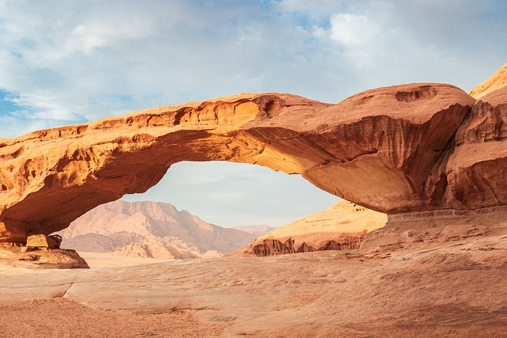
The Wonders of Our Natural World

Slide 2
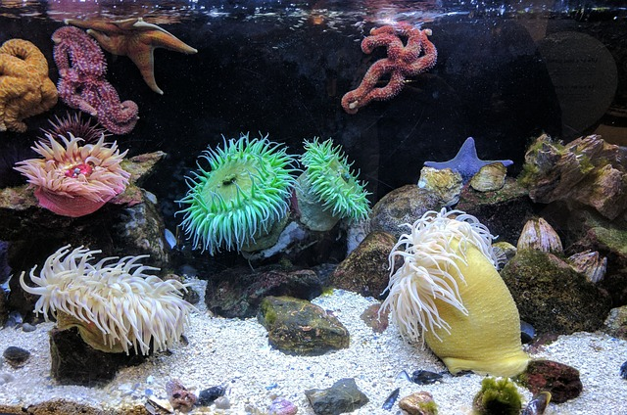
Diverse Ecosystems
Forests produce oxygen and regulate the global climate.
Oceans support millions of unique marine species.
Deserts showcase incredible evolutionary adaptations.

Slide 3
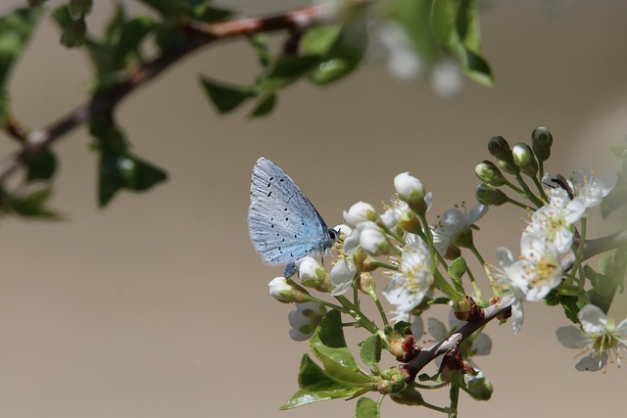
Flora and Fauna
Plants convert sunlight into usable energy.
Animals maintain the balance of food chains.
Microorganisms decompose waste and enrich the soil.

Slide 4

Crucial Natural Resources
Freshwater sustains all terrestrial life forms.
Fertile soil enables agriculture and food security.
Renewable energy sources power modern society cleanly.

Slide 5
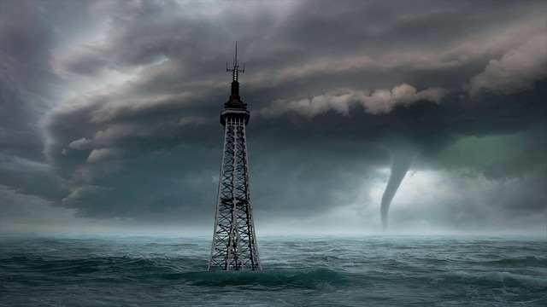
Threats to the Environment
Deforestation destroys critical wildlife habitats.
Pollution poisons air, water, and soil systems.
Climate change alters global weather patterns rapidly.

Slide 6
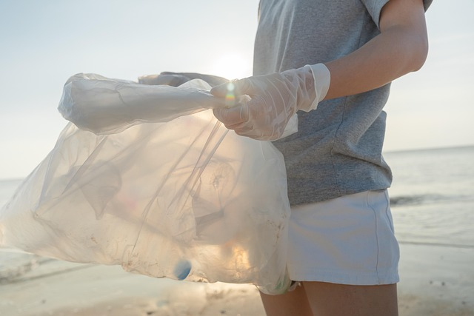
Conservation and Protection
Reforestation restores damaged ecological landscapes.
Sustainable practices preserve resources for future generations.
Protected areas safeguard endangered plant and animal species.

