Slide 1
Discovering Pakistan: Land of Diversity

Slide 2
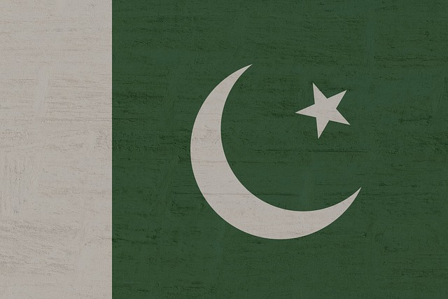
Introduction to Pakistan
Located in South Asia with highly strategic borders.
Fifth most populous nation, home to over 240 million people.
Islamabad is the capital, while Karachi is the largest city.

Slide 3
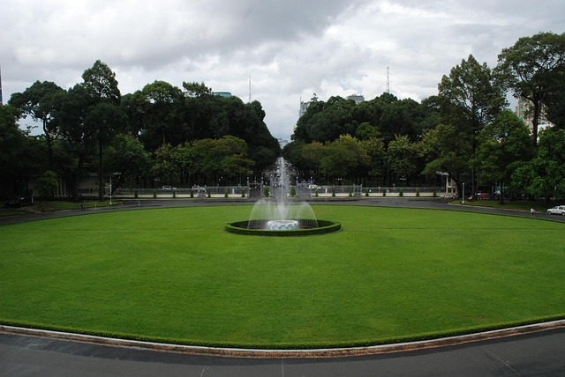
History and Independence
Gained independence from British rule on August 14, 1947.
Founded by Muhammad Ali Jinnah as a sovereign nation.
Cradle of the ancient, 5000-year-old Indus Valley Civilization.

Slide 4

Rich Cultural Diversity
Urdu is the national language, widely spoken alongside English.
Vibrant cultural mix of Punjabi, Pashtun, Sindhi, and Balochi heritages.
Famous globally for Sufi music, exquisite cuisine, and truck art.

Slide 5

Economy and Key Industries
Agriculture drives the economy, employing a vast workforce.
Major global exporter of textiles, surgical instruments, and sports goods.
Rapidly expanding digital economy and IT freelance sector.

Slide 6

Tourism and Natural Wonders
Home to K2, the world's second-highest mountain peak.
Diverse landscapes spanning from northern glaciers to southern deserts.
Rich in UNESCO World Heritage sites and ancient forts.

